Slide 1
Applying for the 2024 NSF Graduate Research Fellowship (GRF) in Fall 2023
Laura Argys
Laura.Argys@ucdenver.edu
Associate Dean for Research and Creative Activities
Professor of Economics
College of Liberal Arts & Sciences
Carol Achziger
Carol.Achziger@ucdenver.edu
Grants Development Coordinator
College of Liberal Arts & Sciences
Tracy Kohm
Tracy.Kohm@ucdenver.edu
Grants Management Specialist
College of Liberal Arts & Sciences

Slide 2
Topics
NSF GRF Program Purpose and Description
Eligibility
Citizenship/permanent resident
Participation in graduate school
Areas of research
What is required to apply and how applications are reviewed
How to prepare your application
Resources for preparation
Questions

Slide 3
Purpose of the GRFP
The purpose of the NSF Graduate Research Fellowship Program (GRFP) is to ensure the quality, vitality, and diversity of the scientific and engineering workforce of the United States.
GRFP seeks to broaden participation in science and engineering of underrepresented groups, including women, minorities, persons with disabilities, and veterans.

Slide 4
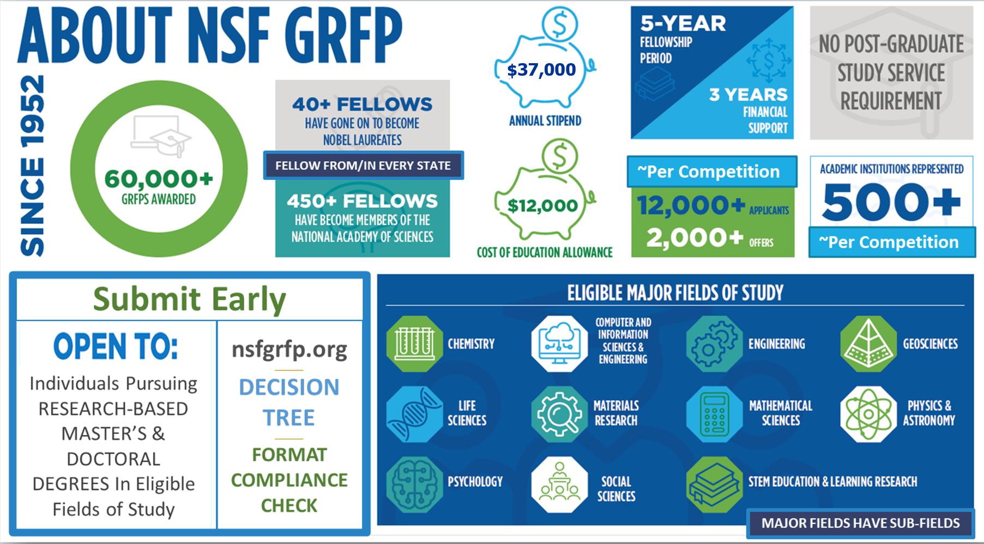
Notes:
The historical success rate is approximately 15% (12-18)

Slide 5
NSF Graduate Research Fellowships
Five Year Awards – $147,000
Three years of financial support
$37,000 stipend each year to the graduate institution
$12,000 educational allowance directly to graduate institution (In lieu of tuition and fees)
Portability – fellowship stays with you as long as you are enrolled in grad school full time, in an NSF recognized field

Slide 6
Eligibility
Fields of study
Applicant Eligibility
Eligibility verification
Eligibility level

Slide 7
Fields of Study
Selection of a major field of study determines the application deadline, the broad disciplinary expertise of the reviewers who will review the application, and the discipline of the graduate program if the fellowship is excepted. This subfield category designates specific expertise of the reviewers. Applicants can select “other” if their specific subfield is not represented in the list of subfields under the major field of study.
Chemistry
Computer and Information Sciences
Engineering
Geosciences
Life Sciences
Materials Research
Mathematical Sciences
Physics and Astronomy
Psychology
Social Sciences
Stem education and Learning Research
https://www.nsf.gov/about/research_areas.jsp
https://www.nsf.gov/funding/programs.jsp?org=SBE

Slide 8
APPLICANT ELIGIBILITY
BY THE APPLICATION DEADLINE – October 2023 Be a U.S. citizen, national, or permanent resident Intend to enroll or be enrolled full-time in a research-based master's or doctoral degree program in an eligible Field of Study in STEM or STEM education
If previously offered a Graduate Research Fellowship, have declined by the acceptance deadline Have never previously applied to GRFP while enrolled in a graduate degree program Have never earned a doctoral or terminal degree in any field Have never earned a master's or professional degree (see joint bachelor's-master's degree information below) in any field, or completed more than one academic year in a graduate degree-granting program, unless (i) returning to graduate study after an interruption of two (2) or more consecutive years immediately preceding the application deadline, and; (ii) are not enrolled in a graduate degree program at the application deadline Not be a current NSF employee

Slide 9
Eligibility Verification
Use the NSF Online Eligibility Questionnaire
https://www.nsfgrfp.org/applicants/fellowship-eligibility/
This eligibility questionnaire is provided as a tool to assist potential applicants for the NSF GRFP. The information contained in this questionnaire is based on the official eligibility information in the NSF GRF Program Solicitation but is not an official determination of an individual's eligibility.
Part of the application process is you certifying you are eligible!

Slide 10
Levels of Applicants and Number of Times You Can Apply
Level 1 - Can apply unlimited number of times until enter any post-bac studies
Undergraduate students in their Senior year
Individuals who hold Baccalaureate degrees and have not pursued any graduate studies
Levels 2 – 4 – Can apply only 1 time
First year Grad students
Students enrolled in Bachelors - Master’s Programs
Grad students who have not completed more than 1 year of graduate study
Returning Grad students who had a 2 or more years break or not currently enrolled

Slide 11
GRFP Application Materials and Review
Application Materials
Review Process
Review Criteria

Slide 12
GRF APPLICATION
COMPONENTS https://nsfgrfp.org/applicants/application_components
PERSONAL INFORMATION:
CV: Education, Work and Other Experience
Electronic Transcripts
PERSONAL, RELEVANT BACKGROUND, AND FUTURE GOALS STATEMENT (3 PAGES)
3. GRADUATE RESEARCH PLAN STATEMENT (2 PAGES)
4. NAMES AND EMAIL ADDRESSES OF REFERENCE LETTER WRITERS (at least two must be received for review; three are allowed for review)
* Five may be submitted, but only top three letters are considered

Slide 13
PERSONAL, RELEVANT BACKGROUND AND FUTURE GOALS (3 PAGES)
COMPONENTS
Outline your educational and professional development plans and career goals: “How do you envision that graduate school will prepare you for a career that allows you to contribute to scientific understanding and broadly benefit society?” Your personal, educational and/or professional experiences with specific examples of research and/or professional activities.
Clearly marked sections for INTELLECTUAL MERIT (IM) and BROADER IMPACTS (BI)
Address how you will use the GRF to advance knowledge in STEM fields (IM), benefits to society, potential for your future leadership and global engagement (BI)
Emphasize
Your fascination (passion) with research (origin and examples); unique characteristics (experience); individual strengths (self-assessment); GRF and your future (specific goals and plans); balance independence (initiative) and collaboration. Narrative form can be good, but statement is not a biography

Slide 14
GRADUATE RESEARCH PLAN (2 PAGES)
Present an original research topic you would like to pursue in grad school
Describe the research idea, your approach, and any resources needed
Limit to only important/relevant literature citations
INTELLECTUAL MERIT (IM) AND BROADER IMPACTS (BI) separately identified and labeled: IM is the potential of your research to advance knowledge, transform your field and BI is the potential for impacts
The research topic discussed must be in a field listed in the Solicitation (Appendix X, Fields of Study).
Emphasize
Excitement; contribution of your unique technical knowledge and skills; mentoring and training you expect; feasibility of completion; "big picture" importance of your research; and a realistic plan of activities and tasks.

Slide 15
REFERENCE LETTERS should address the NSF Merit Review Criteria of Intellectual Merit and Broader Impacts, labelled. CONTENT should include comments on the applicant’s:
relationship to the letter writer
potential for contributing to US science and engineering workforce,
academic potential and relevant prior experiences
proposed research
other information to aid reviewers
FORMAT:
MAXIMUM LENGTH IS TWO (2) PAGES, SINGLE SPACE
HOW DO THEY SUBMIT A LETTER:
All referees must have a NSF Research.gov account.
All letters are submitted via Research.gov
Each of your referees will receive an e-mail from NSF with an invitation code. They must use that code to submit their letter

Slide 16
Selection Process
Panel review and recommendations by academics and research-active professionals in relevant field
Applicant ratings ranked by reviewers and sorted into a top tier (~25%)
NSF decides on total number awards and allocates based on panel rankings and research priorities
“Honorable Mention” is prestigious outcome
2017 data: top tier = 3,809, or 29.3% of applicants.
If you were in the top tier, probability of an award is over 50%!

Slide 17
Panel Review Process
Reviewers are invited to serve on panels typically consisting of 15 – 20 members, mostly academics
Panelists are matched by general area of expertise
Panel membership is confidential
Conflicts of interest management standards
Each proposal typically is reviewed by 3 panelists, so each panel initially reviews more than 100 applications
NSF compiles individual scores (P, F, G, VG, E) and selects composite ratings of 3 reviewers.
Selected applications (about 1/3) are discussed in a one-day group meeting on-line. Final ratings after discussion.
As many as 50 - 60% of this group will be awarded the GRF and the rest are likely to receive honorable mention.

Slide 18
What’s in a Review??
Overall Intellectual Merit Rating
Scale: E, VG, G, F, P
Comments on Strengths and Weaknesses
Overall Broader Impacts Rating
Scale: E, VG, G, F, P
Comments on Strengths and Weaknesses
Overall Score between 1 and 50
40-50 Excellent, Highly Meritorious, recommend for award
30-39 Very Good, Meritorious, recommend for award or honorable mention
1–29 P, F, G, Not recommended

Slide 19
INTELLECTUAL MERIT
creative, original, or potentially transformative concepts?
well-reasoned, well-organized plan with a method to assess success
Applicant is well qualified and adequate institutional resources are available

Slide 20
BROADER IMPACTS
…of the research itself or secondary benefits:
FULL PARTICIPATION of women, persons with disabilities, and underrepresented minorities in STEM;
improved STEM education at any level;
increased public scientific literacy and engagement;
improved well-being of individuals in society;
develop a diverse, globally competitive STEM workforce;
partnerships between academia, industry, and others;
improved national security;
increased economic competitiveness of the US;
enhanced infrastructure for research and education

Slide 21
Advice from a Recent Reviewer
Academic Qualifications:
Preparation for successful graduate school and research
Academic preparation (particularly classes beyond what is required)
Research experience
Additional training, work, experiences
Independent learning or research
Motivation (overcoming obstacles – don’t ignore mis-steps but don’t dwell on it)
How are these demonstrated:
Personal statement – don’t be shy; explain what you’ve done. Use your accomplishments as a replacement for (or in addition to) adjectives.
Research plan if you are building on earlier research
References should highlight your readiness for independent research

Slide 22
Advice - Continued
Broader Impacts:
Think creatively, there are lots of options
Diversity of perspective, workforce diversification
Leadership
Translation or training to diverse groups or educators
Importance of your work to other disciplines
Informing policy – and illuminate the societal need
How are these demonstrated:
Be sure to include broader impact in both of your documents.
Include any ways you enhance diversity and experience with your BI activities in your personal statement.
And the potential for broader impacts of your research and plans to disseminate them to those who can act on it.

Slide 23
Advice - Continued
Research plan advice:
Explain the big picture of where you would like to have a research impact
This is a good lead-in to your specific project
Provide a well-thought out specific project that addresses challenges in your discipline.
Give methodological details that demonstrate mastery in your area, but be sure to return to the importance of answering your research question. (For an undergraduate applicant there may be a bit more emphasis on big picture than methodology.)
But don’t forget to return to why learning the answer to your research question is important.

Slide 24
Suggestions from a Recent Applicant/Awardee
Practice verbally explaining your research plan.
Emphasize why you are the right person to do this research, and what makes you a good “investment” for the NSF.
Have other people read your application.
Make sure you understand logistics, deadlines, technicalities (like font size), etc.
Submit your application and get all of your transcripts, letters of recommendation, etc. taken care of EARLY.

Slide 25
Submission Process
If you will be staying at CU Denver and want your award to come here, please send an e-mail to ORCA@UCDenver.edu as soon as possible to let us know. Please contact us no later than September 25, 2023.
We’ll walk you through the internal review process that when completed now will make the award process so much easier!
If you will not have your award come to CU Denver, please just skip this step and move forward to preparing to submit your proposal.

Slide 26
Research.gov
You and anyone submitting a reference letter will need a Research.gov account.
Be sure to make sure you or a referee do not already have an account (even an old, old one). Double accounts create HUGE issues.
Once you have confirmed you do not have an existing account, you need to register for one. Here’s a step-by-step video to help you: https://resources.research.gov/common/attachment/Desktop/AcctMgmtSIDVidRegNewUser.html
Register early (now would be good) so you can become familiar with the website and how to upload your items.

Slide 27
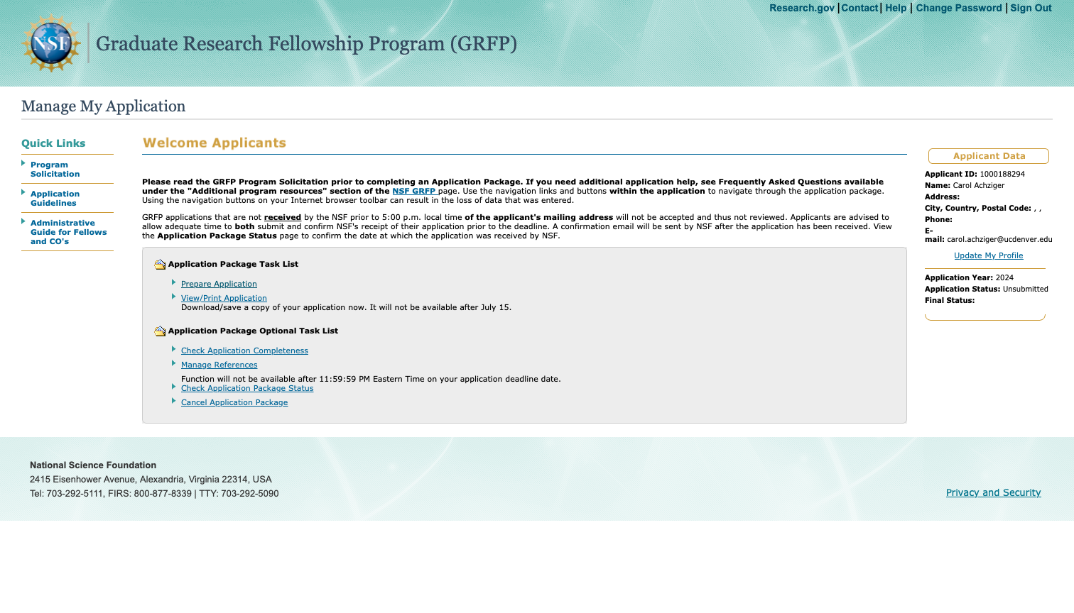
What to expect at Research.gov
Once you log into the GRFP application portal (accessed via Research.Gov), you’ll see this screen.

Slide 28
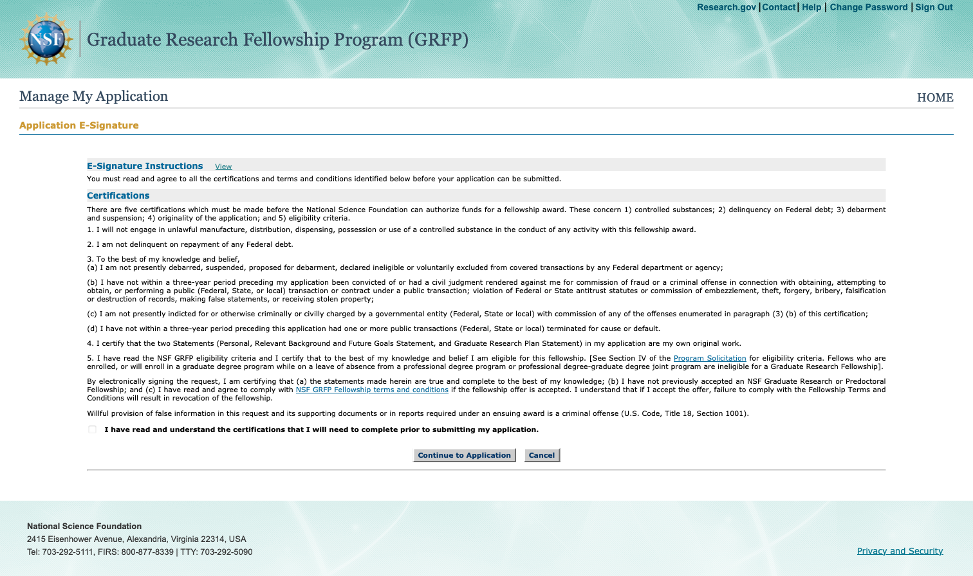
The first step is to Certify you are Eligible
You cannot move forward without certifying

Slide 29
This is the application portal

Slide 30
SUBMISSION: ALL APPLICATIONS MUST BE UPLOADED TO RESEARCH.GOV BY 5:00 PM LOCAL TIME (e.g., MDT)
SUBJECT AREAS | GRF APPLICATION DUE DATE
LIFE SCIENCES | OCTOBER 16, 2023
COMPUTER AND INFORMATION SCIENCE AND ENGINEERING; MATERIALS RESEARCH; PSYCHOLOGY; SOCIAL, BEHAVIORAL, AND ECONOMIC SCIENCES; STEM EDUCATION AND LEARNING | OCTOBER 17, 2023
ENGINEERING | OCTOBER 19, 2023
CHEMISTRY; GEOSCIENCES; MATHEMATICAL SCIENCES; PHYSICS, AND ASTRONOMY | OCTOBER 20, 2023
DAY/TIME DEADLINES ARE RIGID. PLAN TO SUBMIT EARLY. RESEARCH.GOV SOMETIMES CRASHES IN HEAVY TRAFFIC. AWARDS ARE ANNOUNCED IN EARLY APRIL.

Slide 31
Date | Checklist
ASAP | Go to the GRFP website and make sure you are eligible Register on research.gov: https://www.research.gov/grfp/Login.do Read the solicitation and applicant guidelines Assemble transcript information and upload to research.gov (SAVE) Identify five references and contact them about writing letters Upload reference contact information to research.gov (SAVE) Include all publications, presentations, awards, fellowships, etc. in the “Other experience” box (SAVE) File a “DEPA” conflict of interest statement with your home office of contracts and grants Prepare outlines for personal statement and research plan Talk with your advisor(s) about your research plan and personal statement Draft research plan and personal statements. Be sure to identify and label IM and BI sections Circulate draft statements to advisor(s), fellow students and, if possible, a skilled writer. Edit statements accordingly.
September-October | Upload latest drafts of personal and research plan statements Continue editing uploading revisions and saving on research.gov Check to see if references are being submitted and ping references if necessary DO NOT WAIT UNTIL THE DUE DATE TO SUBMIT COMPLETE APPLICATION

Slide 32
How we can help you moving forward
Make these slides available for your review.
Provide guidance for reference writers so that they know how to frame their letters for maximum impact.
Providing a pool of reviewers willing to read your Personal Statement and/or Research Plan from a non-specialist perspective. Please contact us at ORCA@UCDenver.edu before October 5 if you would like to take advantage of this review.
Contact us with questions as you prepare your application. ORCA@UCDenver.edu

Slide 33
Resources
Main NSF GRFP site: Home - NSF Graduate Research Fellowships Program (GRFP) (nsfgrfp.org)
Application Resources - NSF Graduate Research Fellowships Program (GRFP) (nsfgrfp.org)
GRFP FAQ site : https://nsfgrfp.org/applicants/faqs/
GRFP videos and resources https://www.nsfgrfp.org/resources/
GRFP events/webinars https://www.nsfgrfp.org/events/
CLAS contacts: ORCA@UCDenver.edu

