Slide 1
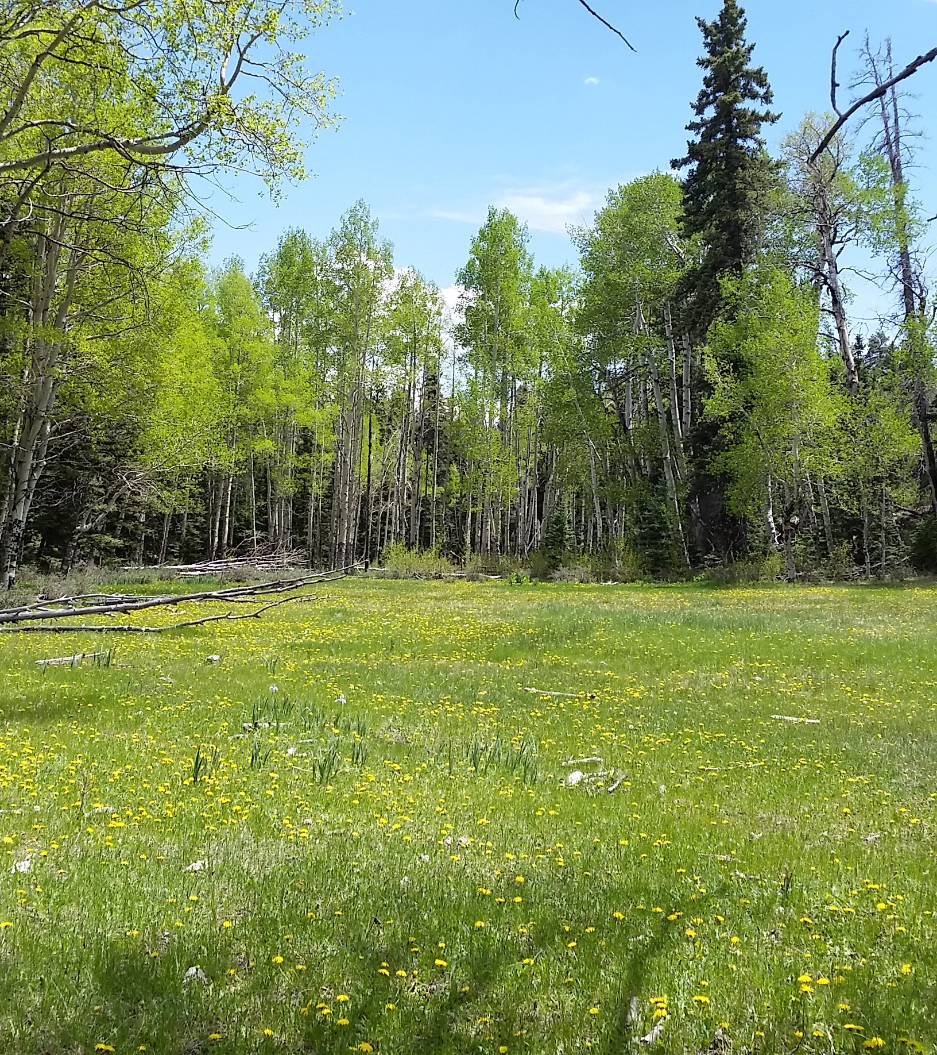
In Light of Ecology: Eco-Evolutionary Strategies for Persistence in Seasonal Environments
The annual cycle of seasons is one of the most important sources of environmental variation that organisms face. In response, species have evolved a wide array of adaptive mechanisms to accommodate these cyclical fluctuations. Yet, our understanding of why particular responses comprise evolutionarily fit solutions to the “problem” of seasonality remains limited for most species. Herein I present and apply a conceptual framework for addressing questions about ultimate eco-evolutionary drivers of organismal responses to seasonality such as seasonal migration and variance in life history strategies.
Scott Yanco
Dissertation Defense
2:00 p.m. March 9, 2017
Please email jacki.craig@ucdenver.edu for Zoom Link information

