Slide 1
Clas HCM/CU Careers Lecturer Posting Guide

Slide 2
Equal Pay for Equal Work Act
A salary range or rate must be included in all postings
All new or vacant positions must be posted on CU Careers
    Must post for a minimum of 5 calendar days.
    Must run a defensible search process that includes interviews for those who meet all minimum qualifications and best meet preferred qualifications.
  This includes Lecturer positions, though we can still hire multiple lecturers form one posting.
    All lecturer applications must be reviewed and candidates must be dispositioned in CU Careers as they are reviewed.
  Per Central HR, appointment type 2 (also referred to as a search waiver) are no longer allowed without a posting: transfers, rehiring former employees, students moving from a TA to lecturer role.

Slide 3
Hiring Lecturers vs.
Hiring Students
Lecturers
  A search or appointment type 1 is required.
  For Lecturer postings, you can use this language: The hiring rate for this position has been established at $1,559 per credit hour (lower division), $1,645 per credit hour (upper division), or $1,808 per credit hour (graduate level).
Students
  We must notify students of available opportunities. This could be either a job posting on Handshake or a message on your department website letting students know of available positions and who to contact if they are interested.
    Please note that the department’s website should include a pay rate or range based on the type of student position. It is a good faith estimate of what you think you might pay.
  Handshake Employer Guide that provides information on signing up, posting, etc.
    https://www1.ucdenver.edu/docs/librariesprovider41/default-document-library/handshake-employer-guide_high-quality.pdf?sfvrsn=dbc79fb8_4
  Here is a link with additional information from the Career Center:
    https://www1.ucdenver.edu/services/career-center/hire Click on “Handshake – job postings” for more information.

Slide 4
Posting a lecturer position in cu careers

Slide 5
Step 1: Go to Position Data to either update an existing position or create a new position, if necessary. Wait for CLAS HR to approve position change. Update funding if necessary.
Step 2: Go to Non-Person Profile (NPP) and pull up the approved position.

Slide 6
Step 3: Fill in required information:
  Use today’s date as the Effective Date > Select “Vacant Position” as the reason > Type “Search” in the comments
  Don’t update any position information
  Select Yes for Position Summary, HR Consultant, Required Training, Background Check Types, and Degrees
  Add a new Position Summary (make sure Feed to CU Careers box is checked); click on Add New HR Consultant and enter the central HR faculty posting contact
  If not already populated, click Add New Required Training to add training requirements (F00001, U00063 and U00067 are required)
  Click Add New Background Check to add Criminal Background Check if not already populated
  Click Add New Degrees to populate required degree and field of study
  Attach job description and submit NPP. Do not ad hoc in any approvers. Note: Second level approval is not required for Lecturers.

Slide 7
Step 4: Once central HR approves, NPP feeds to CU Careers (if box is checked)
Step 5: Edit the draft of the posting in CU Careers (include search committee [add collaborators], posting contact, position description, minimum qualifications, and preferred qualifications if applicable)
Step 6: Save as Open & email our Talent Acquisition Consultant letting them know it is ready to post.

Slide 8
Dispositioning candidates from a search

Slide 9
Click on the candidate(s) you want to disposition
Click on More Actions and select Change Step/status until you have dispositioned the candidates into the appropriate status
All candidates should be dispositioned to either Not Selected or Hired
For the candidate you want to hire, create an offer in CU Careers (refer to next slide)
Send correspondence to candidates who are not selected (unless otherwise notified)
Central HR now requires that candidates are dispositioned and postings are closed within 6 months

Slide 10
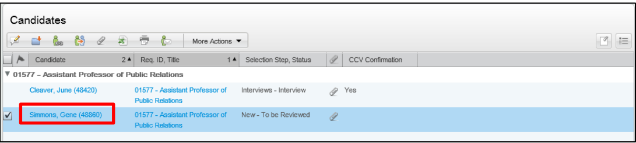

Creating an offer in cu careers
Select the candidate for whom you want to create an offer (they must have been dispositioned to ‘Offer to be made’ status first)
Click More Actions

Slide 11
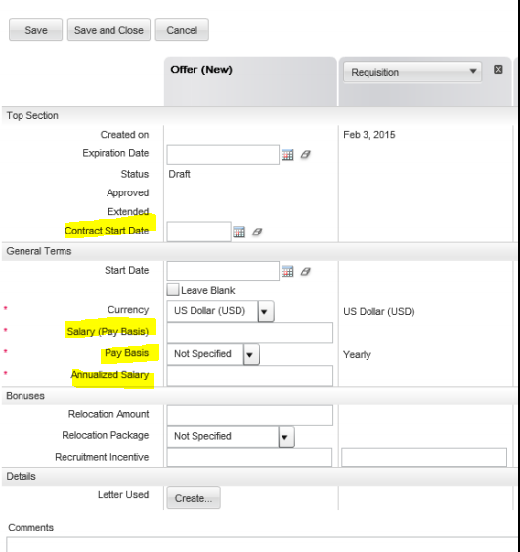
Creating an offer in cu careers cont.
Choose Create Offer
Select a Start Date (required).
Specify Salary, Pay Basis, and Annualized Salary (required)
Click Save and Close and continue to Offer Approval Request by clicking More Actions

Slide 12
Search Summary
If you are hiring a lecturer from a search, you must submit the Application Review Matrix.
  Send completed Application Review Matrix to our Talent Acquisition Consultant when it is completed.

Slide 13
Hiring an Employee via Appointment Type

Slide 14
The following reason can be communicated to HR as part of a request to fill a position.
  #1: Qualified candidate is available from previous search. Job descriptions must be similar. Must include previous search’s Job Posting/Requisition #, proposed salary, & a copy of the candidate’s resume in your submission.
    Use this appointment type when hiring from a posting you leave open that gathers a pool of applicants

Slide 15
In your NPP, include the following in the comments field:
  Appointment Type 1
  Name of person you wish to appoint
  Employee ID number (EID) (if applicable)
  Requisition number
  Proposed salary
  Start Date
  Follow the instructions above to complete the rest of the NPP, but do NOT check the box to Feed to CU Careers
Please be sure to attach candidate’s resume and the job description to NPP
  This ensures that Central HR can verify that the candidate meets minimum qualifications.
Email your ePAR number to our Talent Acquisition Consultant to request approval.

Slide 16
Dispositioning candidates from an appointment type

Slide 17
Click on the candidate(s) you want to hire via Appointment Type #1
Go to More Actions and select Change Step/status
Indicate that the candidate Meets minimum qualifications > Save and continue > Under Review - Selected for Interview > Not selected
Reason for not selected is ‘Hired into another position number’
In the comments section, please indicate that the candidate was hired into a different position number and include the position number.

Slide 18
PMR
Please be sure to enter PMR comments in HCM for all hires/rehires/additional jobs
The PMR Report is no longer required, but signed letters of offer must be submitted by the department for all lecturers who have been newly hired or rehired to personnel.matters@ucdenver.edu.
PMR Instructions can be found here: https://clas.ucdenver.edu/hr-finance/appointments/pmr/
PMR’s are due to Central HR on or before the effective date of the action

