Slide 1
Make it Accessible…
PowerPoint

Slide 2
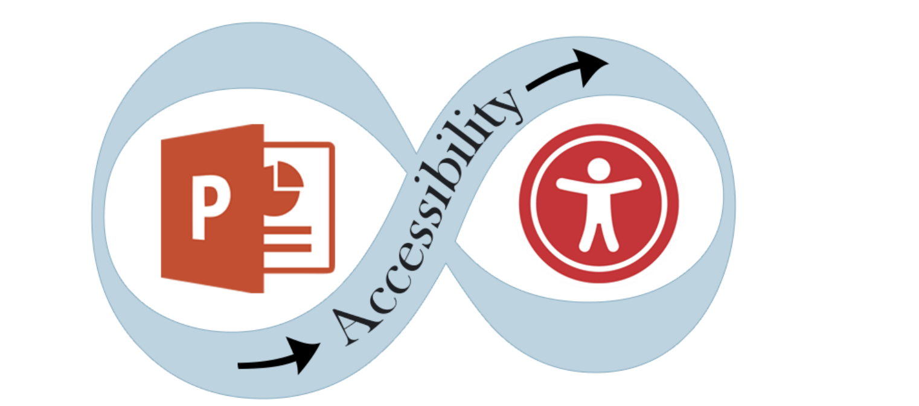
Agenda for our time together today
Welcome
Understanding abilities
Accessibility is the ___ thing to do!
Understanding PowerPoint accessibility
Your turn!
Resources
Closing

Slide 3
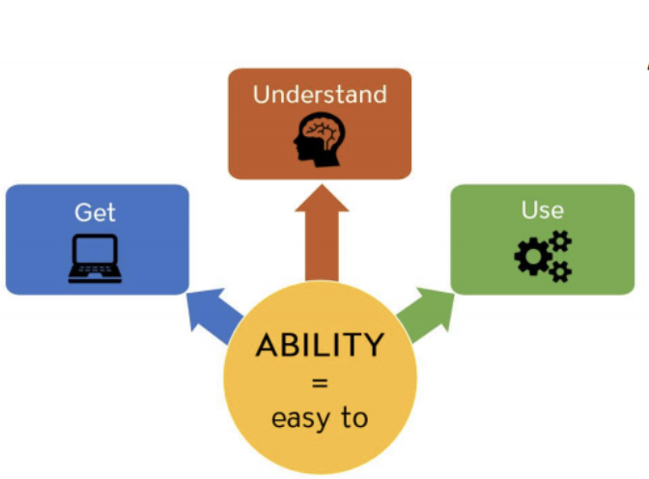
Understanding Abilities
Accessibility is about making it easy for everyone to:
1
Acquire the same information
2
Engage in the same interactions
3
Enjoy the same services

Slide 4
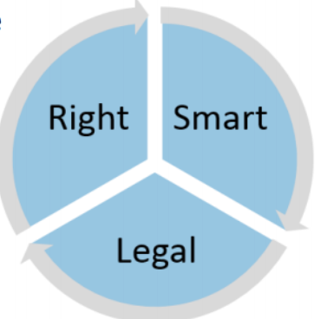
Accessibility, it’s the _______ thing to do!
Right: Aligns with a mission and/or vision, increase usability for all people, attracts students
1
Smart: Sustainable, 19% of the pop. Has a disability, creating a welcoming environment, supporting success
2
3
Legal: equal access, department of justice scrutiny, risk of litigation

Slide 5
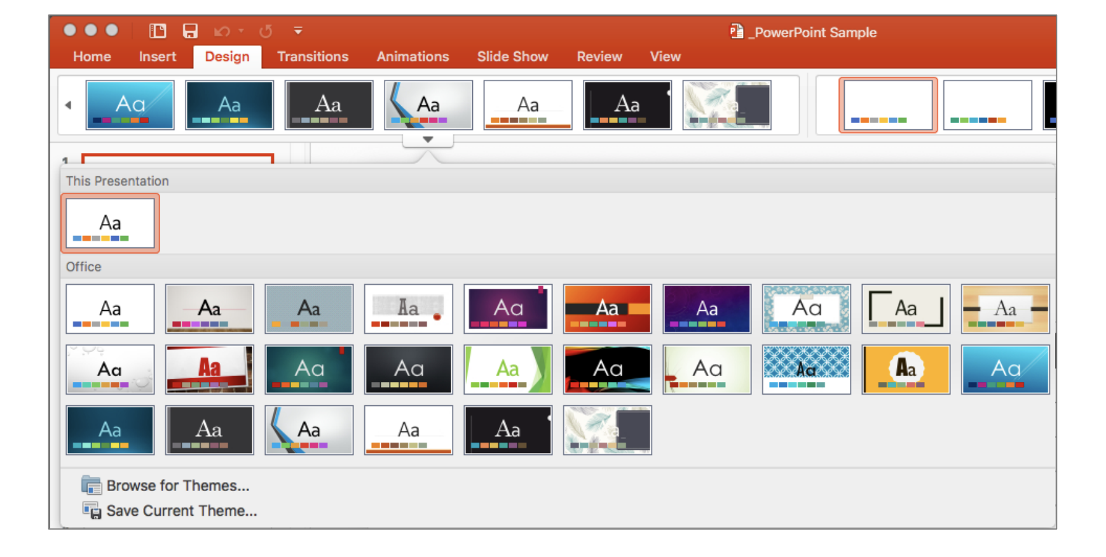
Understanding PowerPoint Accessibility (1 of 3)
Slide designs may NOT be accessible…
The themes come with default background and foreground colors and fonts may be difficult for some viewers to see it. The Accessibility Checker in PowerPoint does not check for color contrast. Use simple and light background with dark text or dark background with white text is the best approach.
Notes:
To make an accessible PowerPoint, you should consider not just the types of information in the file, but also the ways in which users will access the content. Sometimes people will access your PowerPoint as a file on their computer; other times it will be shown in a live presentation or in a presentation over a conferencing app like Zoom.
If the PowerPoint will be displayed visually in a live or pre-recorded presentation…
Verbally describe all meaningful visual content.
Ensure there is adequate color contrast on all slides, and that color alone is not used to convey meaning.
Consider how someone with a hearing disability will access the audio content.
If the presentation is accessed as a pre-recorded video, provide closed captions.
For live presentations, be prepared to arrange for live captions, an ASL interpreter, or hearing assistive devices if an accommodation request is received.
If an amplification system is available for an in-person event, always use it and repeat questions from the audience into the microphone.
If the presentation is at an in-person event, review our Guidelines for Accessible Events.
Review our Guidelines for Accessible Presentations.
Share access to the digital file with your audience.
It is a best practice to provide the audience with digital access to your file so they can follow along with your presentation in the way that works best for them. This can benefit individuals with vision impairments, attention disorders, and more.
You may be required to share your content digitally if someone has requested an accommodation for a disability.
A good way to share the file is to provide a short link to the presentation on the title slide that you read out loud at the beginning of your presentation.

Slide 6
Understanding PowerPoint Accessibility (2 of 3)
Slide layout Simple themes, pre-defined slide layout templates
• Slides with unique titles
• Default bulleted and numbered lists
• Avoid themes with drop shadows on design, colors or text
• Avoid text boxes (inaccessible)

Slide 7
Understanding PowerPoint Accessibility (3 of 3)
• Slide Titles are meaningful and unique • Maximum 6 to 8 lines of text per slide • Minimum font size 24 points or above • Sans-Serif fonts are more suited to electronic formats (Arial, Calibri, Verdana or Franklin Gothic Book) • Capitalization for the heading is fine not the entire paragraph. Most people have difficult to read it if all text capitalized. • Avoid underlining text. Underlining is interpreted by screen readers and people with low vision as linked text. • Avoid Transitions and Animations

Slide 8
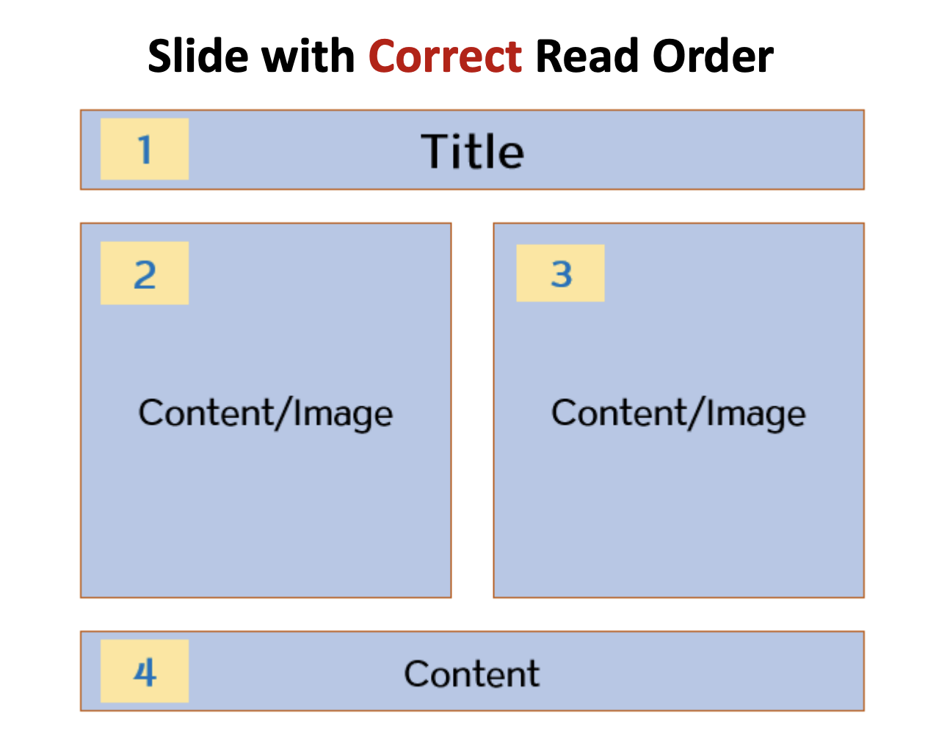
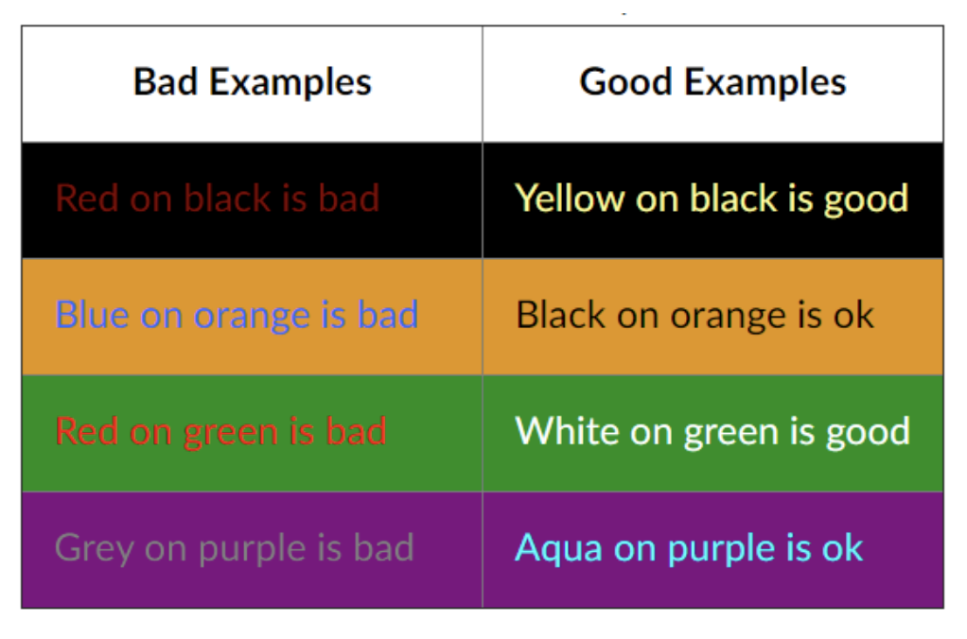
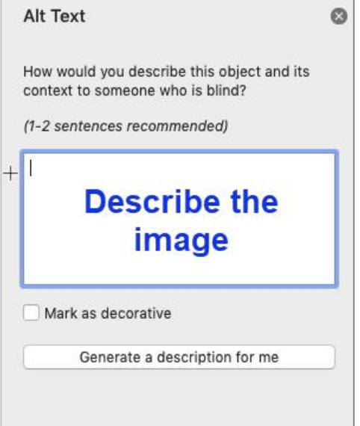
PowerPoint Accessibility: Basic Content
1
Ensure the reading order of content on each slide is correct
2
Ensure all meaningful content has adequate color contrast
3
Add alt text to all images

Slide 9
PowerPoint Accessibility: Specialized Content (1 of 2)
1
Add table column and/or row header where appropriate
2
Provide caption files for videos
3
Avoid animations and transitions – can be distracting, can cause screen readers to re-read the slide, may miss info.
Notes:
Add table column and/or row headers as appropriate.
“Header Row” should be selected if the header cells describe the columns below them. “First Column” should be selected if the header cells describe the rows to the right of themselves.
Animations.
If animations convey meaning, that information needs to also appear in written form.
This can happen either on or off-screen; see "Insert long descriptions for complex graphics" above for an example of off-screen content.
If an animation does not convey meaning, consider not using it, since it may be distracting or induce nausea or disorientation in individuals with vestibular disorders. It's recommended that any transitions you add to your slides are done using the "on click" option, versus timing the animations and transitions. This allows the user/viewer to control the speed at which they view the content and progress through the slides.
Graphs.
If possible, provide the graph data in a table.
Describe the shape and layout of the graph in text (either on- or off-screen).
Videos.
Provide caption files for videos. Some versions of PowerPoint allow you to add caption files within PowerPoint; others may require you to burn in or encode the caption files into the video file in advance. For assistance with captioning, please contact the CU Boulder captioning service.
Ensure the video has sufficient description of any visual content in the video. If the video does not adequately describe its visual content, consider adding any missing visual descriptions into an offscreen text box for screen reader users.
Notes.
​Avoid using the Notes field to convey important information.
If you want to use Notes, consider duplicating that text in an offscreen content placeholder so screen reader users are more likely to encounter it.
Embedded narration.
The narrator should describe all visual content audibly as they would in a normal presentation.
Provide an annotated transcript for the narration that contains all spoken content and note when each slide appears or when an animation activates.

Slide 10
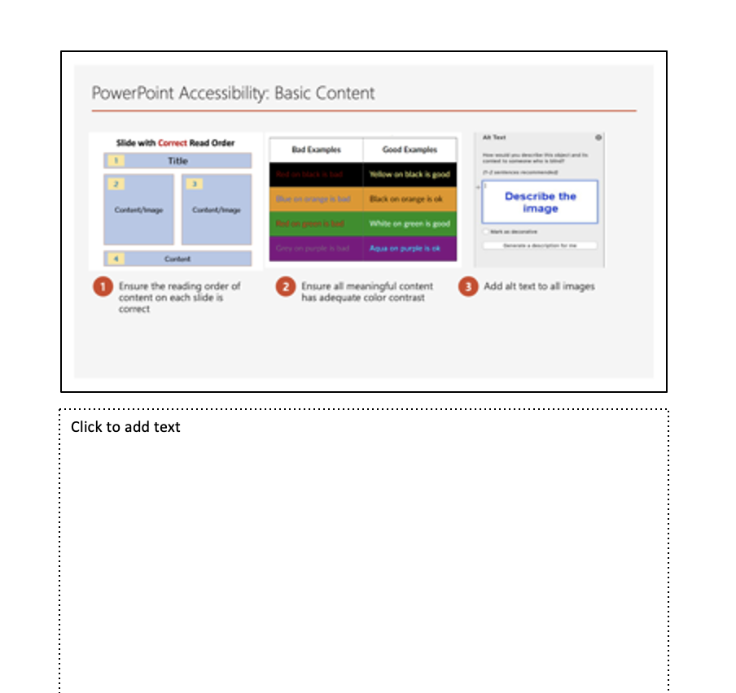
PowerPoint Accessibility: Specialized Content (2 of 2)
1
Avoid using the notes field to convey important information
2
Embedded narration
Notes:
Notes.
​Avoid using the Notes field to convey important information.
If you want to use Notes, consider duplicating that text in an offscreen content placeholder so screen reader users are more likely to encounter it.
Embedded narration.
The narrator should describe all visual content audibly as they would in a normal presentation.
Provide an annotated transcript for the narration that contains all spoken content and note when each slide appears or when an animation activates.
PowerPoint Presentations are often a staple of face-to-face classes. With the move to online courses, PowerPoints, originally used to accompany face-to-face lectures, were uploaded to online content. However, without the accompanying lectures, they are generally of little value to students. In order to ameliorate this problem, audio narrations were added as a supplement. However, adding audio portions to existing PowerPoint presentations have also had added unintended accessibility issues for students with hearing impairments. There are two options currently available to improve accessibility of these PowerPoints:
Add the audio transcription to the notes section of the PowerPoint presentation; and
Add captions to each PowerPoint slide using a screencasting software such as Camtasia.
Universal Design for Learning
Captioning narrated PowerPoints is also an effective universal design for learning strategy. The narrated PowerPoints assist students whose first language may not be English, it assists those who may be visual learners, as well as those who may be studying in a loud environment who do not have access to headphones.

Slide 11
Your Turn!
What questions do you have? What examples would you like to share?

Slide 12
Resources
accessibility checker
WebAIM PowerPoint Accessibility article
Microsoft Office PowerPoint Accessibility documentation
WebAIM checker or Colour Contrast Analyzer
Microsoft accessible template website

Slide 13
More questions about PowerPoint?
Reach out to me – Kate Miller, Kate.Miller@ucdenver.edu

