Slide 1
Science Fair: Our Experience
Edwin Bodoni
Evelyn Bodoni
Notes:
Habari Tanzania
Habari Dar es Salaam
Habari Kisutu Secondary School
Tambaza High School

Slide 2
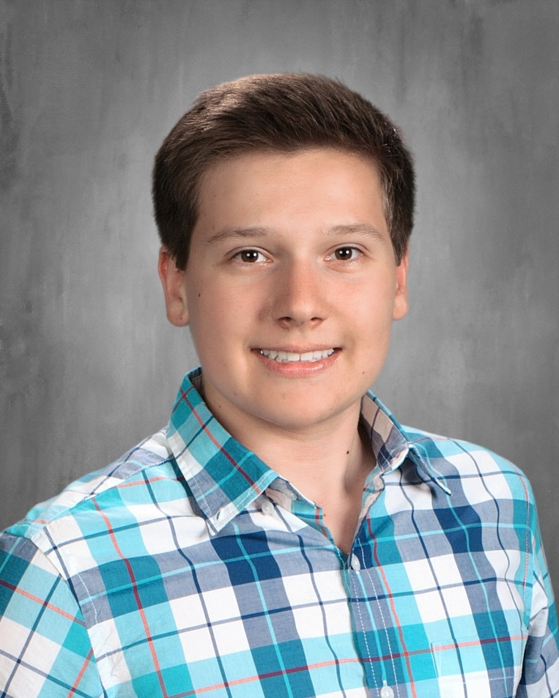
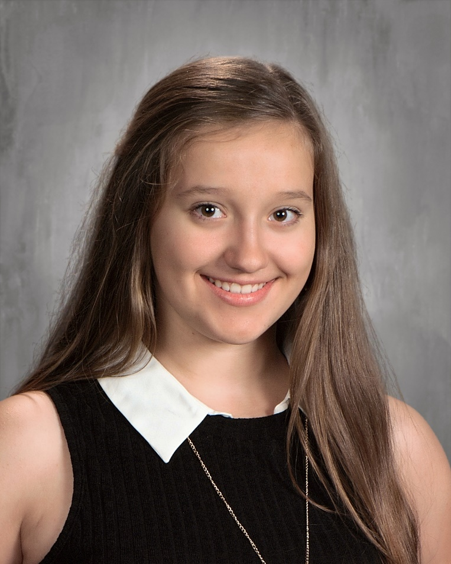
Who Are We?
Edwin Bodoni
12th Grade
Evelyn Bodoni
11th Grade
Notes:
Jina langu ni ______________

Slide 3
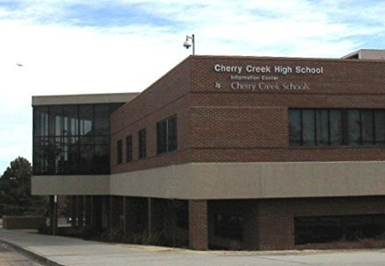
Cherry Creek High School

Slide 4
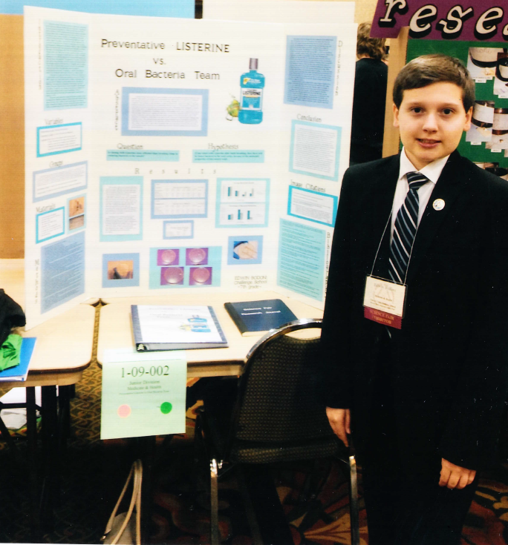
DMRSEF 2014 (7th Grade)

Slide 5
Preventative Listerine
Vs.
Oral Bacteria
Team

Slide 6
Mentorship

Slide 8
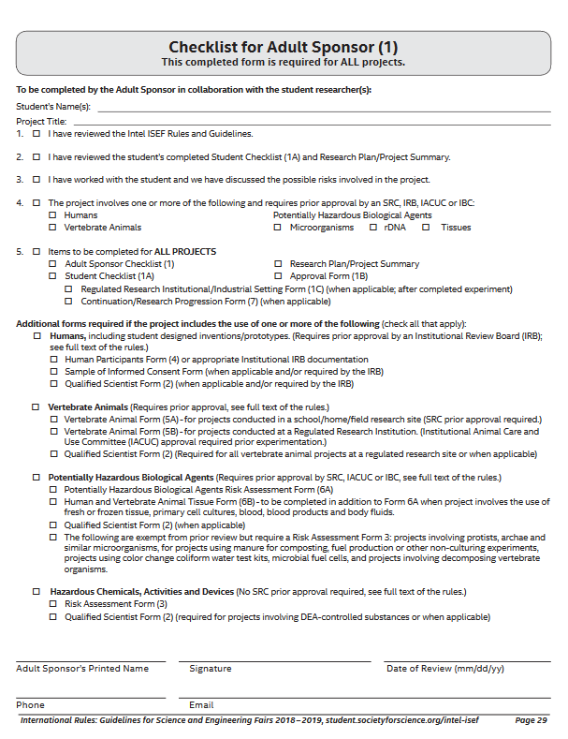
First Challenge

Slide 9
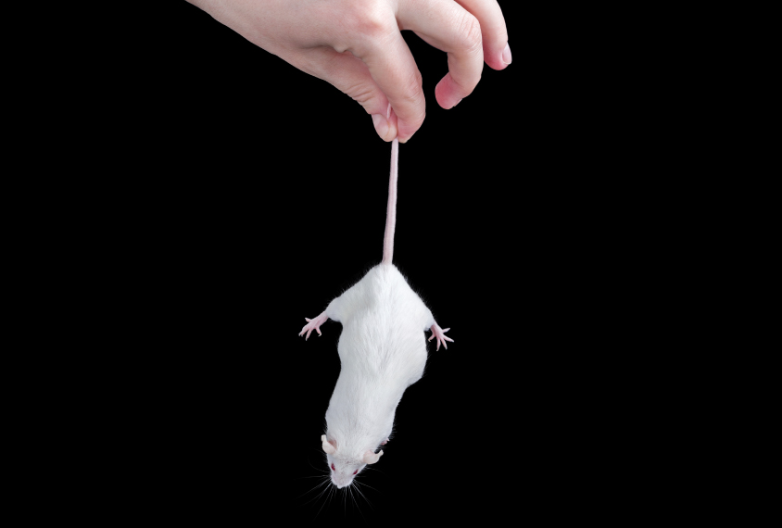
“Mousewash”

Slide 10
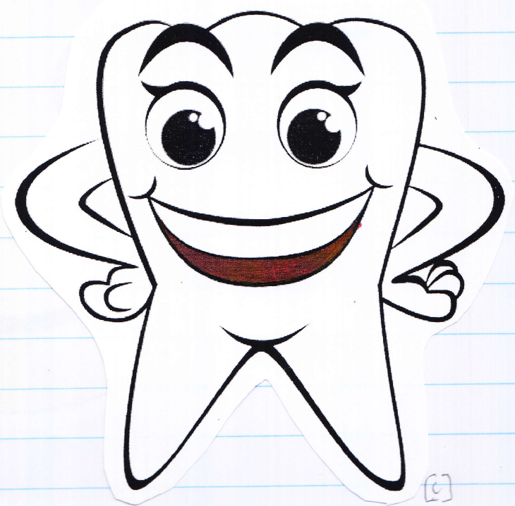
You’re Fired!!!!

Slide 11
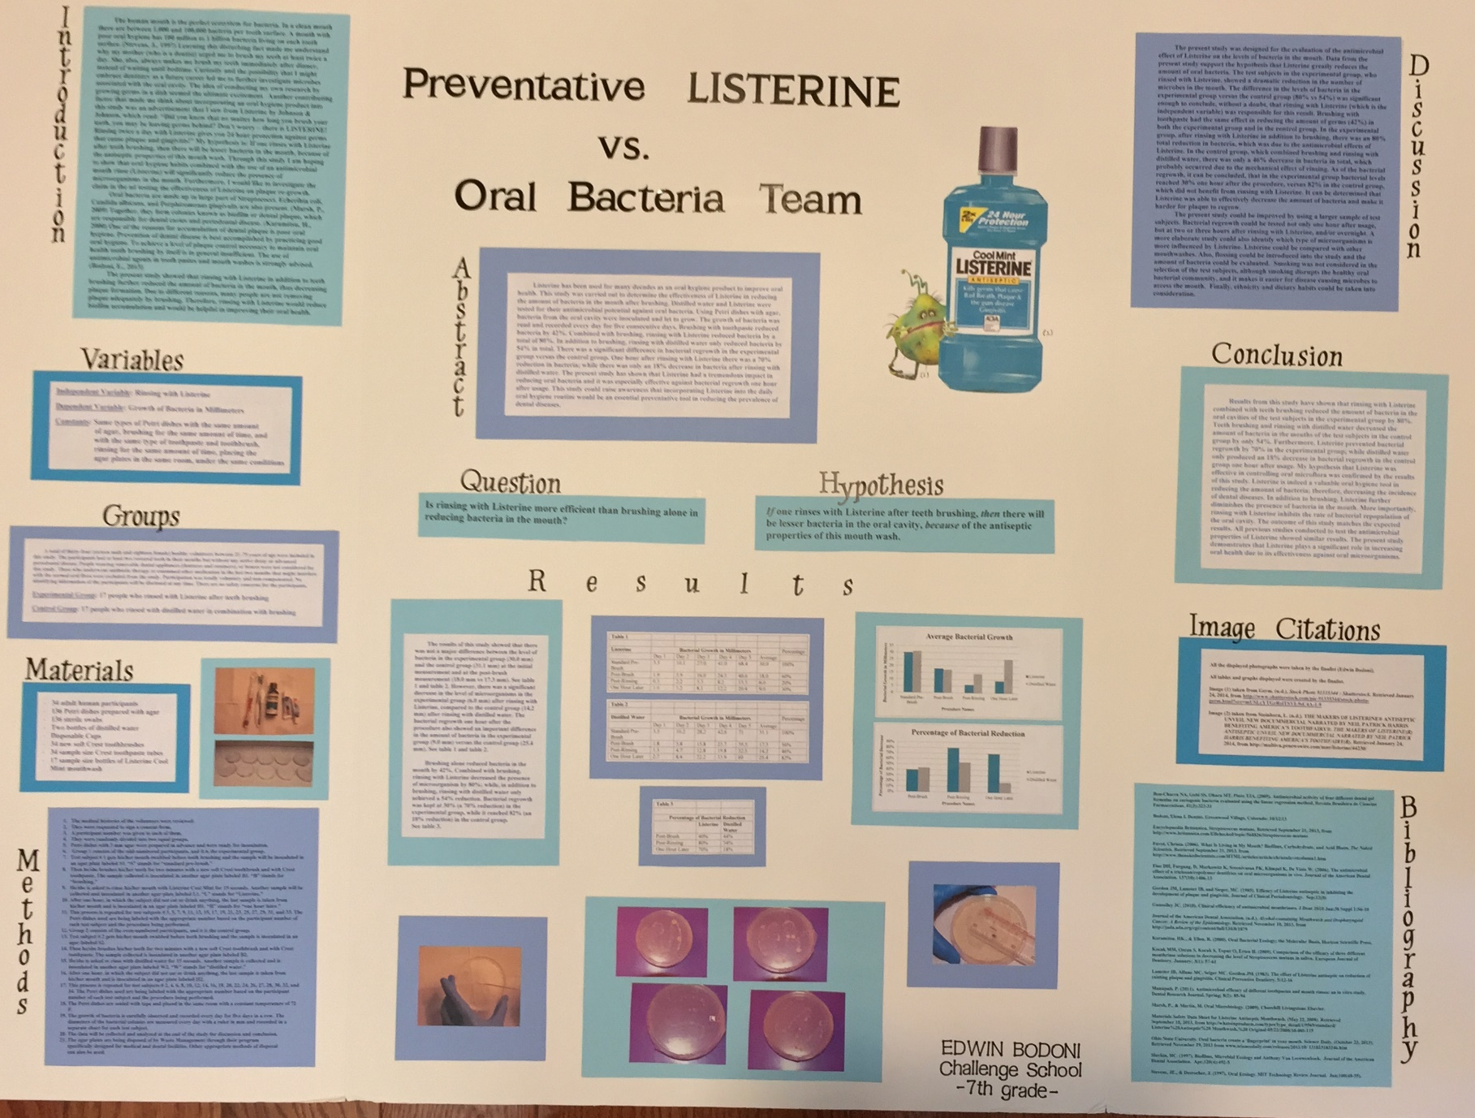
I finished the project!

Slide 12
Its important to find the right MENTOR

Slide 13
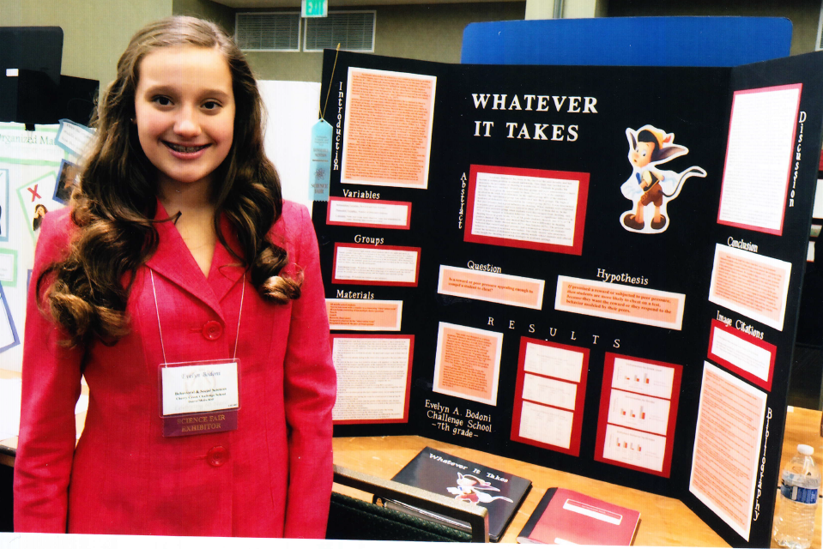
DMRSEF 2015 (7th Grade)

Slide 14
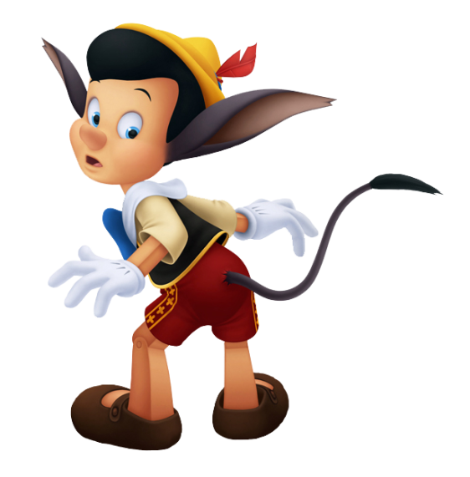
Whatever
It
Takes

Slide 15
I’m a Finalist!

Slide 16
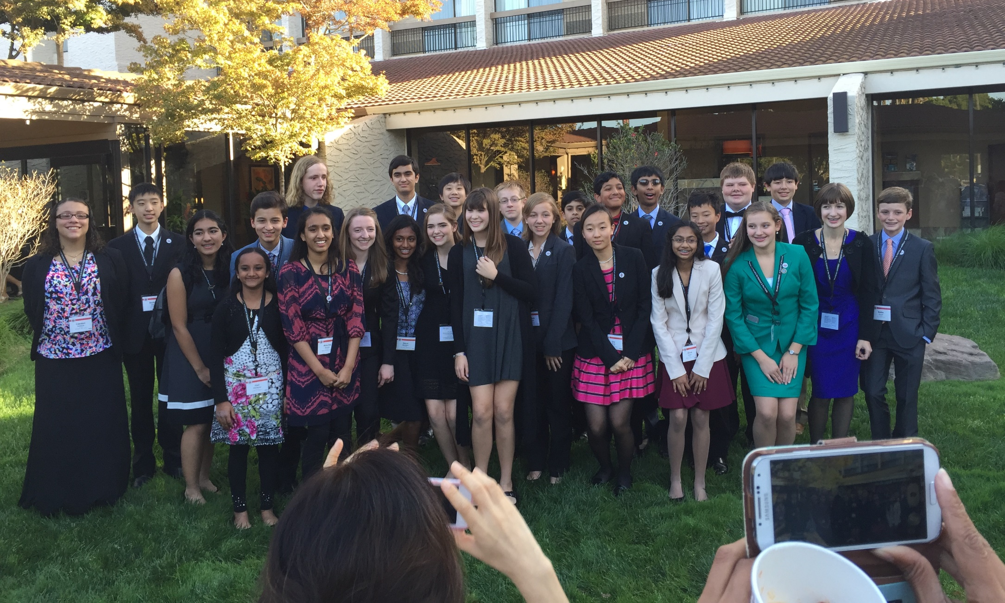
Broadcom Masters - Nationals

Slide 17
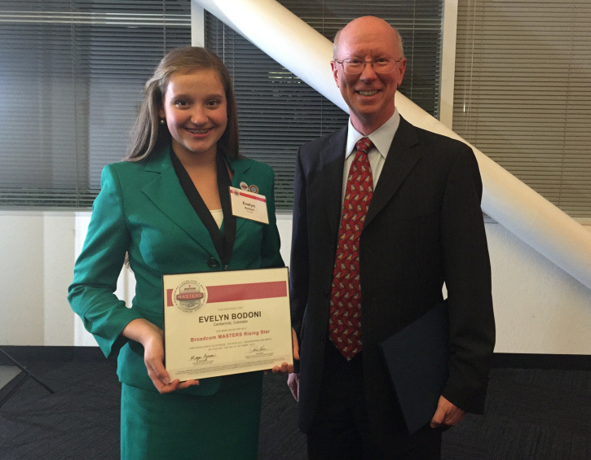
Rising Star Award

Slide 18
Broadcom Masters - International
Phoenix, Arizona

Slide 19
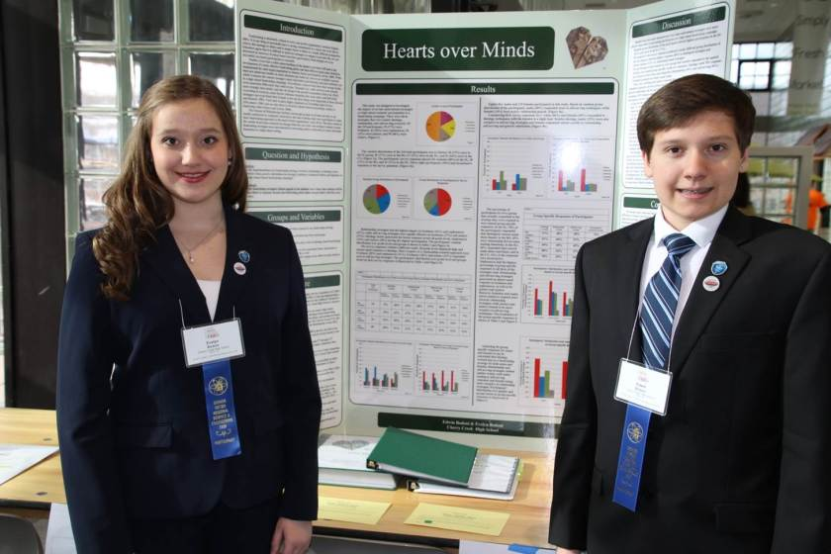
In High School

Slide 20
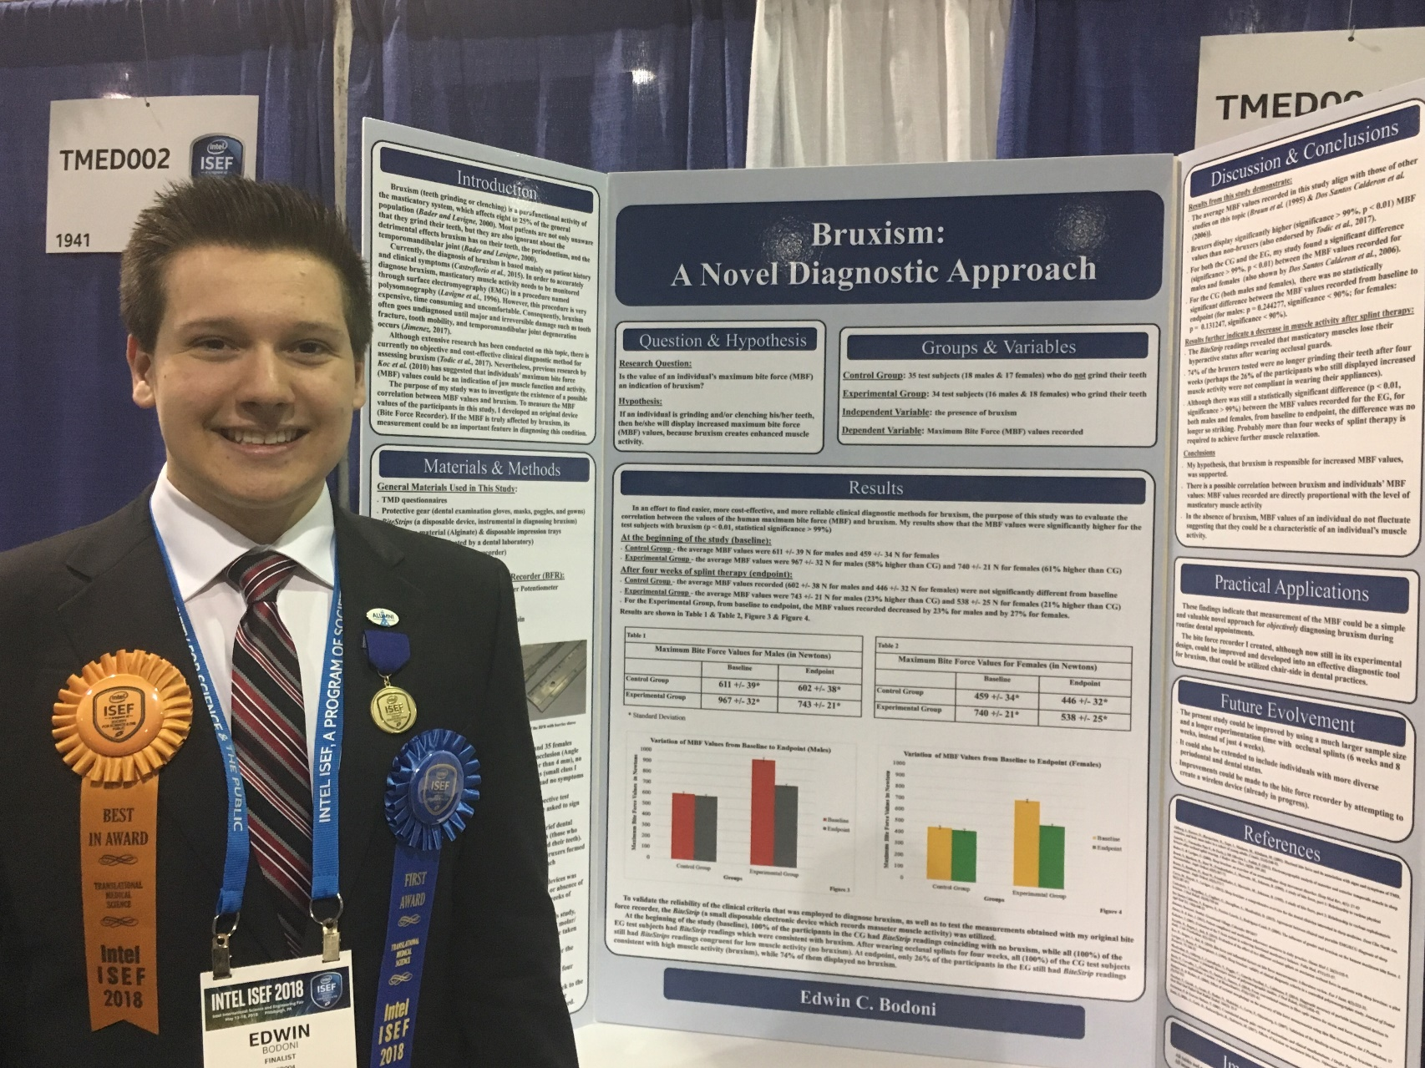
11th Grade

Slide 21
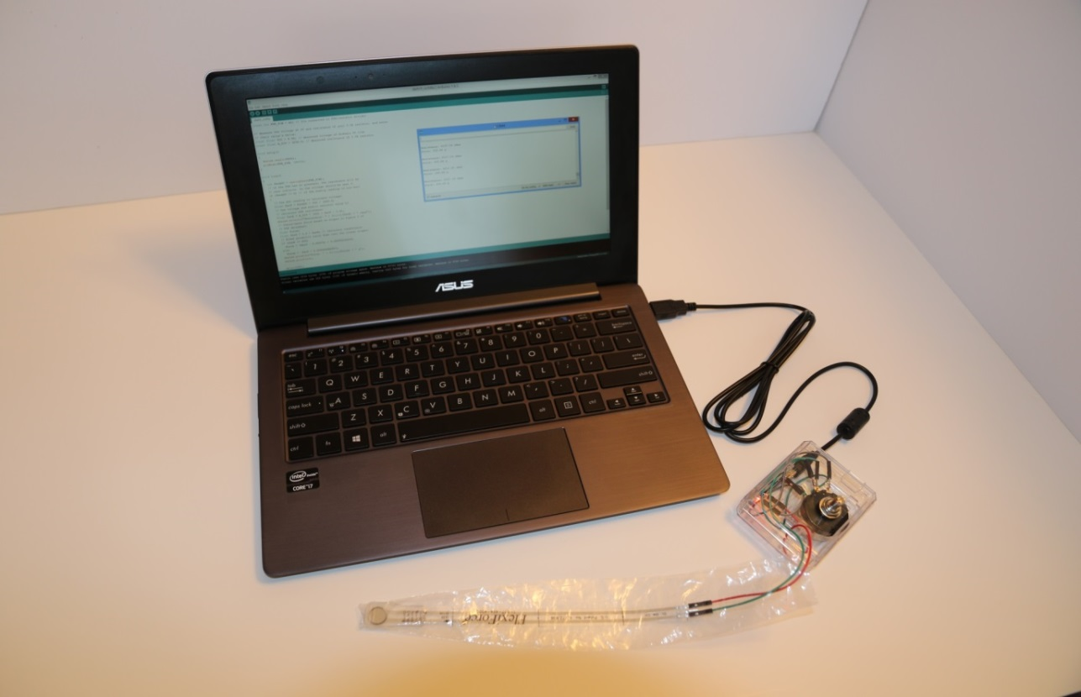
Bruxism: A Novel Diagnostic Approach

Slide 22
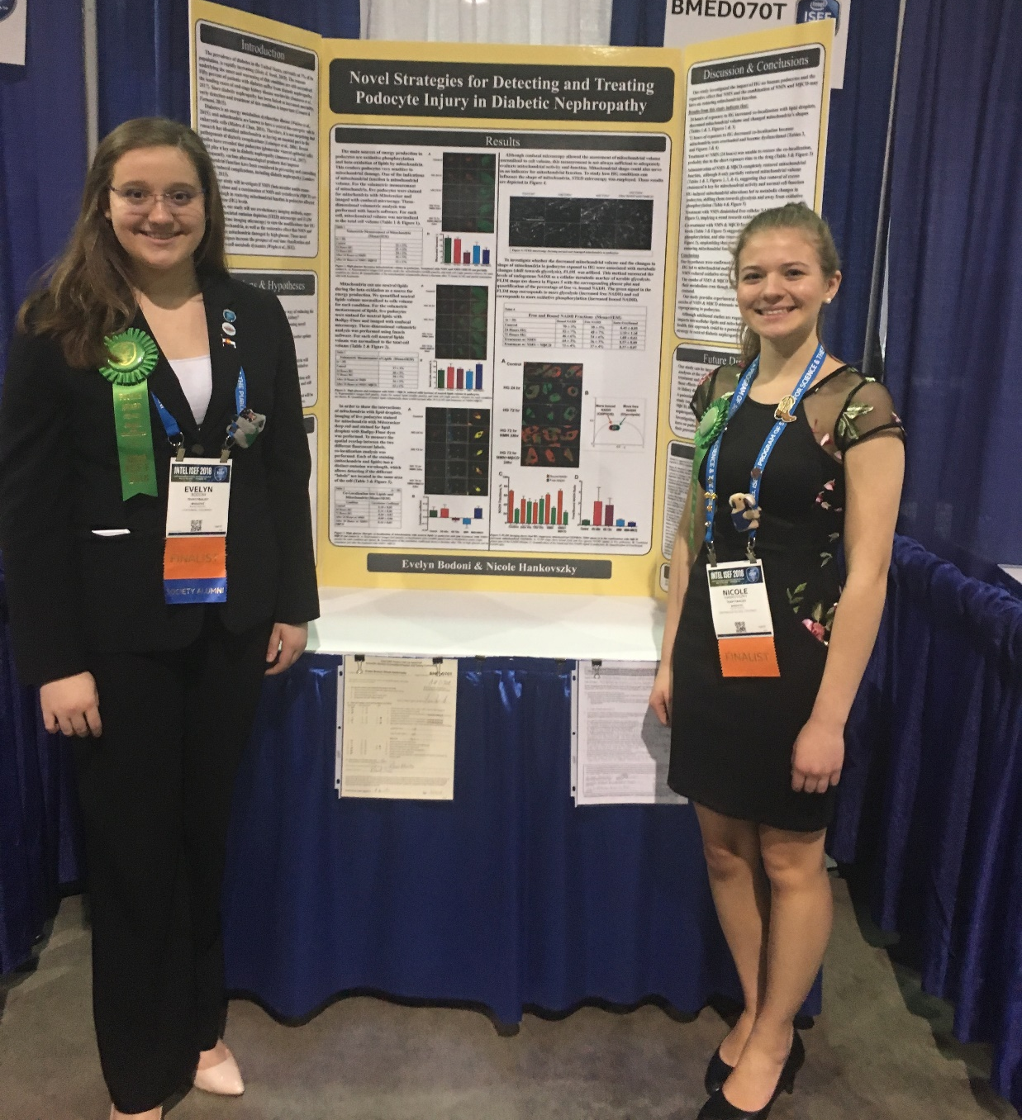
10th Grade

Slide 23
Novel Strategies for Detecting and Treating Podocyte Injury in Diabetic Nephropathy
Evelyn Bodoni
Nicole Hankovszky

Slide 25
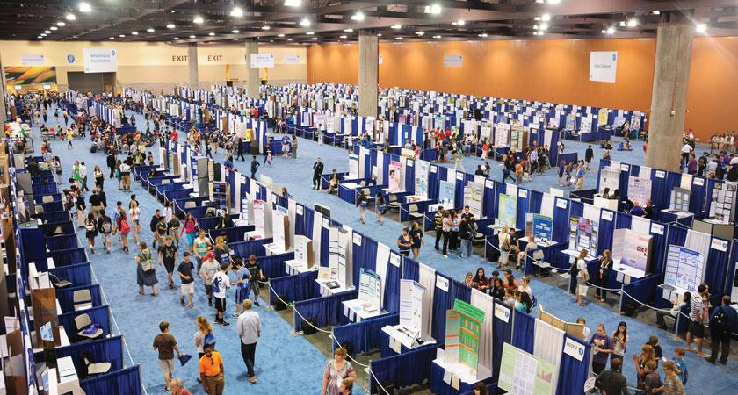
Intel International Science and Engineering Fair
Pittsburg, Pennsylvania

Slide 26
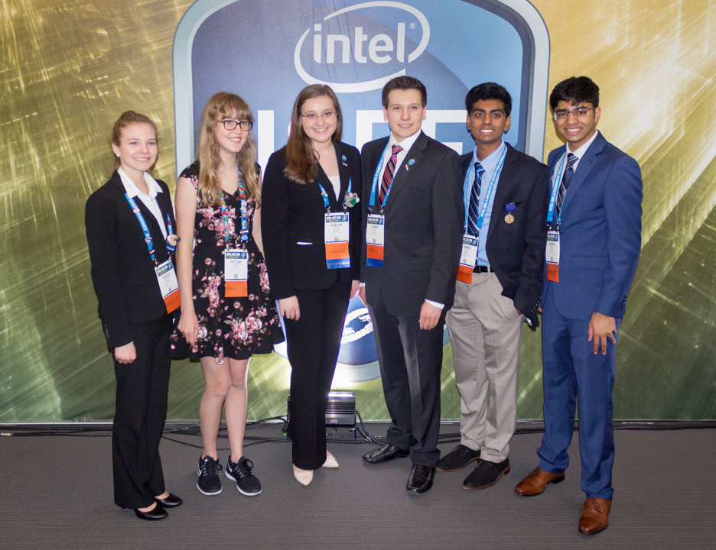
Denver Metro Delegation to Intel ISEF

Slide 27
Why Do Science Fair?

Slide 28
Try Something New

Slide 29
Develop Creativity

Slide 30
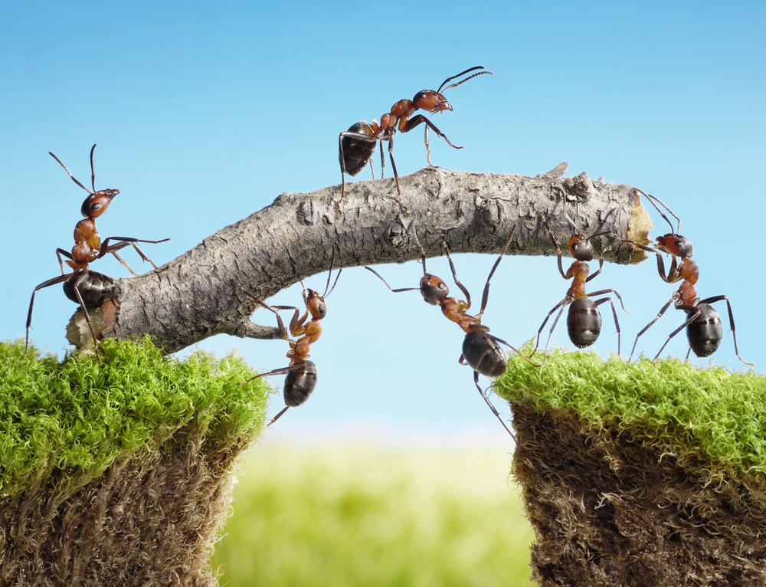
Science Fair Means Teamwork

Slide 31
Gain Presentation Skills

Slide 32
Networking Skills

Slide 33
Competition Experience

Slide 34
Earn Awards and Recognition

Slide 35
Travel the World

Slide 36
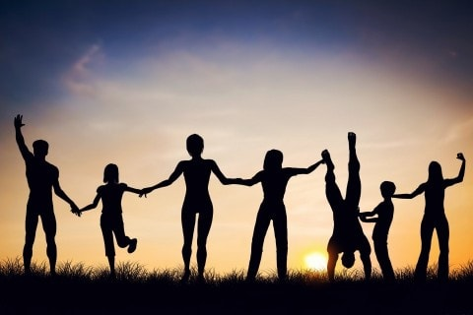
Friendship and Fun

Slide 37
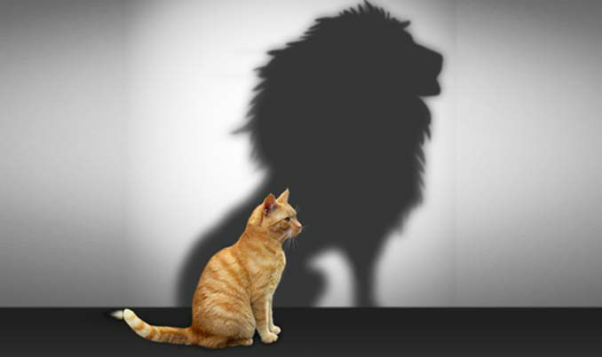
Most Importantly: Gain Confidence

Slide 38
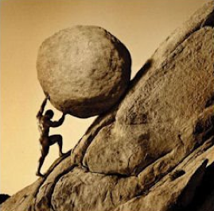
Science Fair Is Hard
Science Fair Is Not For Everyone
Are You Up To The Challenge?

Slide 39
But It Is Definitely Worthwhile
I Hope You Will Give It A Try!

Slide 40
Thank You Very Much!

Slide 41
Questions?

