Slide 1
SciComm: Preparing Your Poster
January 13, 2021

Slide 2
2021 Virtual DMRSEF Schedule
Student Deadlines:
November 16, 2020: Student Registration Opens January 8, 2021: Student Registration Closes February 8, 2021: Final Project Materials and Paperwork Edits Due
58th Annual CoorsTek DMRSEF: February 15 - 22, 2021
Monday, 15th: Opening Ceremony and Keynote Address by Dr. Temple Grandin Tuesday, 16th: Speak with a Scientist: CoorsTek Edition Wednesday, 17th: Student Social: Trivia Night! Thursday, 18th: Virtual Live Activities Fair Saturday & Sunday, 20th & 21st: Judging Interviews Monday, 22nd: Awards Ceremony
Visit the WEEK OF FAIR tab of our website to learn more and register!
Notes:
Please be aware that if your progress tofuture competitions, your presentation mayneed to be adapted to fit their (stricter)requirements, such as black font on awhite background.
At DMRSEF, however, you are encouragedto use your creativity to engage youraudience in your project as long as youremain mindful of both professionalism andreadability.
We are going to be using an online platform called zFairs to host everything from registration to the fair itself. Look of for more details and specific instructions in the coming weeks. Digital poster + 2-3 minute audio or video introduction
Tease community engagement events – keynote speaker, student social, at-home experiments with scientists, opportunity to learn more about CoorsTek

Slide 3
2021 Virtual DMRSEF Materials
Required:
Project Presentation Slides: PDF document of up to 12 slides containing all project details that would typically be on your poster board
Project Introduction Video: A 3-minute video that introduces the viewer to your project. In other words, your research ‘Elevator Pitch’!
Optional:
Demo Video
Supporting Documents
FULL MATERIALS GUIDE has been sent to all registrants and is available on our website.
Notes:
Please be aware that if your progress tofuture competitions, your presentation mayneed to be adapted to fit their (stricter)requirements, such as black font on awhite background.
At DMRSEF, however, you are encouragedto use your creativity to engage youraudience in your project as long as youremain mindful of both professionalism andreadability.
We are going to be using an online platform called zFairs to host everything from registration to the fair itself. Look of for more details and specific instructions in the coming weeks. Digital poster + 2-3 minute audio or video introduction
Tease community engagement events – keynote speaker, student social, at-home experiments with scientists, opportunity to learn more about CoorsTek

Slide 4
Digital Poster Requirements
Project Presentation Slides: PDF document of up to 12 slides containing all project details that would typically be on your poster board
Templates provided for Microsoft PowerPoint and Google Slides (Materials Instructions on Students tab of DMRSEF website)
Project Presentation must be a single PDF document of no more than 12 pages.
Page size must not exceed 8½” x 11” and should be in Landscape orientation.
The PDF document must not include any animations or active hyperlinks (except for original source material in the references).
The information on each page must be readable.
The PDF document must open with the default magnification set to “Fit Page” so that the entire page is visible at the same time.
All Project Presentation elements must conform to the same Display & Safety rules as the in-person fair. See page 4 for details
Notes:
Remember! A poster is not a paper and should not include everything you would include in a paper.
Please be aware that if your progress tofuture competitions, your presentation mayneed to be adapted to fit their (stricter)requirements, such as black font on awhite background.
At DMRSEF, however, you are encouragedto use your creativity to engage youraudience in your project as long as youremain mindful of both professionalism andreadability.
We are going to be using an online platform called zFairs to host everything from registration to the fair itself. Look of for more details and specific instructions in the coming weeks. Digital poster + 2-3 minute audio or video introduction
Tease community engagement events – keynote speaker, student social, at-home experiments with scientists, opportunity to learn more about CoorsTek

Slide 5
Sample Poster
Notes:
Please be aware that if your progress tofuture competitions, your presentation mayneed to be adapted to fit their (stricter)requirements, such as black font on awhite background.
At DMRSEF, however, you are encouragedto use your creativity to engage youraudience in your project as long as youremain mindful of both professionalism andreadability.
We are going to be using an online platform called zFairs to host everything from registration to the fair itself. Look of for more details and specific instructions in the coming weeks. Digital poster + 2-3 minute audio or video introduction
Tease community engagement events – keynote speaker, student social, at-home experiments with scientists, opportunity to learn more about CoorsTek

Slide 6
Notes:
INTRODUCTION - What is your research question?
•Explain what is known or has already been done in your research area.
•Include a brief review of relevant literature.
•If this is a continuation project, a brief summary of your prior research is appropriate here. Be sure to distinguish your previous work from this year’s project.
•What were you trying to find out?
•Include a description of your purpose, your research question, and/or your hypothesis.

Slide 7
Notes:
METHODS - Explain your methodology and procedures for carrying out your project in detail.
•What did you do?
•What data did you collect and how did you collect that data?
•Discuss your control group and the variables you tested.
•DO NOT include a list of materials.

Slide 8
Notes:
RESULTS - What were the result(s) of your project?
•Include tables and figures which illustrate your data.
•Include relevant statistical analysis of the data.

Slide 9
Notes:
DISCUSSION - What is your interpretation of these results?
•What do these results mean?
•Compare your results with theories, published data, commonly held beliefs, and expected results.
•Discuss possible errors.
•Did any questions or problem arise that you were not expecting?
•How did the data vary between repeated observations of similar events?
•How were results affected by uncontrolled events?

Slide 10
Notes:
CONCLUSIONS - What conclusions did you reach?
•What do these results mean in the context of the literature review and other work being done in your research area?
•How do the results address your research question?
•Do your results support your hypothesis?
•What application(s) do you see for your work?

Slide 11
Notes:
REFERENCES
•This section should not exceed one page.
•Limit your list to the most important references.
•List the references/documentation used which were not of your own work (i.e. books, journal articles, etc.).
•Hyperlinks to original source material are the only permissible hyperlinks allowed within the presentation.

Slide 12
Display and Safety Rules
Virtual display/poster CAN NOT contain:
Logos, trademarks, flags, patent status, (written or graphic), awards or medals.
Personal information (addresses, social media accounts, phone number, etc.) of finalist.
Animations or active hyperlinks.
Prior year’s written material or visual depictions
Anything labeled as “Abstract”.
Acknowledgements (written or graphic) of people or labs

Slide 13
Photos, Images, Charts, Tables and Graphs
Must be properly credited.
If all photos, images, graphs, etc. were taken or created by the student researcher, then a single statement to that fact should be placed on the Title Page of the Project Presentation.
If the photos, images, graphs, etc. come from different sources, then EACH individual photo, image, graph, etc. must have its own credit line below it.
Must not be deemed offensive or inappropriate (which includes images/photos/videos showing vertebrate animals/humans in surgical, necrotizing or dissection situations) by the SRC, Display & Safety Committee or DMRSEF staff.
Images from the Internet, magazine, newspaper, journal, etc. and a credit line is attached immediately underneath it.
Photographs of a person other than that of the student presenter(s) as long as there is a photo release signed by the subject, and if under 18, also by the guardian of the subject. Photo releases must be uploaded with the researcher’s project plan for verification.

Slide 14
Photo Credits
Stock Images:
Image from Stock Images, Microsoft PowerPoint for Microsoft Office 365
Online Images:
Image from https://thisisnoordinaryworld.files.wordpress.com/2014/04/cats-playing.jpg

Slide 15
Tips and Tricks
Use your creativity to engage your audience in your project as long as you remain mindful of both professionalism and readability.
Be as clear and concise as possible! Use bullet points or numbered lists instead of long paragraphs.
Make your titles the largest font size on your page, followed by your headings and then your text so that your information is tiered and judges can easily find the information they may be looking for.
Images and graphics should support your content, not distract from it. But do make sure to include some images or color to make your poster visually appealing to your audience.
Have a few people such as your parents, adult sponsors, teachers or friends review your digital poster before submitting it.
Poster Design Resource: https://guides.auraria.edu/ld.php?content_id=28624853
A poster should make people stop, read, think, and ask questions!
Notes:
Please be aware that if your progress to future competitions, your presentation may need to be adapted to fit their (stricter) requirements, such as black font on a white background.

Slide 16
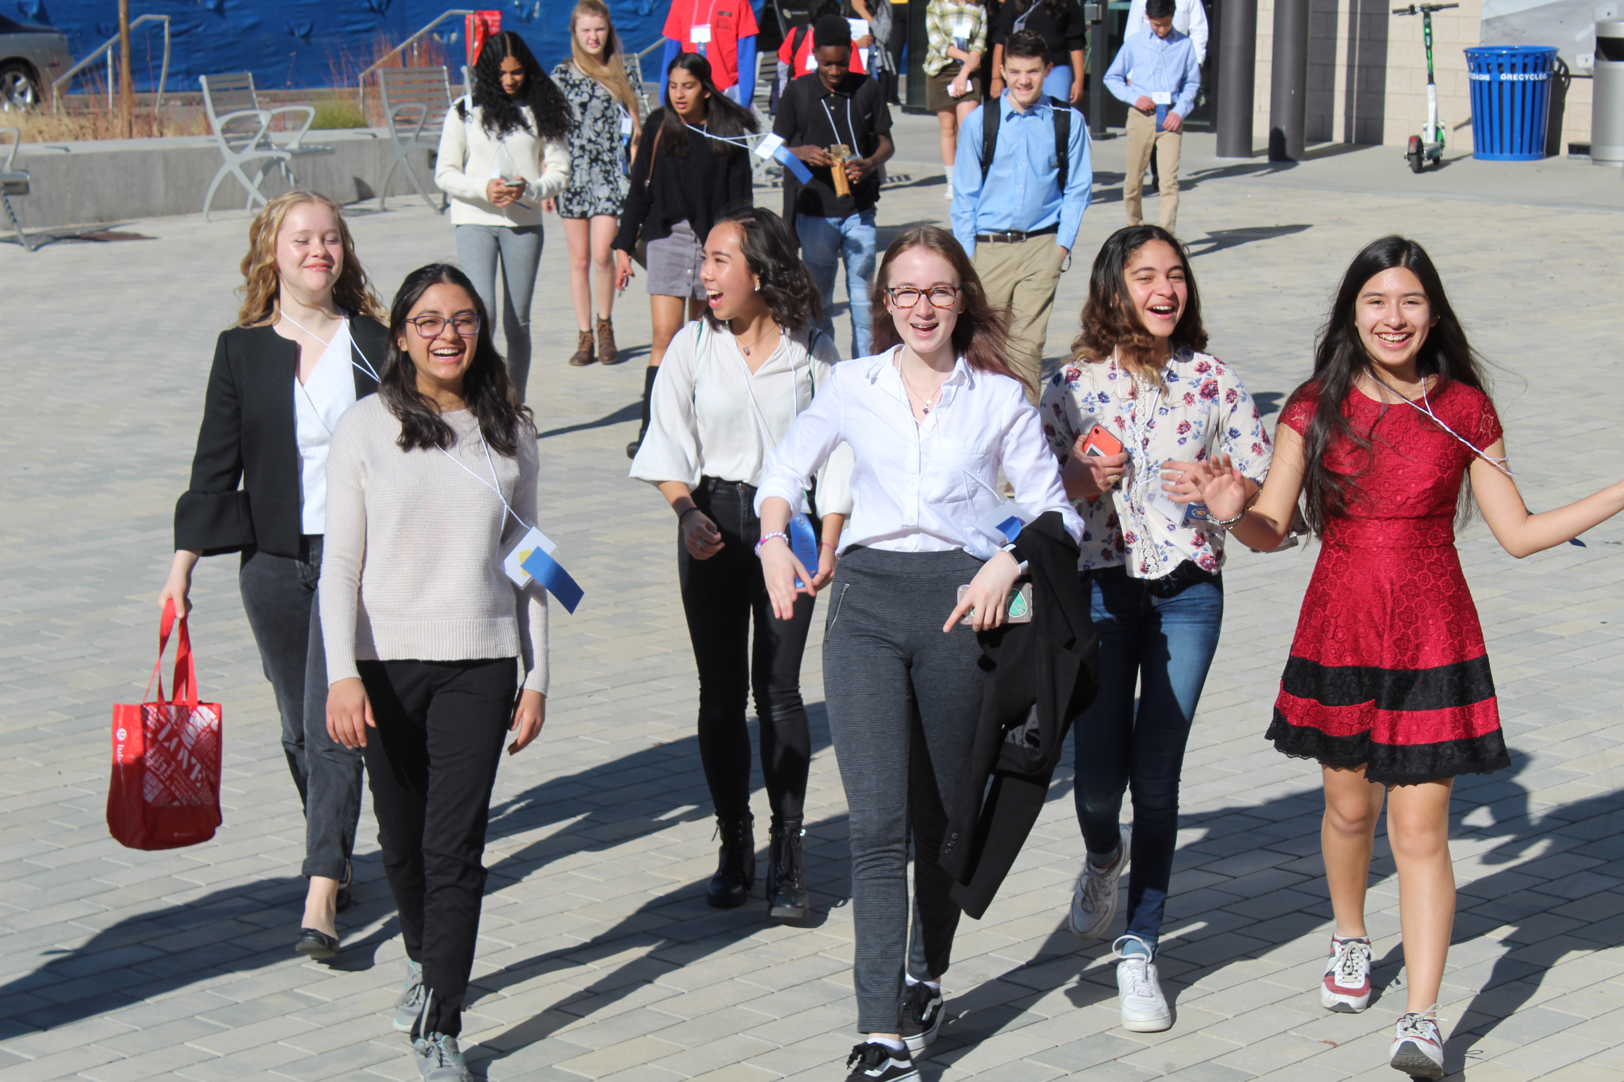
Connect with DMRSEF on Discord!

Slide 17
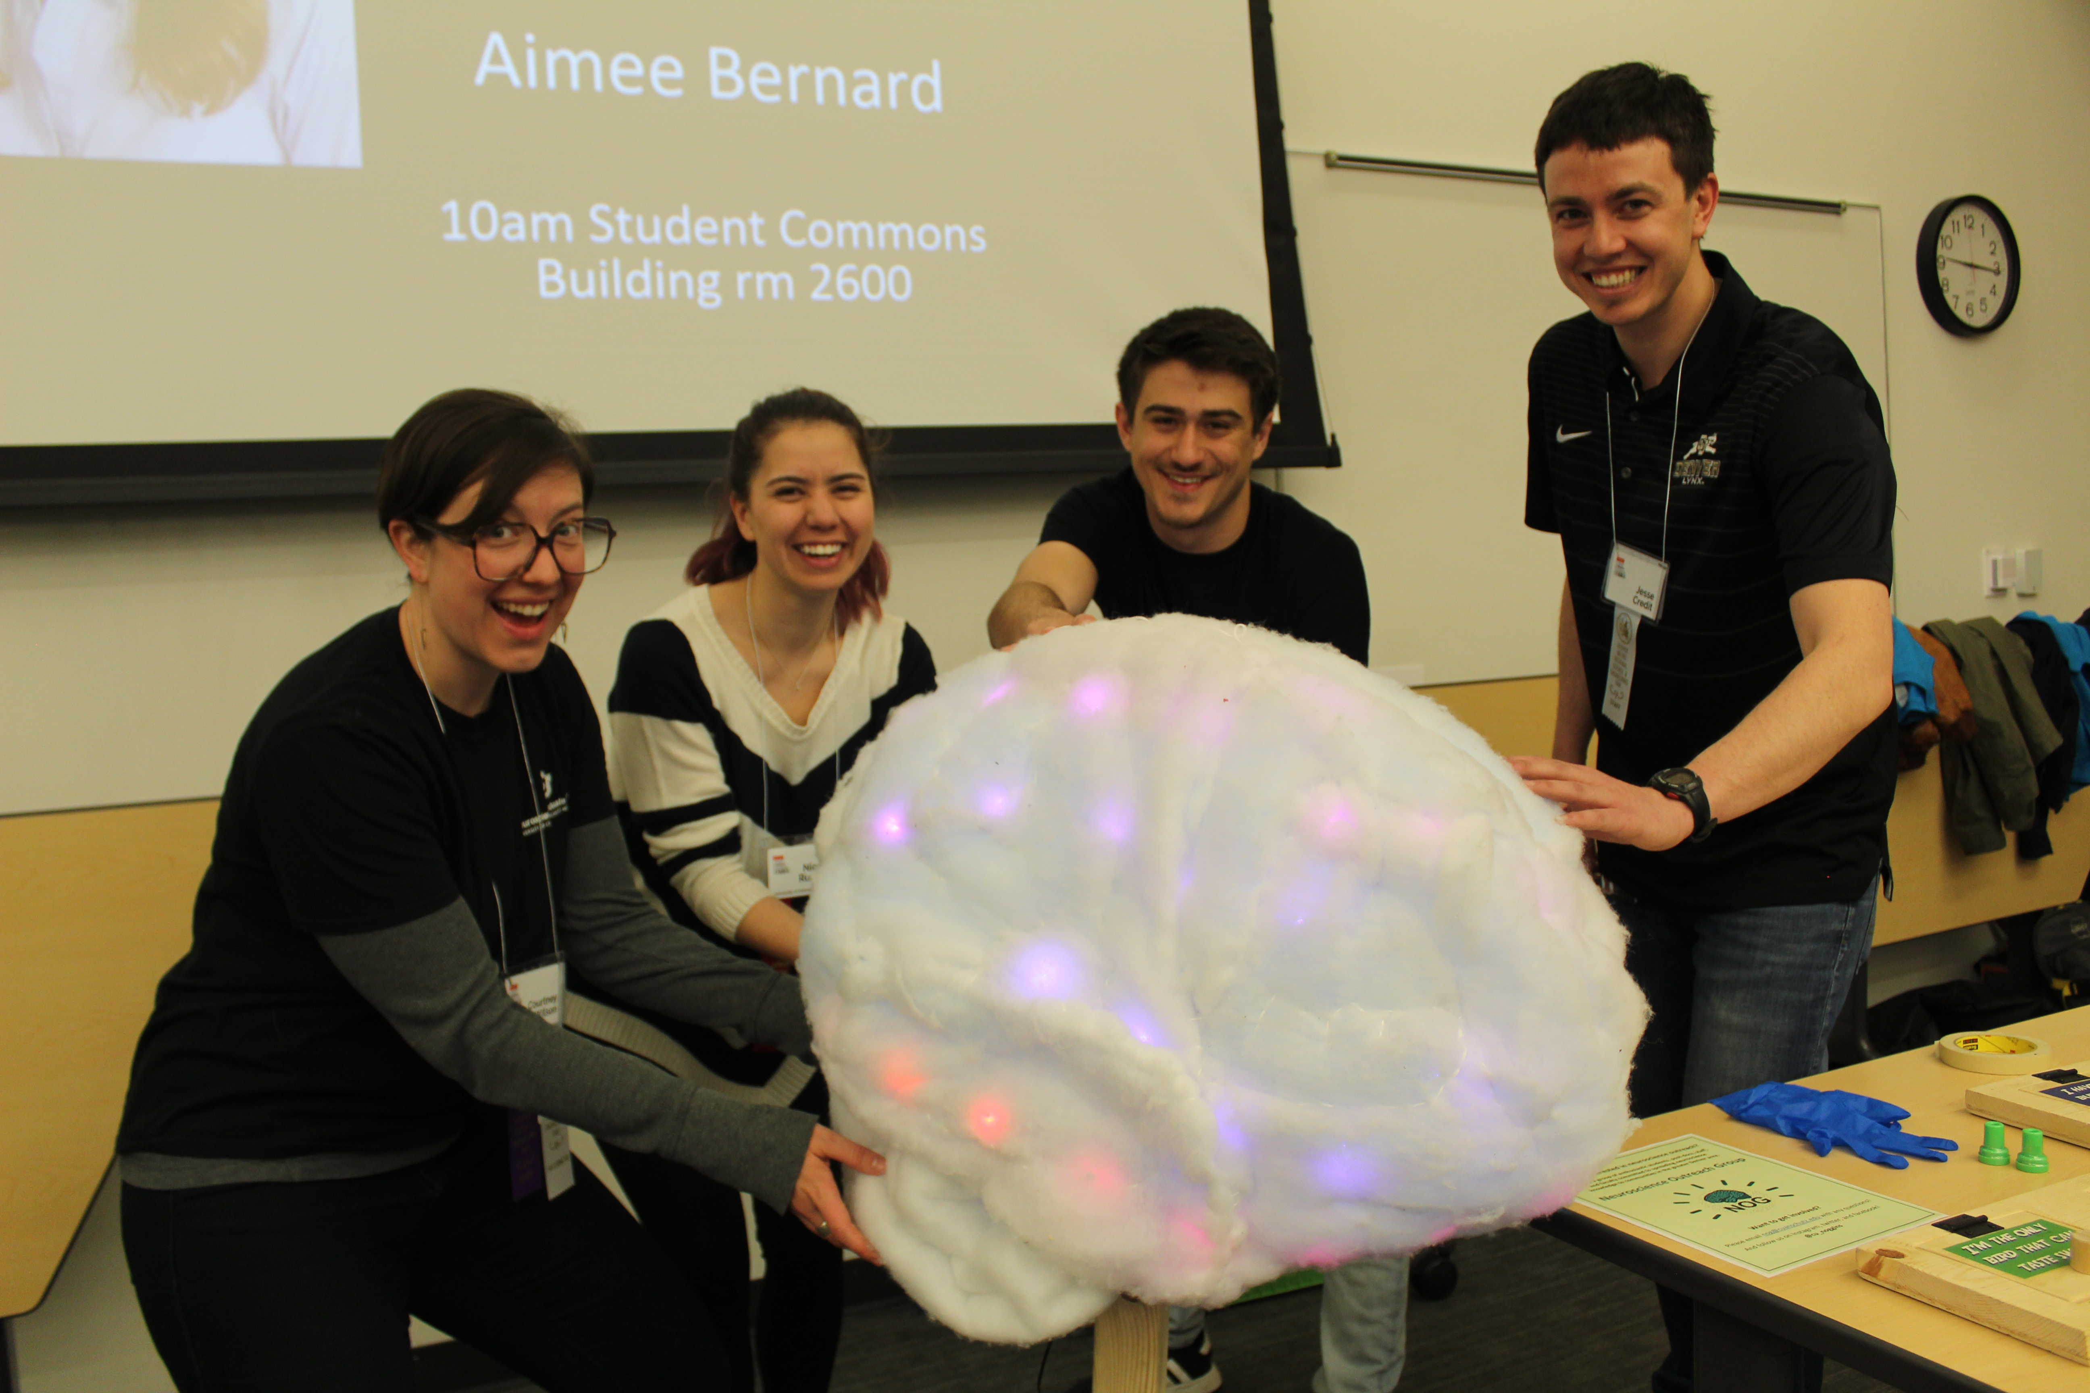
The Competition Ready Series
https://clas.ucdenver.edu/denversciencefair/events-2

Slide 18
Next Sessions:
January 16th 10-11a Speak with a Scientist
January 20th 6-7p SciComm – Video Prep
January 23rd 10-11a Science Fair Q&A
January 27th 6-7p Speak with a Scientist
February 2nd 6-7p SciComm – Acing your Interview
February 4th 6-7p Science Fair Q&A
February 10th 6-7p Science Fair Q&A
February 12th 4-7p SciComm – Practice your Pitch
February 13th 9a-12p SciComm – Practice your Pitch
Notes:
Please be aware that if your progress tofuture competitions, your presentation mayneed to be adapted to fit their (stricter)requirements, such as black font on awhite background.
At DMRSEF, however, you are encouragedto use your creativity to engage youraudience in your project as long as youremain mindful of both professionalism andreadability.
We are going to be using an online platform called zFairs to host everything from registration to the fair itself. Look of for more details and specific instructions in the coming weeks. Digital poster + 2-3 minute audio or video introduction
Tease community engagement events – keynote speaker, student social, at-home experiments with scientists, opportunity to learn more about CoorsTek

Slide 19
Questions?
Contact Us!
Dr. Erin Golden – Director
Kayla Ahr – Associate Director
Samantha Sands – Outreach & Engagement
DenverScienceFair@ucdenver.edu
https://clas.ucdenver.edu/denversciencefair/

