Slide 1
SciComm: Acing Your Interview
February 2, 2021

Slide 2
2021 Virtual DMRSEF Schedule
Student Deadlines:
November 16, 2020: Student Registration Opens January 8, 2021: Student Registration Closes February 8, 2021: Final Project Materials and Paperwork Edits Due
58th Annual CoorsTek DMRSEF: February 15 - 22, 2021
Monday, 15th: Opening Ceremony and Keynote Address by Dr. Temple Grandin Tuesday, 16th: Speak with a Scientist: CoorsTek Edition Wednesday, 17th: Student Social: Trivia Night! Thursday, 18th: Virtual Live Activities Fair Saturday & Sunday, 20th & 21st: Judging Interviews Monday, 22nd: Awards Ceremony
Visit the WEEK OF FAIR tab of our website to learn more and register!
Notes:
Please be aware that if your progress tofuture competitions, your presentation mayneed to be adapted to fit their (stricter)requirements, such as black font on awhite background.
At DMRSEF, however, you are encouragedto use your creativity to engage youraudience in your project as long as youremain mindful of both professionalism andreadability.
We are going to be using an online platform called zFairs to host everything from registration to the fair itself. Look of for more details and specific instructions in the coming weeks. Digital poster + 2-3 minute audio or video introduction
Tease community engagement events – keynote speaker, student social, at-home experiments with scientists, opportunity to learn more about CoorsTek

Slide 3
2021 Virtual DMRSEF Materials
Required:
Project Presentation Slides: PDF document of up to 12 slides containing all project details that would typically be on your poster board
Project Introduction Video: A 3-minute video that introduces the viewer to your project. In other words, your research ‘Elevator Pitch’!
Optional:
Demo Video
Supporting Documents
FULL MATERIALS GUIDE has been sent to all registrants and is available on our website.
Notes:
Please be aware that if your progress tofuture competitions, your presentation mayneed to be adapted to fit their (stricter)requirements, such as black font on awhite background.
At DMRSEF, however, you are encouragedto use your creativity to engage youraudience in your project as long as youremain mindful of both professionalism andreadability.
We are going to be using an online platform called zFairs to host everything from registration to the fair itself. Look of for more details and specific instructions in the coming weeks. Digital poster + 2-3 minute audio or video introduction
Tease community engagement events – keynote speaker, student social, at-home experiments with scientists, opportunity to learn more about CoorsTek

Slide 4
Interview Format
Saturday, February 20th 9 a.m. - 12 p.m. for Seniors, 12:30 p.m. - 3 p.m. for Juniors
You will be provided a link to a Zoom call and an assigned interview time. Please call in a few minutes before your assigned time.
Fair staff will greet you when you call in and then move you into a breakout room with judges.
Interviews are 15 minutes in length. There will be 3 judges on your judging team.
At the end of the interview, you can move back into the main room or leave the call.
Sunday interviews:
You will be contacted via email by 8 p.m. on Saturday to notify you of any Sunday interviews. Not all students will have Sunday interviews this is not indicative of having placed or not in the overall fair.
Notes:
Please be aware that if your progress to future competitions, your presentation may need to be adapted to fit their (stricter) requirements, such as black font on a white background.

Slide 5
Know Your Audience: Judges!
Judges are STEM Enthusiasts!
They may or may not be experts in YOUR field.
Judges WANT you to succeed!
Judges are evaluating projects on the following categories: research question, design and methodology, execution, creativity, presentation, poster and the interview!

Slide 6
What are the judges looking for?
Research Question
Design & Methodology
Execution
Creativity
Poster/Slides
Introductory Video

Slide 7
Identify Your Message and Practice!
Introduce yourself and your project ( in 60 seconds or less)
Prepare for standard questions such as:
What inspired this project (or where did you get your idea)?
What methods did you use?
What did you learn doing this project?
What might you do differently if you did this project again or had the opportunity to continue the project?
Practice with peers, grown-ups, teachers, etc.
Sign up for a practice session on Feb 12th and 13th
If you do have an idea but are unsure, you can say “Yes, that is a good question that I have not considered before. Now that I am thinking about it, a few quick ideas/thoughts I have are...”
Remember to avoid science jargon!

Slide 8
Tips & Tricks for Success!
Dress for Success- just like you would for the in-person fair
Make eye contact with the camera on your computer.
Don't forget to smile!
Clear and concise answers.
Be in a quiet, well-lit space for the interview.
DMRSEF has virtual backgrounds you can use for your calls! Download them from the Week of Fair tab on the DMRSEF website.

Slide 9
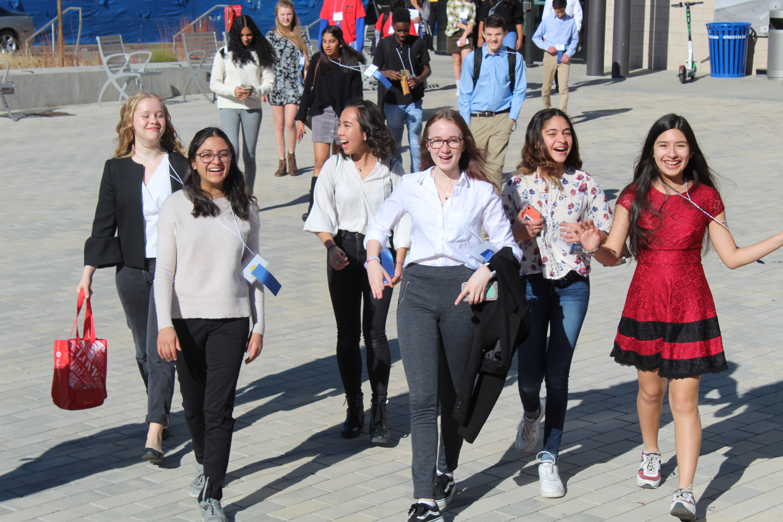
Connect with DMRSEF on Discord!

Slide 10
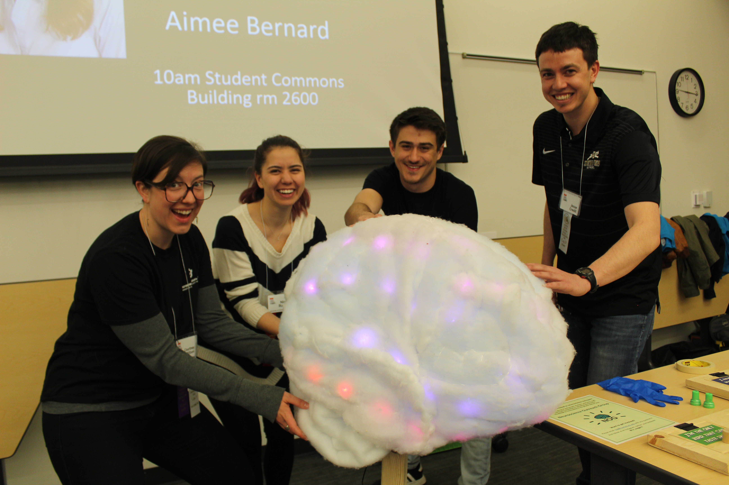
The Competition Ready Series
https://clas.ucdenver.edu/denversciencefair/events-2

Slide 11
Next Sessions:
February 4th 6-7p Science Fair Q&A
February 10th 6-7p Science Fair Q&A
February 12th 4-7p SciComm – Practice your Pitch
February 13th 9a-12p SciComm – Practice your Pitch
Notes:
Please be aware that if your progress tofuture competitions, your presentation mayneed to be adapted to fit their (stricter)requirements, such as black font on awhite background.
At DMRSEF, however, you are encouragedto use your creativity to engage youraudience in your project as long as youremain mindful of both professionalism andreadability.
We are going to be using an online platform called zFairs to host everything from registration to the fair itself. Look of for more details and specific instructions in the coming weeks. Digital poster + 2-3 minute audio or video introduction
Tease community engagement events – keynote speaker, student social, at-home experiments with scientists, opportunity to learn more about CoorsTek

Slide 12
Questions?
Contact Us!
Dr. Erin Golden – Director
Kayla Ahr – Associate Director
Samantha Sands – Outreach & Engagement
DenverScienceFair@ucdenver.edu
https://clas.ucdenver.edu/denversciencefair/

