Slide 1
JR-ANM-500
Crickets or Cantaloupe?
Investigating Red-eared Slider Turtle Food Preferences
Muhammad Hussain
Illustration by Muhammad Hussain
Optional Project Video URL: https://www.youtube.com
Optional Project Demo Video URL:

Slide 2
INTRODUCTION
Image from jkraft5 in Canva
Red-eared slider turtles are omnivorous. In captivity, they require a well-balances diet of turtle pellet food, vegetables, fruit and protein, such as worms and crickets.
A turtle expert, Dr. Splinter, says that pet turtles prefer protein sources (such as crickets) over carbohydrates (such as melon). (Splinter, 2020).
Turtles do not have teeth and use the ridges on their jaws as a knife.
Red-eared slider turtles live in ponds, lakes, and rivers with muddy bottoms.
I feed my pet Red-eared slider turtle everyday and I feed it a mix of turtle pellets, lettuce, carrots, cantaloupe and apples.
RESEARCH QUESTION
What food type does my Red-eared slider turtle prefer?
HYPOTHESIS
When presented with a cricket once a day for one week, the Red-eared slider will move across its tank with a lower average time than when it’s presented with cantaloupe cubes at the same rate on a subsequent week.

Slide 3
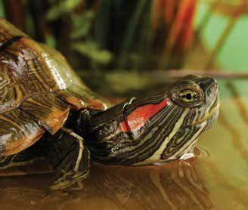
METHODS
STEP 1
Prepare the test food.
1A: If this is a melon trial, use a carving knife to prepare a 1 inch piece of cantaloupe
1B: If this is a cricket trial, remove 1 freeze-dried cricket from the bag using tweezers
Place the test food on the far end of the cage.
While wearing gloves, place the turtle in the other end of the cage, approximately 8 inches away from the test food
Start stopwatch and observe how long it takes the turtle to approach the food.
Record observations in lab notebook
Repeat steps 2-5 each day for 1 week.
STEP 2
STEP 3
Image from https://assets.petco.com/petco/image/upload/f_auto,q_auto/red_eared_slider
STEP 4
STEP 5
STEP 6
Image from Stock Images, Microsoft PowerPoint for Microsoft 365

Slide 4
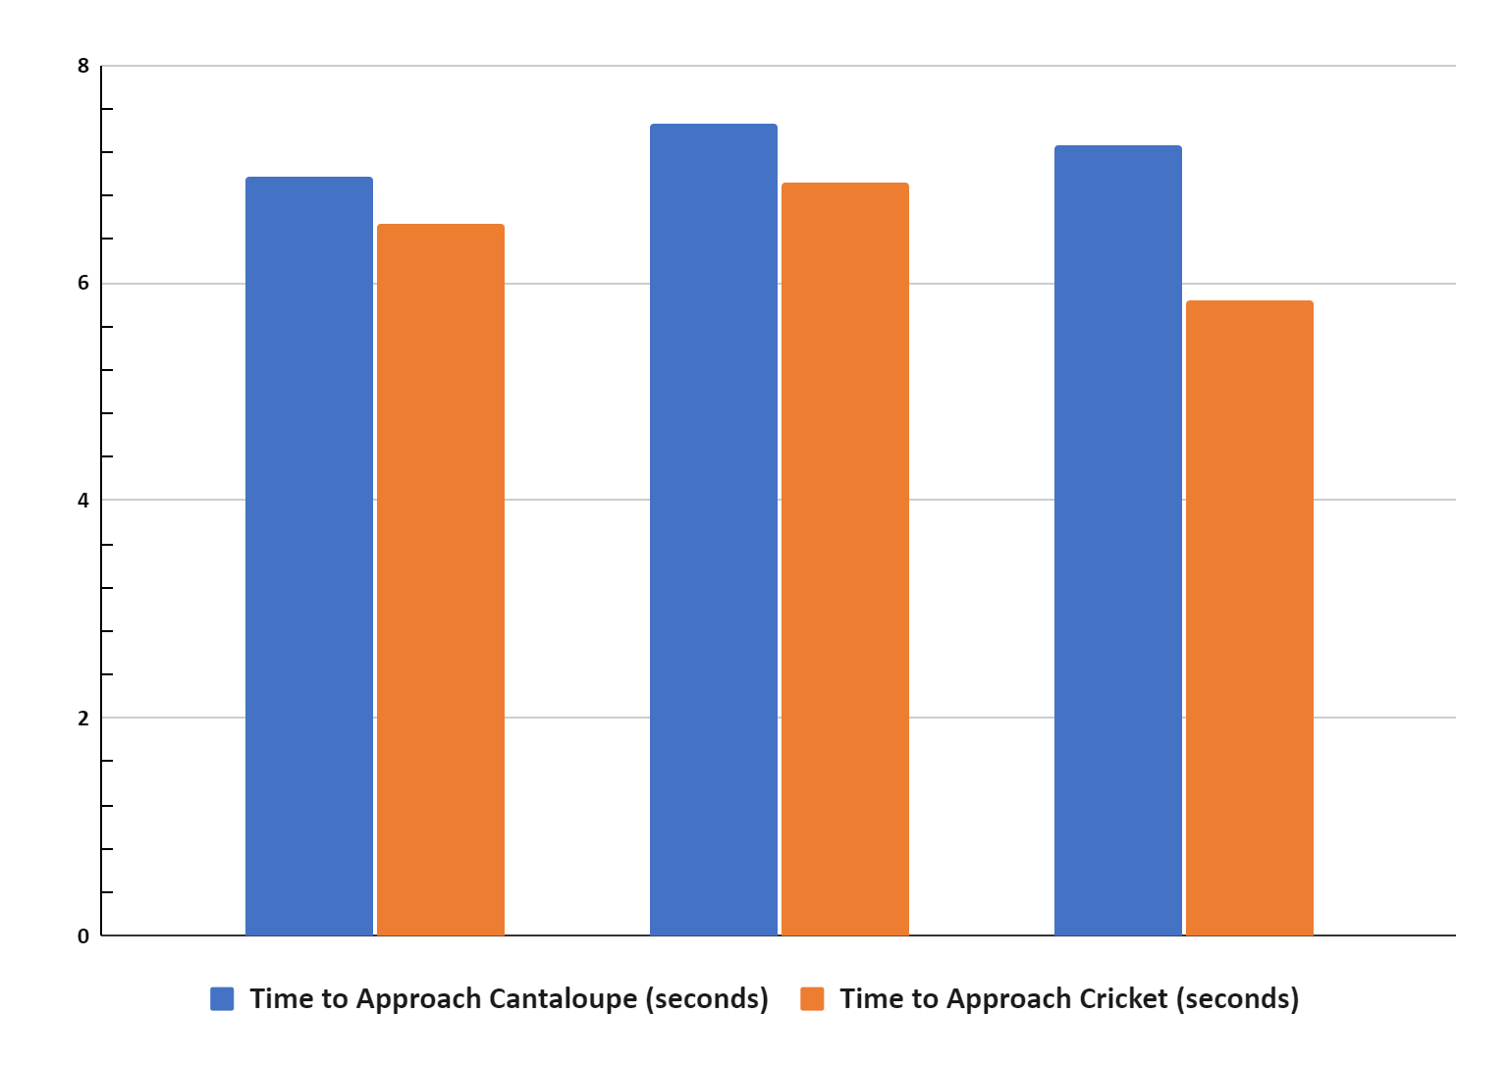
RESULTS
The average time for the turtle to
approach the cantaloupe was 6.4
seconds.
The average time for the turtle to approach the cricket was 5.7 seconds.
 | Time to Approach Food (seconds)
Food Type | Trial | Day 1 | Day 2 | Day 3 | Day 4 | Day 5 | Average
Cantalopue | 1 | 7.2 | 6.1 | 8.2 | 5.1 | 8.3 | 6.0
 | 2 | 6.4 | 7.8 | 6.8 | 7.1 | 9.2 | 6.6
 | 3 | 10.5 | 7.8 | 5.4 | 6.9 | 5.7 | 6.6
 |  |  |  |  |  |  | 6.4
Cricket | 1 | 5.3 | 6.3 | 6.8 | 5.7 | 8.6 | 5.6
 | 2 | 7.2 | 6.4 | 7.8 | 6.5 | 6.7 | 6.1
 | 3 | 5.8 | 4.7 | 6.5 | 5.9 | 6.3 | 5.4
 |  |  |  |  |  |  | 5.7
Chart by M. Hussain

Slide 5
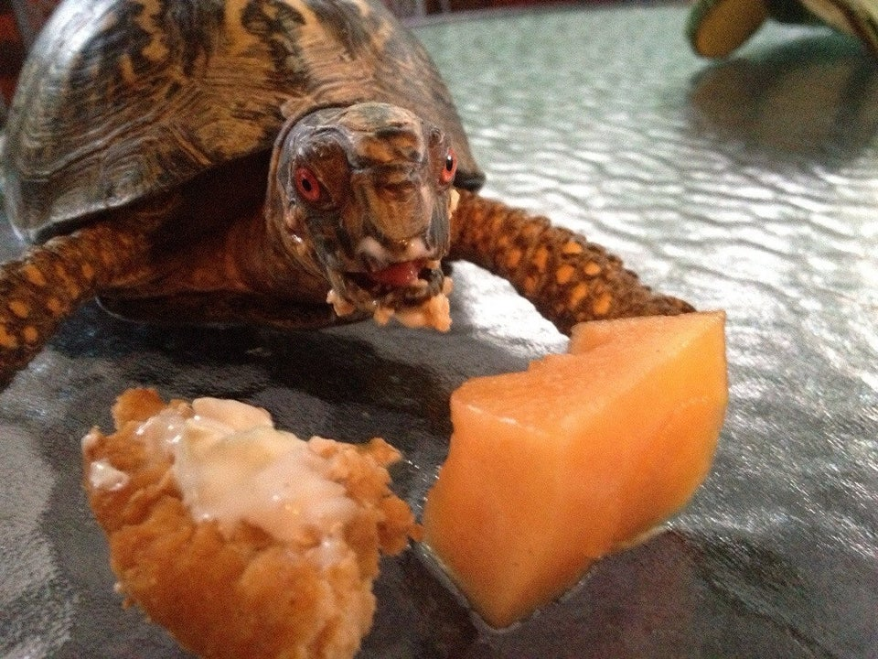
DISCUSSION
The turtle moved at a higher average speed when presented with the crickets than when it was presented with cantaloupe squares.
In this experiment, the turtle moved more quickly to the crickets than the cantaloupe, however the difference between the approach times is not statistically significant.
There is a misconception that Red-eared turtles are carnivorous but studies have shown that they are omnivorous and this experiment supports that research.
While I tried to feed the turtle at the same time every day (before school), on several occasions I forgot and feed the turtle after school instead. This may have affected how hungry the turtle was and how quickly it approached the food.
I cleaned the turtle’s tank between the cantaloupe and cricket trials. This may have induced stress in the turtle, which could have affected the results.
Image from https://external-preview.redd.it/NaGSwmQ1mfHytYGV8UWC9_11w3moW0H-7g6gLVhsqCA.jpg?width=960&crop=smart&auto=webp&s=239186d80255acad28aeda6e359652a687e2ac13

Slide 6
CONCLUSIONS
Illustration by Muhammad Hussain
Our experiment indicates that protein sources are correlated with higher movement speed, and we can
speculate that the protein source LIKELY caused the increase in speed. This supports the hypothesis the
Red-eared slider will move across its tank with a lower average time than when it’s presented
with cantaloupe cubes.
Further research is needed including repeating the experiment with different turtles, measuring other variables such as room temperature and standardizing the feeding time.

Slide 7
REFERENCES
Back, D.-S., Shin, G.-W., Wendt, M., & Heo, G.-J. (2016). Prevalence ofSalmonellaspp. in pet turtles and their environment. Laboratory Animal Research, 32(3), 166. https://doi.org/10.5625/lar.2016.32.3.166
Girondot, M., Archinard, C., Prévot-Julliard, A.-C., Cadi, A., & Gousset, E. (2007). Pets and invasion risks: is the Slider turtle strictly carnivorous? Amphibia-Reptilia, 28(1), 139–143. https://doi.org/10.1163/156853807779799036
Jenny Burger. (2009, December). Red-eared slider turtles (Trachemys scripta elegans). http://depts.washington.edu/oldenlab/wordpress/wp-content/uploads/2013/03/Trachemys-scripta-elegans_Burger.pdf
Kass, R. E., Ullrey, D. E., & Trapp, A. L. (1982). A Study of Calcium Requirements of the Red-Eared Slider Turtle (Pseudemys scripta elegans). The Journal of Zoo Animal Medicine, 13(2), 62. https://doi.org/10.2307/20094572
McKibben JS, Porterfield PD, Westergaard JM. Effect of dry versus wet bowl environment on pet turtles. American Journal of Veterinary Research. 1978 Jan;39(1):109-114.
P. (2020, May 19). Red Eared Slider Care Sheet. Petco. https://www.petco.com/content/petco/PetcoStore/en_US/pet-services/resource-center/caresheets/red-eared-slider-care-sheet.html#:%7E:text=red%2Deared%20sliders%20need%20a,may%20be%20offered%20as%20treats.
Splinter, Dr., personal communication, December 20, 2020.

