Slide 1
CoorsTek DMRSEF 2020 Season Kick-off
57th annual Denver Metro Regional Science and Engineering Fair

Slide 2
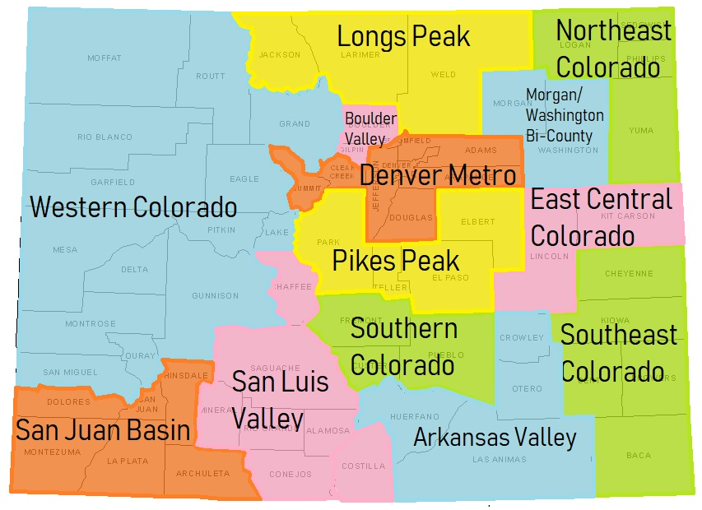
ABOUT THE COORSTEK DMRSEF
Serves eight counties in Denver metropolitan area: Adams, Arapahoe, Broomfield, Clear Creek, Denver, Douglas, Elbert, Jefferson, and Summit
CoorsTek DMRSEF is one of 13 International Science and Engineering Fair Regions in the state that feed into the Colorado State Science Fair
Notes:
BEGAN IN 1963! WE’RE IN OUR 57TH YEAR!

Slide 3
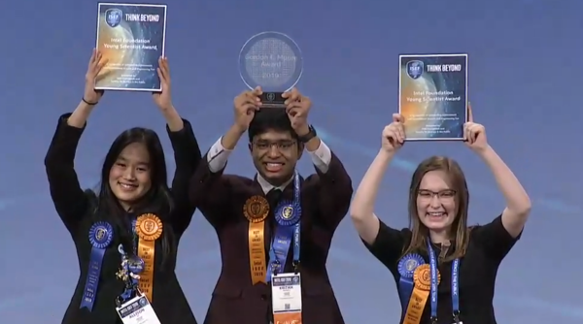
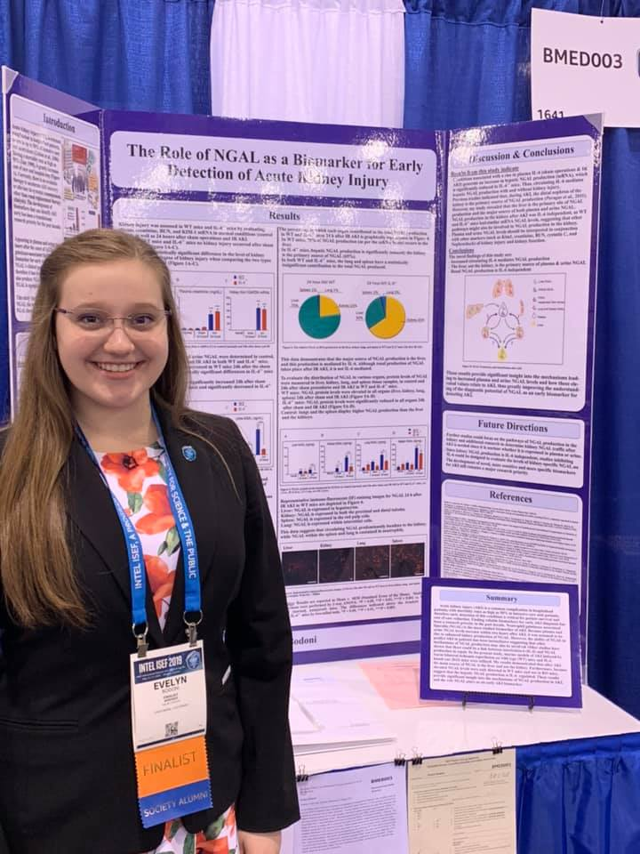
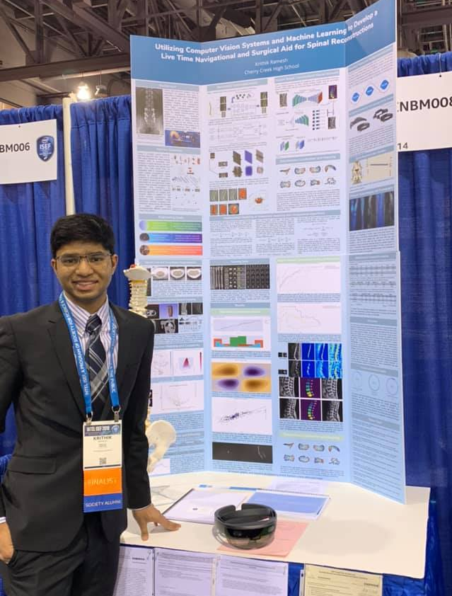
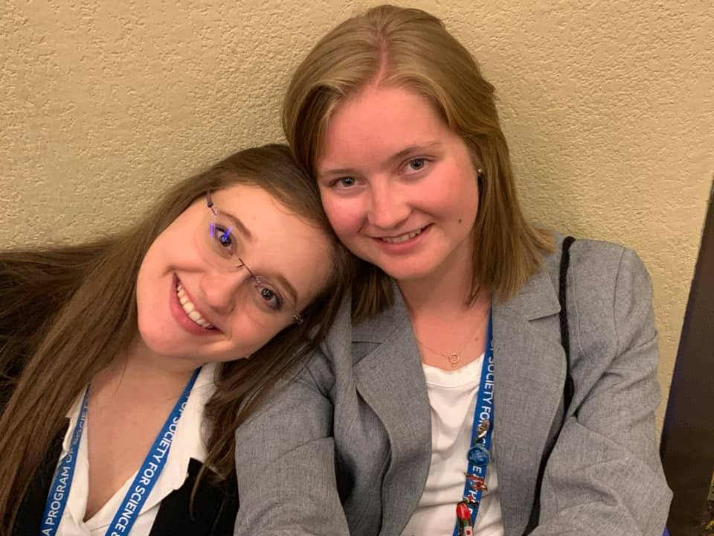
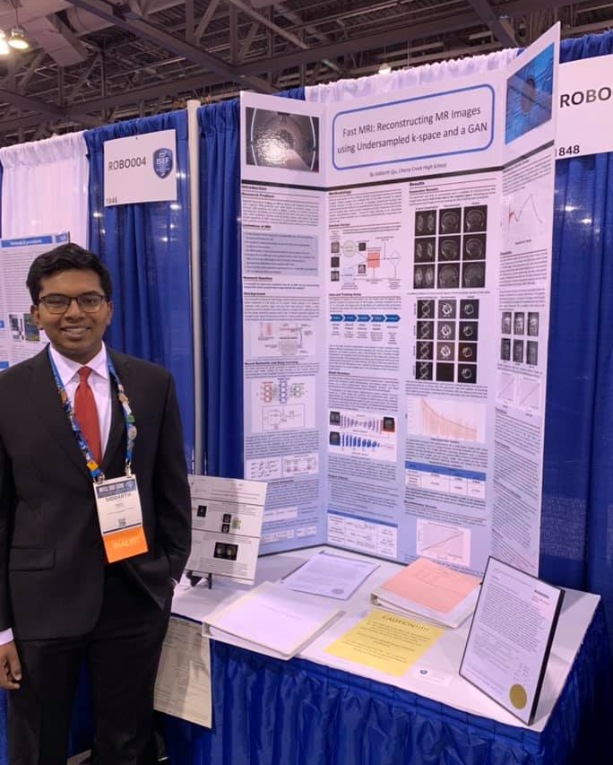
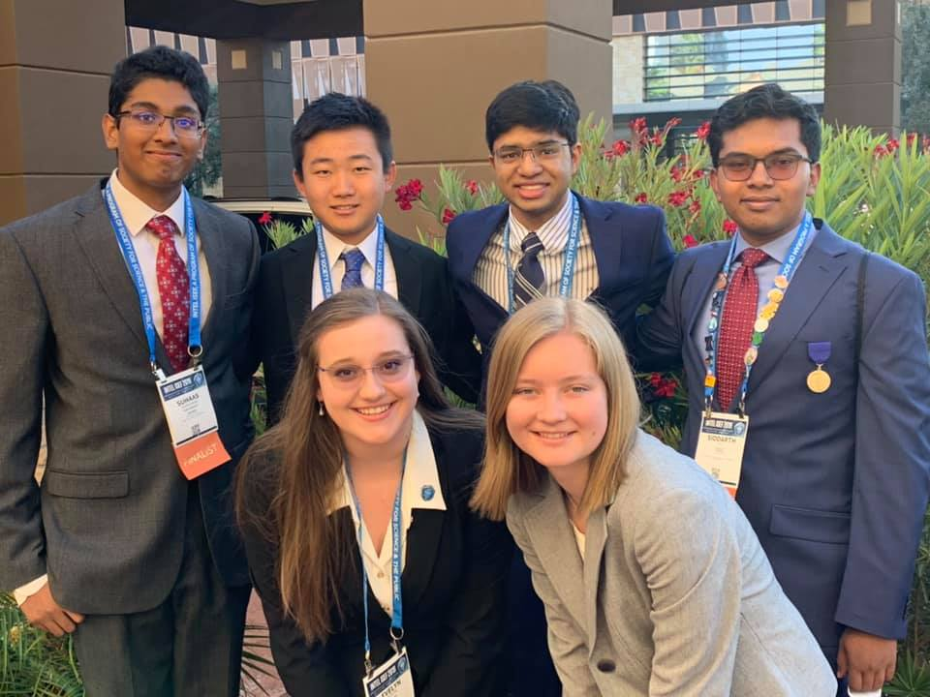
OUR 2019 ISEF WINNERS!

Slide 4
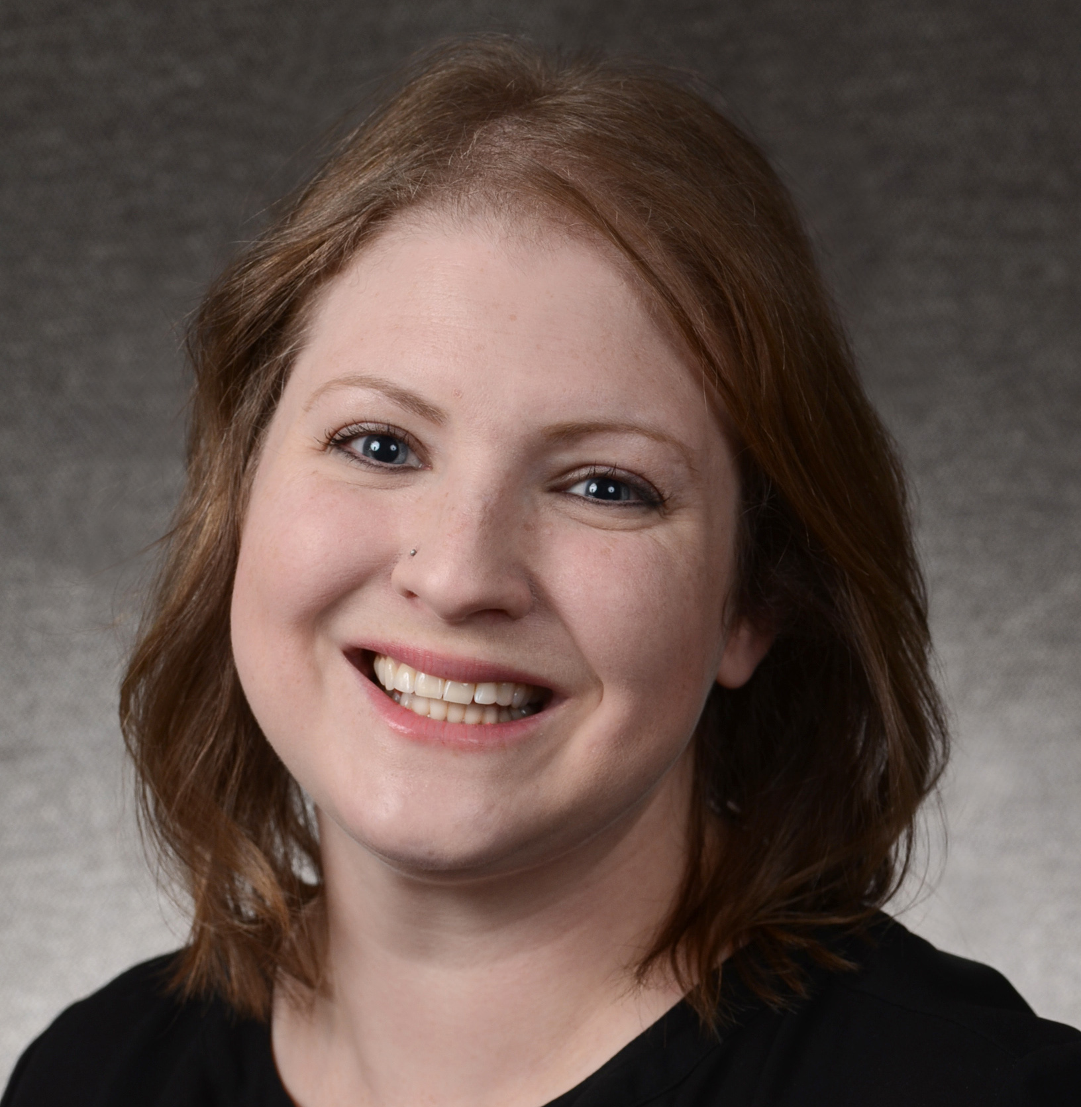
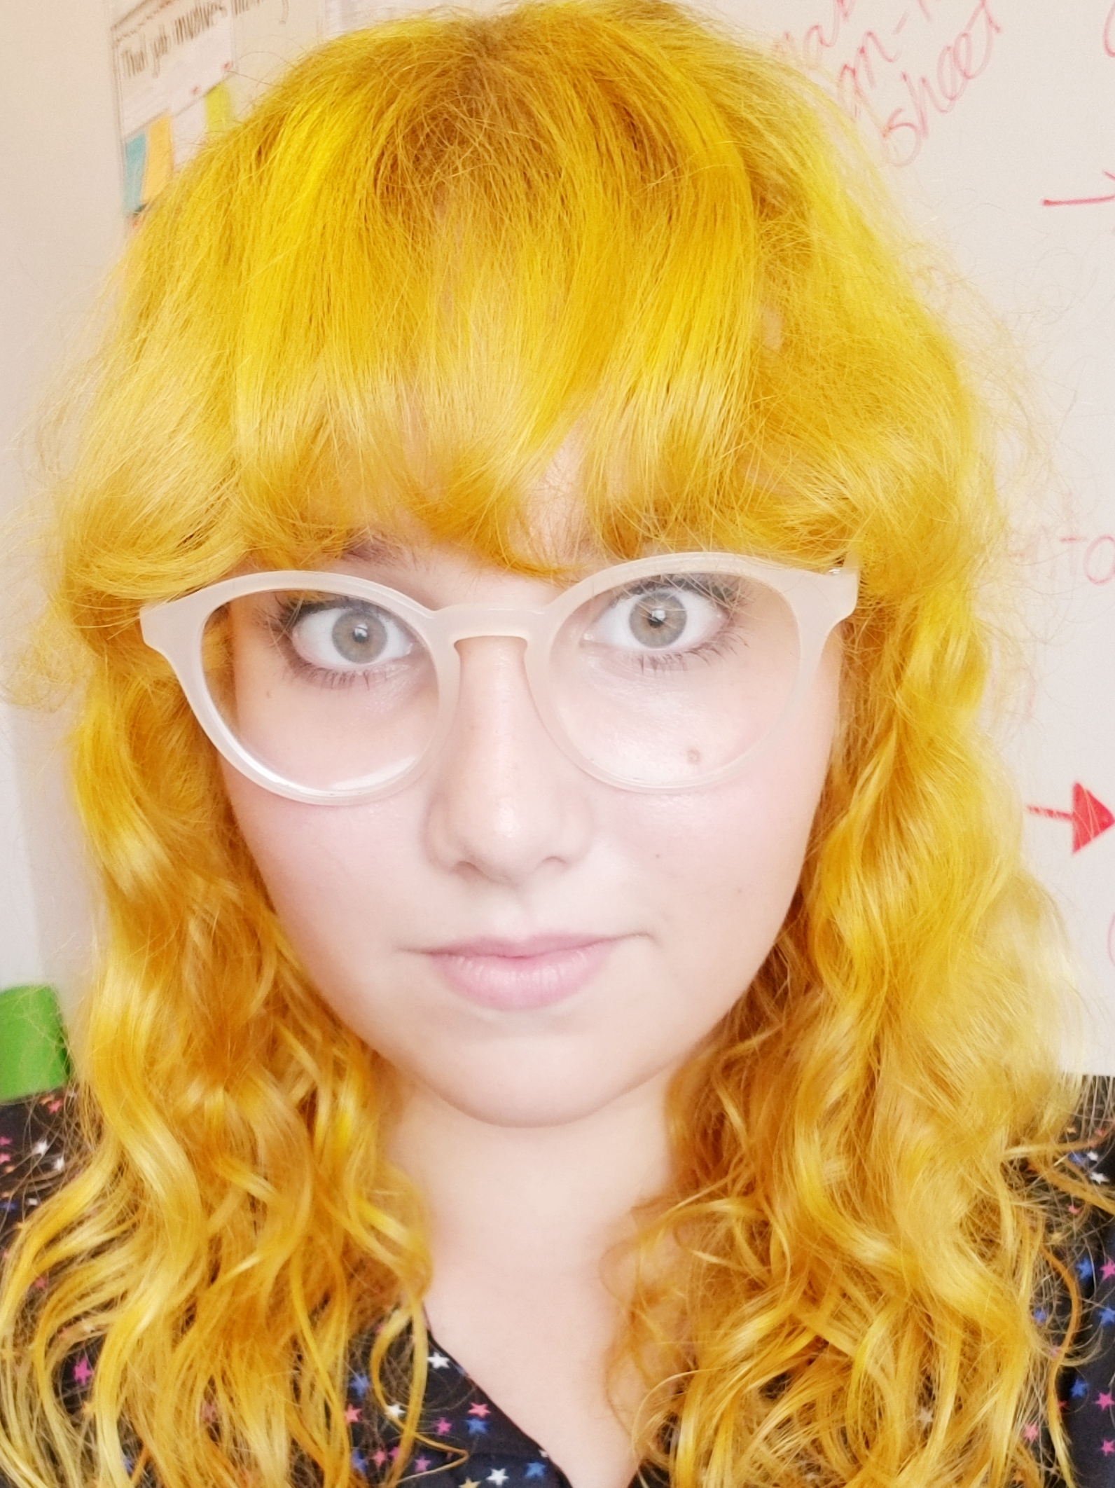
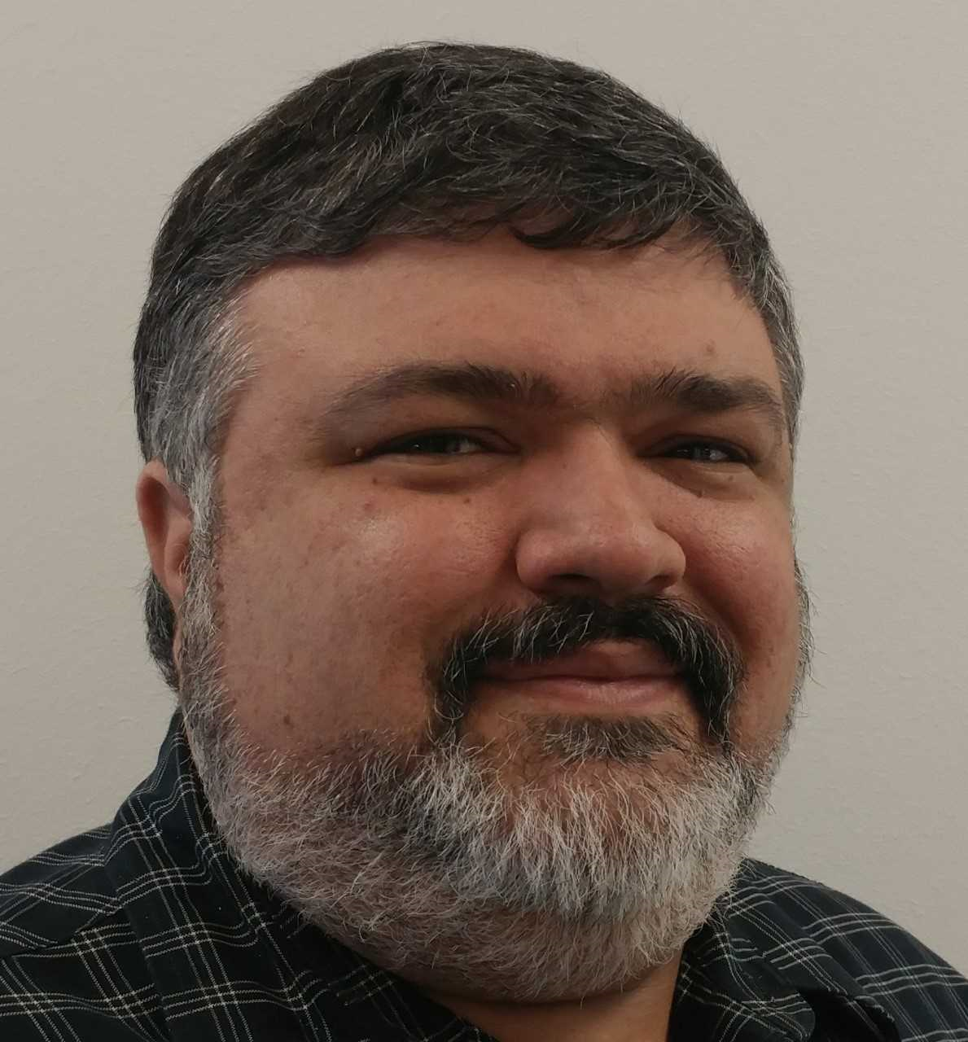
UPDATES
The 2020 CoorsTek DMRSEF Leadership Team
Dr. Erin Golden
Fair Director
Kayla Ahr
Fair Associate Director
Dr. Mike Ferrara
CLAS
CONTACT US AT FIRSTNAME.LASTNAME@UCDENVER.EDU
OR
DENVERSCIENCEFAIR@UCDENVER.EDU

Slide 5
WHY SCIENCE FAIR?
Motivates students to explore the world through a scientific lens
Builds transferable skillsets: project management, written and oral communication, data analysis, among others
Contributes to social development
Exposes students to diverse STEM careers
Engages students in inquiry-based hands-on learning and exploration
Notes:
PBL, inquiry-based, or "hands-on" learning

Slide 6
2019 AWARDS
SENIOR AWARDS
BEST IN CATEGORY
1ST PLACE: $100
2ND PLACE: $85
3RD PLACE: $70
BEST IN FAIR**
1ST PLACE: $750
2ND PLACE: $500
3RD PLACE: $250
JUNIOR AWARDS
BEST IN CATEGORY
1ST PLACE: $70
2ND PLACE: $55
3RD PLACE: $40
BEST IN FAIR
1ST PLACE: $500
2ND PLACE: $250
3RD PLACE: $125
**SENIOR DIVISION BEST IN FAIR WINNERS (1ST – 3RD) RECEIVE AN ALL
EXPENSE PAID TRIP TO COMPETE AT ISEF
ANAHEIM, CA | MAY 10TH - 15TH

Slide 7
COORSTEK DMRSEF CATEGORIES
Animal Sciences (AS)
Behavioral Science (BS)
Biological Sciences (BIO)
Engineering (ENG)
Chemistry (CH)
Computer Sciences (CMP)
Earth and Environmental Sciences (EV)
Energy (EGY)
Materials Science (MS)
Medicine & Health Science (MED)
Microbiology (MI)
Physics and Astronomy (PA)
Plant Sciences (PS)
Social Sciences (SS)
Notes:
PBL, inquiry-based, or "hands-on" learning

Slide 8
SUCCESSFUL CATEGORIES AT DMRSEF, CSEF, & ISEF (2012-2017)

Slide 9
TIMELINE
NOVEMBER 1, 2019 REGISTRATION OPENS FOR COORSTEK DMRSEF
JANUARY 3, 2020 EARLY REGISTRATION DEADLINE
JANUARY 17, 2020 REGISTRATION CLOSES – NO EXCEPTIONS!!!
FEBRUARY 21, 2020 FINAL PAPER WORK CORRECTIONS DUE
FEBRUARY 28, 2020 COORSTEK DMRSEF!
MARCH 1, 2020 AWARDS CEREMONY
APRIL 2-4. 2020 COLORADO SCIENCE & ENGINEERING FAIR (CSEF)
MAY 10-15, 2020 INTERNATIONAL SCIENCE & ENGINERING FAIR (ISEF)

Slide 10
ORGANIZING A LOCAL FAIR
Science and Engineering Fair Planner:
STEP 1: What are your goals?
Positive experience
Improve science knowledge by implementing scientific method
Improve organization and communication skills
STEP 2: Set a date
Find out the regional and state fair dates
ISEF is generally the first week of May
*** Tell students/teachers/parents ***
STEP 3: Find a location/space to hold the Fair
Will need to have x # of 8’-tables, x # of chairs
Breakout rooms for judges
Registration/check-in area

Slide 11
ORGANIZING A LOCAL FAIR
Science and Engineering Fair Planner:
STEP 4: Determine your registration deadlines
Keep in mind that DMRSEF online registration opens November 1st
The last day to register for DMRSEF is January 17th – NO EXCEPTIONS!
Paperwork corrections are due by February 21st
STEP 5: Determine categories
STEP 6: Determine awards/certificates
Fundraise for category awards
Ask companies/professional groups for special awards
Design certificates (participation and category winners)
Purchase ribbons for 1st, 2nd, and 3rd places
Determine ”Best in Fair” awards, if applicable

Slide 12
ORGANIZING A LOCAL FAIR
Science and Engineering Fair Planner:
STEP 7: Layout Fair Day Schedule
2019 DMRSEF SCHEDULE
Registration 8:30-9:30 a.m.
Display & Safety/Photos 9:30-11:30 a.m.
Tours/Activities/Lunch 11:30 a.m.-1:00 p.m.
Judges Preview (no students) Noon-1:00 p.m.
Student Interviews with Judges 1:00-5:00 p.m.
Students dismissed 5:00 p.m.

Slide 13
ORGANIZING A LOCAL FAIR
Science and Engineering Fair Planner:
STEP 8: Call for Judges/Volunteers
Positions included
Fair Set-up/Tear-down
Display and Safety Judges
First Aid Station
Judges & Judging Support
Photographer & Note Taker
Scientific Review Committee Assistant
Student Advocates & Surveyors
Translators
Wayfinders

Slide 14
ORGANIZING A LOCAL FAIR
Science and Engineering Fair Planner:
STEP 1: Determine goals
STEP 2: Set a date
STEP 3: Find a location/space
STEP 4: Set registration deadlines
STEP 5: Determine categories for competition
STEP 6: Determine awards/certificates
STEP 7: Fair Day Schedule
STEP 8: Call for Judges/Volunteers

Slide 15
PAPERWORK & FORMS
clas.ucdenver.edu/denversciencefair

Slide 16
FORMS REQUIRED FOR ALL PROJECTS
Checklist for Adult Sponsor ( Form 1)
Student Checklist (Form 1A)
Research Plan/Project Summary
Approval Form (Form 1B)
Risk Assessment Form (Form 3)
Participant Notice of Risk and Waiver

Slide 17
COMMON PAPERWORK MISTAKES
INCOMPLETE PAPER WORK
Double check your check boxes!
VAUGE RESEARCH PLAN
ONE CONTINUOUS ADULT MUST SUPERVISE THE PROJECT
IMPROPER DOCUMENTATION OF RISK ASSESSMENT AND MITIGATION
Don’t forget form 3!
DATES: MOST FORMS MUST BE DATED PRIOR TO WHEN EXPERIMENTS ARE PERFORMED
NOTE: Forms 1c and 5b must be dated AFTER Experimentation
ANIMAL RESEARCH: IACUC APPROVAL REQUIRED BEFORE EXPERIMENTATION
HUMAN RESEARCH: SCHOOL IRB MUST APPROVE RESEARCH PLAN BEFORE EXPERIMENTATION BEGINS
PARTICIPANTS 18 OR ABOVE MUST GIVE THEIR INFORMED CONSENT
PARTICIPANTS UNDER 18 MUST GIVE ASSENT AND PARTENTAL WRITTEN PERMISSION MAY BE NEEDED AS WELL

Slide 18
PAPERWORK
Videos detailing how to complete all fair paper work can be found at:
tinyurl.com/DMRSEF-guide
Or on the CoorsTek DMRSEF website:
clas.ucdenver.edu/denversciencefair

Slide 19
RULE CHANGES 2020
PLEASE CONTACT US WITH ANY QUESTIONS OR CONCERNS ABOUT RULE CHANGES FOR THIS UPCOMING SEASON!
DENVERSCIENCEFAIR@UCDENVER.EDU

Slide 20
DISPLAY & SAFETY
No food (candy included) OR water
Nothing that contains chemicals in vials
No syringes, knives, or ammunition
No mechanical devices that have pinch points
No animals or animal parts
No glass
No plants, no dirt, no rocks
DISPLAY & SAFETY CHAIR: ZACH RICHARDS

Slide 21
JUDGING: CATEGORY & SPECIAL AWARDS
Over 200 volunteer category judges are recruited from academic institutions, industry, retired professionals, and community members
Category judging is based on a 100 point rubric from ISEF
Rubric: student.societyforscience.org/judging-criteria-intel-isef
Special awards judges are recruited to judge specific awards based on criteria from award sponsors
Judging Goals:
Determine category, special award, and best in fair winners
Give all students feedback on their presentations
Provide positive interactions with career scientists
CATEGORY JUDGES CHAIR: MEREDITH TENNIS
SPECIAL AWARDS JUDGES CHAIR: JOJO LAW

Slide 22
GET PUMPED!
PLEASE CONTACT US WITH ANY QUESTIONS OR CONCERNS!
Erin.Golden@ucdenver.edu
Kayla.Ahr@ucdenver.edu
DenverScienceFair@ucdenver.edu

