Slide 1
SCIENCE FAIR 101
Jennifer Hellier, PhD
Fair Director
Denver Metro Regional Science and Engineering Fair

Slide 2
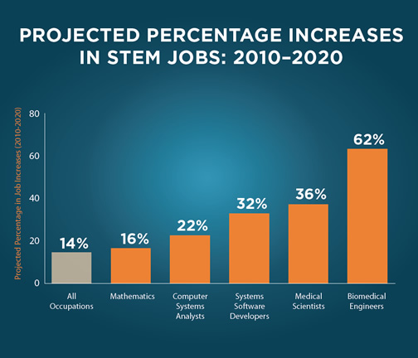



STEM Careers
https://www.ed.gov/stem
Academic achievement is IMPORTANT for this career path
Shadow different science careers
Compete in science fairs
Learn to study...and study to learn

Slide 3
Value of Science Fairs
Nobel Prizes
585 Awards to about 931 Nobel Prize winners (1901-2017)
397 Science-based Nobel Prizes to US citizens (about ½ foreign born)
157 Harvard (1st in the world)
116 Cambridge (2nd in the world)
13 Intel Science and Engineering Fair
5 University of Colorado
(https://news.nationalgeographic.com/2017/10/nobel-prize-winners-laureates-charts-graphics-science/)

Slide 4
Value of Science Fairs
Important factor that motivates students toward science
Contributes to their social developments
Increases writing, math, computer, library, organization, and presentation skills
Increases student interest in being a scientist and engineer
Uses active learning techniques (e.g., PBL, inquiry-based, or "hands-on" learning)
A coordinated set of activities, which is deeply integrated with the NGSS or Common Core requirements
References:
  EMRE, 2016
  ScienceBuddies.com
  Olive, 2017
  Hill, 2017
  Grinnell et al, 2018

Slide 5
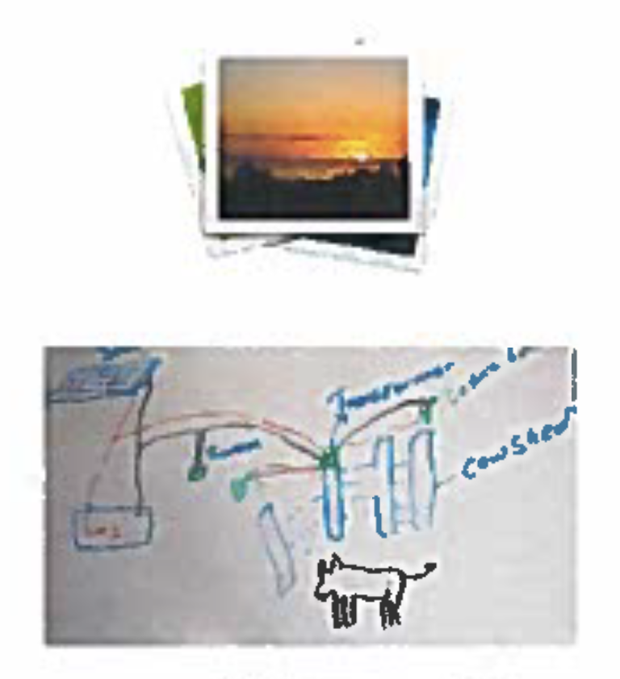
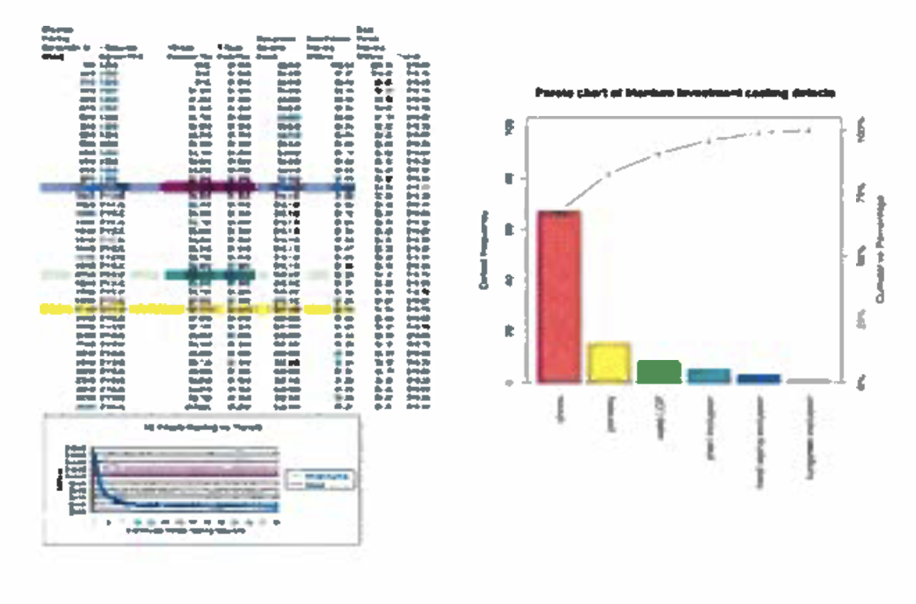
KEY: Connections to the NGSS Scientific and Engineering Practices
Connections to the Common Core State Standards Guiding Questions/Notes
Purpose
Asking Questions and Defining Problems
Make sense of problems and preserve in solving
Why are you doing the experiment?
What did you observe in the world that made you ask your question?
What made you curious?
Project Title
A good title attracts attention, but also gives information about the project.
Results
Analyzing and interpreting data
Obtaining, evaluating, and communicating evidence
Reason abstractly and quantitatively
Attend to precision
Look for and make use of structure
Write informative/explanatory texts to examine and convey complex ideas and information, clearly and accurately, through effective analysis of content
This is a summary of results from the experiment.
Explain your data, photos, charts, graphs, and models in paragraph form.
Abstract
Provide a concise paragraph/summary of your project, including purpose, hypothesis, procedures used, data summary/analysis, and conclusions.
Question/Problem
Asking Questions and Defining Problems
Make sense of problems and preserve in solving
Conduct short as well as more sustained research projects based on focused questions, demonstrating understanding of the subject under investigation
What are you trying to figure out?
What problem are you trying to solve?
Materials & Methods
Record everything you use for your project.
Record the steps you took during your experiment. Make sure others can follow them.
Data
Visually communicate your data in the format that matches the type of data you collected. You can show both raw and interpreted data. For example, spreadsheets, photos, diagrams, charts, maps, graphs, models, etc.
Conclusion
Engaging in argument from evidence
Applying evidence to claims with reasoning
Obtaining, evaluating, and communicating evidence
Construct viable arguments and critique the reasoning of others
Draw evidence from informational texts (including student data) to support analysis, reflection, and research
Write arguments to support claims, using an analysis
(of all components of process and research) using valid reasoning and sufficient evidence
Restate question
Describe your observations before, during, and after
the experiment
Summarize your research
Explain and justify your conclusion with your data and observations
Hypothesis
Develop and use models
Construct explanations and design solutions
Construct viable arguments and critique the reasoning of others
Write arguments to support claims using valid reasoning
What do you think a likely answer or solution to your question/problem could be? Why?
Planning and carrying out investigations
Developing and using models
Using mathematics and computational thinking
Make sense of problems and persevere in solving
Model with mathematics
Use appropriate tools strategically
Attend to precision
Integrate and evaluate content presented in diverse media formats, including visual and quantitative, as well as in words
Research/Background
Obtaining, evaluating, and communicating evidence
Attend to precision
Integrate and evaluate content presented in diverse media formats, including visual and quantitative, as well as in words
Gather relevant information from multiple print and digital sources, assess the credibility and accuracy of each source, and integrate the information while avoiding plagiarism
Draw evidence from informational text to support analysis, reflections, and research
What have others have said about the topic of your inquiry?
How does this research influence how you will approach your project?
Have others done this experiment before?
How will you project further the research and experimentation that has already been done?
Next Steps
Obtaining, evaluating, and communicating evidence
Asking questions and defining problems
Reason the validity of claims
Make sense of problems & persevere in solving
Conduct short, as well as more sustained, research projects based on focused questions, demonstrating understanding of the subject
What new questions do you have as a result of your inquiry?
Write down everything you do from start to finish. Do not include preparing the board. Journal should be handwritten and authentic. Be sure to have your journal on display with your board.
Original document developed by @marybwalls; adapted by DMRSEF Sept. 2018

Slide 6

Science Fair

Slide 7

Society for Science & the Public

Slide 8
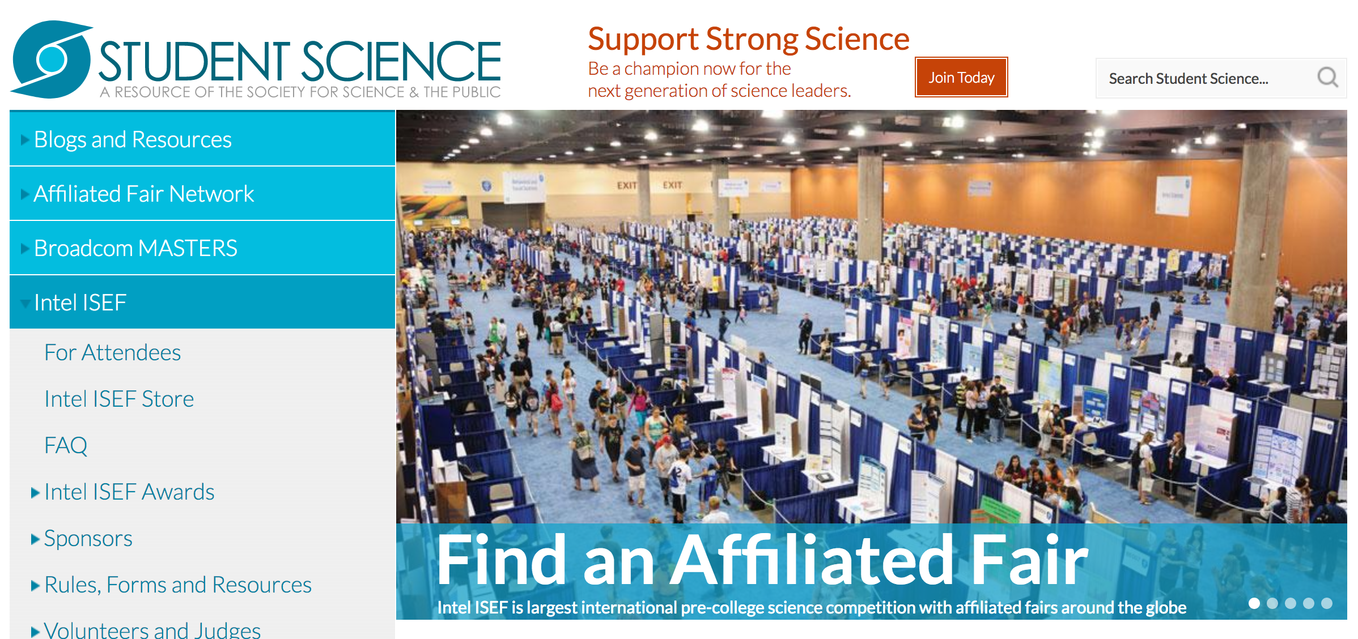
Society for Science & the Public

Slide 9

Society for Science & the Public

Slide 10
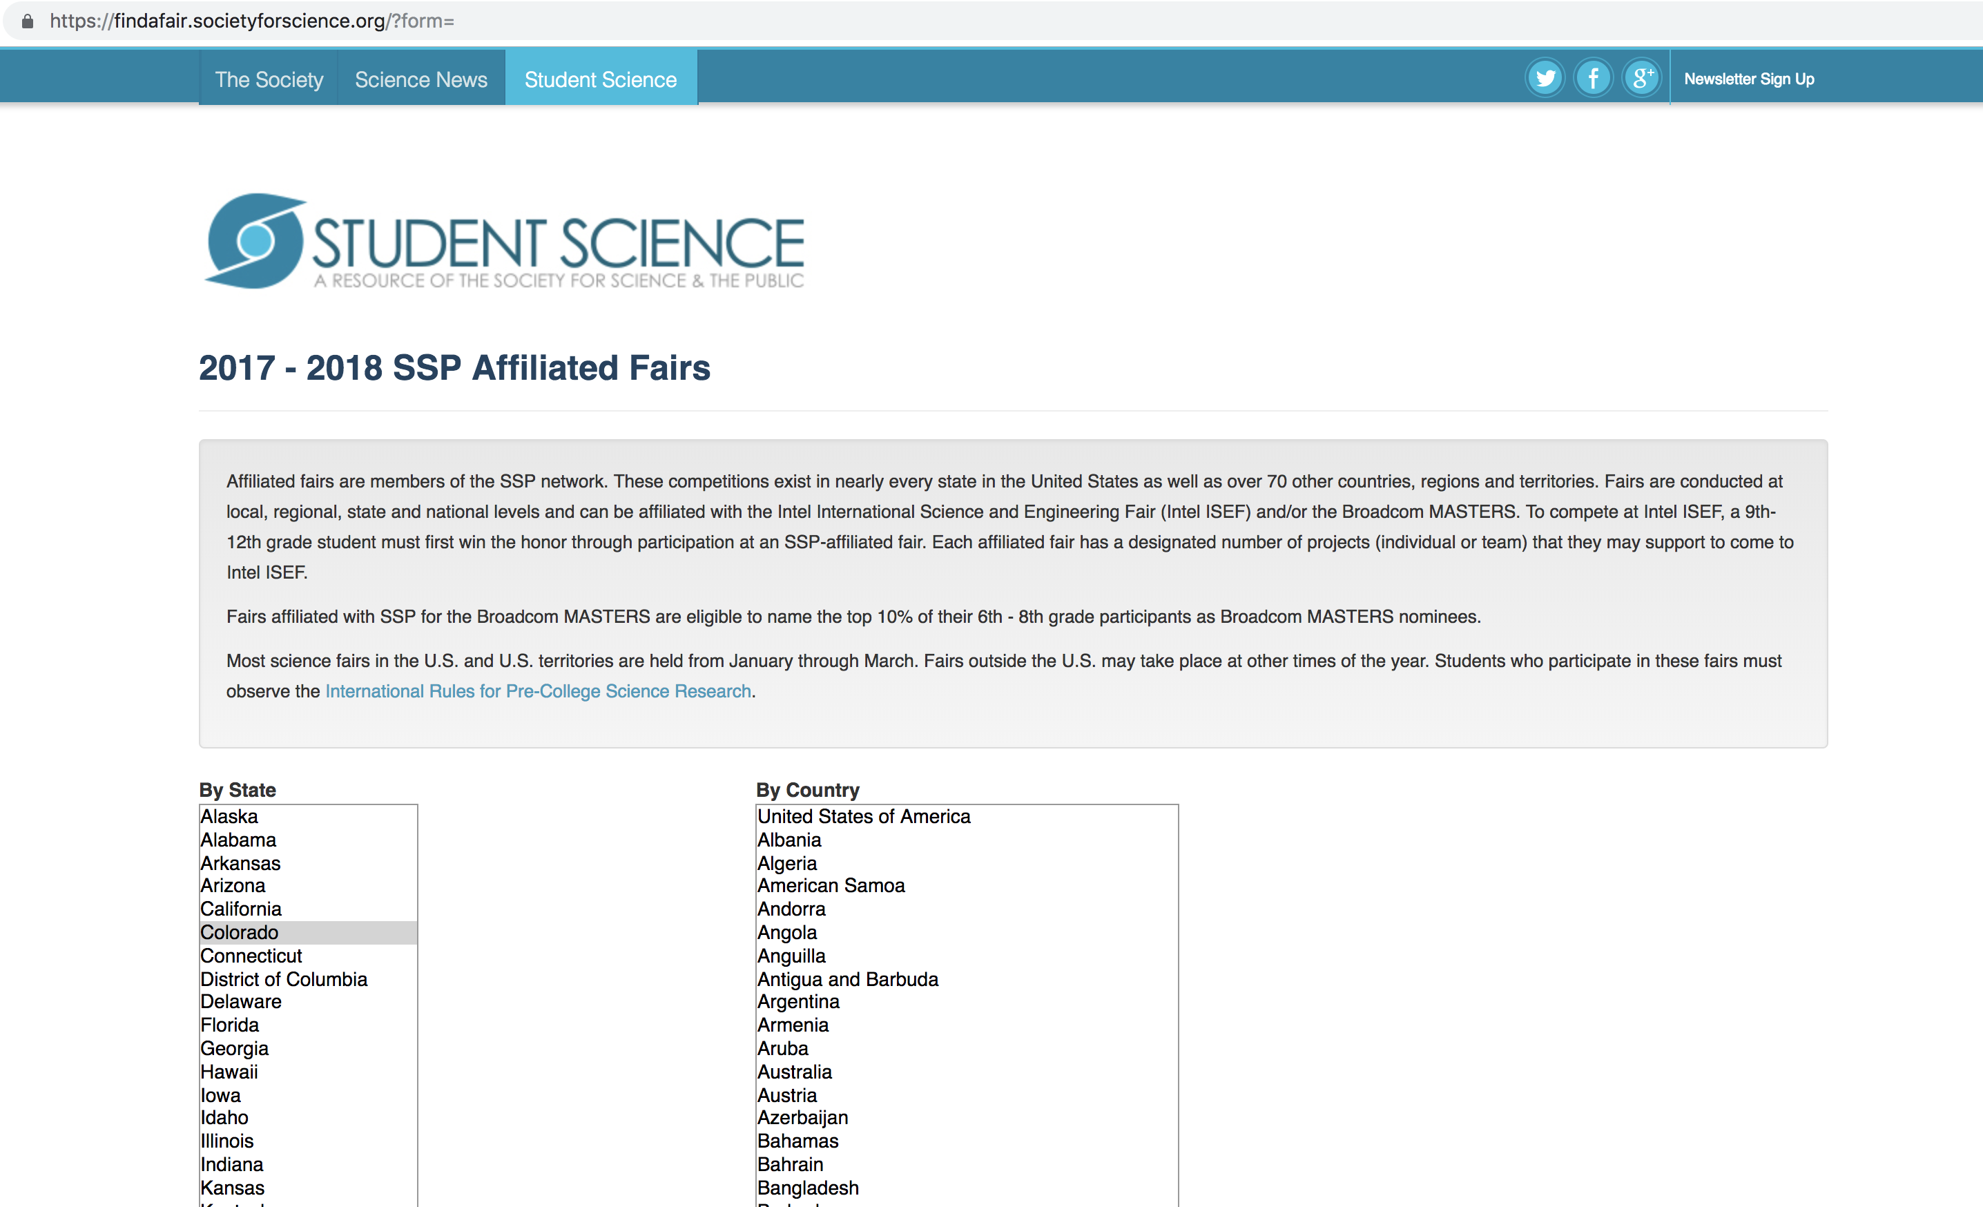
Society for Science & the Public

Slide 11
Denver Metro Region
The DMRSEF is one of Colorado’s 13 International Science and Engineering Fair Regions that feeds into the Colorado State Science and Engineering Fair.

Slide 12
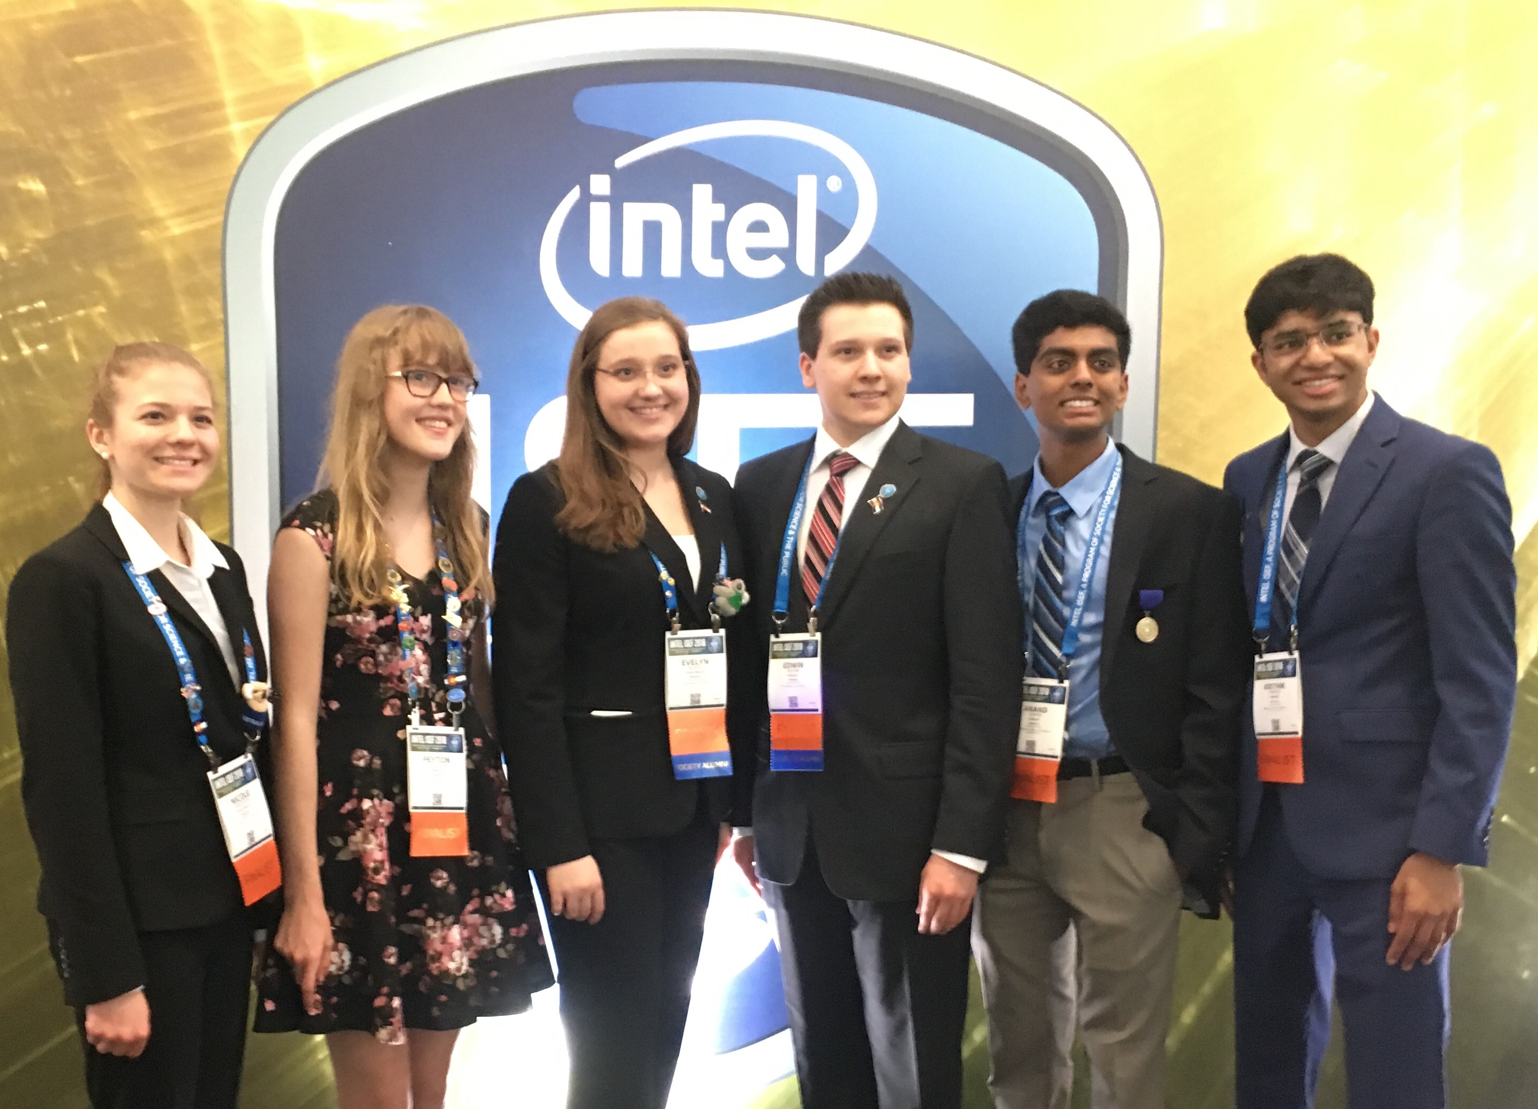
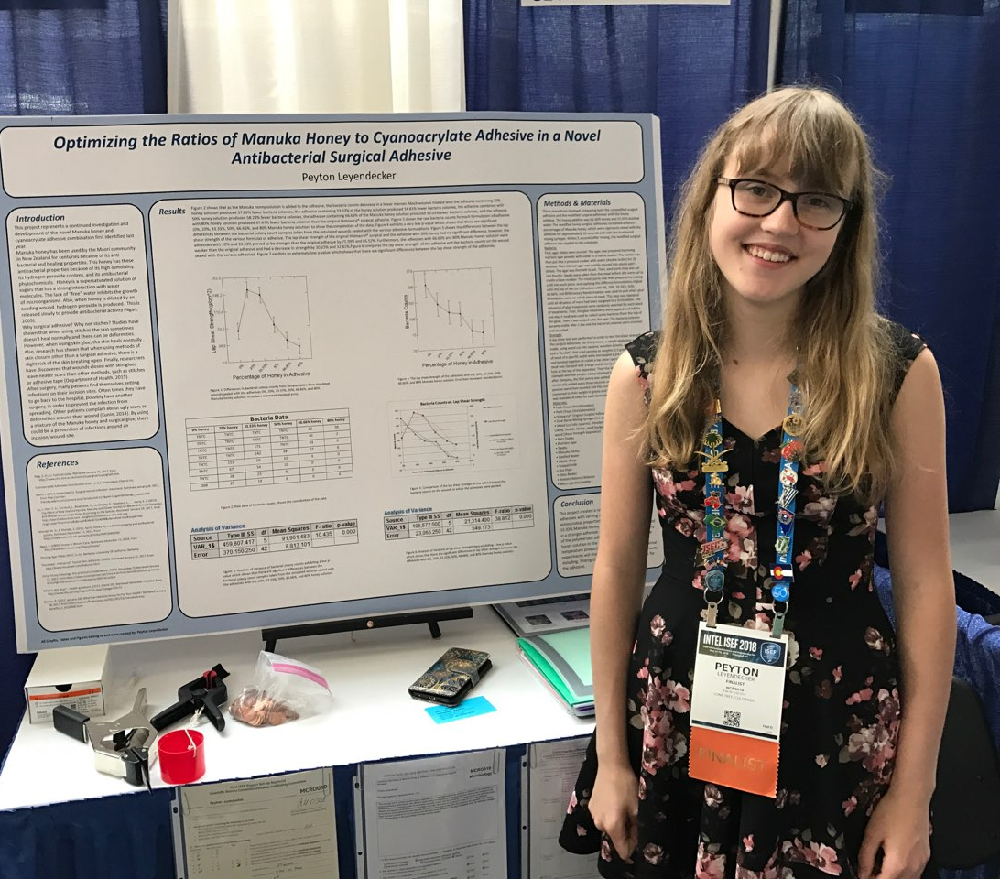
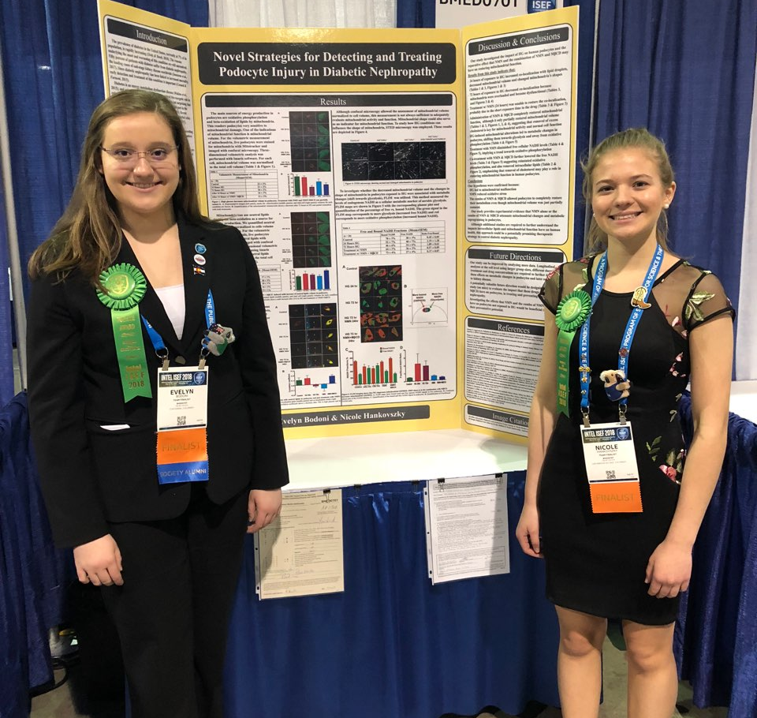
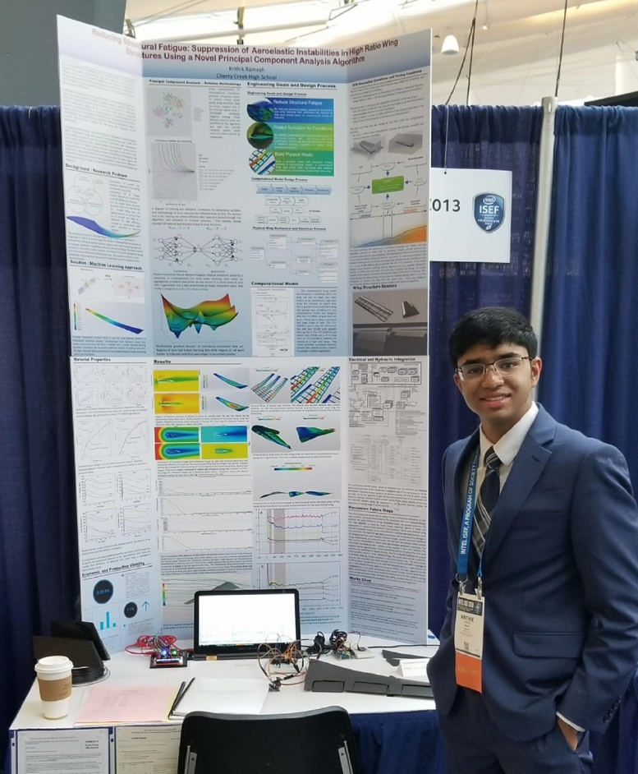
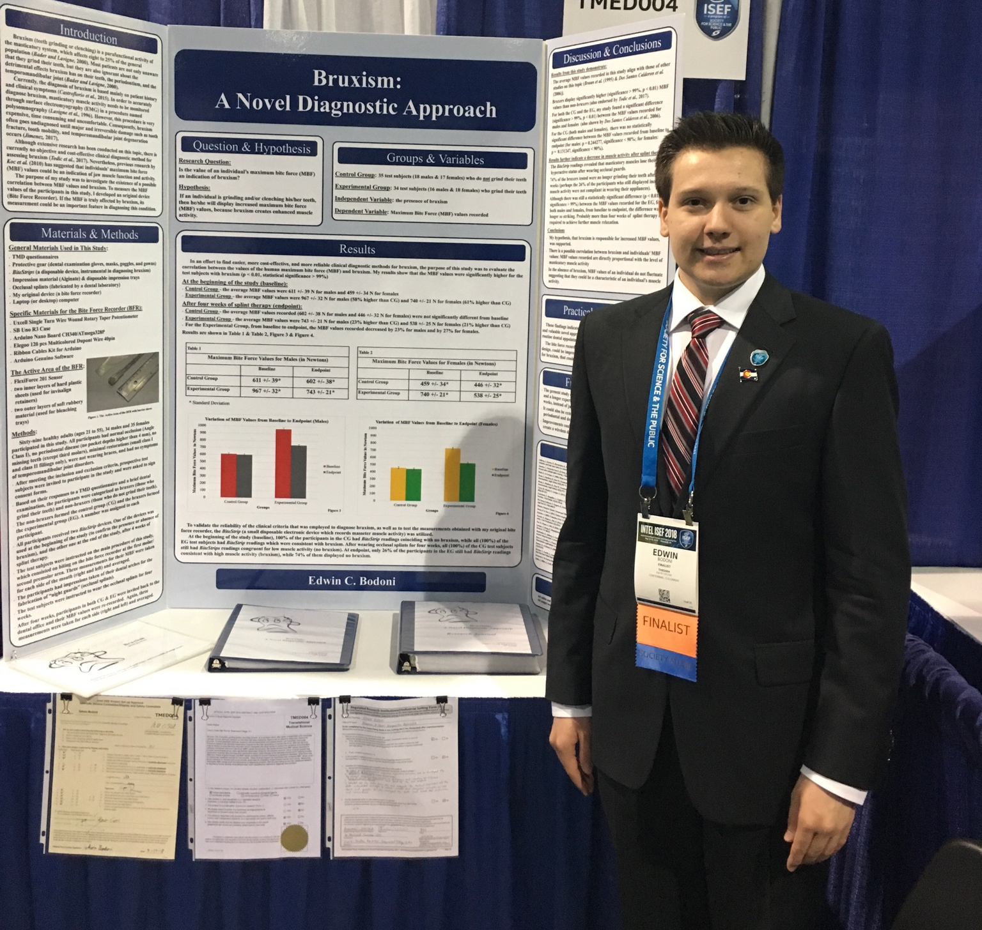
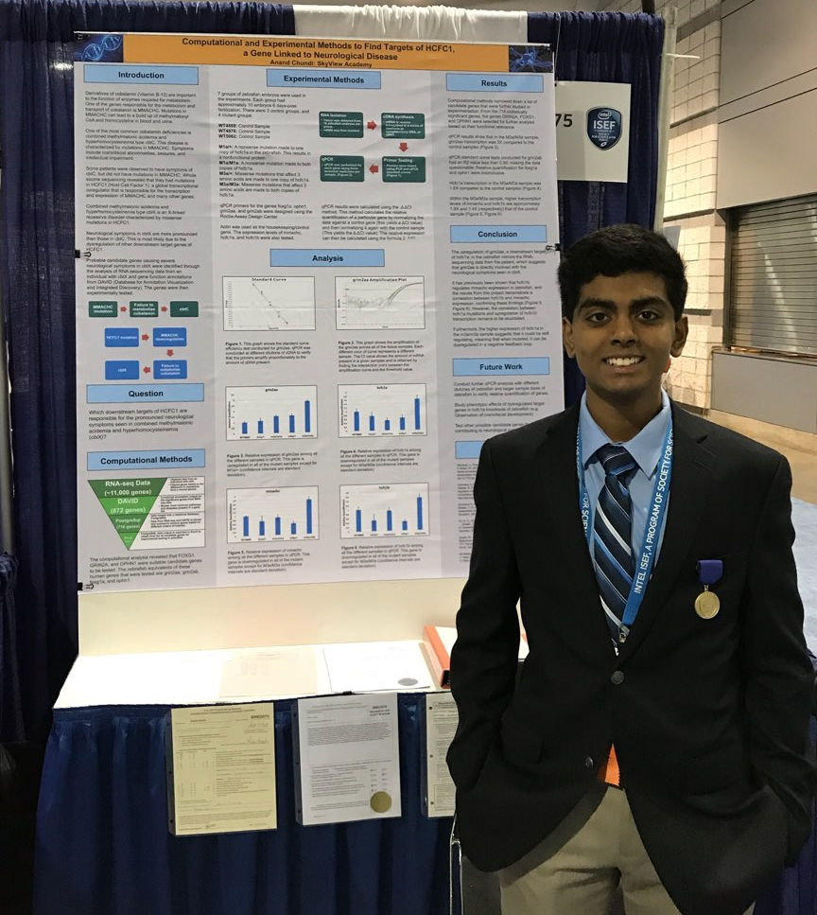
2018 Top DMRSEF Winners

Slide 13
Organizing a School Science and Engineering Fair
Science and Engineering Fair Planner:
  STEP 1: What are your goals?
    Positive experience
    Improve science knowledge by implementing scientific method
    Improve organization and communication skills
  STEP 2: Set a date
    Find out the regional and state fair dates
    ISEF is generally the first week of May
    *** Tell students/teachers/parents ***
  STEP 3: Find a location/space to hold the Fair
    Will need to have x # of 8’-tables, x # of chairs
    Breakout rooms for judges
    Registration/check-in area

Slide 14
Organizing a School Science and Engineering Fair
STEP 4: Determine registration deadlines
Online registration opens Nov. 30, 2018.
Last day to register is January 15, 2019.
NO EXCEPTIONS
Paperwork corrections due February 5, 2019.

Slide 15
Organizing a School Science Fair
STEP 5: Determine categories
Animal Sciences (AS)
Behavioral Science (BS)
Biological Sciences (BIO)
Engineering (ENG)
Chemistry (CH)
Computer Sciences (CMP)
Earth & Environmental Sciences (EV)
Energy (EGY)
Materials Science (MS)
Medicine & Health Science (MED)
Microbiology (MI)
Physics & Astronomy (PA)
Plant Sciences (PS)
Social Sciences (SS)

Slide 16
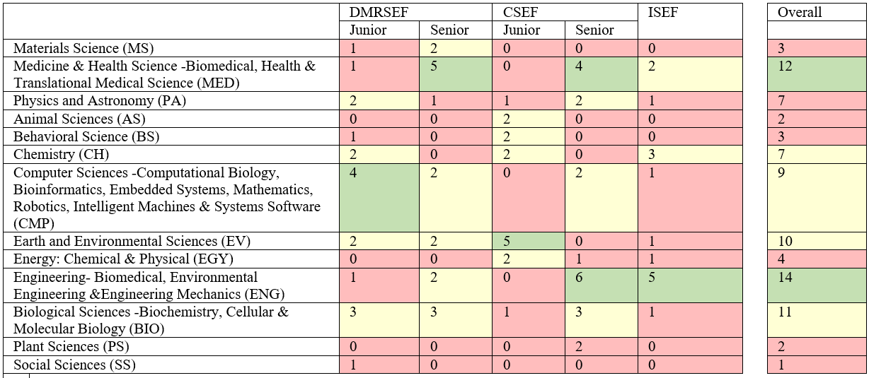
Successful Categories in the last five years at DMRSEF, CSEF, & ISEF

Slide 17
Organizing a School Science Fair
STEP 6: Determine awards/certificates
  Fundraise for category awards
  Ask companies/professional groups for special awards
  Design certificates (participation and category winners)
  Purchase ribbons for 1st, 2nd, and 3rd places
  Determine ”Best in Fair” awards, if applicable
Senior Division:
  1st Place = $120
  2nd Place = $100
  3rd Place = $80
Junior Division:
  1st Place = $80
  2nd Place = $60
  3rd Place = $40

Slide 18
2018 DMRSEF Awards
Junior Best in Show:
  First Place = $500
  Second Place = $250
  Third Place = $125
Senior Best in Show:
  First Place = $750
  Second Place = $500
  Third Place = $250
Senior Division Best in Show winners (1st – 3rd) receive all expense paid trip to compete at ISEF.
Special awards: provided by sponsors of the fair.

Slide 19
Organizing a School Science Fair
STEP 7: Fair Day Schedule
Friday, February 15, 2019: Day of the Fair
Registration 8:30-9:30 a.m.
Display & Safety/Photos 9:30-11:30 a.m.
Tours/Activities/Lunch 11:30 a.m.-1:00 p.m.
Judges Preview without students Noon-1:00 p.m.
Interviews with Judges 1:00-5:00 p.m.
Students dismissed with projects 5:00 p.m.
Sunday, February 17, 2019: Awards
Ceremony 6:30-8:30PM

Slide 20
Organizing a School Science Fair
STEP 8: Call for Judges/Volunteers
  Positions include:
Fair Set-up/Tear-down
Display and Safety Judges
First Aid Station
Judges – category & special awards
Judging Support
Photographer
Photographer's Note Taker
Professional Development Assistant
Scientific Review Committee Assistant
Student Advocates
Surveyors
Translators
Wayfinders and much more...

Slide 21
Organizing a School Science Fair
STEP 9: Make your planning calendar
  Three months to Fair
  Two months from Fair
  One month prior of Fair
  2-weeks before
  1-week before
  Science Fair Eve
  Day of Fair
  Awards Ceremony

Slide 22
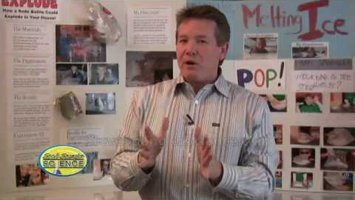
Resources – Projects

Slide 23
Resources – General
http://stemed.unm.edu/sites/all/docs/SB-SciFairTeacher_GUIDE.pdf
https://web.uvic.ca/~virsf/SMARTS_Guide-E.pdf
https://www.societyforscience.org/intel-international-science-and-engineering-fair
https://www.stemwizard.com/benefits-competing-science-fairs-students-perspective/
http://blog.scientix.eu/2016/03/the-importance-of-science-fair-in-stem-education/
https://www.ces.ncsu.edu/files/library/36/The_Value_of_a_Science_Fair_Project.pdf
https://etd.ohiolink.edu/!etd.send_file?accession=ysu1495707213528466&disposition=inline
https://www.parentmap.com/article/stream-stem-science-fair-prizes
https://journals.plos.org/plosone/article?id=10.1371/journal.pone.0202320

Slide 24
?
?
?

