Slide 1
Faculty Access
Class Rosters &
Entering Grades

Slide 2
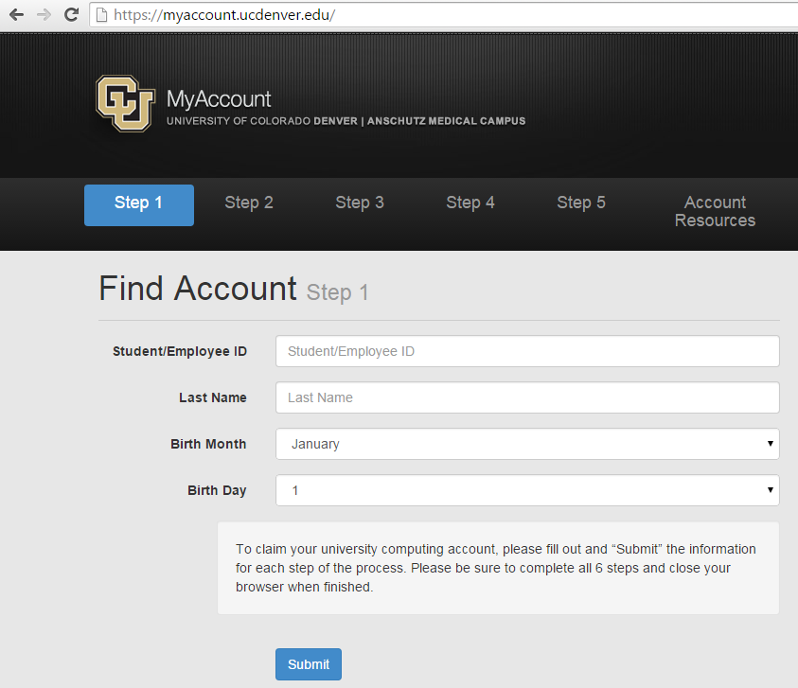
Notes:
If you need to find your username for the portal, go to this page and put in your 9-digit employee (SIS) ID number, last name and birth month and day.

Slide 3
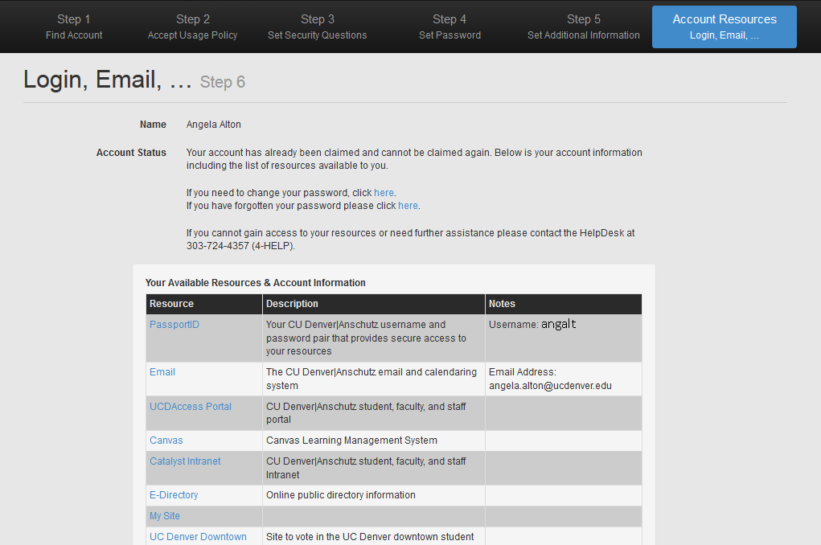
Notes:
Find your username about halfway down the page (usually, it’s your last name, or part, plus first initial).
From here click on the link to UCD Access Portal. The email address listed here is the official CU Denver email assigned to you. We communicate with you using your preferred email, but the rest of the University uses the official email, so be sure to check that from time to time, or set it up to forward to your preferred account.

Slide 4
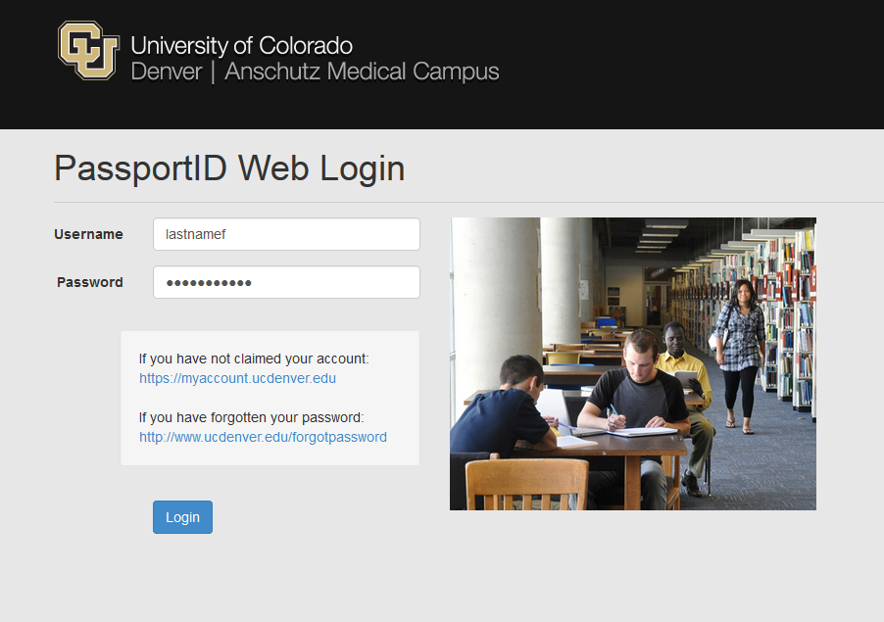
Notes:
Student portal and faculty portal log in through the same place. If you need to reset your password (they expire after 90 days for all users), click on “If you have forgotten your password” to be directed to a site to reset the password. If you get locked out because you don’t remember answers to security questions, call the IT Services Help Desk at 303-724-4357 and select Option 5.

Slide 5
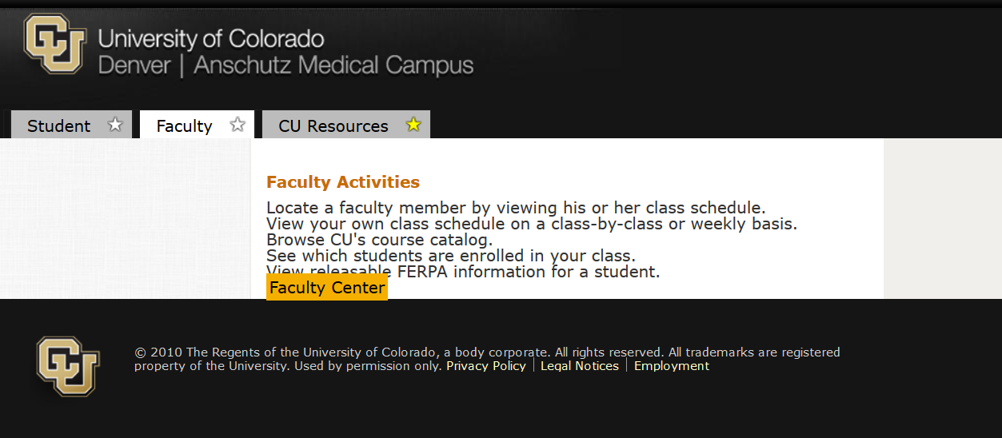

Slide 6
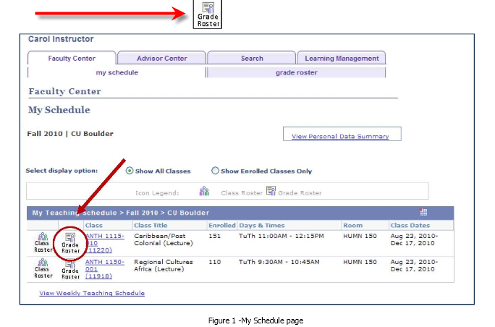
Notes:
Grade roster will only appear once it has been generated by CU. And it will only be available during the open grading period.

Slide 7
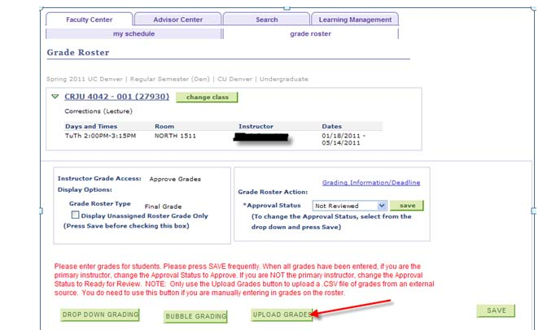
Notes:
Click on green box at bottom to select Drop Down Grading or Bubble Grading

Slide 8
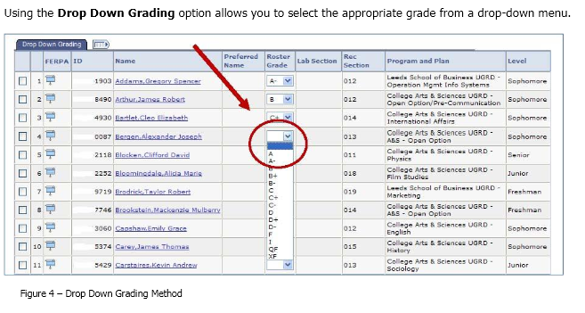
Notes:
If you enter a Failing grade you must also enter attendance information -- did they attend through the entire term or when did they stop coming to class?

Slide 9
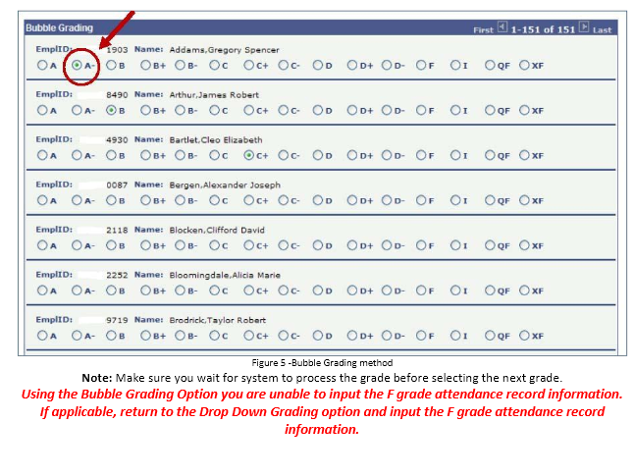

Slide 10
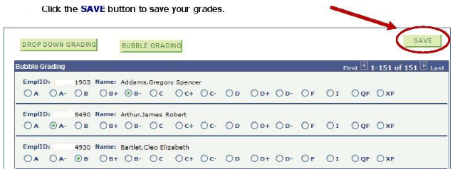

Slide 11
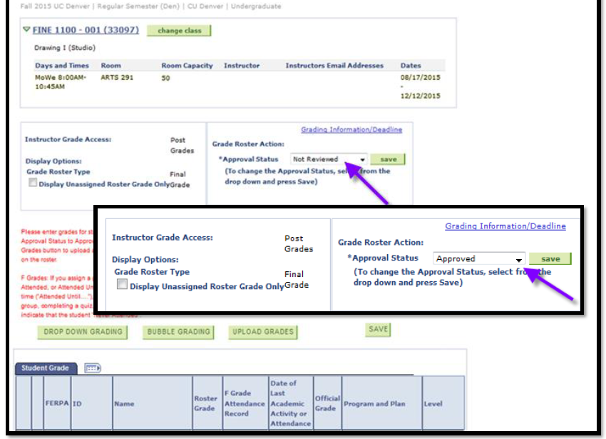
Notes:
Once grades are entered, change the drop down from “Not Reviewed” to “Approved,” and click on Save

Slide 12
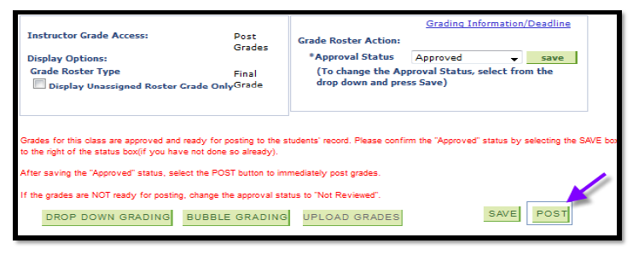
Notes:
Click on Post after you approve and save the grades, then you’ll receive a “Post Confirmation” screen that asks you to verify that you are certain you would like to “Post” your roster. Click on OK. Grades will now be listed as official, and students will be able to see the grade in their student portal.

Slide 13
