Slide 1
How to Make Maps
“Maps from the Wild”
World Map by Michael Tompsett
source: www.michael-tompsett.pixels.com

Slide 2
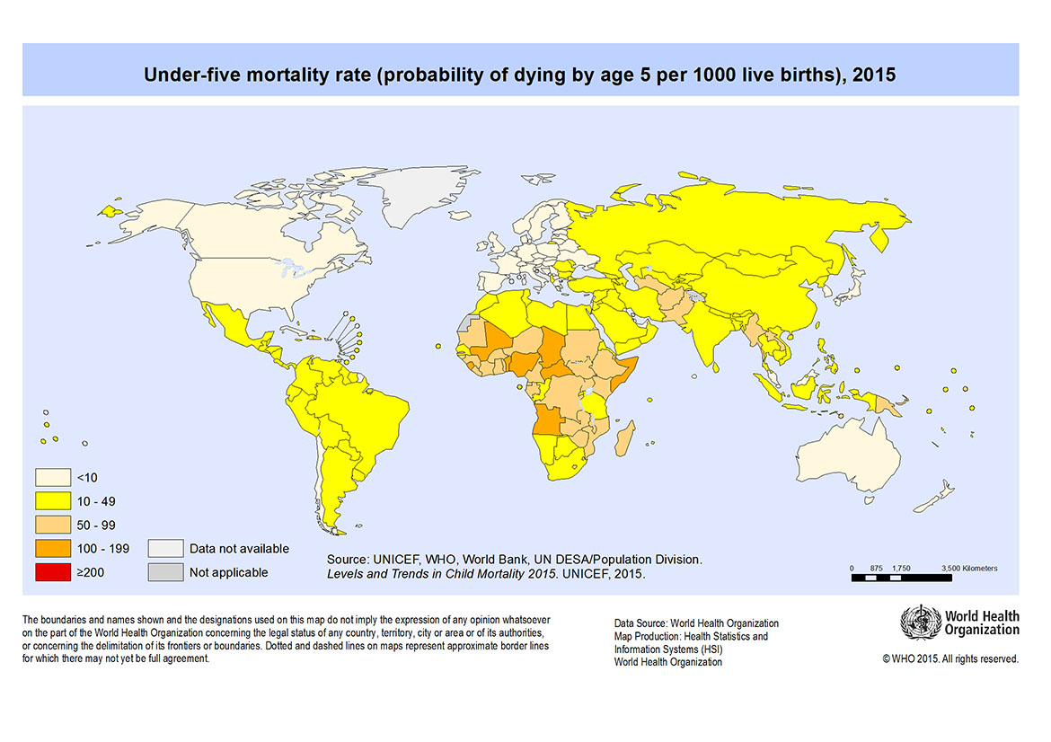
Map of mortality rates by country. World Health Organization. (September 9, 2015). “World : Under-5 mortality rate (probability of dying by age 5) per 1,000 live births, 2015.” Retrieved January 21, 2018, from http://gamapserver.who.int/mapLibrary/Files/Maps/Global_ UnderFiveMortality_2015.png.
Anthamatten
Appendix 01

Slide 3
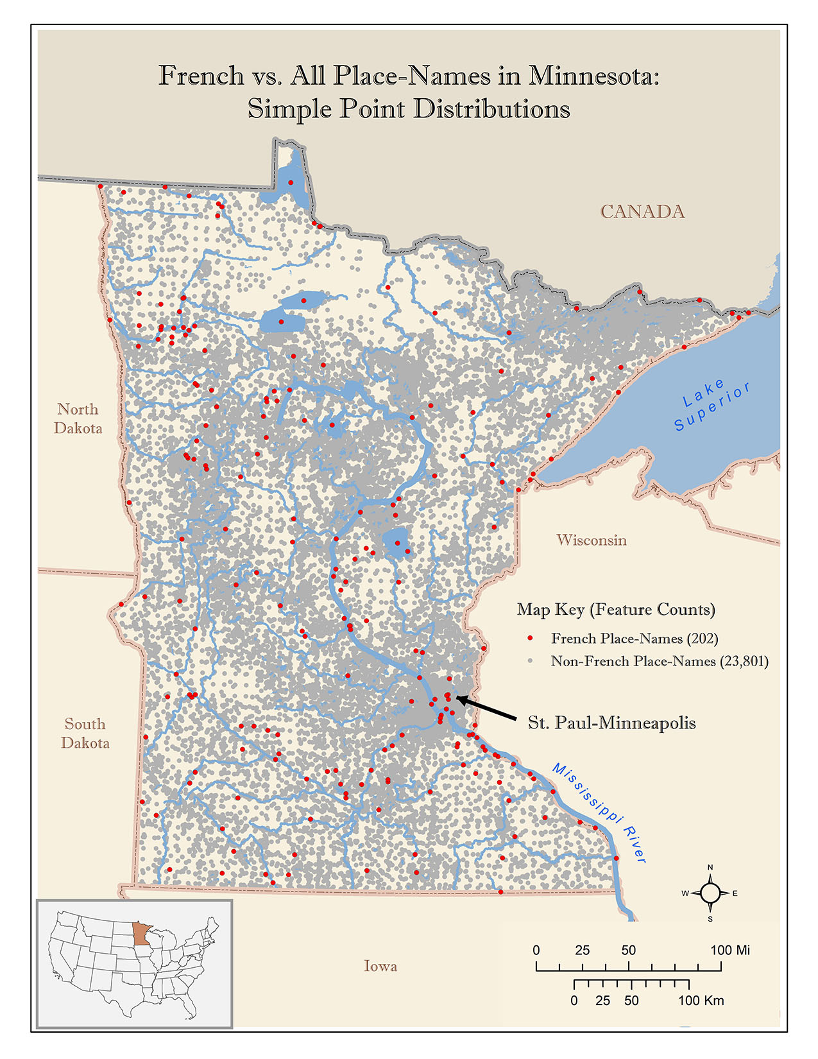
Map of French place names and French ancestry in Minnesota, USA (Marcelle Caturia). Source: Marcelle Caturia, Master’s Thesis, University of Colorado Denver.
Anthamatten
Appendix 01

Slide 4
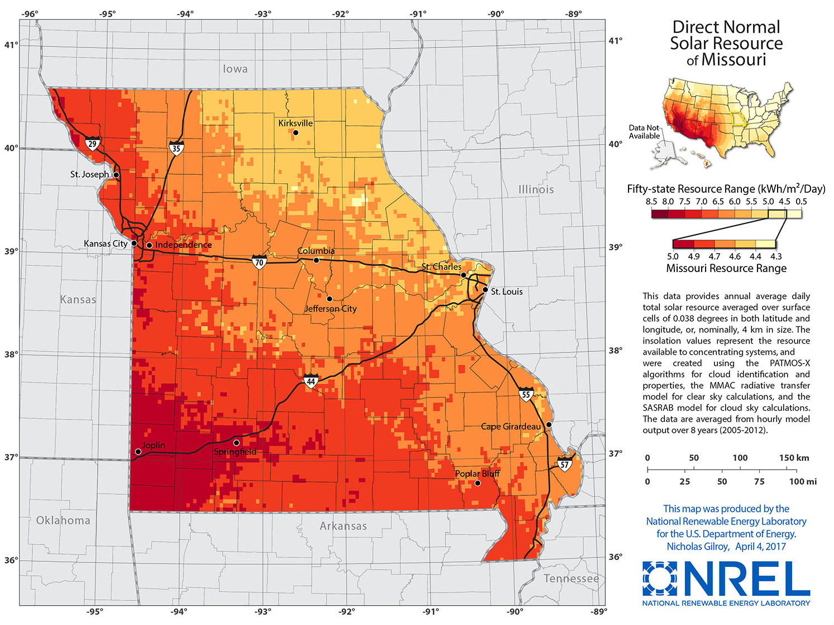
Direct normal solar resource of Missouri (National Renewable Energy Laboratory).
Source: National Rewable Energy Laboratory, US Department of Energy (https://www.nrel.gov/gis/solar.html).
Anthamatten
Appendix 01

Slide 5
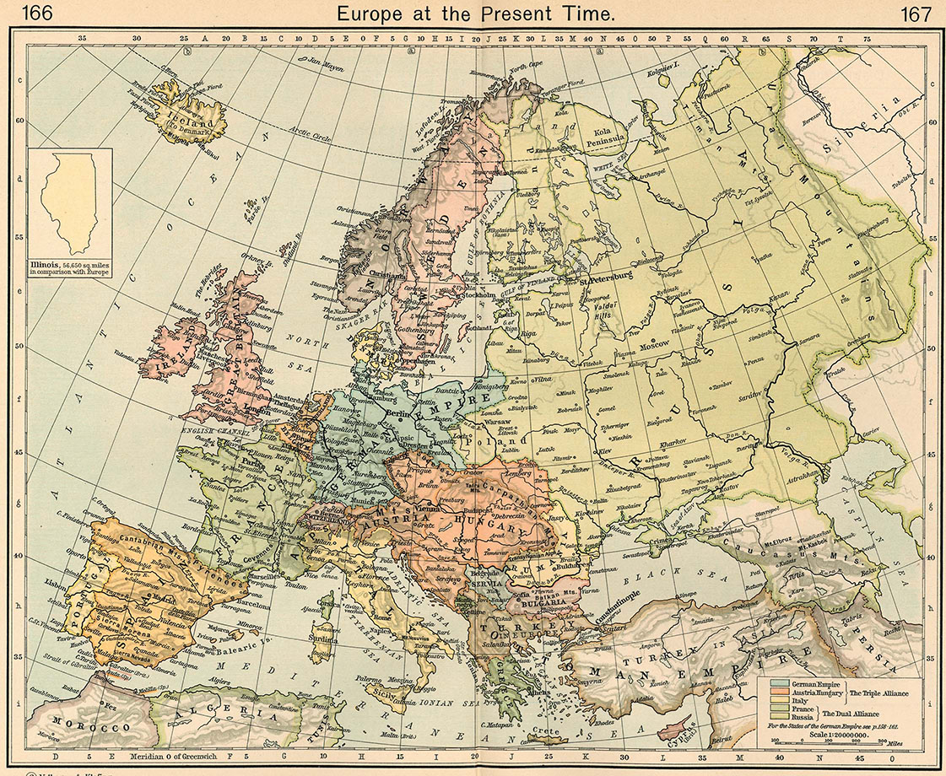
“Europe at the present time”.
Source: Shepherd, W. R. (1923). Historical Atlas. New York, Henry Holt and Company.
Anthamatten
Appendix 01

Slide 6
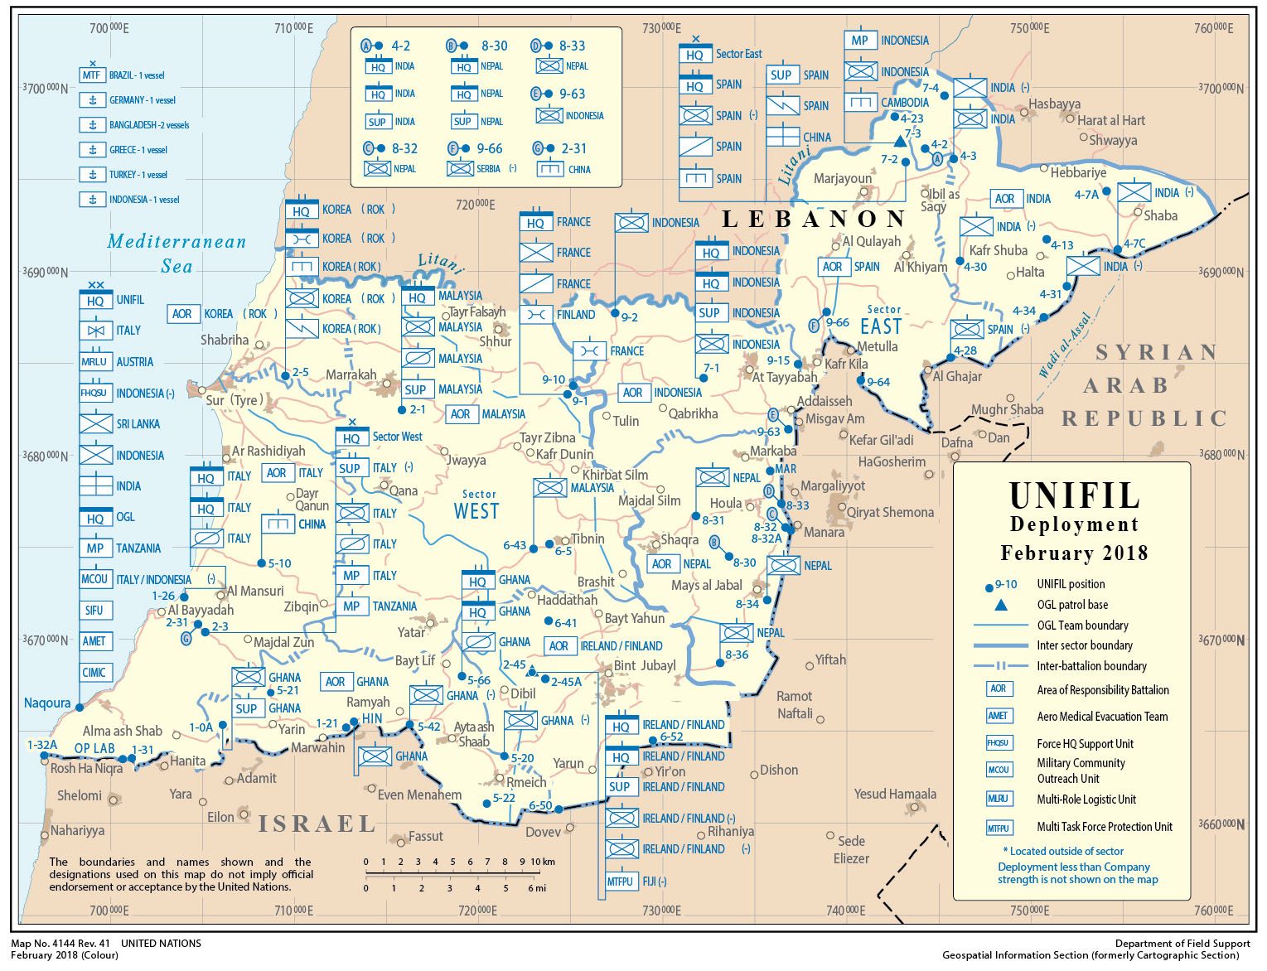
United Nations Interim Force (UNFIL) in Lebanon deployment, February 2018.
Source: United Nations. UNIFIL deployment February 2018 [cartographic material] https://digitallibrary.un.org/record/1473371/files/4144Rev-41.pdf.
Anthamatten
Appendix 01

Slide 7
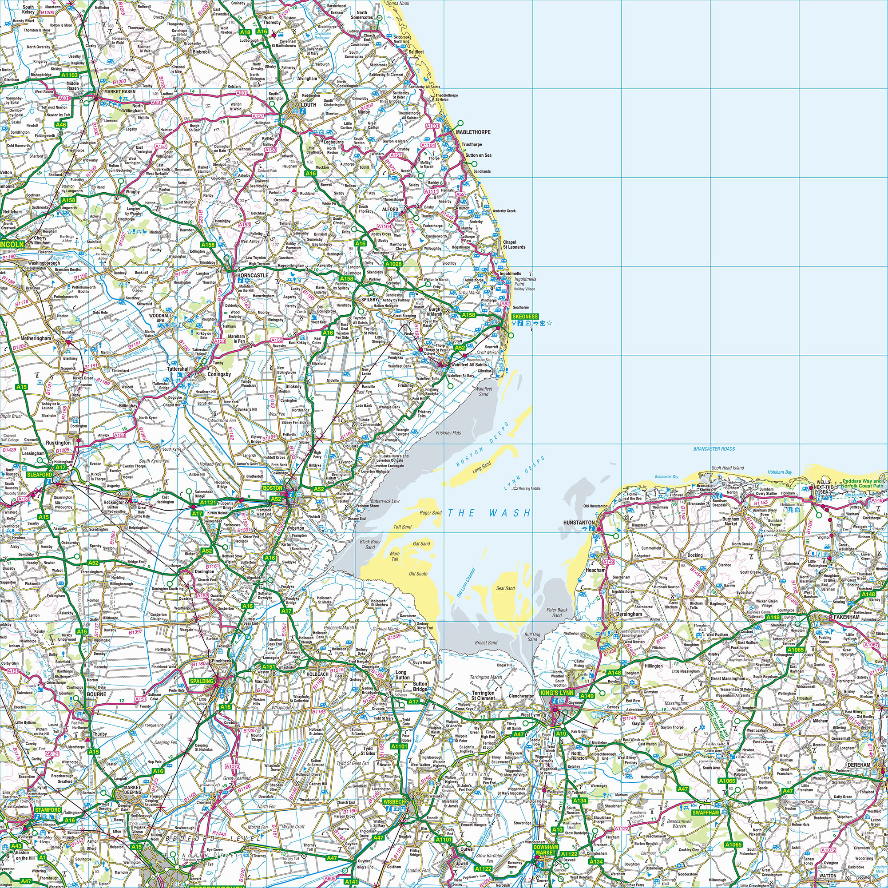
Source: An example of a UK Ordnance Survey Map, designed for 1:250,000. This map shows the area around the Wash in the North Sea. This contains OS data © Crown copyright and database right (2010). Printed under the Ordinance Survey OpenData licence: https://www.ordnancesurvey.co.uk/business-and-government/licensing/using-creating-data-with-osproducts/os-opendata.html.
Anthamatten
Appendix 01

Slide 8
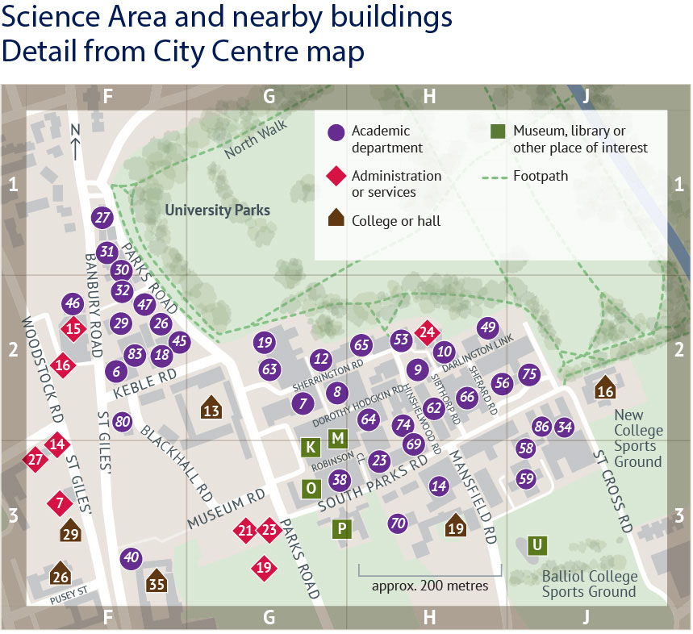
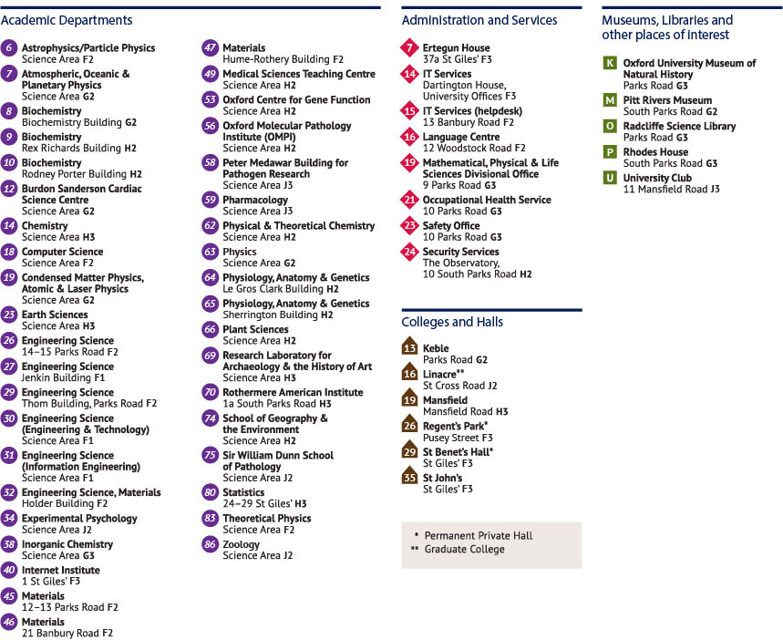
A map of university buildings, Oxford University.
Credit: Sandina Miller / Oxford University Public Affairs.
Anthamatten
Appendix 01

Slide 9
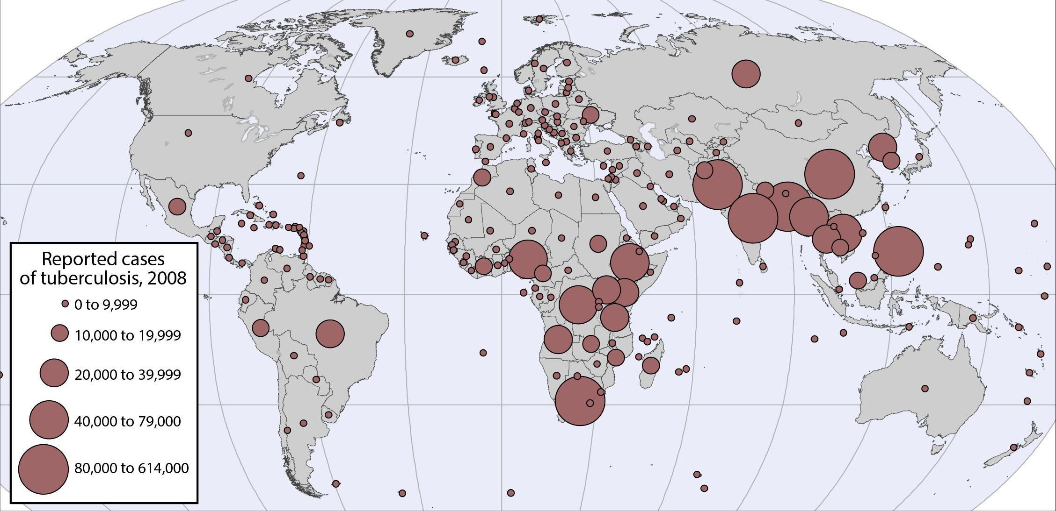
A map of university buildings, Oxford University.
Credit: Sandina Miller / Oxford University Public Affairs.
Anthamatten
Appendix 01

Slide 10
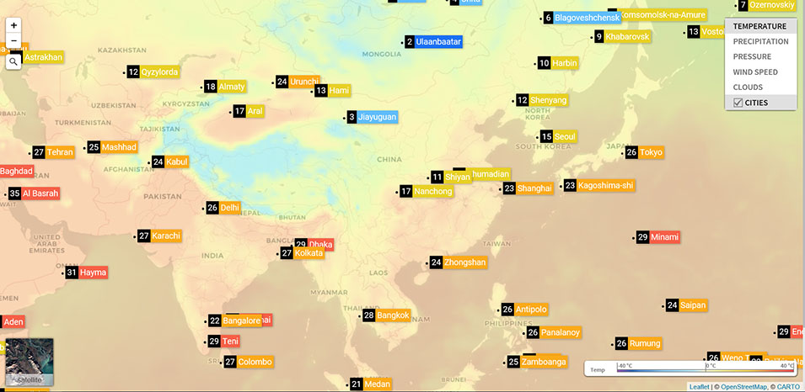
Weather map of Asia.
Source: https://openweathermap.org/weathermap?basemap=map&cities=true&layer=temperature&lat=30&lon=-20&zoom=5.
Anthamatten
Appendix 01

Slide 11
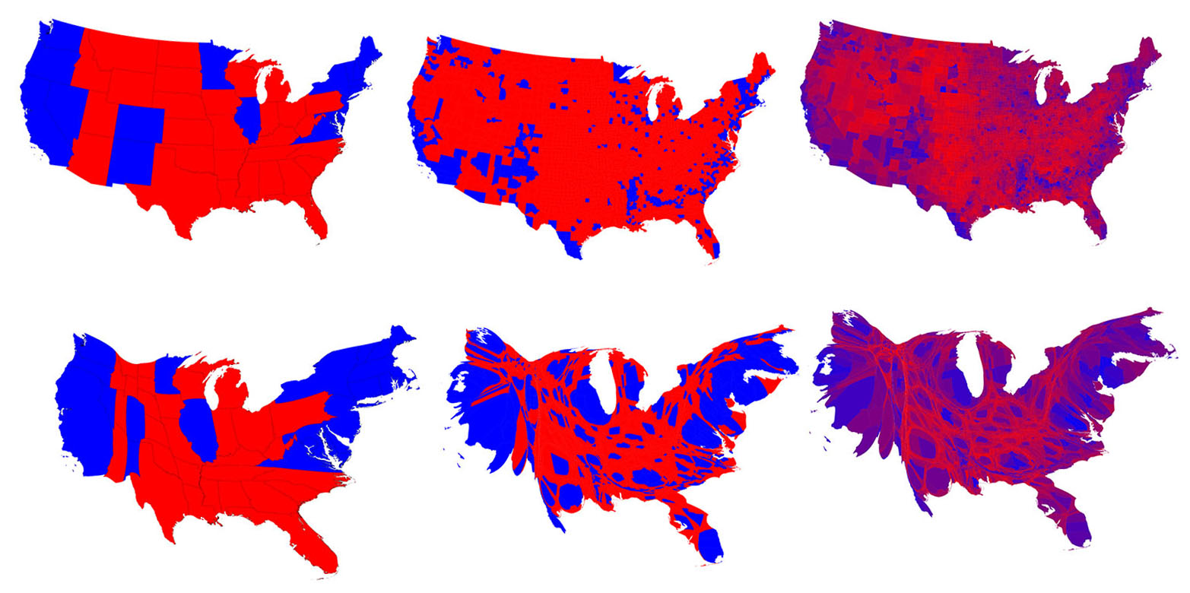
Cartograms of the 2016 election results.
Credit: Mark Newman, Department of Physics and Center for the Study of Complex Systems, University of Michigan.
(http://www-personal.umich.edu/~mejn/election/2016/).
Anthamatten
Appendix 01

Slide 12
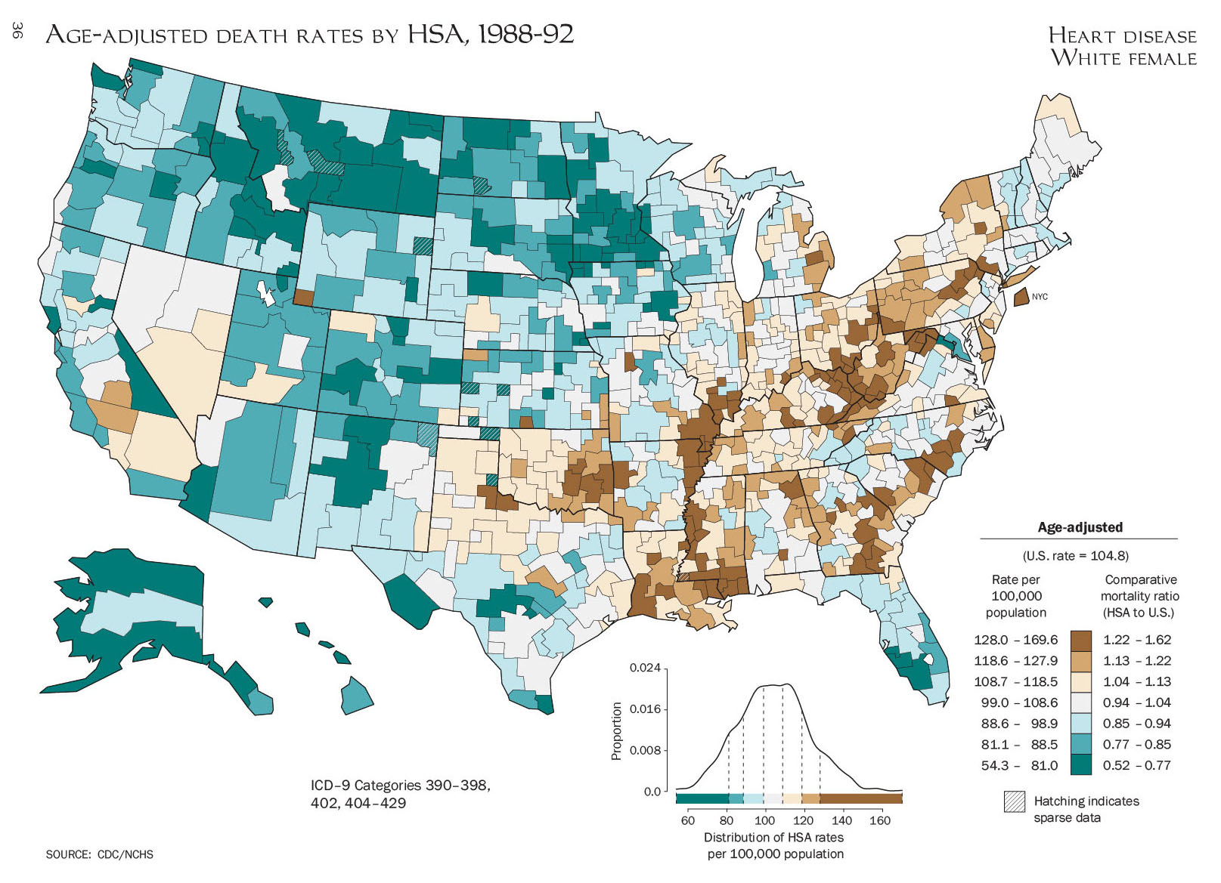
A map from the US Atlas of Mortality.
Source: Pickle, L. W. and National Center for Health Statistics (1996). Atlas of United States Mortality. Hyattsville, MS, National Center for Health Statistics, Centers for Disease Control and Prevention, U.S. Dept. of Health and Human Services.
Anthamatten
Appendix 01

Slide 13
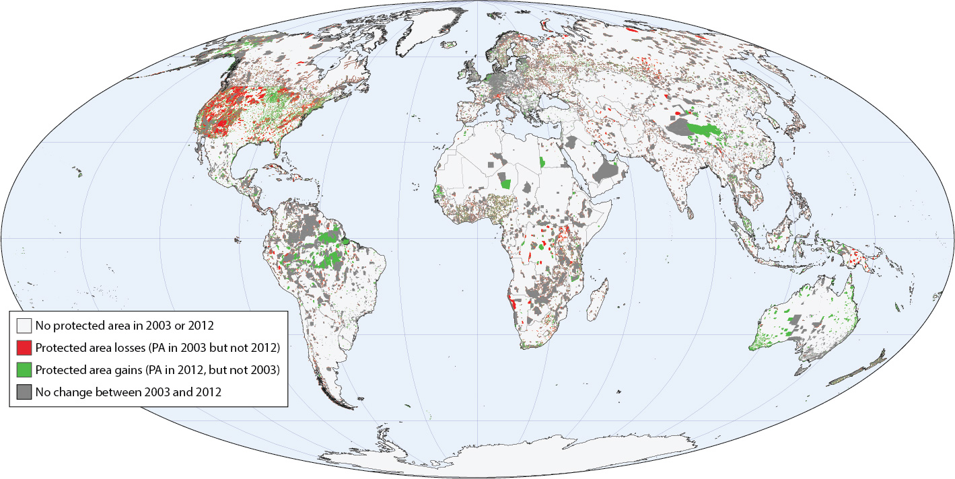
World map of protected area gains and losses between 2003 and 2012.
Source: Anthamatten, P. and H. Hazen (2015). “Changes in the Global Distribution of Protected Areas, 2003–2012.” Professional Geographer 67(2): 195–203.
Anthamatten
Appendix 01

Slide 14
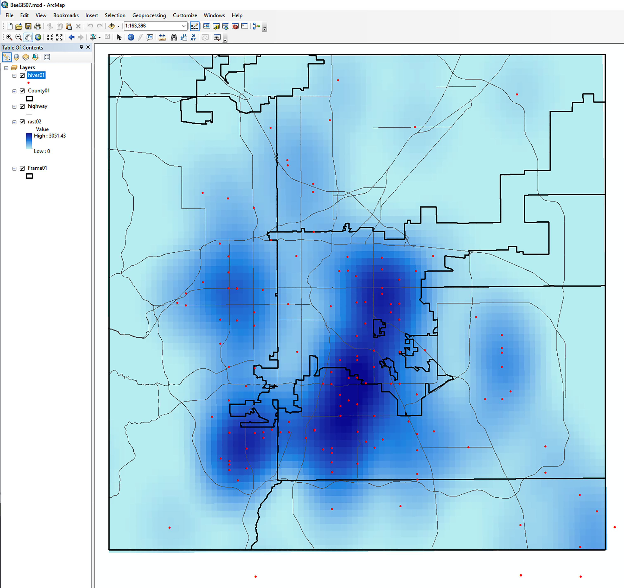
Exploratory map work in a GIS for the Denver Urban Beekeeping project.
Anthamatten
Chapter 12

Slide 15
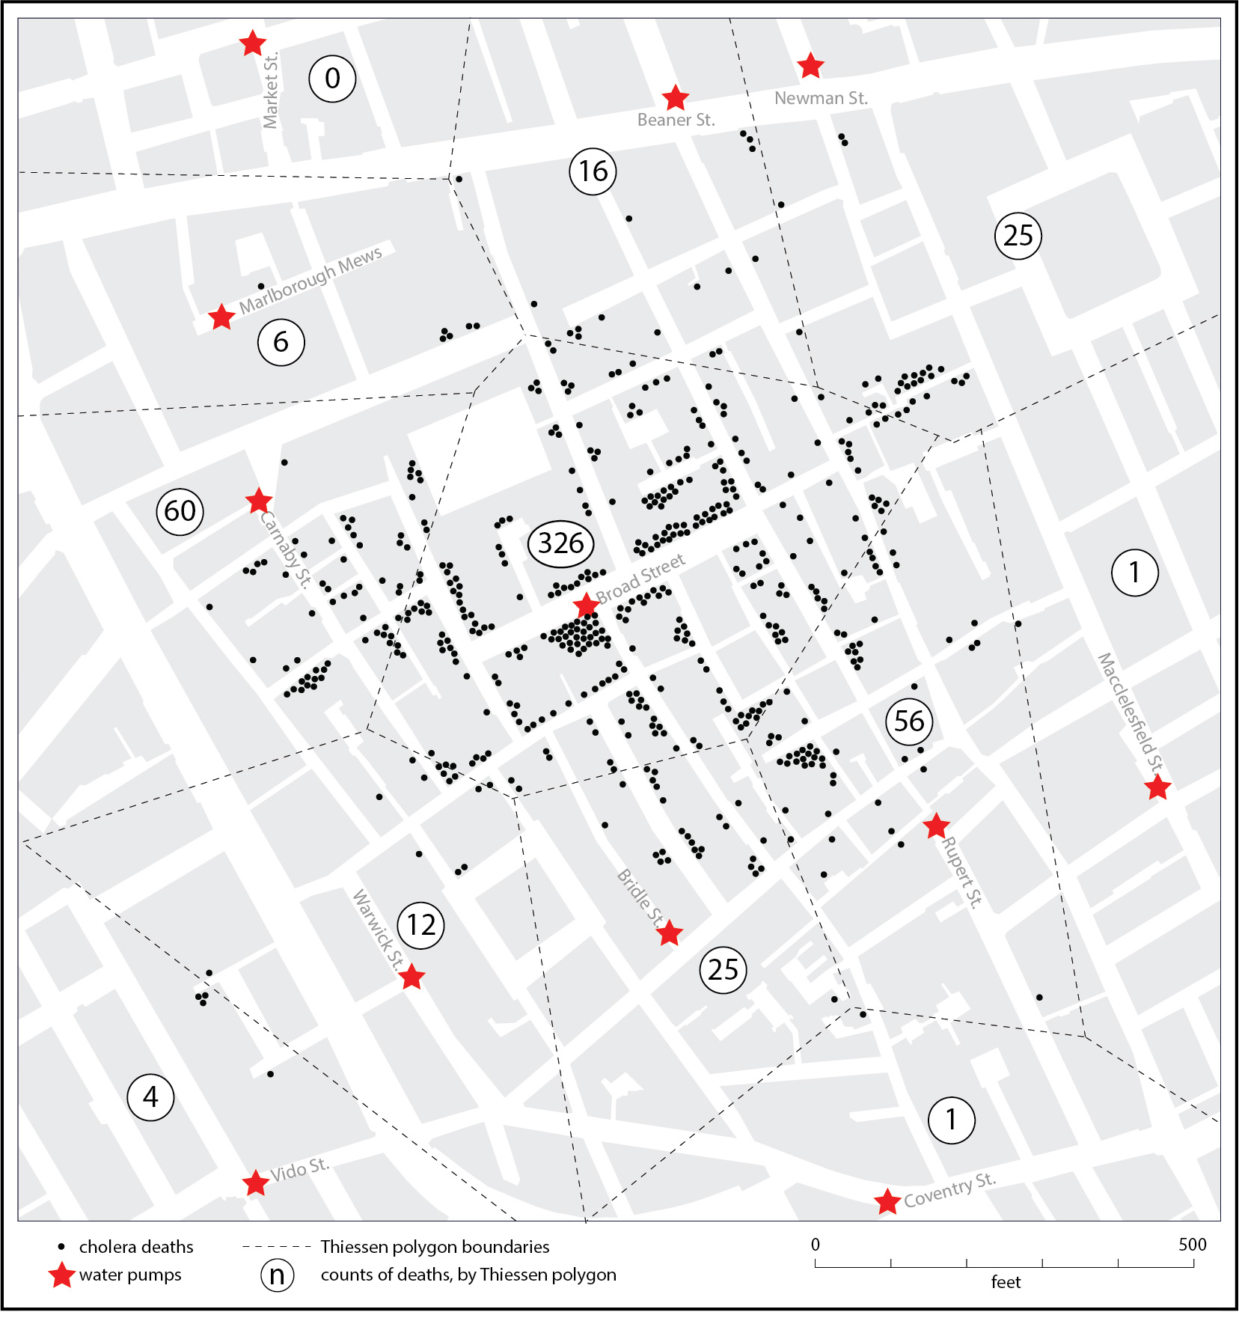
A modern revision of John Snow’s map of cholera in eighteenth-century London.
Anthamatten
Chapter 12

Slide 16
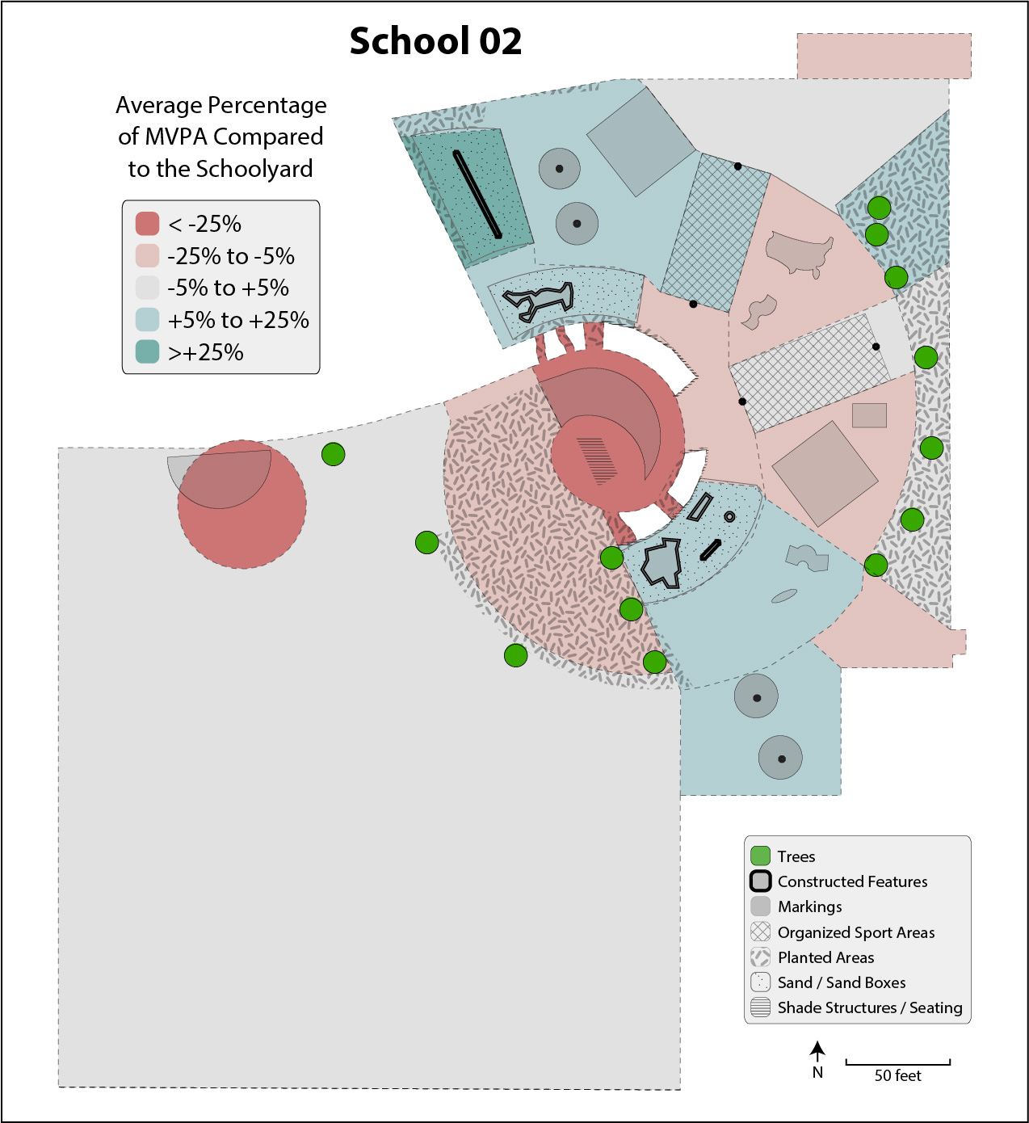
A map of schoolyard activity from a school in Denver, Colorado.
Anthamatten
Chapter 12

Slide 17
How to Make Maps
“Maps from the Wild”
World Map by Michael Tompsett
source: www.michael-tompsett.pixels.com

