Slide 1
How to Make Maps: Chapter 12
“Examples from the Field”
World Map by Michael Tompsett
source: www.michael-tompsett.pixels.com

Slide 2
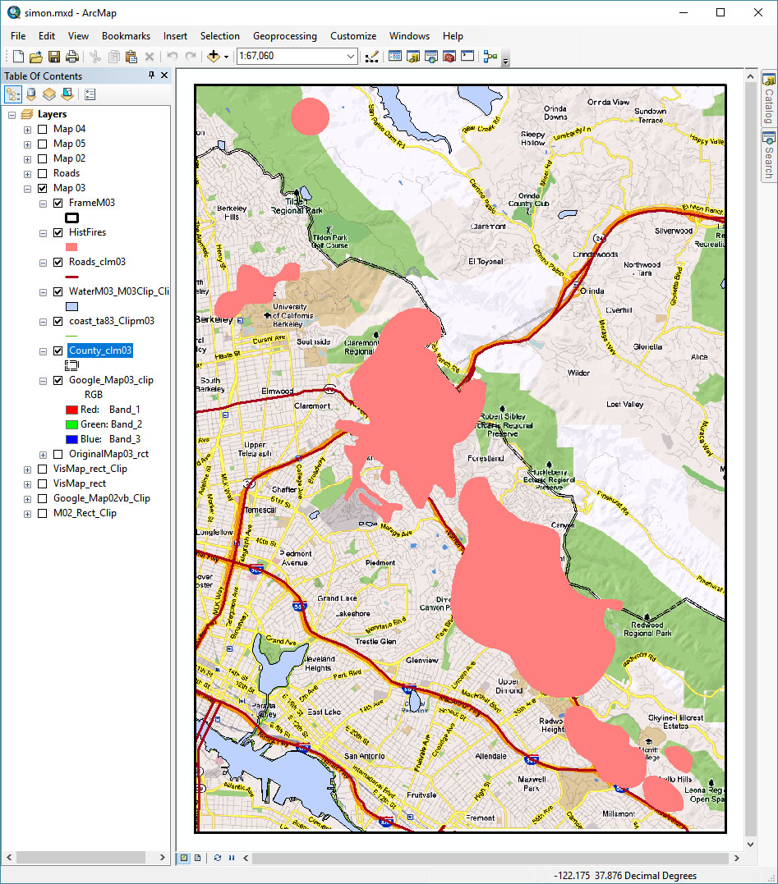
A screenshot of the GIS data view with several layers of data for the Flame and Fortune Mapping project.
Anthamatten
Chapter 12

Slide 3
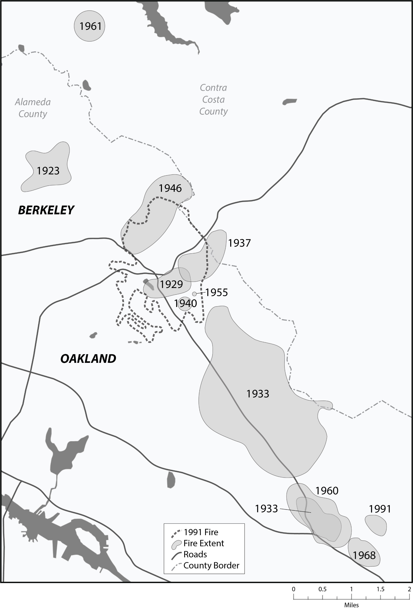
An early draft of one of the Flame and Fortune maps.
Anthamatten
Chapter 12

Slide 4
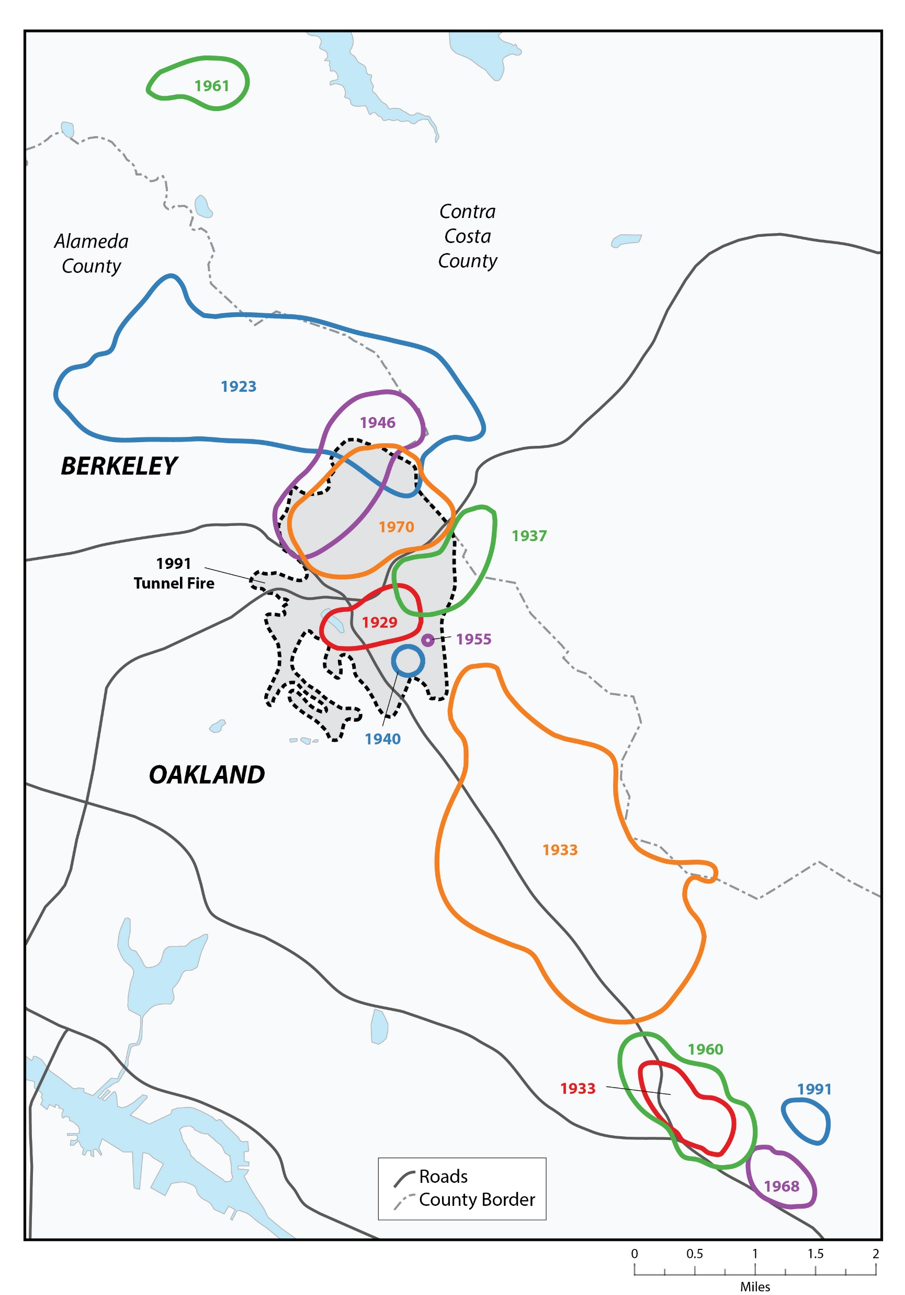
The final draft of the map “Periodic Fires in the East Bay Hills” in the Flame and Fortune mapping project.
Anthamatten
Chapter 12

Slide 5
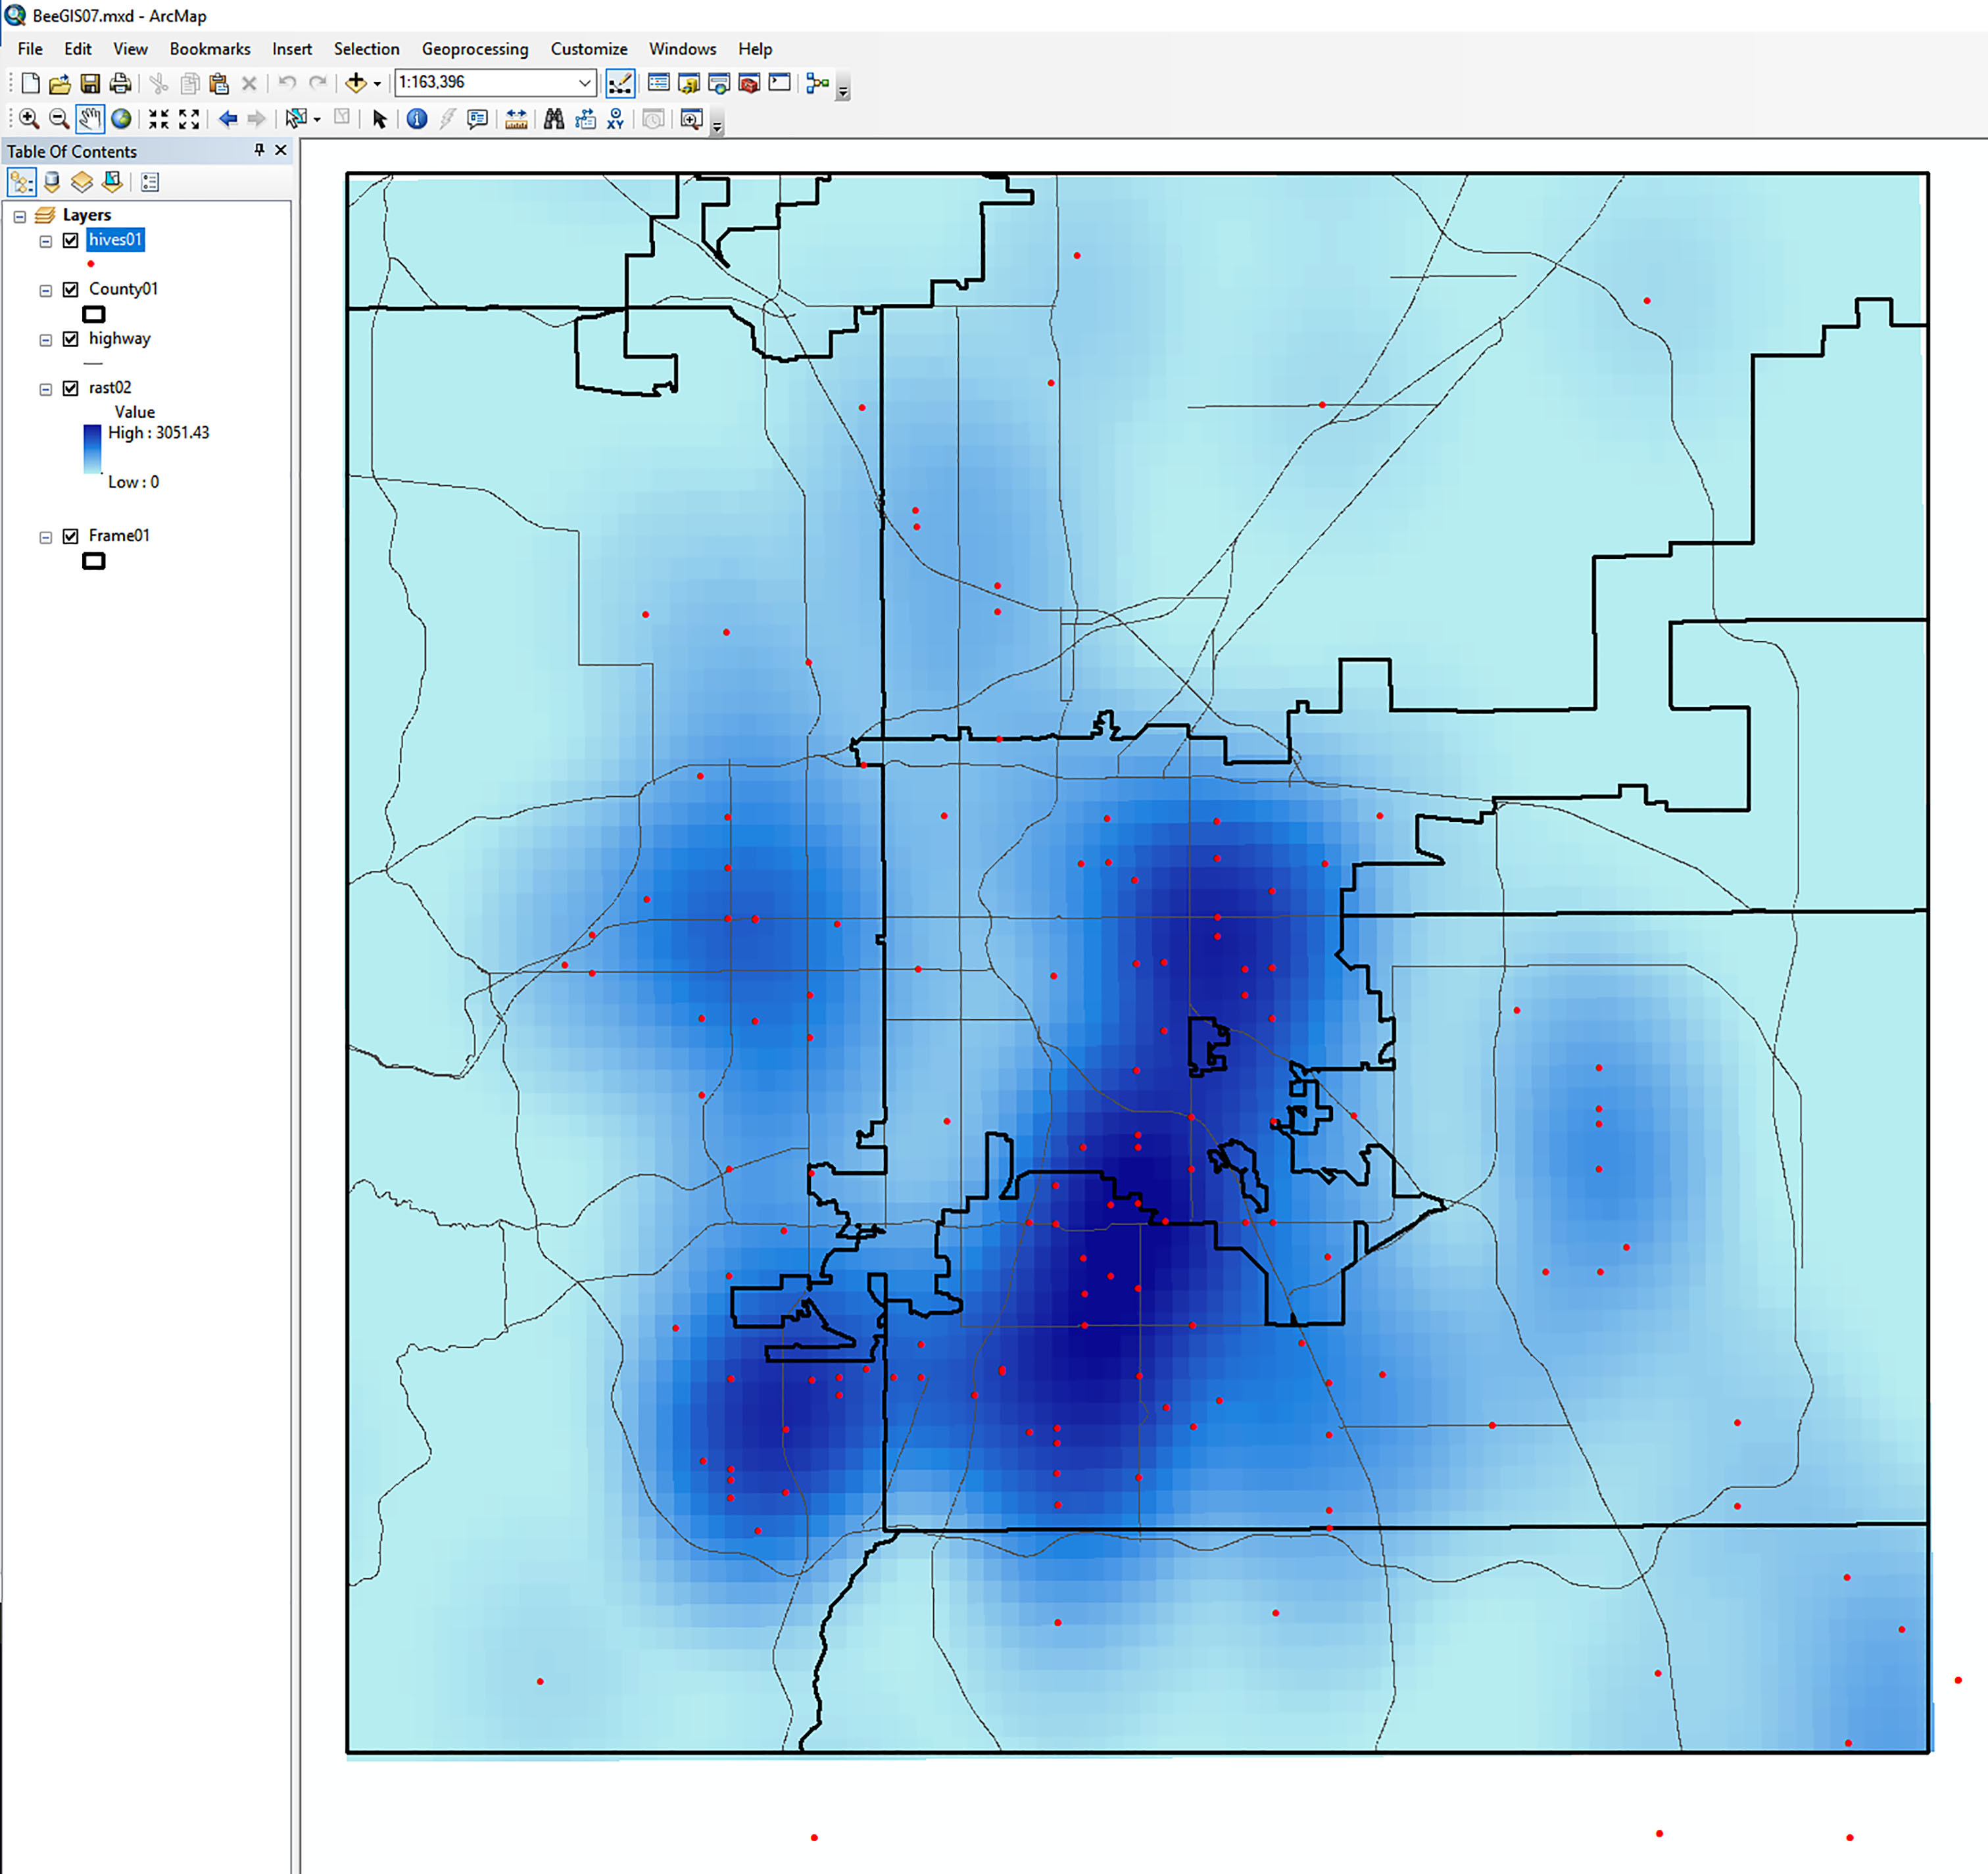
Exploratory map work in a GIS for the Denver Urban Beekeeping project.
Anthamatten
Chapter 12

Slide 6
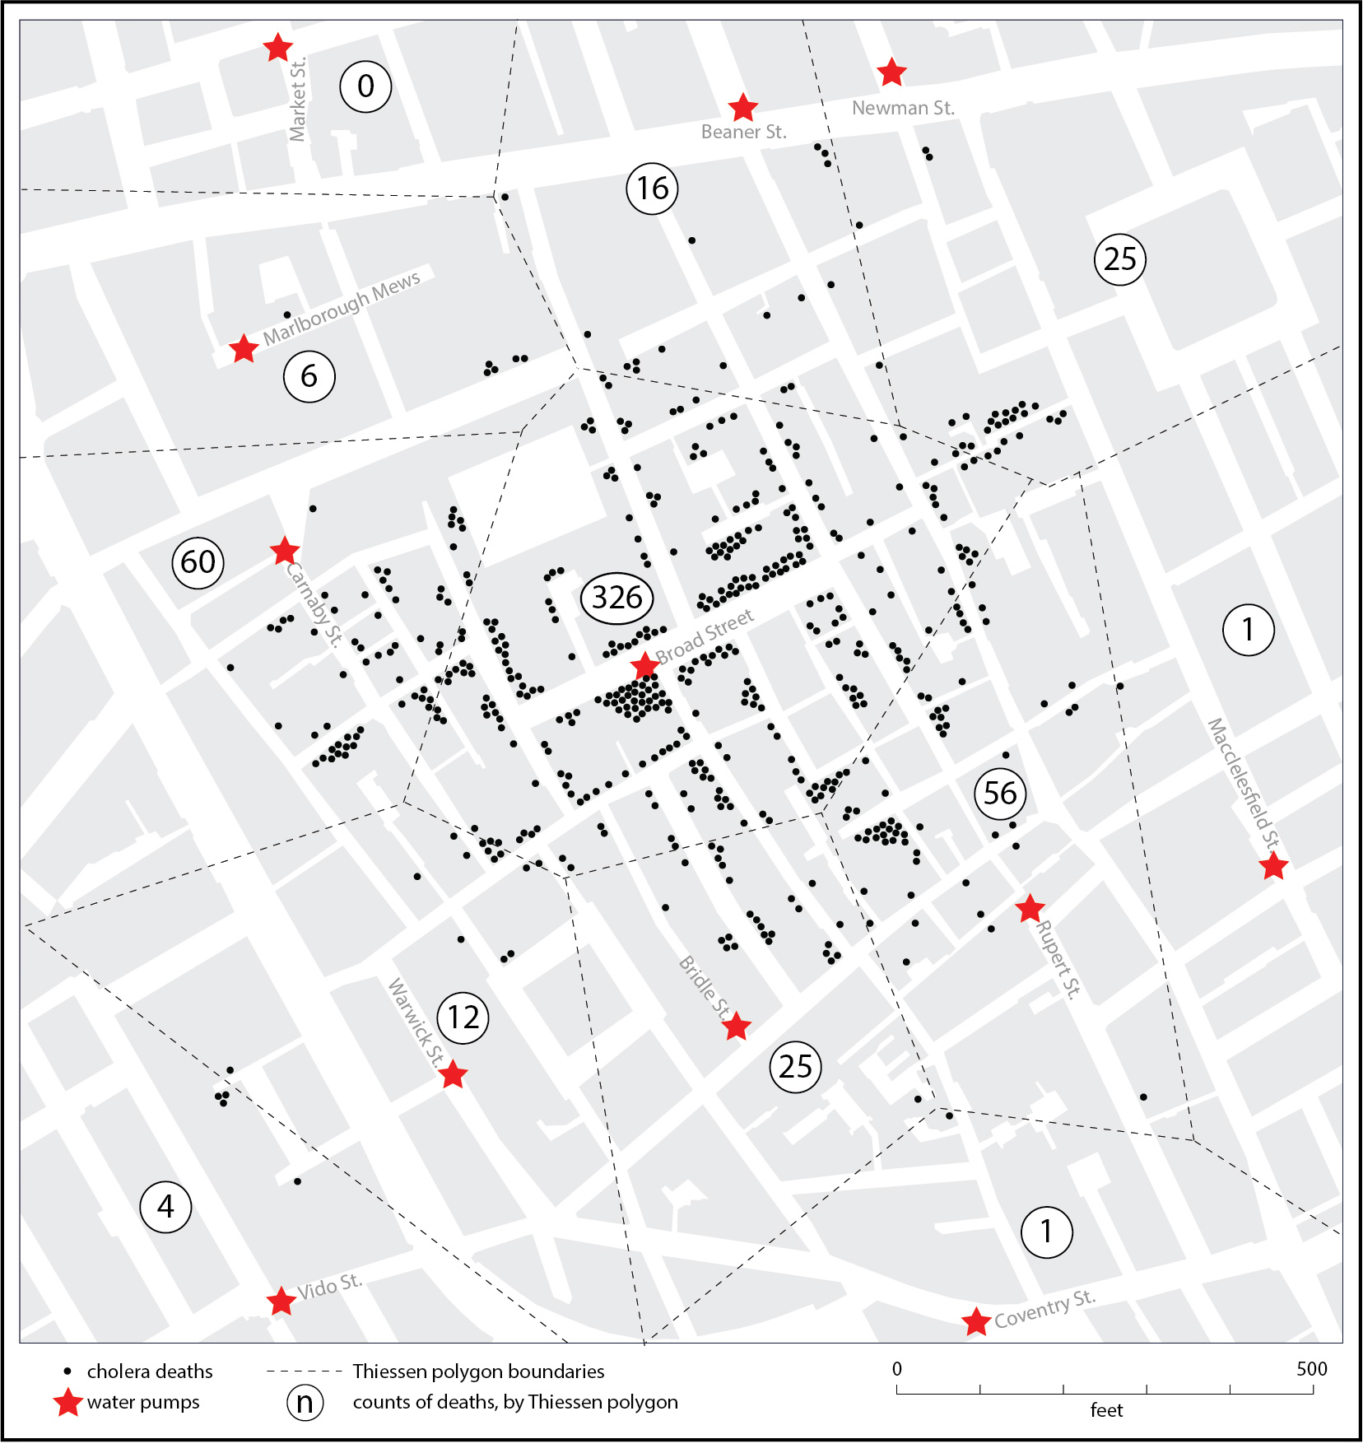
A modern revision of John Snow’s map of cholera in eighteenth-century London.
Anthamatten
Chapter 12

Slide 7
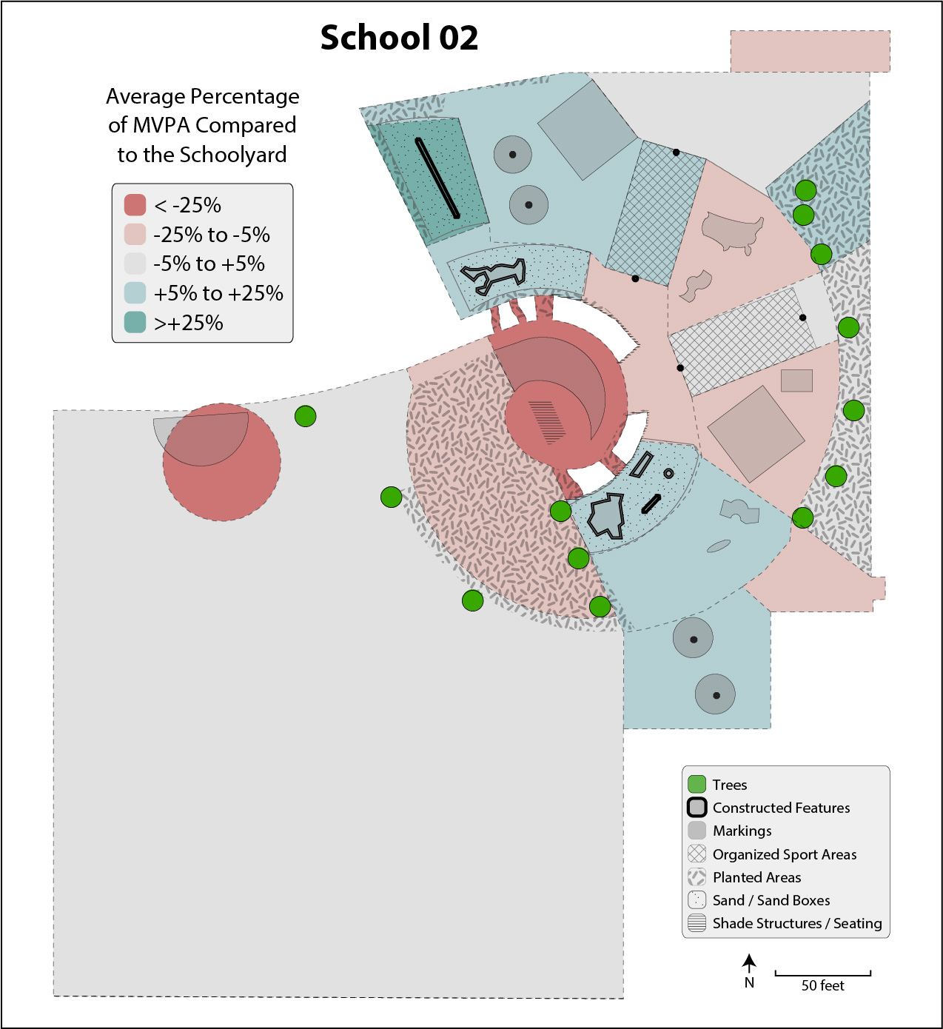
A map of schoolyard activity from a school in Denver, Colorado.
Anthamatten
Chapter 12

Slide 8
How to Make Maps: Chapter 12
“Examples from the Field”
World Map by Michael Tompsett
source: www.michael-tompsett.pixels.com

