Slide 1
How to Make Maps: Chapter 11
“GIS and Graphics Software”
World Map by Michael Tompsett
source: www.michael-tompsett.pixels.com

Slide 2
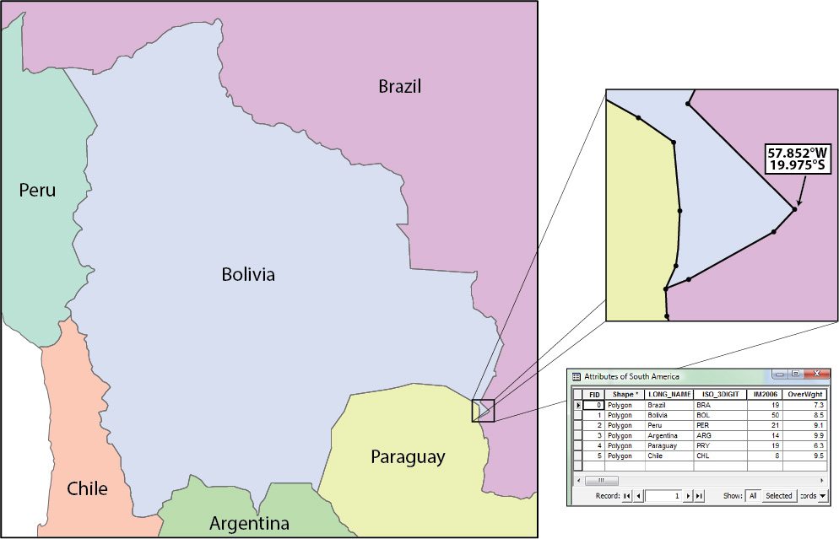
An illustration of country boundaries displayed in a vector GIS.
Anthamatten
Chapter 11

Slide 3
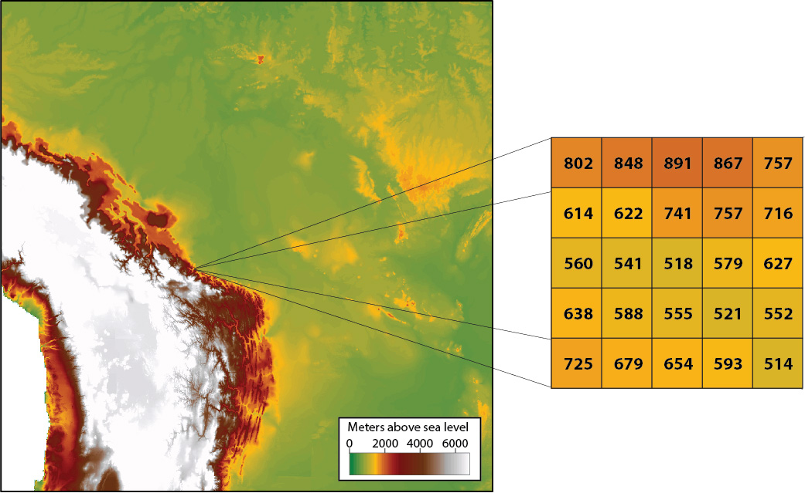
An illustration of a raster data GIS.
Anthamatten
Chapter 11

Slide 4
An example of simple objects with different fill colors and stroke widths.
Anthamatten
Chapter 11

Slide 5
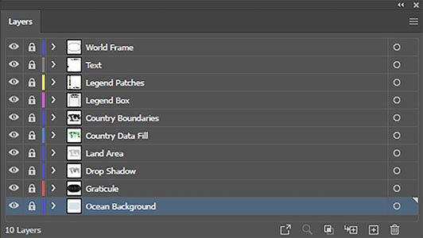
An example of layers panel in a vector graphics application (Adobe Illustrator).
Anthamatten
Chapter 11

Slide 6
Decimal | Hexadecimal
1 | 1
2 | 2
… | …
10 | A
11 | B
12 | C
13 | D
14 | E
15 | F
16 | 10
17 | 11
…
153 | 99
154 | 9A
Examples of numbers in decimal and their conversions to hexadecimal.
Anthamatten
Chapter 11

Slide 7
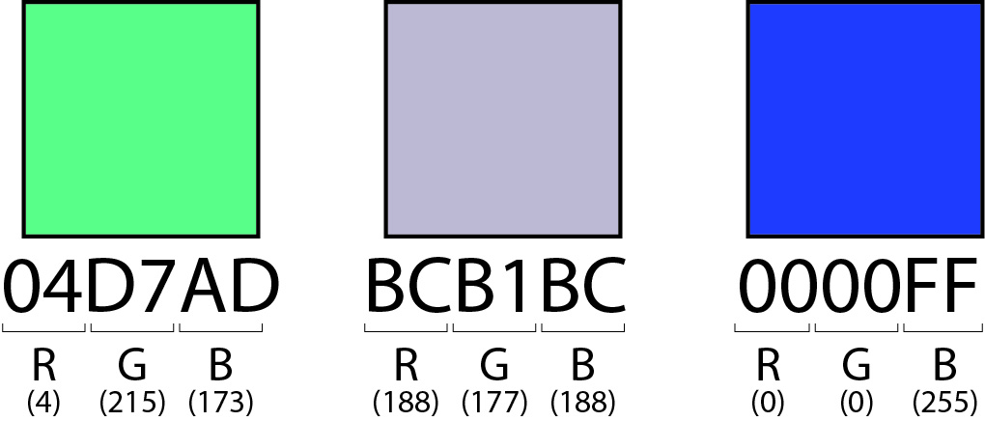
Examples of different hexadecimal codes and their colors.
Anthamatten
Chapter 11

Slide 8
How to Make Maps: Chapter 11
“GIS and Graphics Software”
World Map by Michael Tompsett
source: www.michael-tompsett.pixels.com

