Slide 1
How to Make Maps: Chapter 10
“Data in Mapping”
World Map by Michael Tompsett
source: www.michael-tompsett.pixels.com

Slide 2
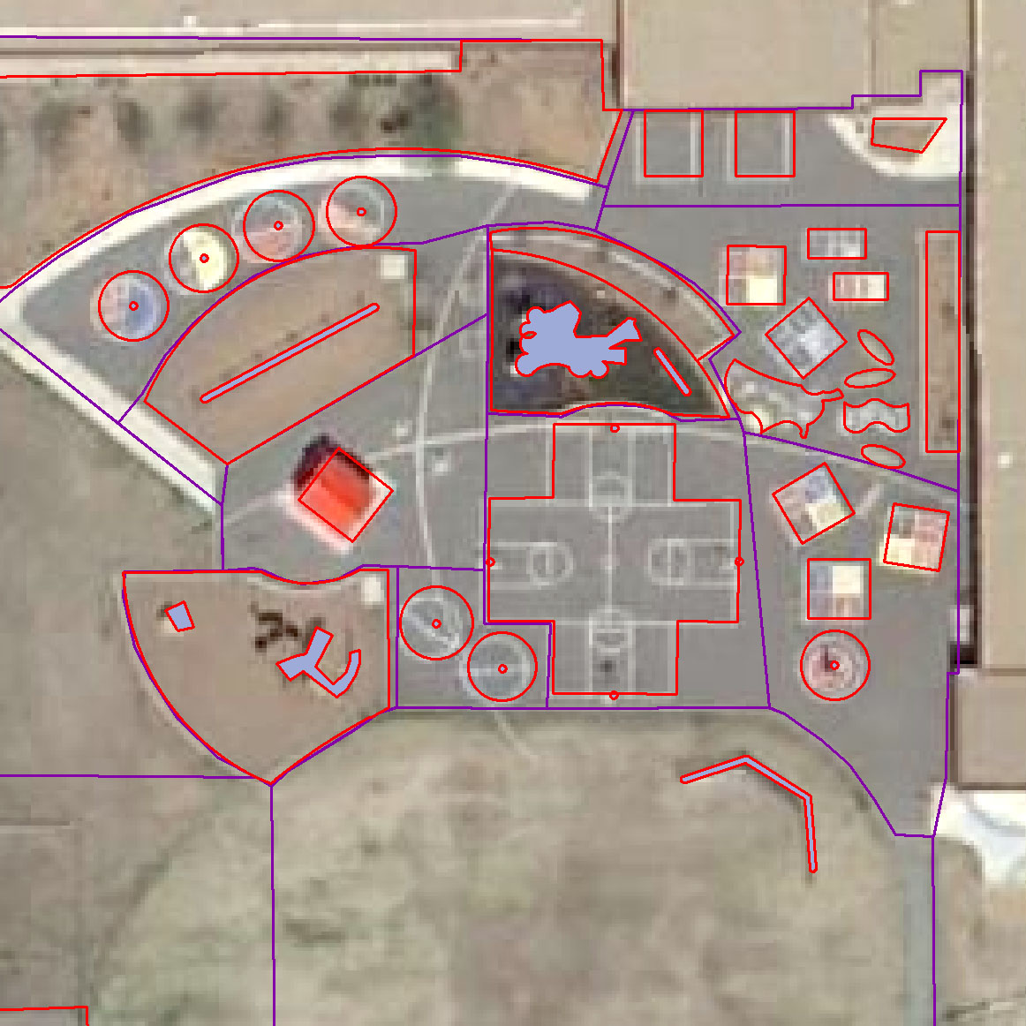
An example of some digitizing work in a GIS.
Anthamatten
Chapter 10

Slide 3
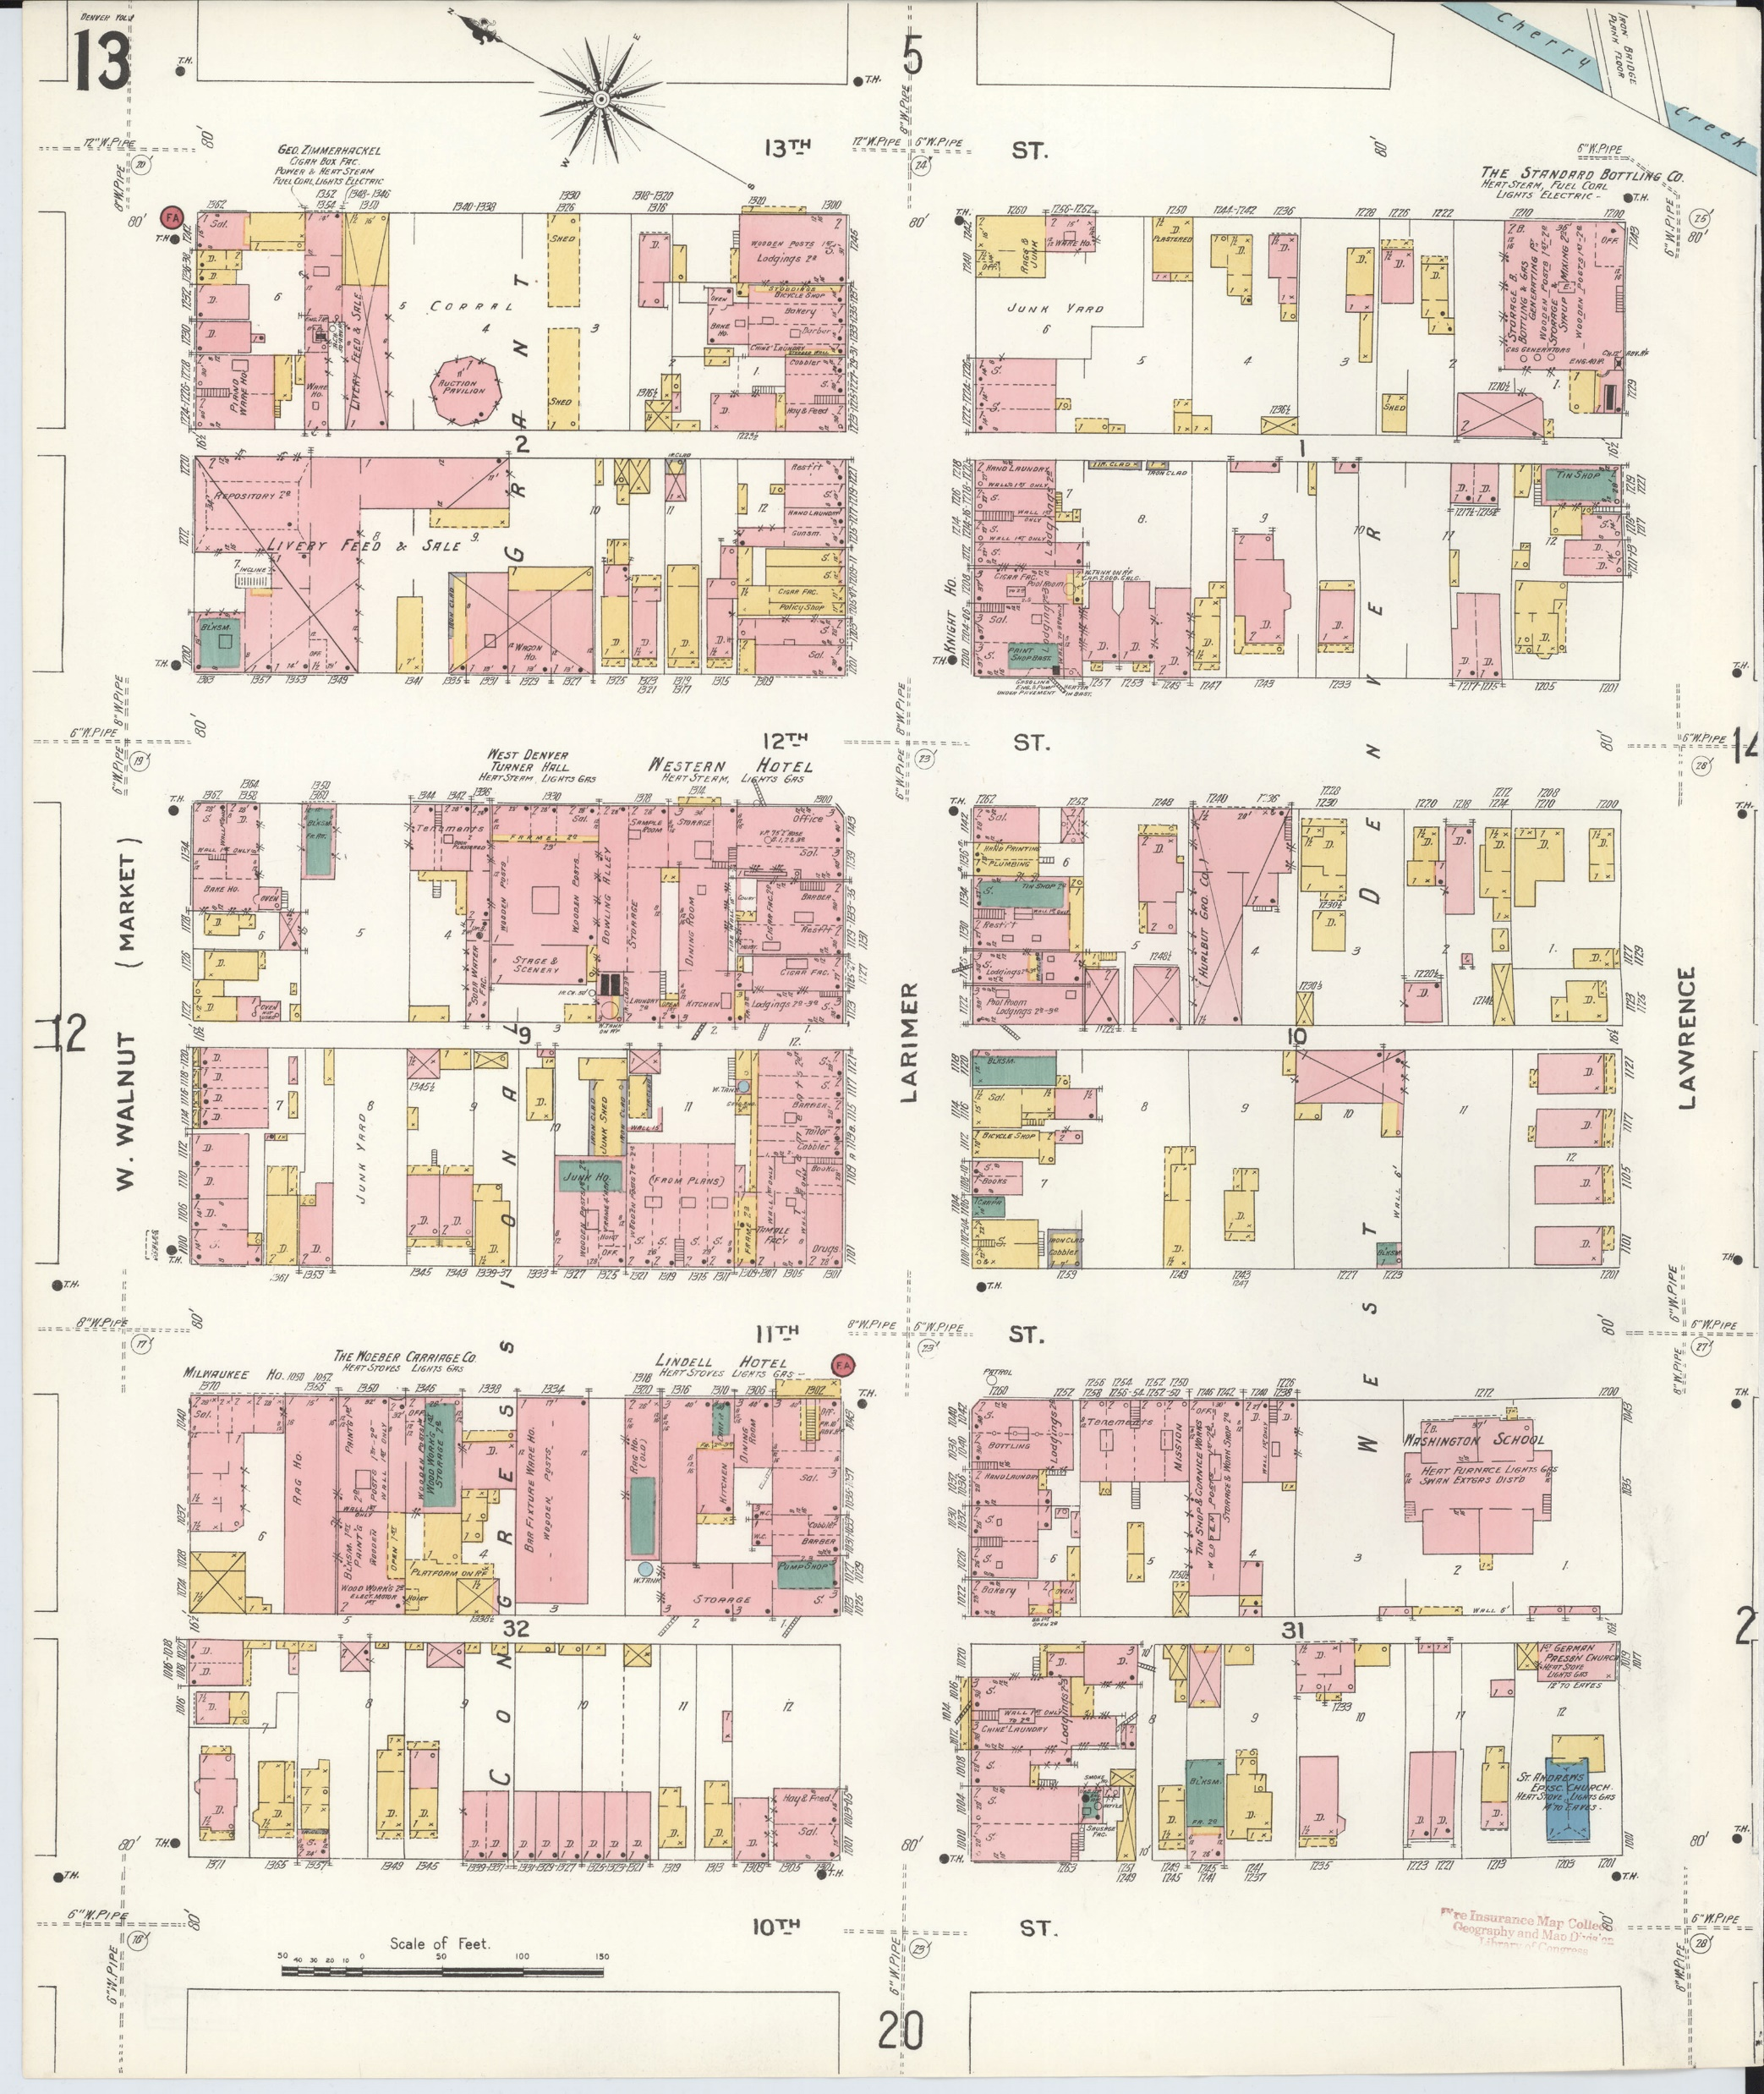
An example of a Sanborn insurance maps, a series originally produced to manage liability and risk for fire insurance companies (Sanborn Insurance Company 1904).
Source: Sanborn Insurance Company. 1904. Sanborn Fire Insurance Map from Denver, Denver County,
Colorado. New York: Sanborn Map Company.
Anthamatten
Chapter 10

Slide 4
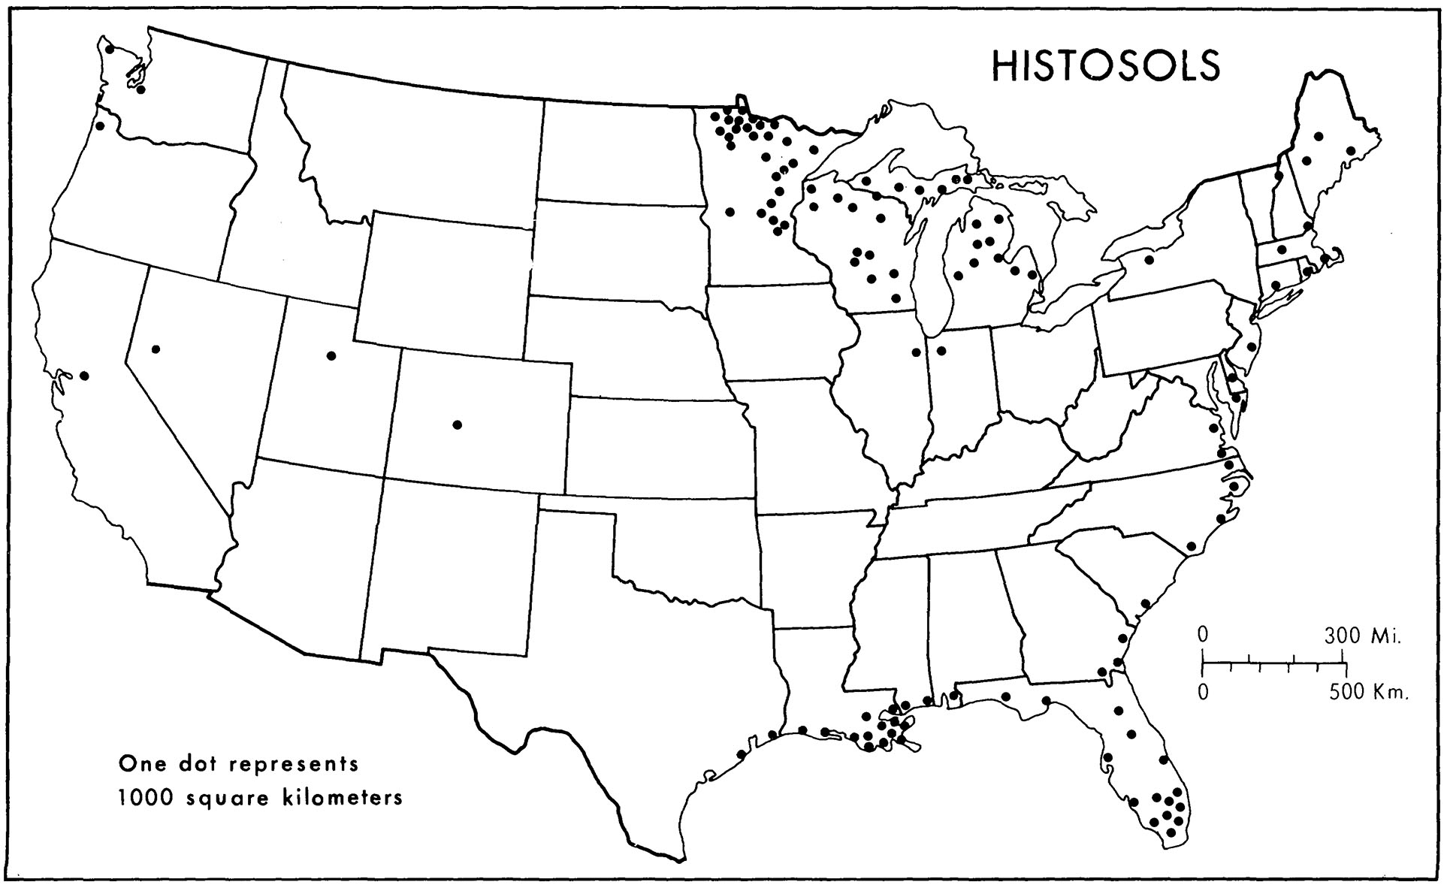
Phil Gersmehl’s (1977) map of Histosols in the United States.
Source: Gersmehl, P.J. 1977. “Soil Taxonomy and Mapping.” Annals of the Association of American Geographers 67 (3):419–428.
doi: 10.1111/j.1467-8306.1977.tb01151.x.
Anthamatten
Chapter 10

Slide 5
Some graphical techniques for communicating uncertainty in maps.
Anthamatten
Chapter 10

Slide 6
How to Make Maps: Chapter 10
“Data in Mapping”
World Map by Michael Tompsett
source: www.michael-tompsett.pixels.com

