Slide 1
How to Make Maps: Chapter 09
“Scholarly Research in Cartography”
World Map by Michael Tompsett
source: www.michael-tompsett.pixels.com

Slide 2
A basic depiction of the communication paradigm of research in cartography. This figure was adapted from MacEachren (1995, 4).
Source: MacEachren, A.M. 2004. How Maps Work: Representation, Visualization, and Design. New York: Guilford Press.
Anthamatten
Chapter 09

Slide 3
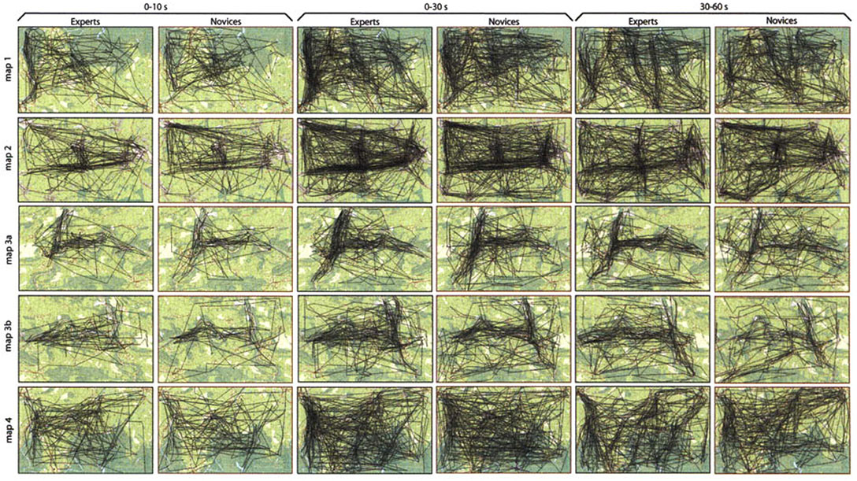
An example of a foveation analysis of topographic maps (Ooms, De Maeyer, and Fack 2014).
Source: Ooms, K., P. de Maeyer, and V. Fack. 2014. “Study of the Attentive Behavior of Novice and Expert Map Users Using Eye Tracking.” Cartography and Geographic Information Science 41 (1):37–54. doi: 10.1080/15230406.2013.860255.
Anthamatten
Chapter 09

Slide 4
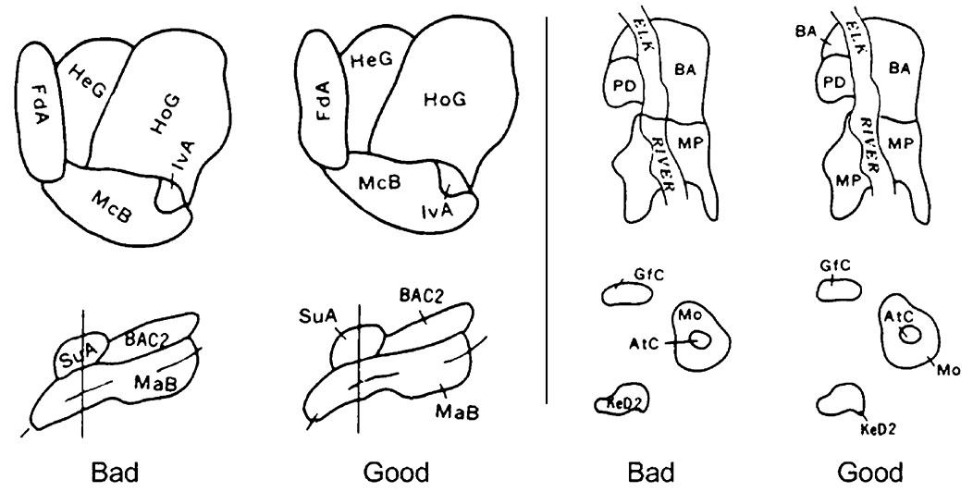
Recommended placement for soil map labels using automated cartography (Freeman 2007).
Source: Freeman, H. 2007. “On the Problem of Placing Names on a Map.” Journal of Visual Languages and Computing 18 (5):458–469.
doi: 10.1016/j.jvlc.2007.08.006.
Anthamatten
Chapter 09

Slide 5
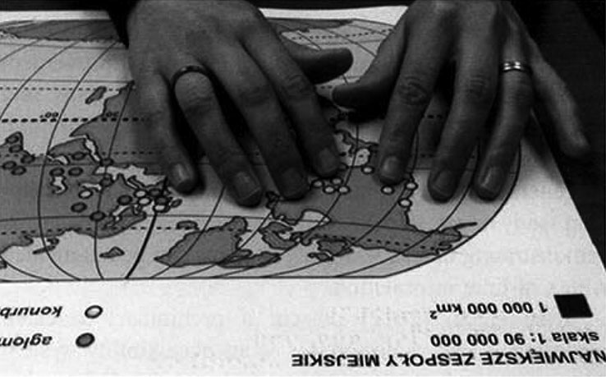
A user using interacting with tactile mapping in an open-source mapping project (Rice et al. 2013).
Source: Rice, M.T., R.D. Jacobson, R.G. Golledge, and D. Jones. 2005. “Design Considerations for Haptic and Auditory Map Interfaces.” Cartography and Geographic Information Science 32 (4):381–391. doi: 10.1559/152304005775194656.
Anthamatten
Chapter 09

Slide 6
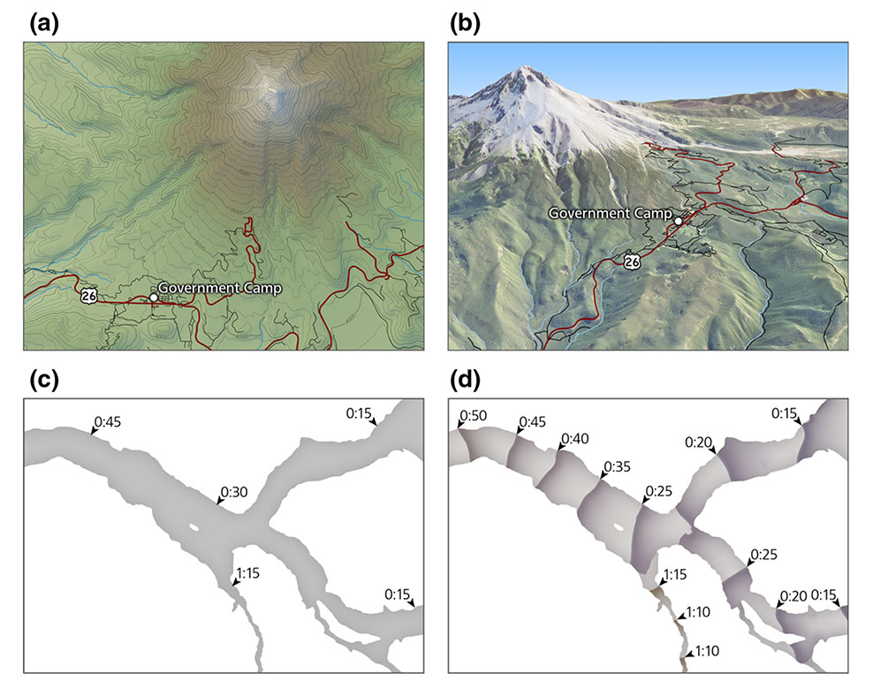
Maps examined in a study to evaluate the effectiveness of 3D perspective maps on user’s ability to navigate with evacuation maps (Preppernau and Jenny 2015).
Source: Preppernau, C.A., and B. Jenny. 2015. “Three-Dimensional versus Conventional Volcanic Hazard Maps.” Natural Hazards 78 (2):1329–1347.
doi: 10.1007/s11069-015-1773-z.
Anthamatten
Chapter 09

Slide 7
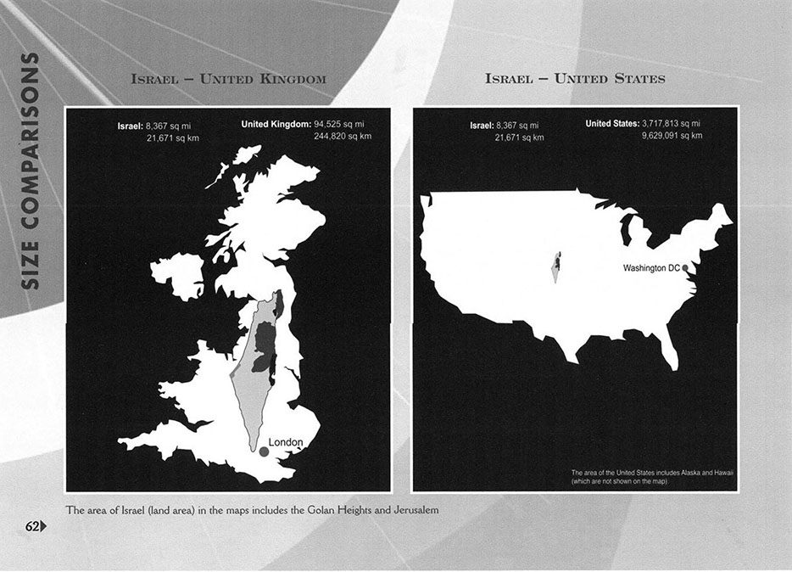
This is a map comparing Israel’s size to the USA and the UK (Leuenberger and Schnell 2010).
Source: Leuenberger, C., and I. Schnell. 2010. “The Politics of Maps: Constructing National Territories in Israel.” Social Studies of Science 40 (6):803–842.
doi: 10.1177/0306312710370377.
Anthamatten
Chapter 09

Slide 8
An example of open-street mapping efforts of Bologna, Italy (Dodge and Kitchin 2013).
Source: Dodge, M., and R. Kitchin. 2013. “Crowdsourced Cartography: Mapping Experience and Knowledge.” Environment and Planning A 45 (1):19–36.
doi: 10.1068/a44484.
Anthamatten
Chapter 09

Slide 9
How to Make Maps: Chapter 09
“Scholarly Research in Cartography”
World Map by Michael Tompsett
source: www.michael-tompsett.pixels.com

