Slide 1
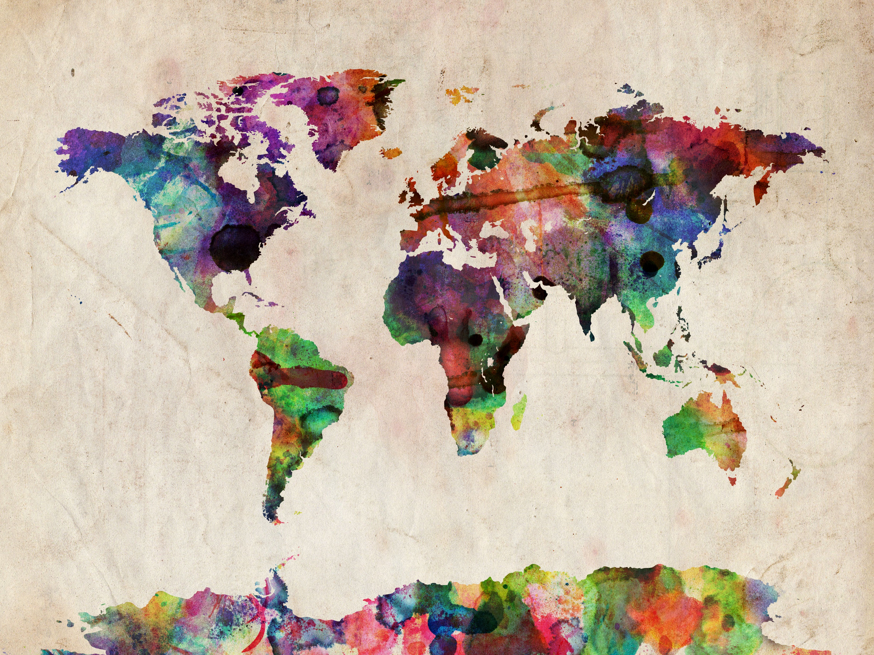
How to Make Maps: Chapter 08
“3D, Animated, and Web Cartography”
World Map by Michael Tompsett
source: www.michael-tompsett.pixels.com

Slide 2
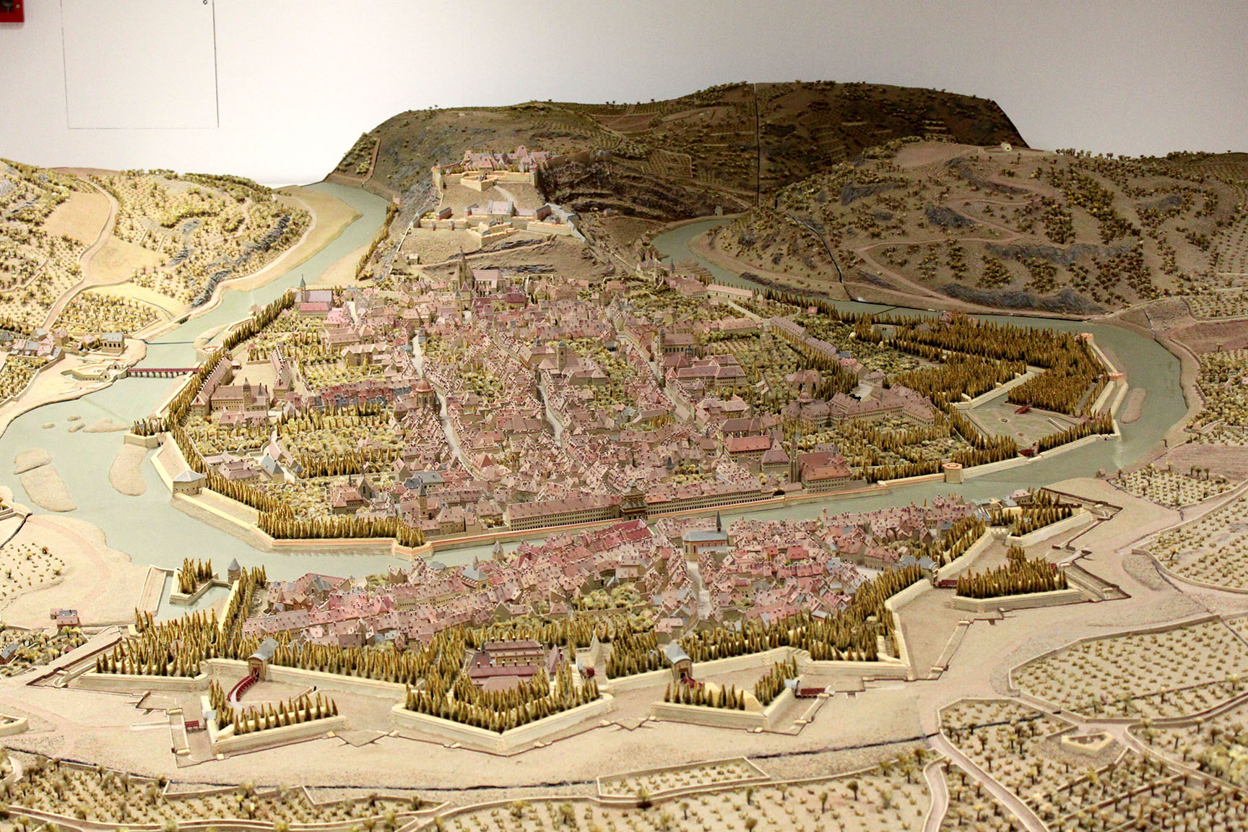
A relief map from the Musée du Temps de Besançon, Besançon, Franche-Comté, France.
Anthamatten
Chapter 08

Slide 3
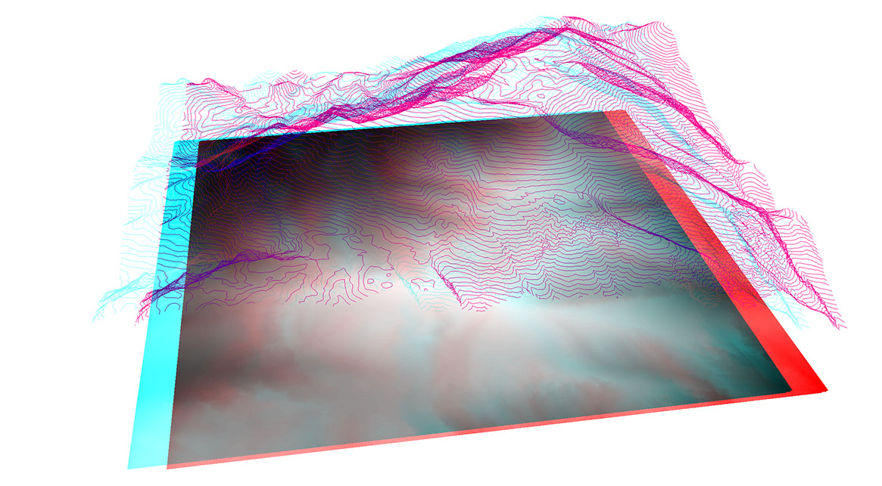
An example of a map anaglyph.
Anthamatten
Chapter 08

Slide 4
The hardware components of a 3D visualization system developed for university classrooms.
Anthamatten
Chapter 08

Slide 5
An example of an oblique, 3D perspective rendered by ArcScene.
Anthamatten
Chapter 08

Slide 6
A map excerpt showing hillshading.
Anthamatten
Chapter 08

Slide 7
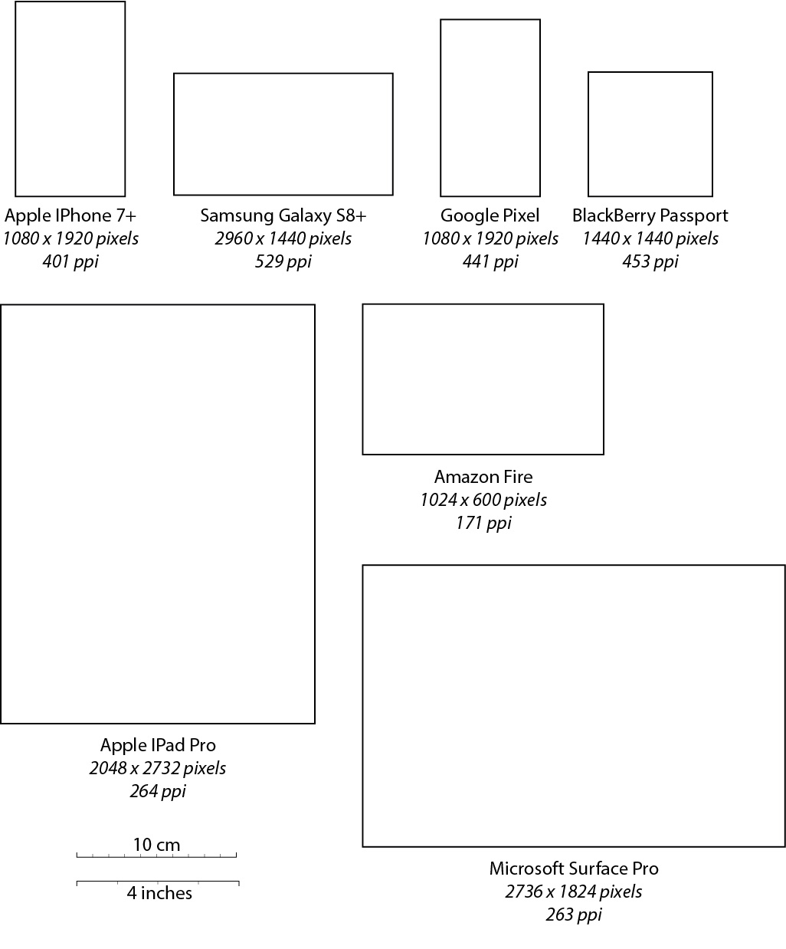
The physical sizes, pixel dimensions, and graphic resolutions (pixels per inch, PPI) of several mobile devices commonly in use at the time of this writing.
Data derived from screensiz.es.
Anthamatten
Chapter 08

Slide 8
How to Make Maps: Chapter 08
“3D, Animated, and Web Cartography”
World Map by Michael Tompsett
source: www.michael-tompsett.pixels.com

