Slide 1
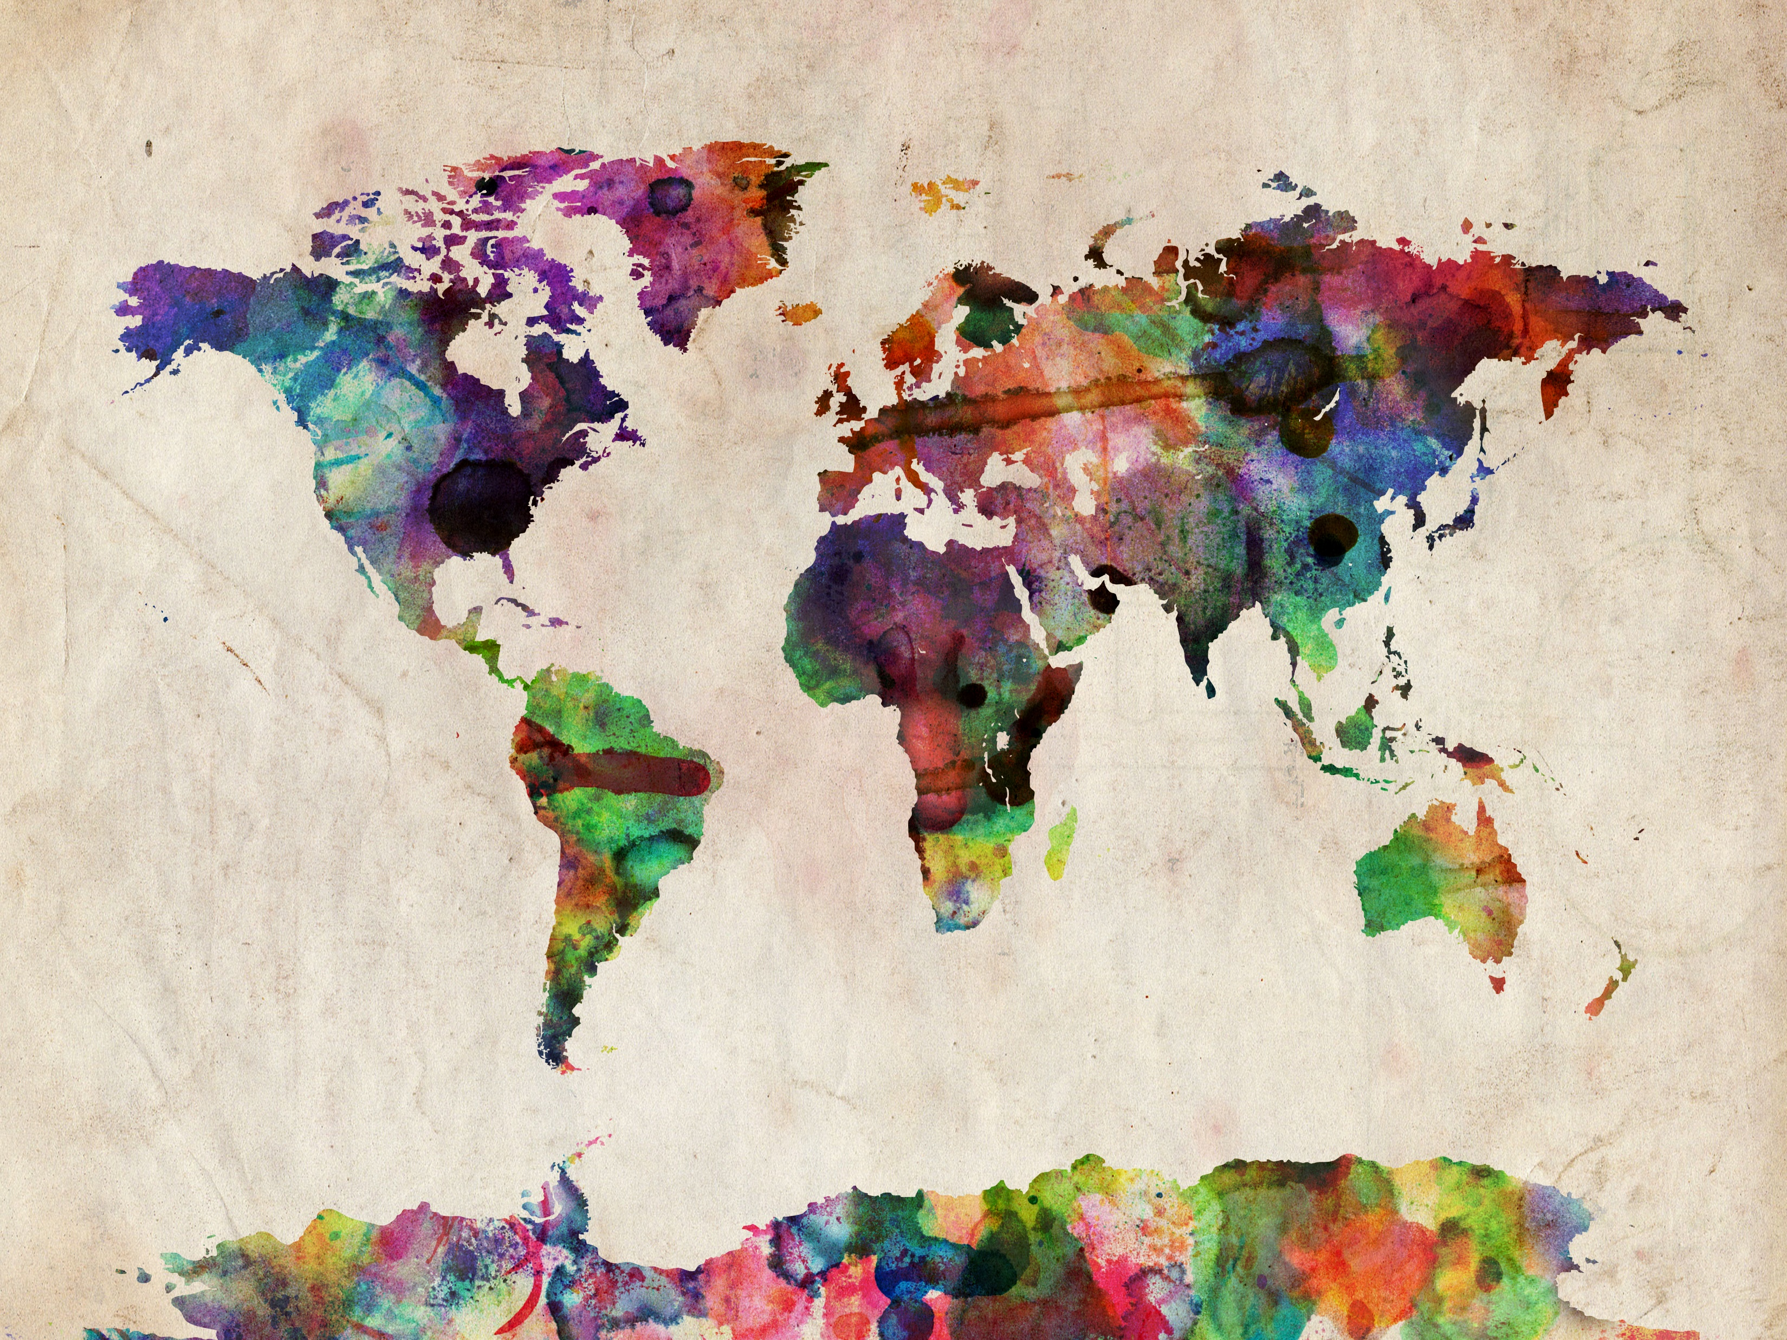
How to Make Maps: Chapter 07
“Color in Cartography”
World Map by Michael Tompsett
source: www.michael-tompsett.pixels.com

Slide 2
A demonstration of simultaneous contrast.
Anthamatten
Chapter 07

Slide 3
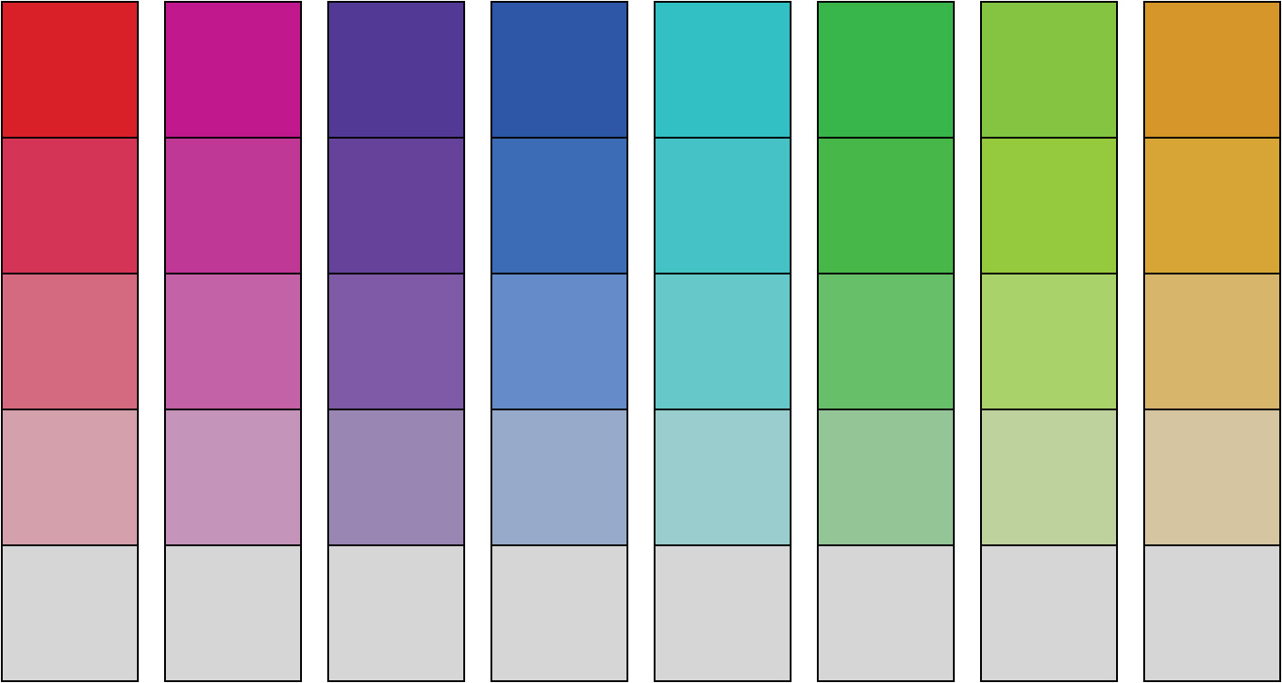
Columns of color patches showing different hues in descending order of saturation.
Anthamatten
Chapter 07

Slide 4
Different hues (in addition to a column of fully desaturated gray) in descending order of lightness or value.
Anthamatten
Chapter 07

Slide 5
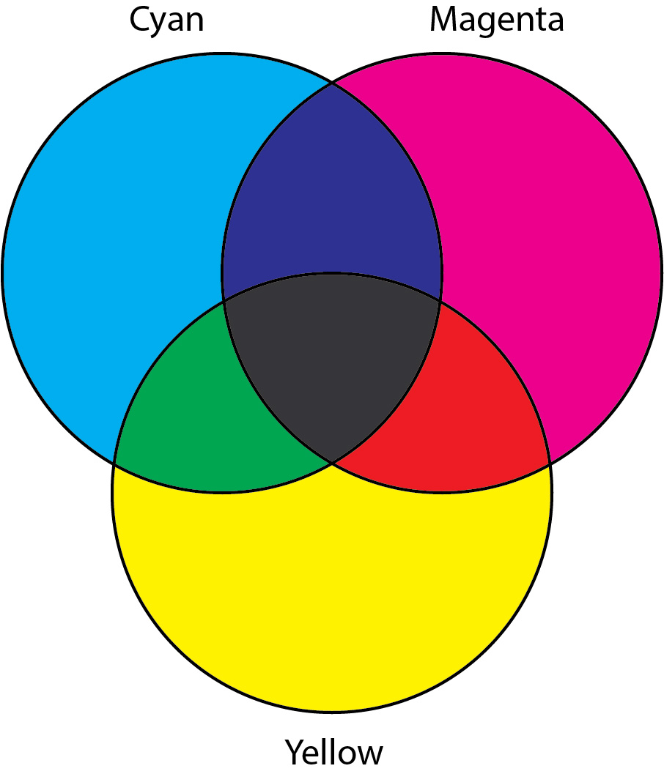
Subtractive colors.
Anthamatten
Chapter 07

Slide 6
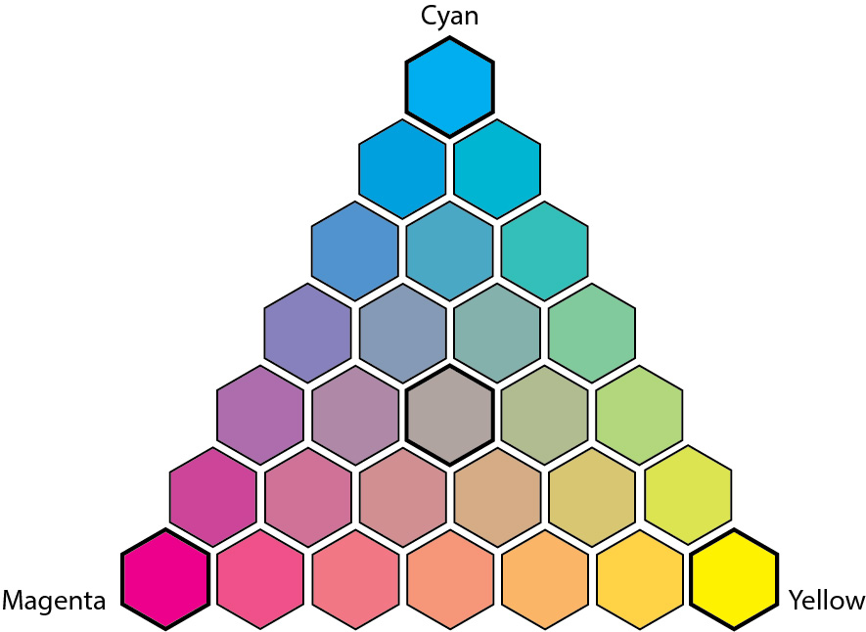
Combinations of cyan, magenta, and yellow ink.
Anthamatten
Chapter 07

Slide 7
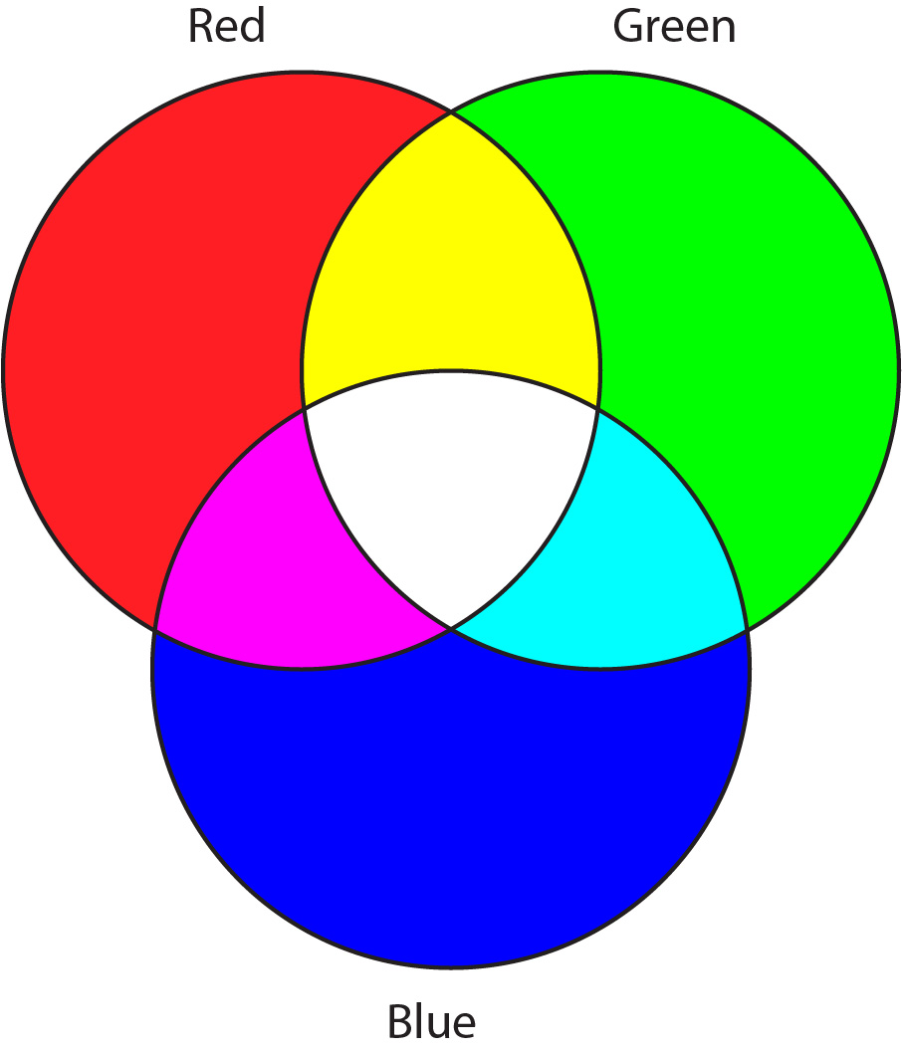
Additive colors.
Anthamatten
Chapter 07

Slide 8
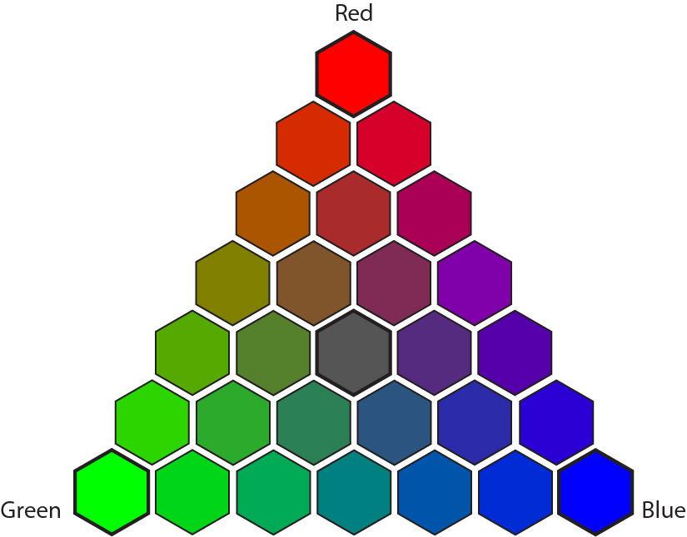
Combinations of RGB intensities.
Anthamatten
Chapter 07

Slide 9
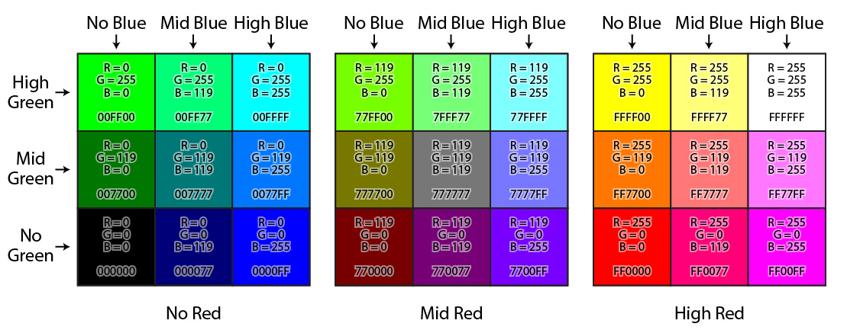
An alternative demonstration of RGB combinations that combine all the intensities of each of the channels.
Anthamatten
Chapter 07

Slide 10
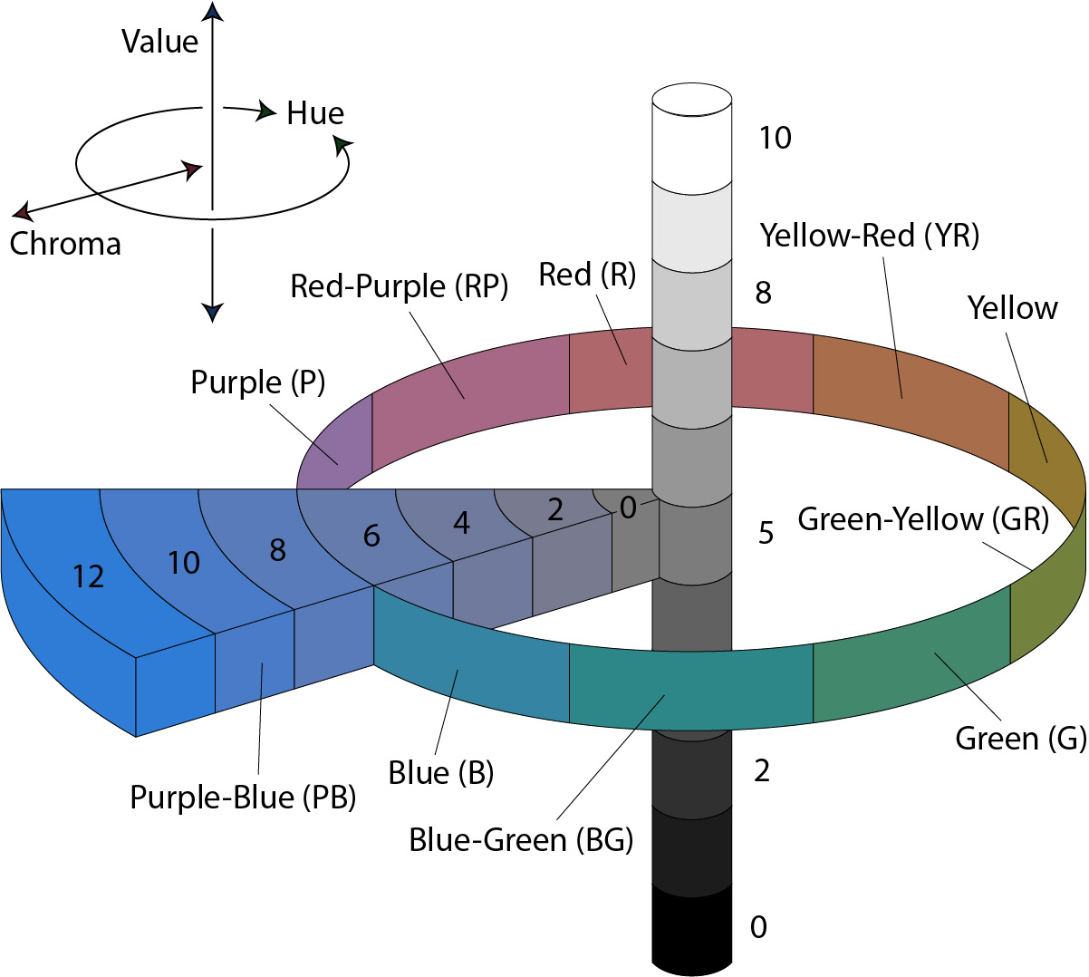
The Munsell Color System.
Image adapted from Jacob Rus, 2007 (https://commons.wikimedia.org/wiki/File:Munsell-system.svg).
Anthamatten
Chapter 07

Slide 11
Color hues in the HSV spectrum.
Anthamatten
Chapter 07

Slide 12
The HSV color grid.
Anthamatten
Chapter 07

Slide 13
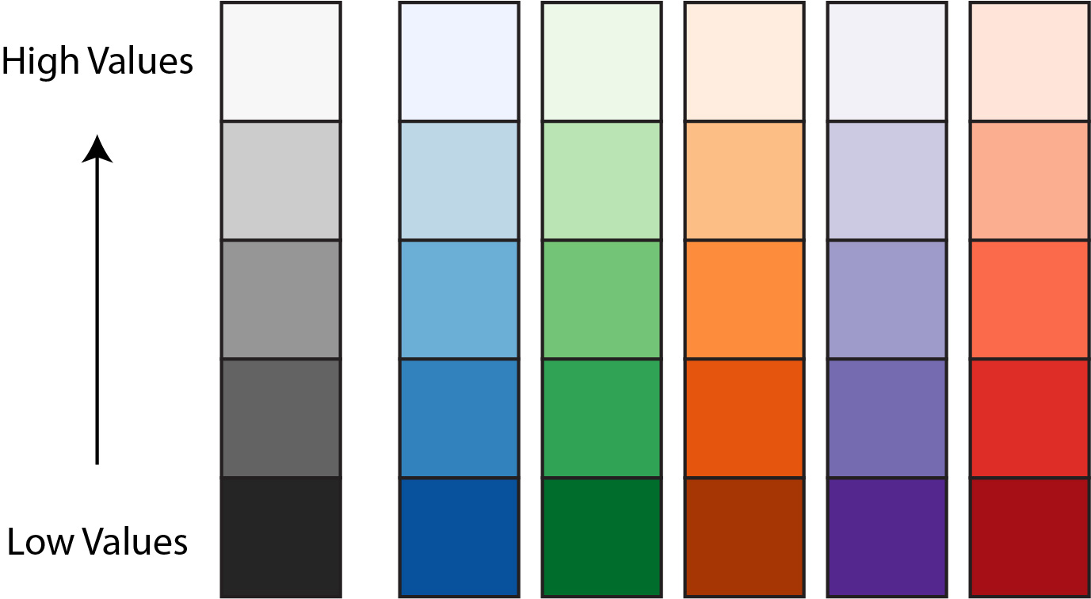
Color sequences designed for quantitative variables on maps. Image adapted from colorbrewer2.org.
Anthamatten
Chapter 07

Slide 14
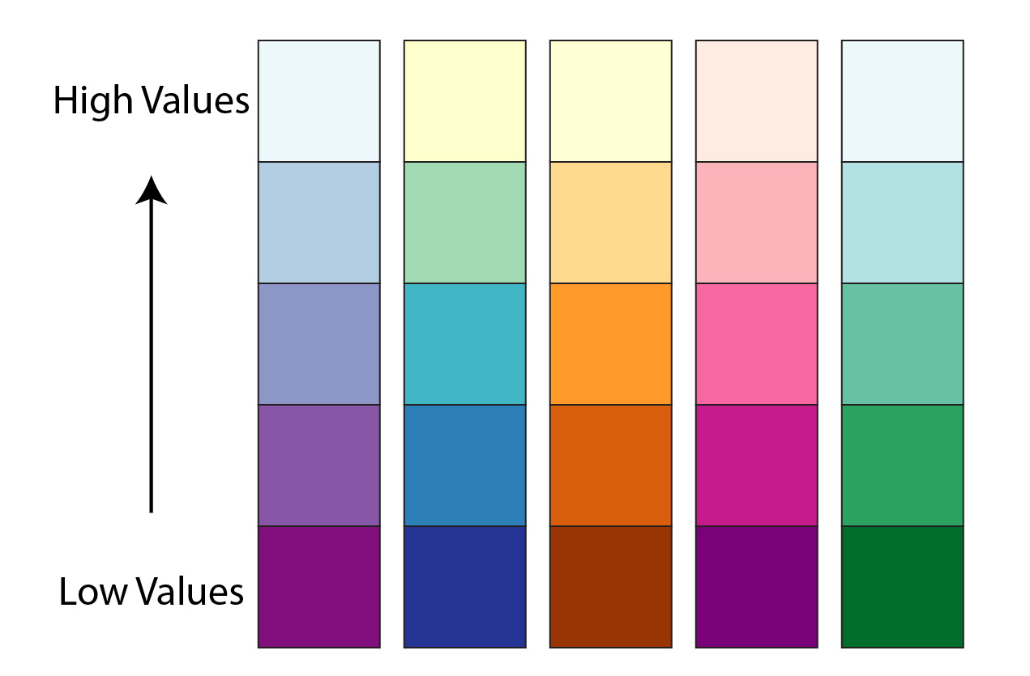
Examples of multi-hue color schemes.
Image adapted from colorbrewer2.org.
Anthamatten
Chapter 07

Slide 15
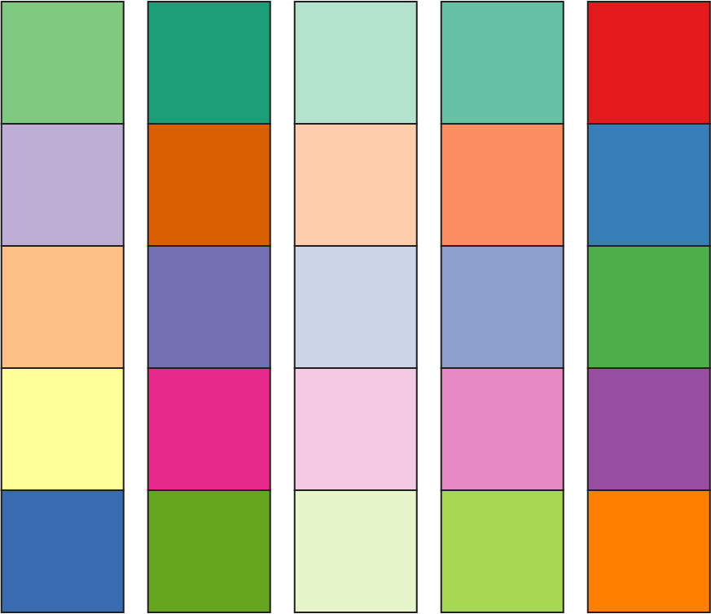
Color schemes suggested by colorbrewer2.org for qualitative maps.
Anthamatten
Chapter 07

Slide 16
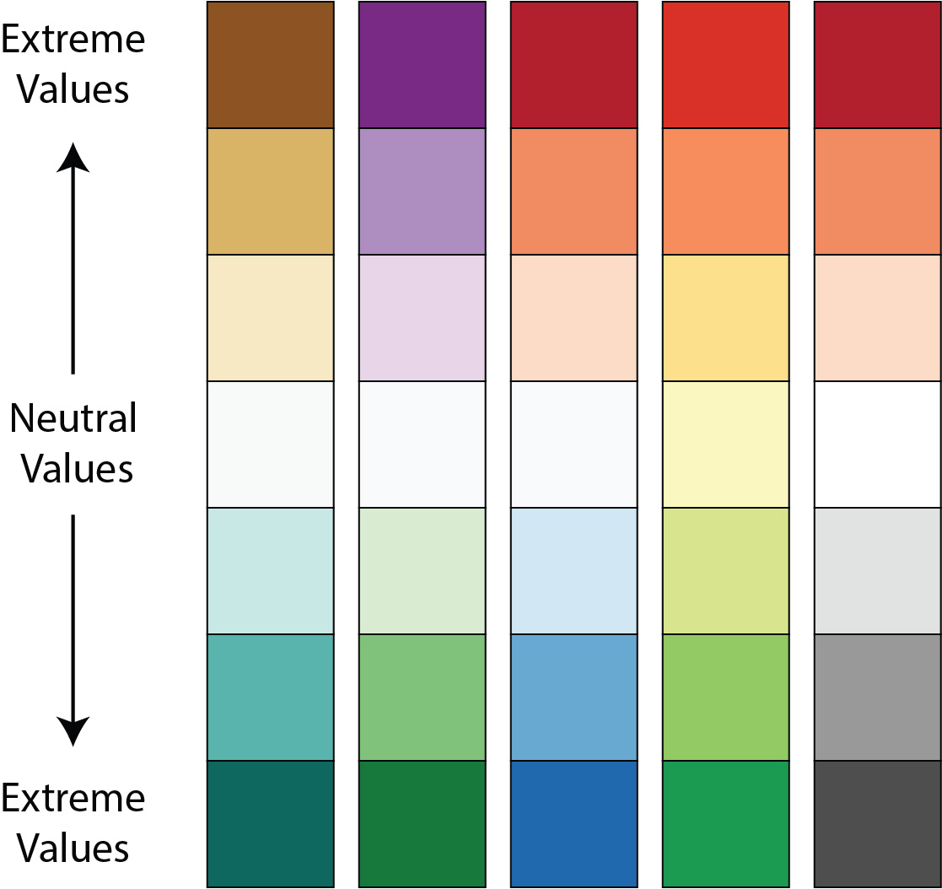
Diverging color schemes for quantitative data. Image adapted from colorbrewer2.org.
Anthamatten
Chapter 07

Slide 17
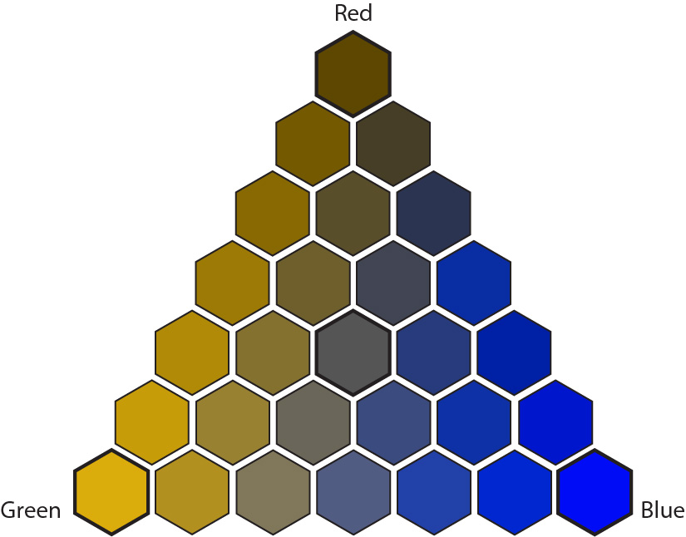
An RGB color grid after it has been transformed (via hclwizard.org) to mimic how it appears to someone with deuteranopia, the most prevalent form of color blindness.
Anthamatten
Chapter 07

Slide 18
How to Make Maps: Chapter 07
“Color in Cartography”
World Map by Michael Tompsett
source: www.michael-tompsett.pixels.com

