Slide 1
How to Make Maps: Chapter 06
“Text and Typography”
World Map by Michael Tompsett
source: www.michael-tompsett.pixels.com

Slide 2
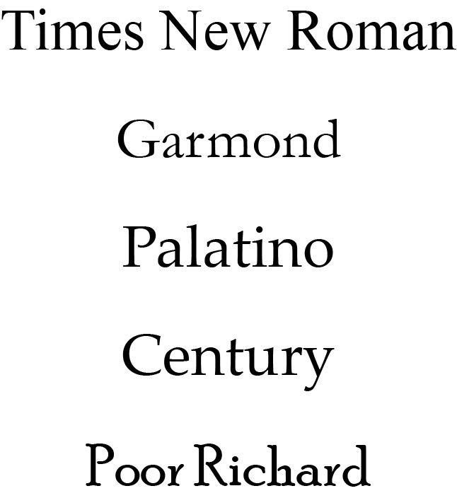
Examples of serif fonts.
Anthamatten
Chapter 06

Slide 3
A demonstration of anti-aliasing and halo effect.
Anthamatten
Chapter 06

Slide 4
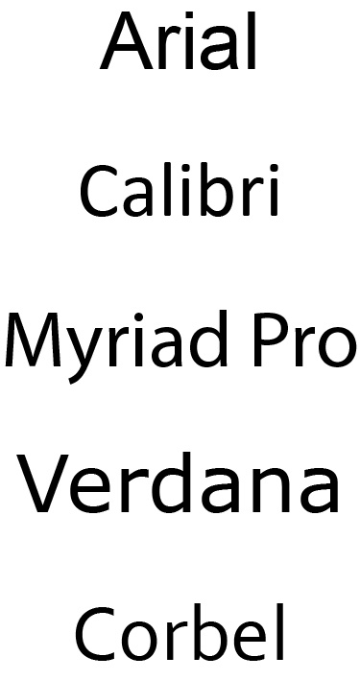
Examples of sans-serif fonts.
Anthamatten
Chapter 06

Slide 5
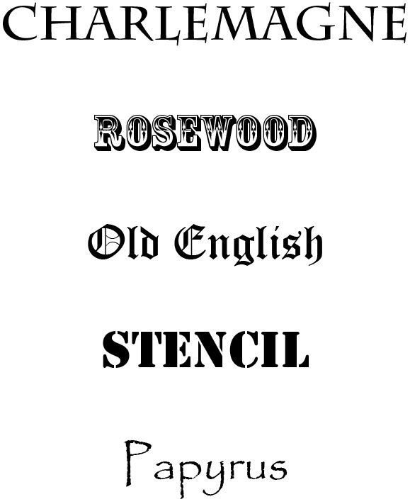
Examples of decorative fonts.
Anthamatten
Chapter 06

Slide 6
Examples of script fonts.
Anthamatten
Chapter 06

Slide 7
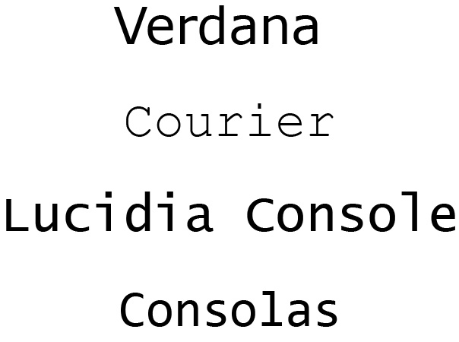
Examples of monospaced fonts.
Anthamatten
Chapter 06

Slide 8
Examples of different type styles using common serif and sans serif fonts.
Anthamatten
Chapter 06

Slide 9
An illustration of kearning.
Anthamatten
Chapter 06

Slide 10
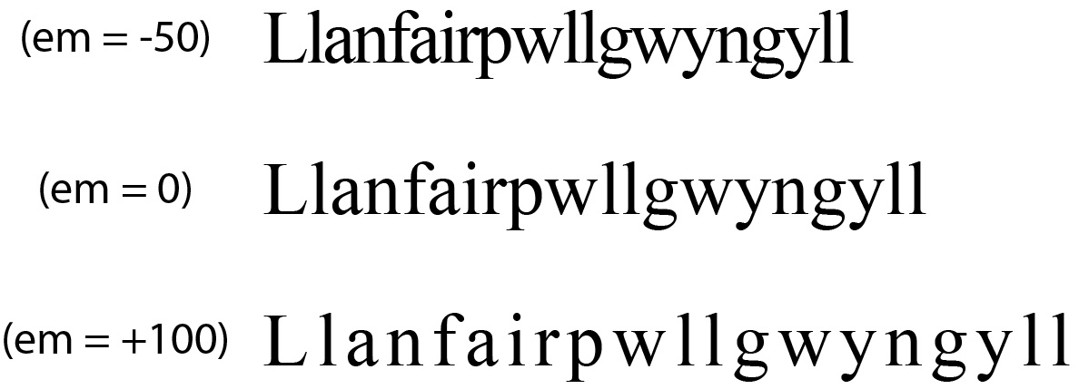
Examples of tracking, with indicated em values.
Anthamatten
Chapter 06

Slide 11
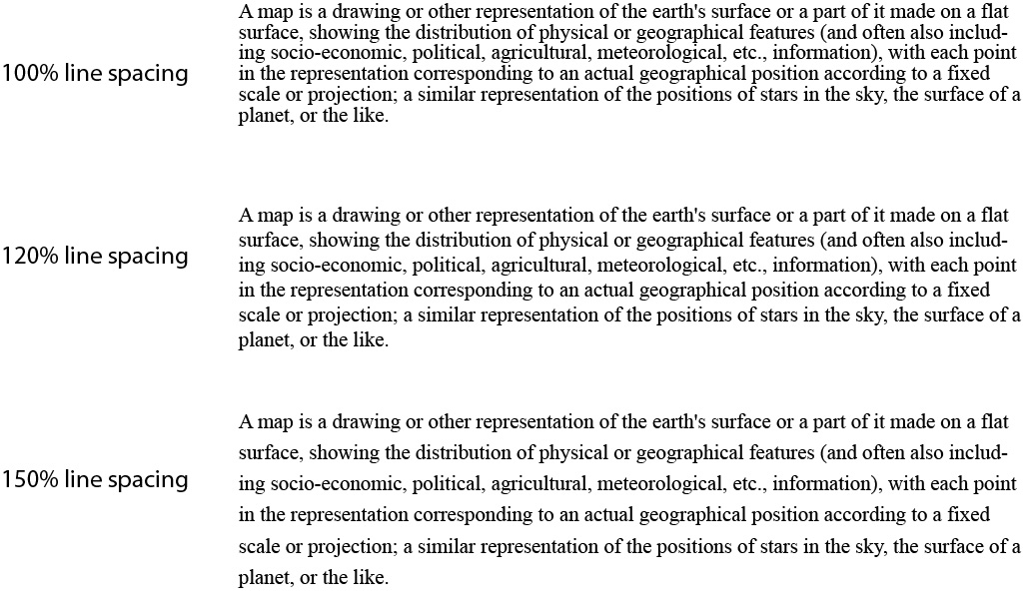
Examples of different line spacings of the Oxford English definition of a map.
Anthamatten
Chapter 06

Slide 12
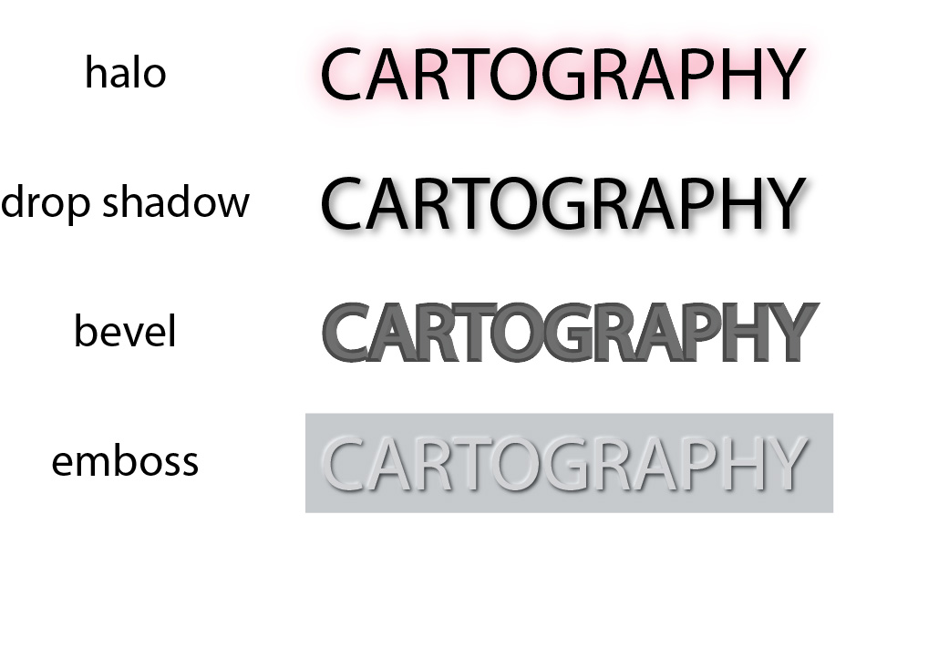
Examples of special effects on text.
Anthamatten
Chapter 06

Slide 13
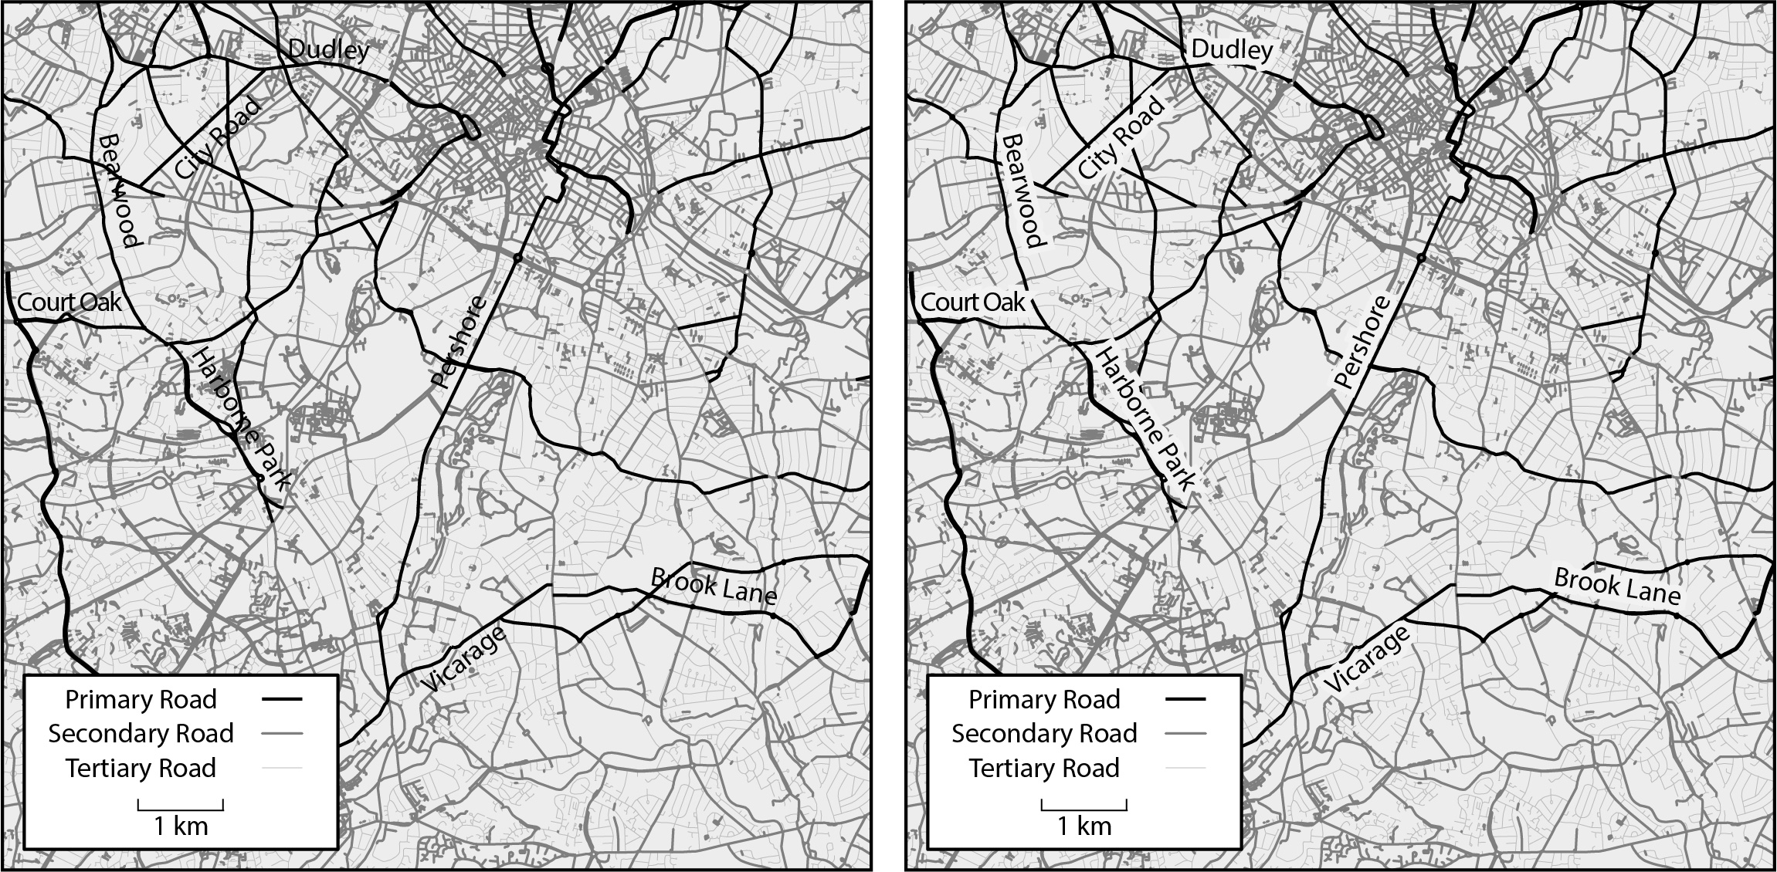
Examples of masking for labels in a map of roads in Birmingham, UK.
The map on the left does not employ masking; the map on the right does.
Anthamatten
Chapter 06

Slide 14
Placement of labels for point symbols.
Anthamatten
Chapter 06

Slide 15
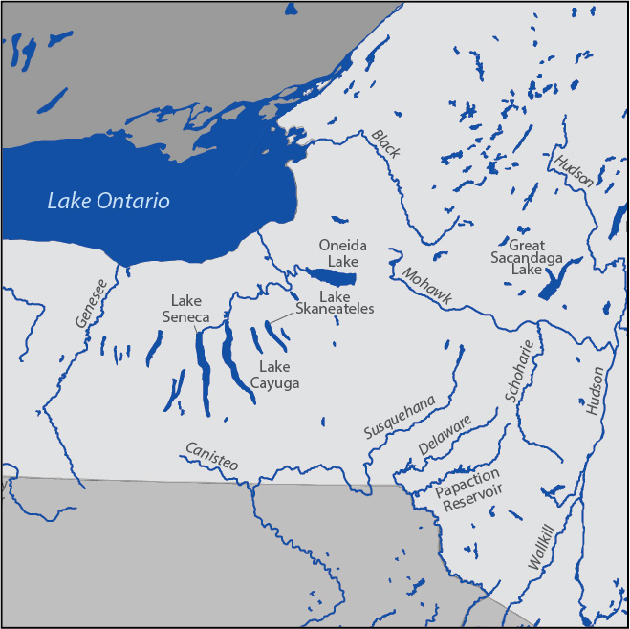
An excerpt of a basic map of lakes and rivers in upstate New York state, USA, to demonstrate
label placement.
Anthamatten
Chapter 06

Slide 16
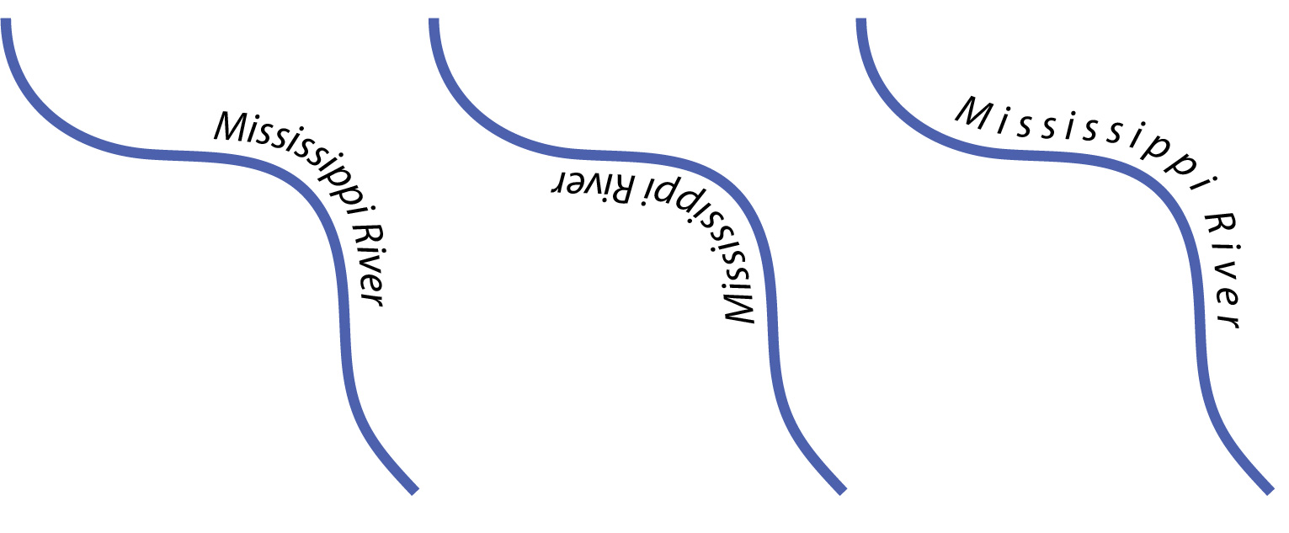
An example of splined text applied to mapping labels.
Anthamatten
Chapter 06

Slide 17
How to Make Maps: Chapter 06
“Text and Typography”
World Map by Michael Tompsett
source: www.michael-tompsett.pixels.com

