Slide 1
How to Make Maps: Chapter 05
“Coordinate Systems and Projections”
World Map by Michael Tompsett
source: www.michael-tompsett.pixels.com

Slide 2
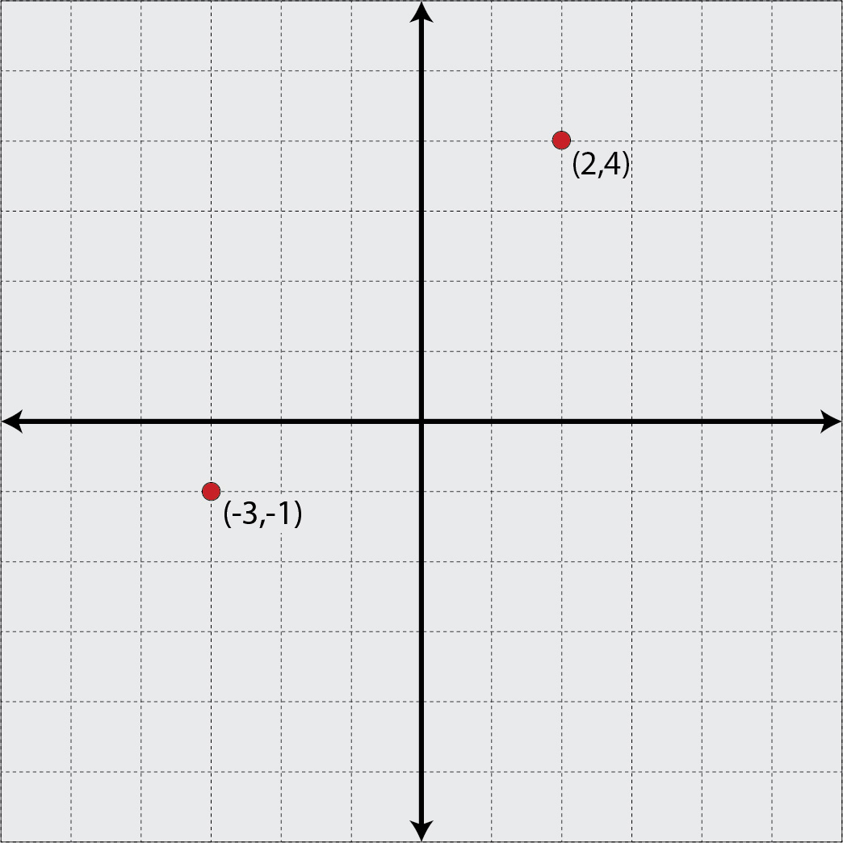
An example of a Cartesian coordinate grid system.
Anthamatten
Chapter 05

Slide 3
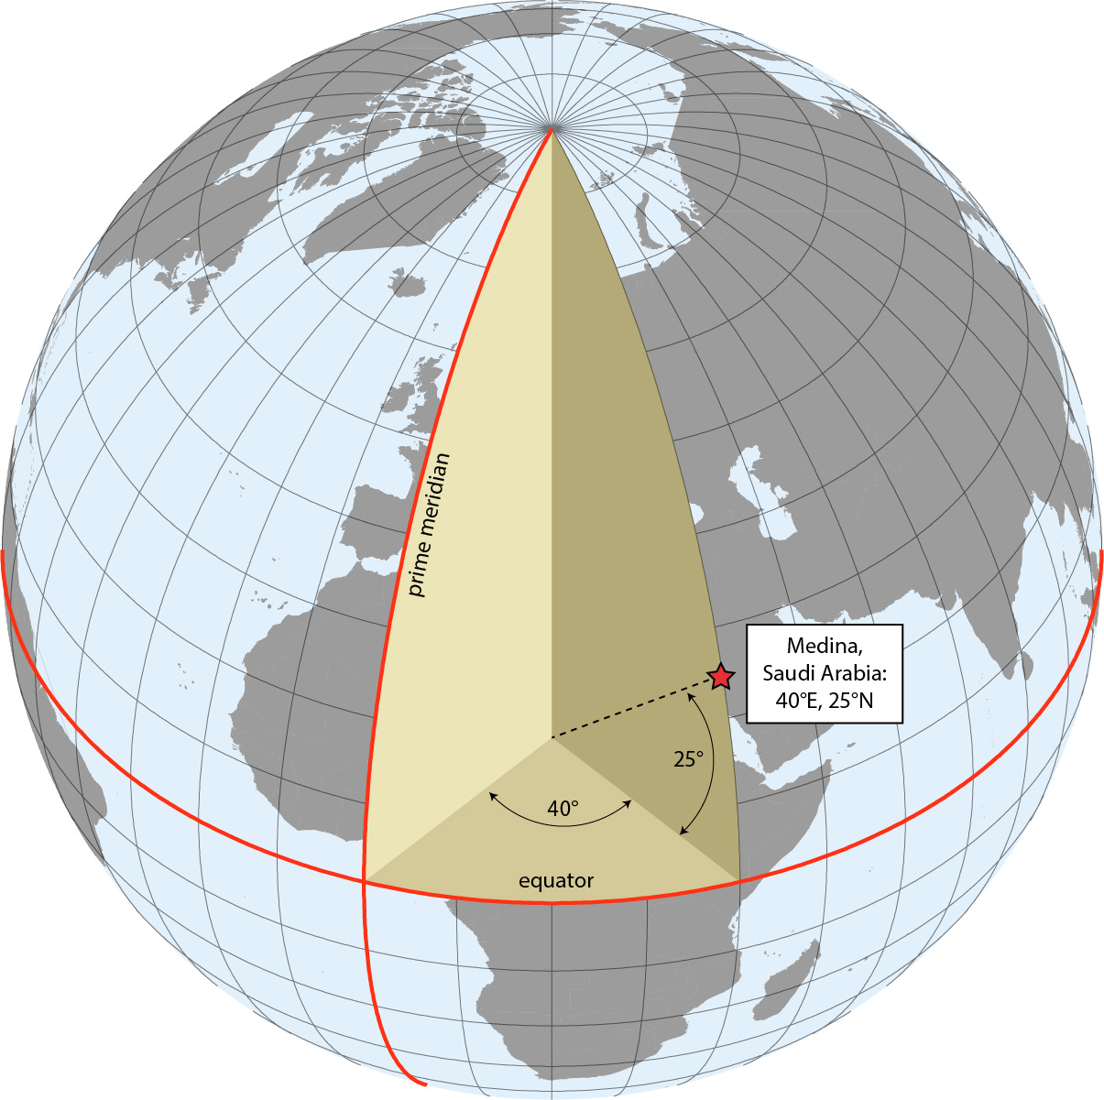
An illustration of the earth’s geographic coordinate system, using Medina, Saudi Arabia as an example.
Anthamatten
Chapter 05

Slide 4
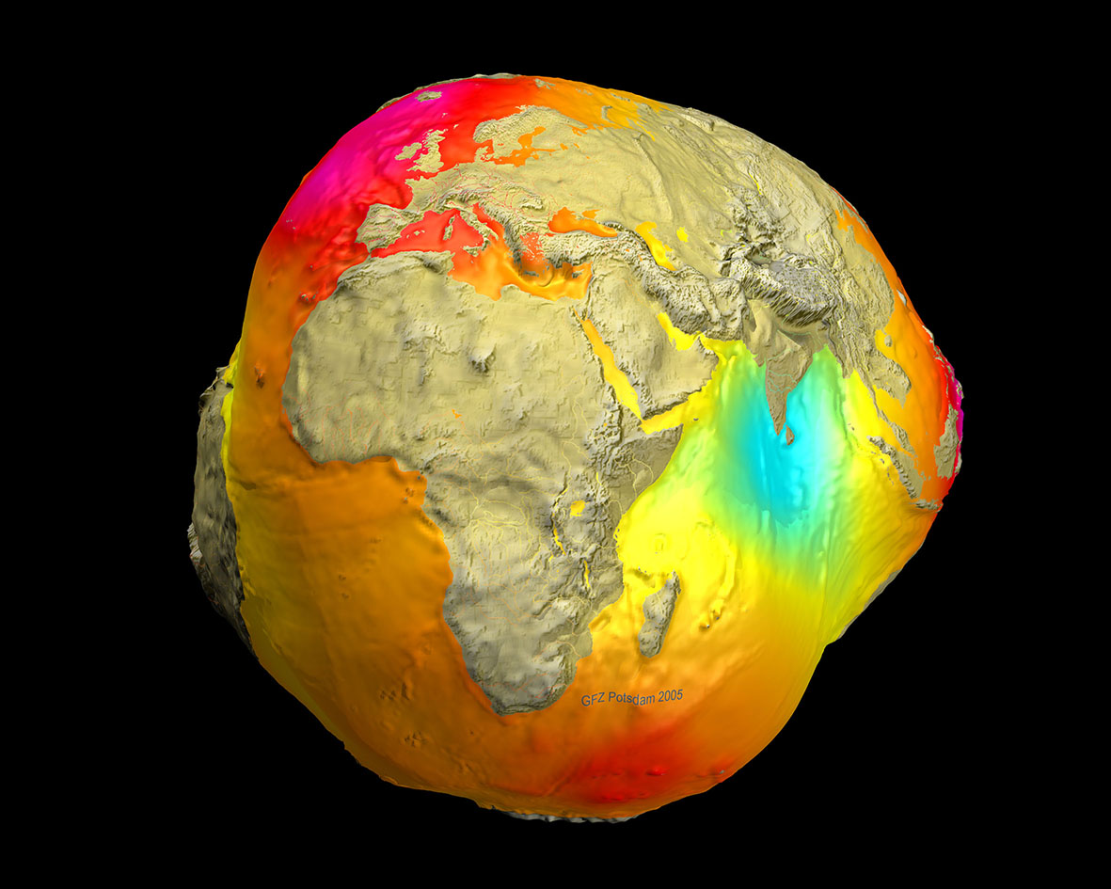
A highly exaggerated representation of the earth’s geoidal surface (NASA).
Anthamatten
Chapter 05

Slide 5
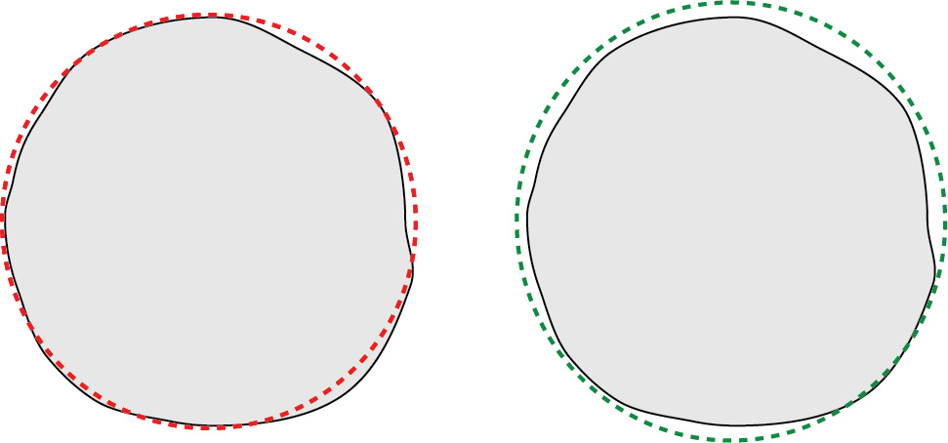
An illustration of different reference ellipsoids.
Anthamatten
Chapter 05

Slide 6
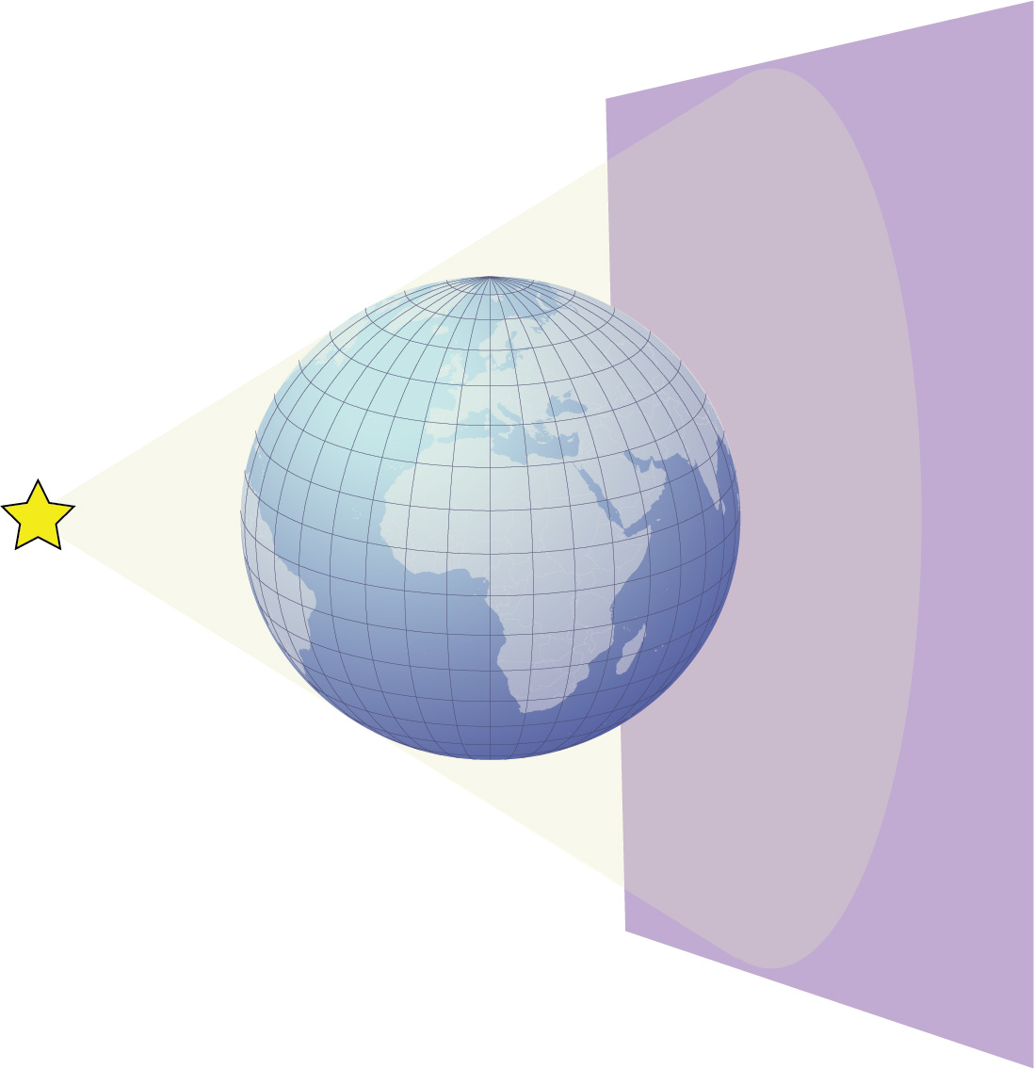
A simple illustration of the concept of projection.
Anthamatten
Chapter 05

Slide 7
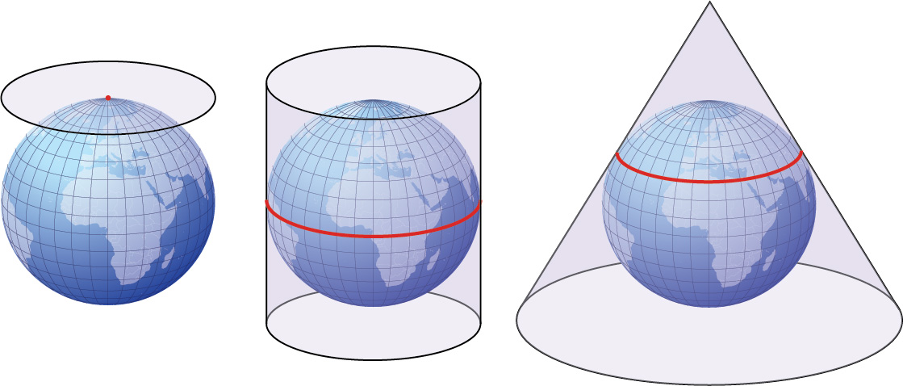
The developable surfaces (families) of projections: planar, cylindrical, and conic. These are shown in their normal aspects.
Anthamatten
Chapter 05

Slide 8
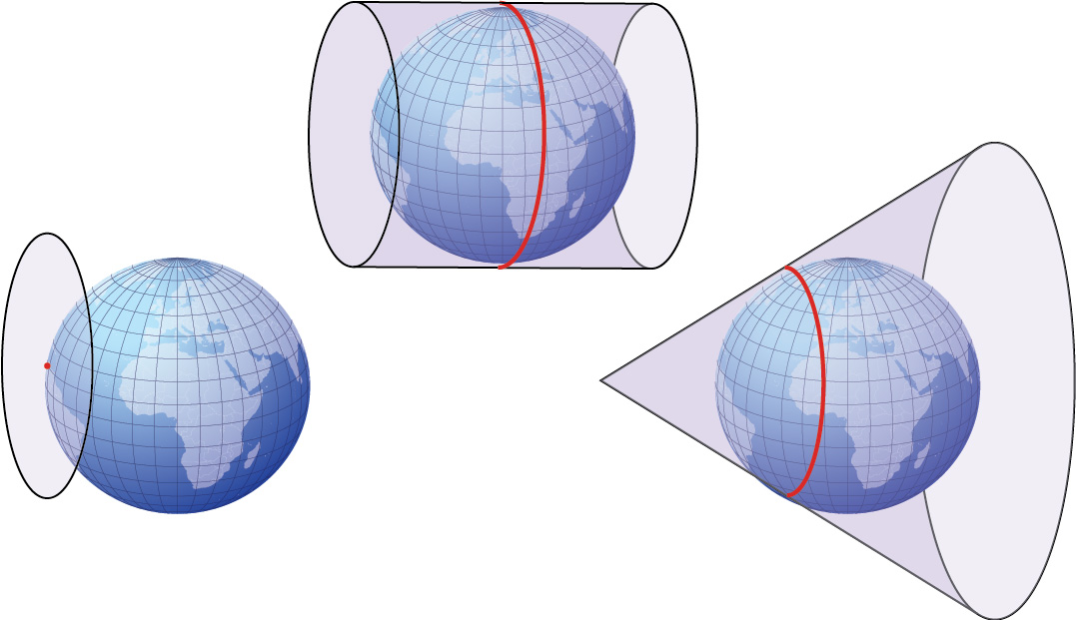
Transverse aspects of the three projection families.
Anthamatten
Chapter 05

Slide 9
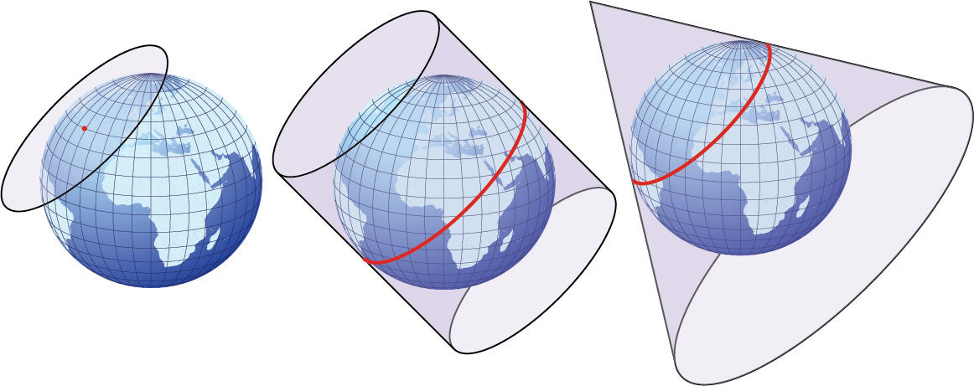
Oblique aspects of the three projection families.
Anthamatten
Chapter 05

Slide 10
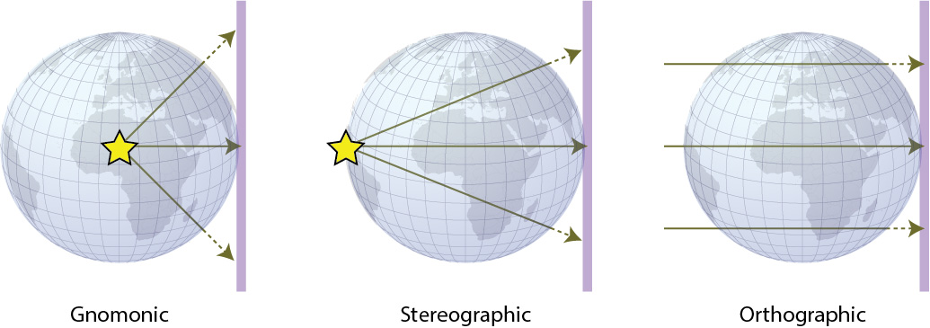
Projection light sources
Anthamatten
Chapter 05

Slide 11
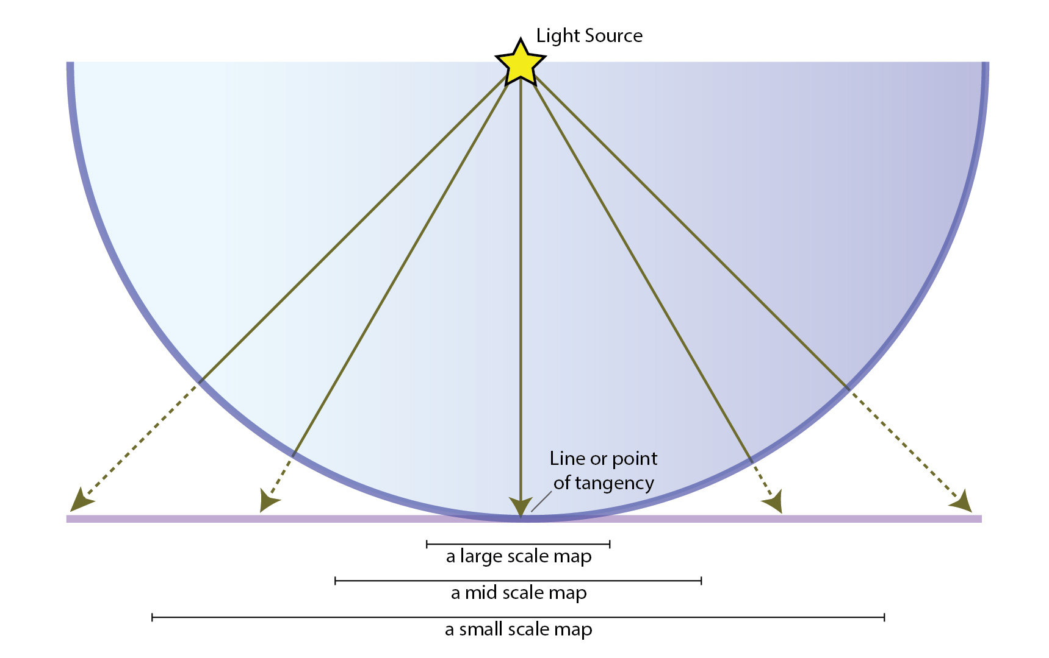
An illustration of the effect of the standard line and distortion on a projected surface.
Anthamatten
Chapter 05

Slide 12
An illustration of a standard line in a cylindrical map projection.
Anthamatten
Chapter 05

Slide 13
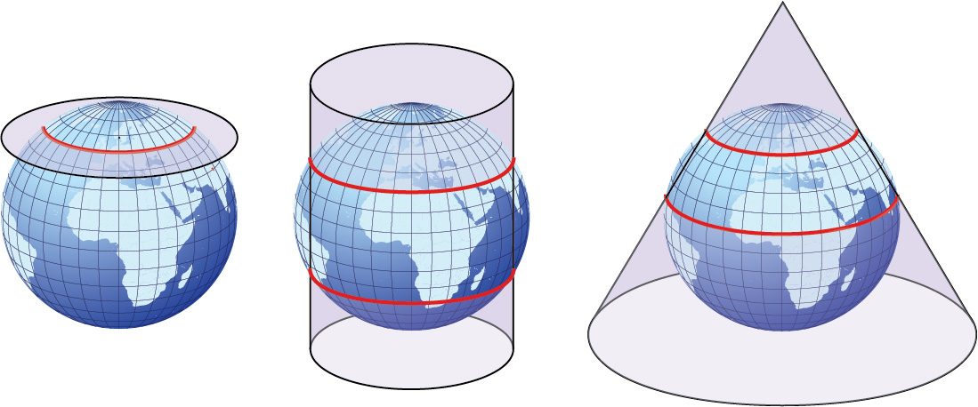
Examples of secant cases of the projection families. Standard lines are shown in red.
Anthamatten
Chapter 05

Slide 14
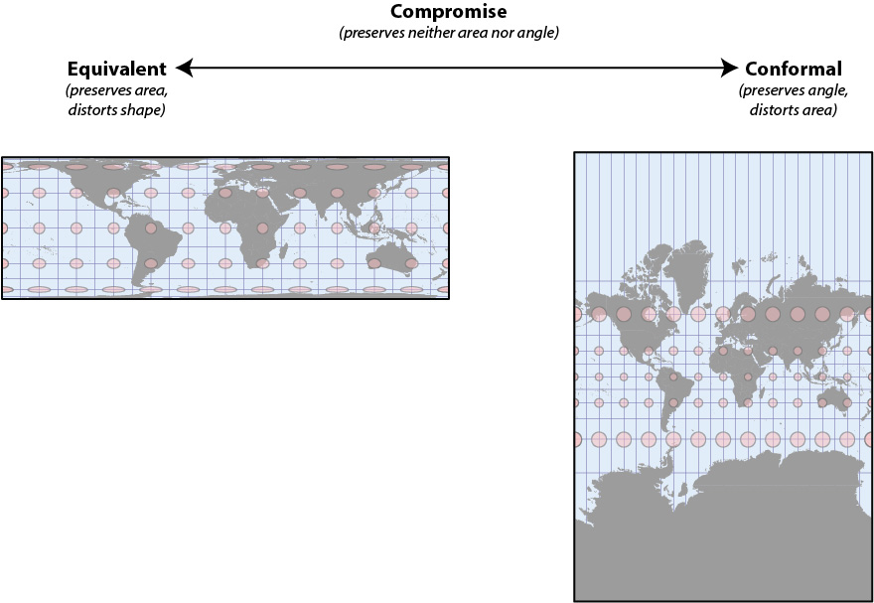
An example of an equivalent (Cylindrical Equal Area), and a conformal (Mercator) projection.
Anthamatten
Chapter 05

Slide 15
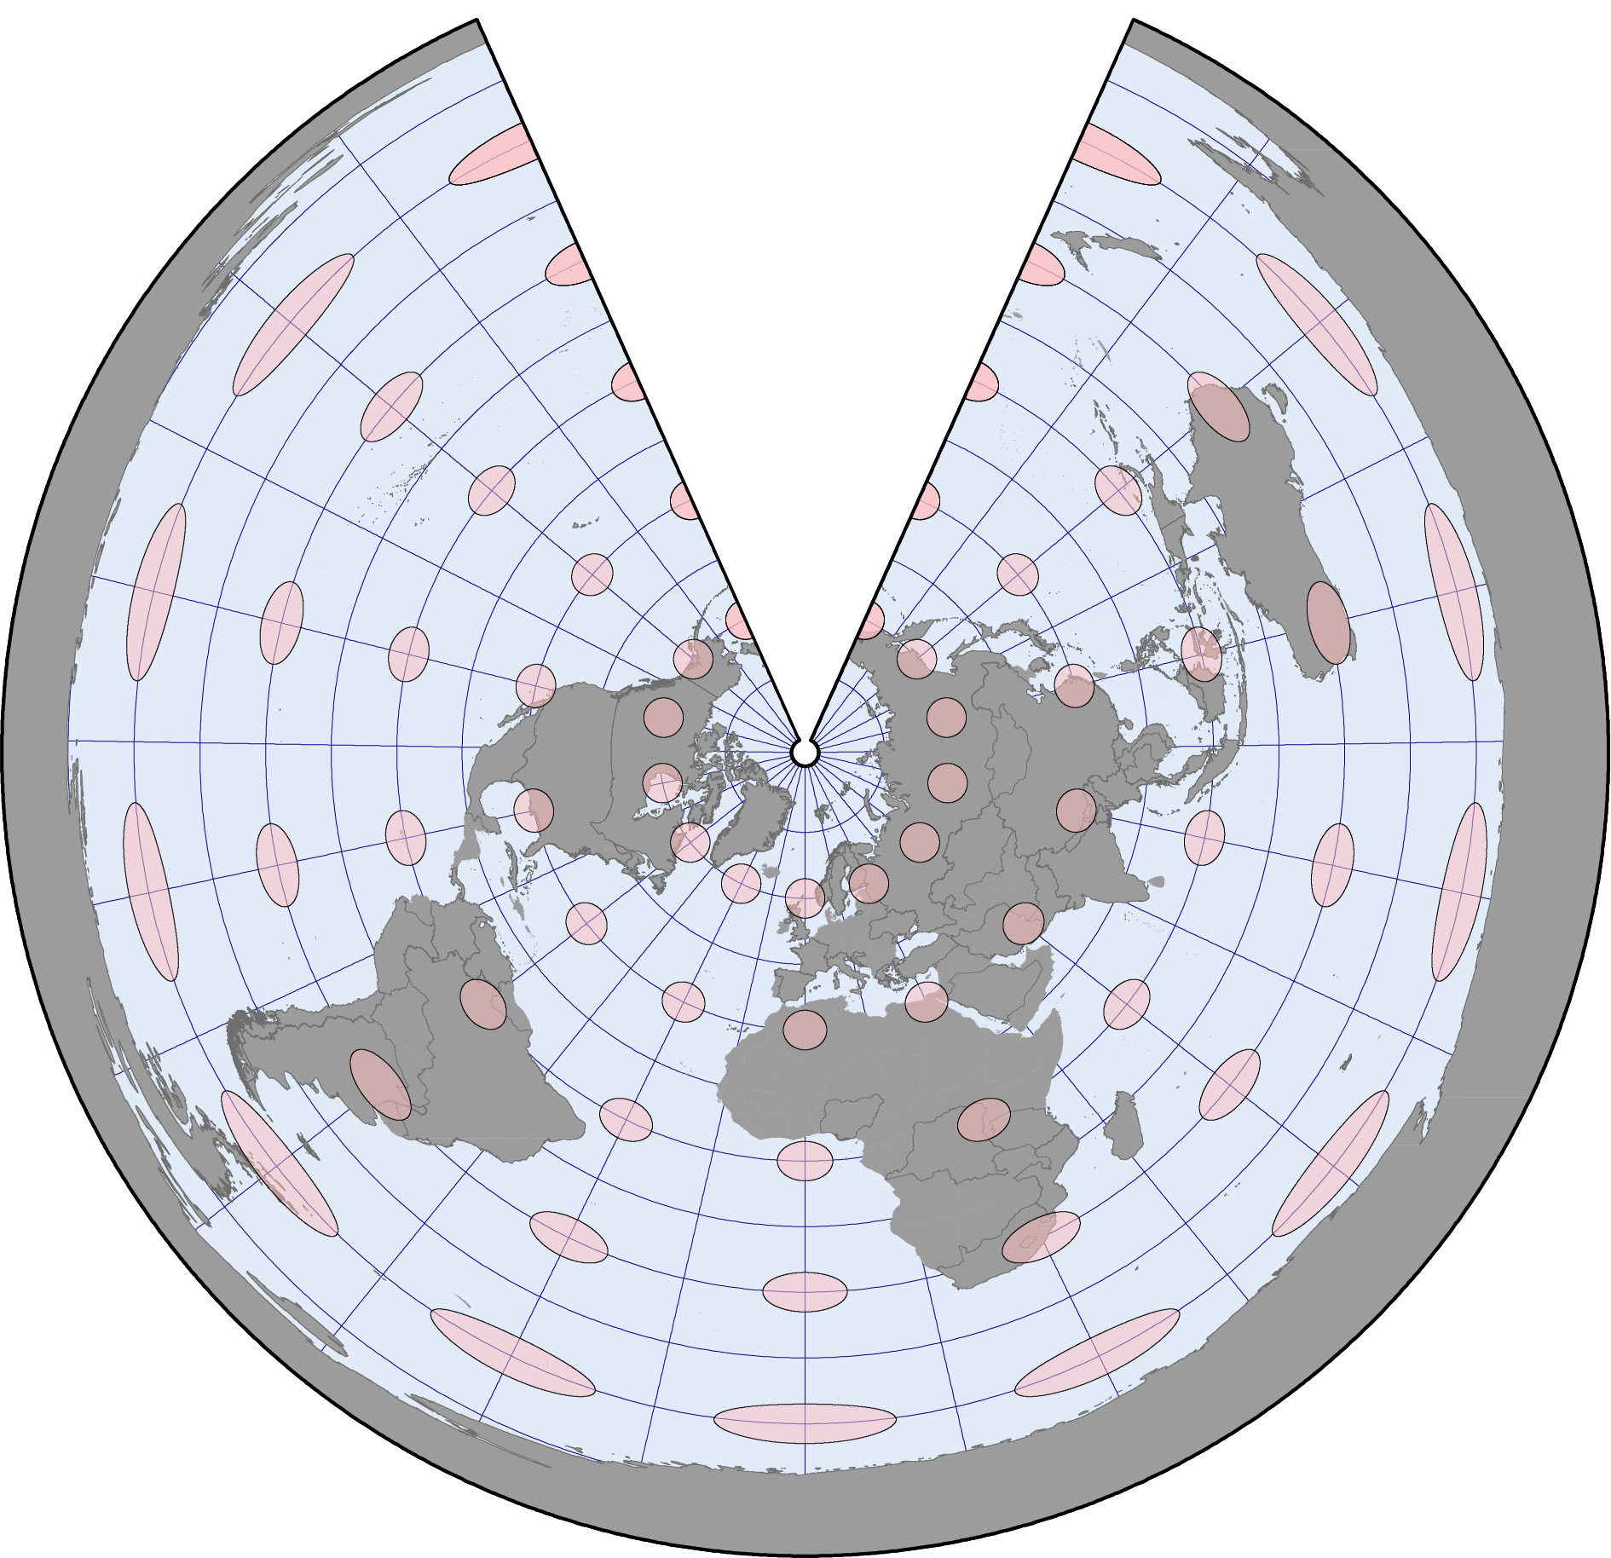
An example of an equidistant conic projection.
Anthamatten
Chapter 05

Slide 16
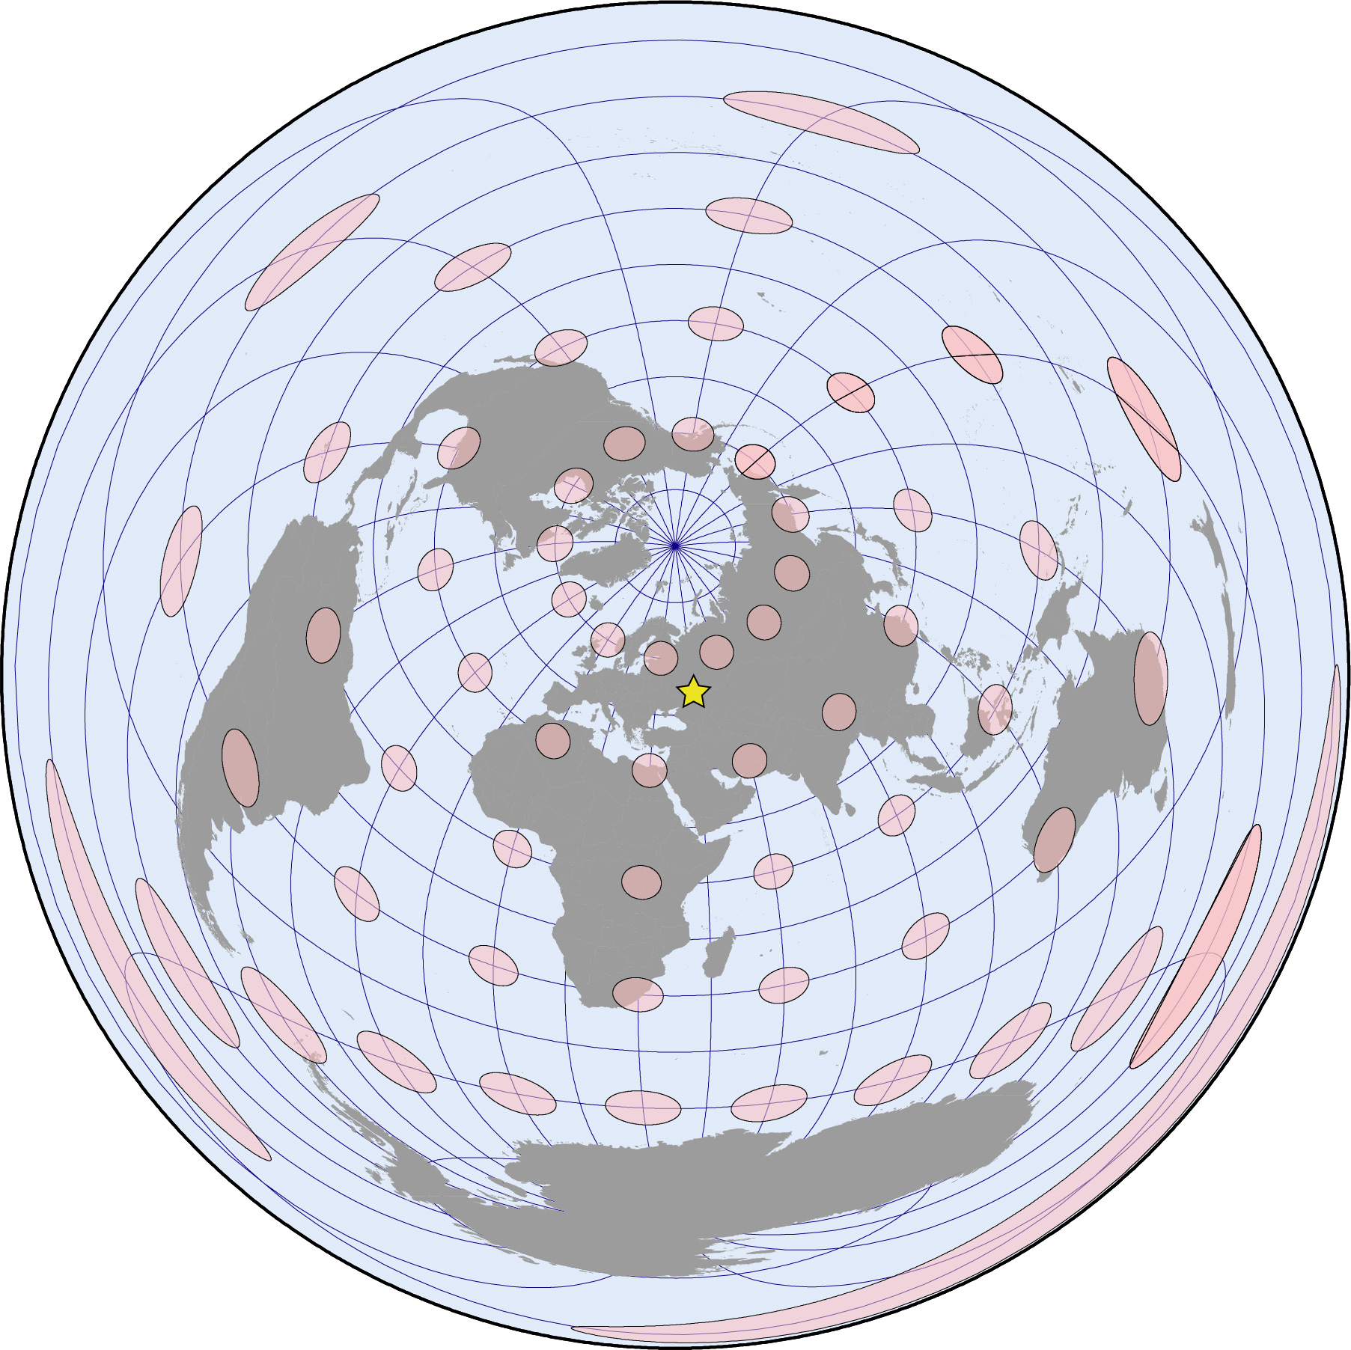
An example of an azimuthal equidistant projection based on the city of Moscow, represented on the map as a yellow star.
Anthamatten
Chapter 05

Slide 17
A transverse Mercator projection of the country of Chile.
Anthamatten
Chapter 05

Slide 18
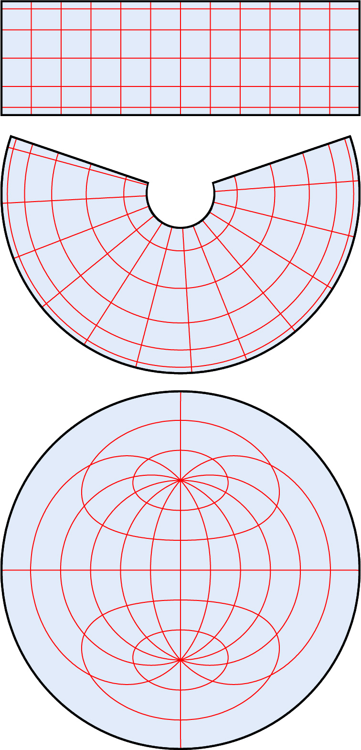
Examples (from top to bottom) of the graticule in a cylindrical, conic, and a planar projection.
Anthamatten
Chapter 05

Slide 19
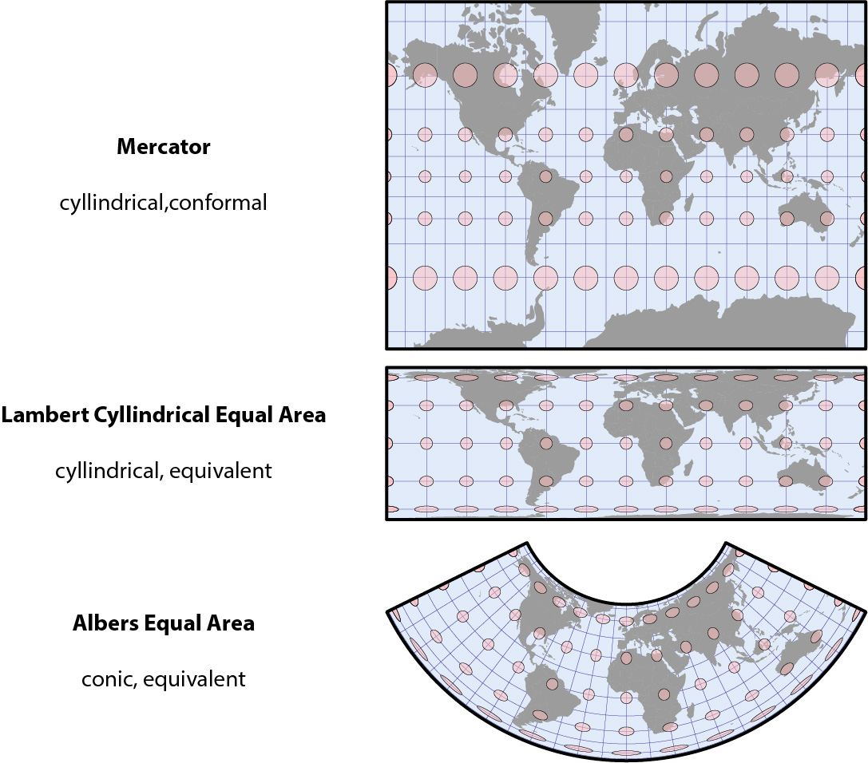
Anthamatten
Chapter 05

Slide 20
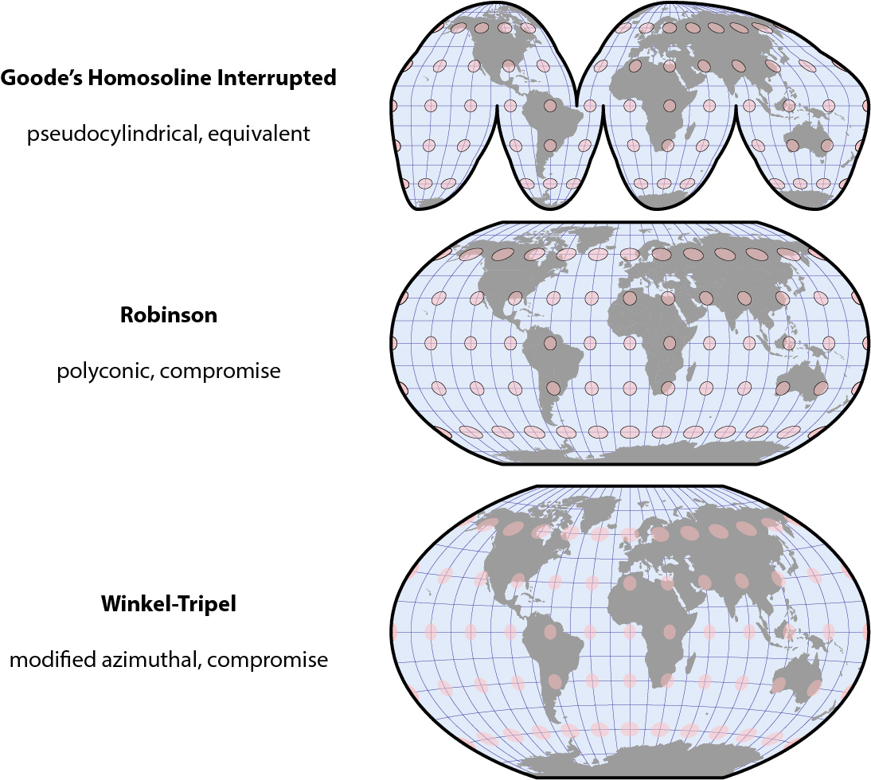
Anthamatten
Chapter 05

Slide 21
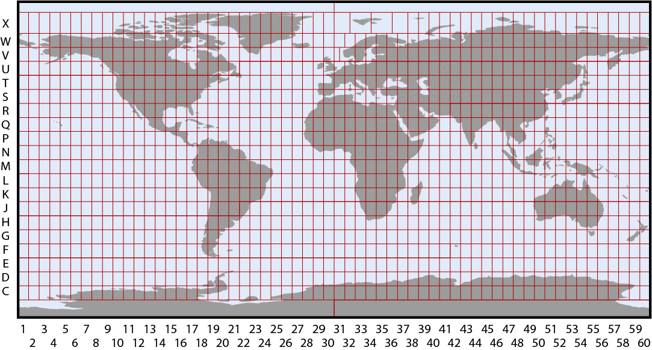
A map that shows the UTM coordinate system zones.
Anthamatten
Chapter 05

Slide 22
How to Make Maps: Chapter 05
“Coordinate Systems and Projections”
World Map by Michael Tompsett
source: www.michael-tompsett.pixels.com

