Slide 1
How to Make Maps: Chapter 04
“Cartographic Design”
World Map by Michael Tompsett
source: www.michael-tompsett.pixels.com

Slide 2
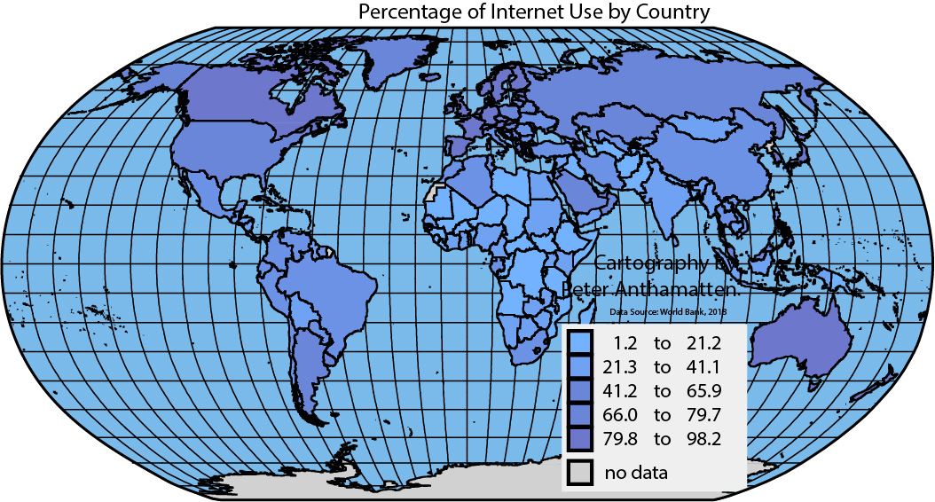
A map of Internet users per capita that lacks legibility, good visual contrast, figure-ground, a clear visual hierarchy, and balance.
Anthamatten
Chapter 04

Slide 3
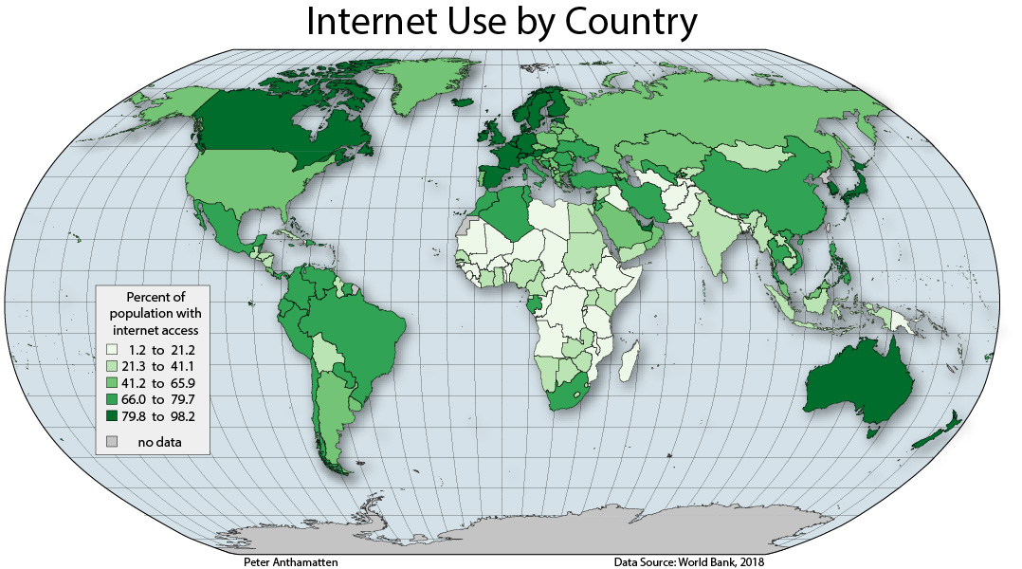
A map of Internet users per capita with improved legibility, good visual contrast, figure-ground, a clear visual hierarchy, and balance.
Anthamatten
Chapter 04

Slide 4
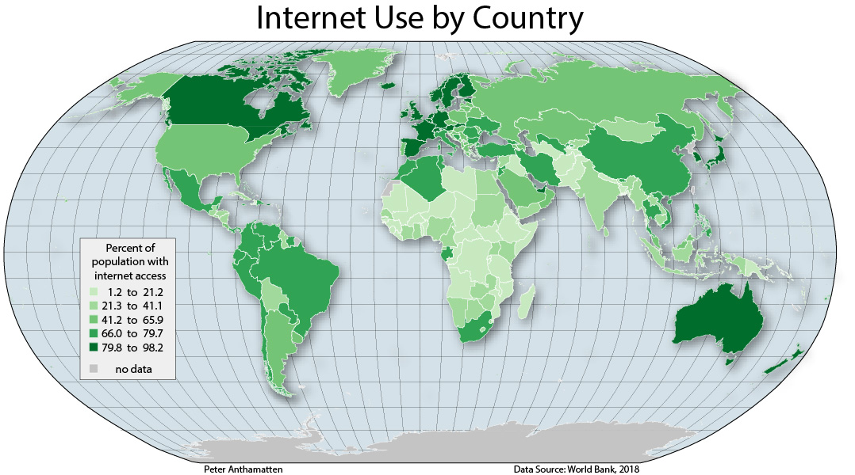
An alternative version of the improved choropleth map of Internet use that reduces non-data ink.
Anthamatten
Chapter 04

Slide 5
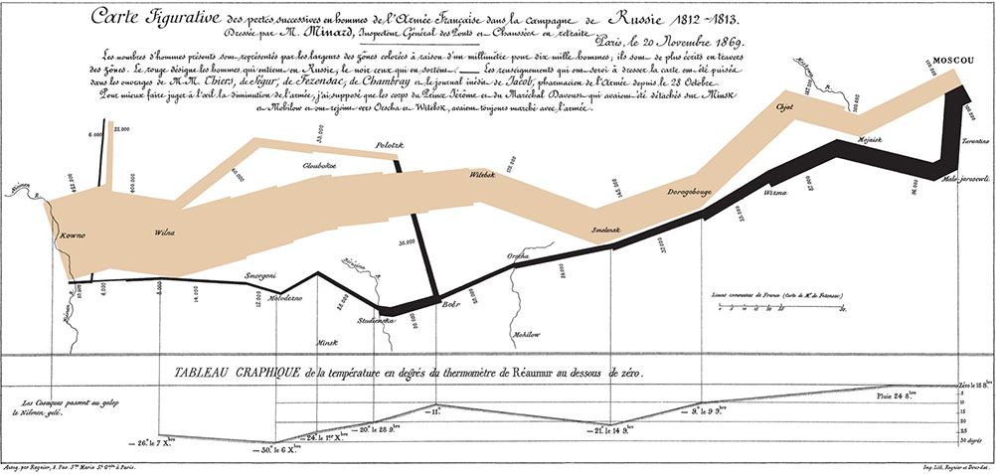
Charles Minard’s map of the advance and retreat of Napoleon’s army in 1812–1813.
Anthamatten
Chapter 04

Slide 6
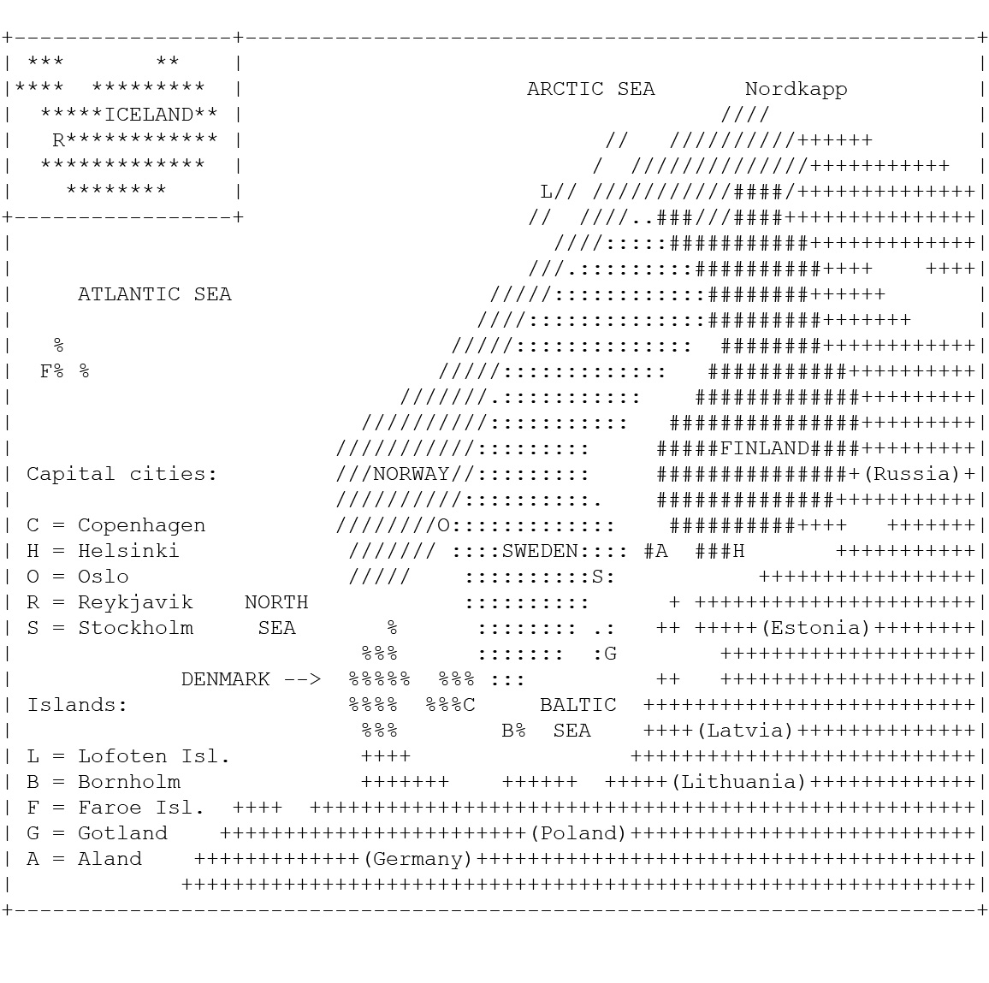
An example of an ACSII map of Scandinavia.
Lehelma, A., and J. Olson. 1994. “The Nordic FAQ.” Accessed July 8, 2020. http://www.lysator.
liu.se/nordic/index.html
Anthamatten
Chapter 04

Slide 7
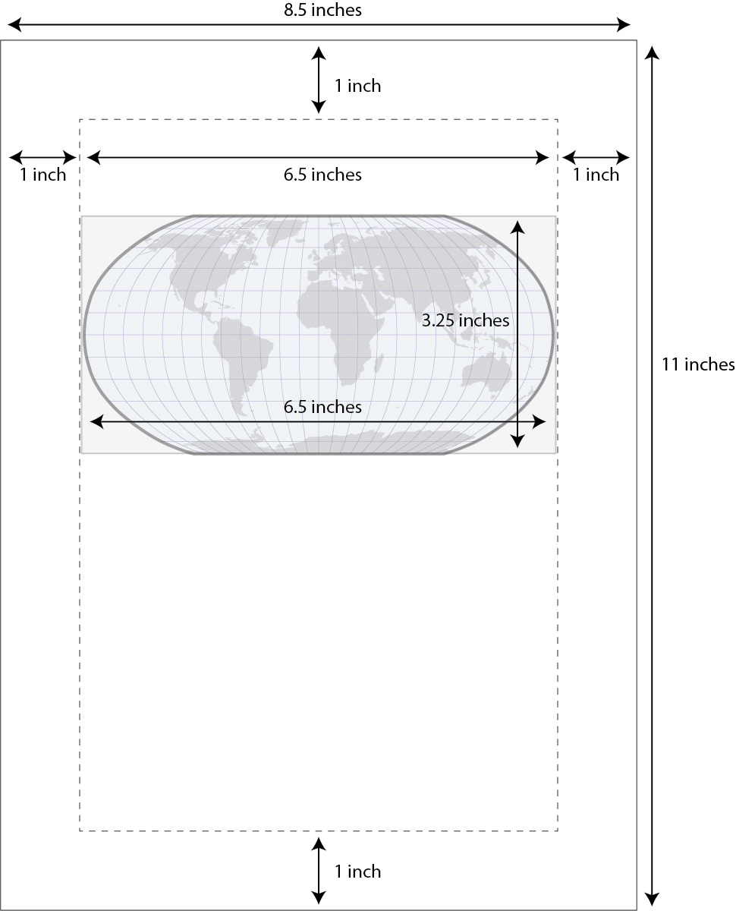
An example of a layout on a standard sheet of paper using a world map in a Robinson
projection.
Anthamatten
Chapter 04

Slide 8
How to Make Maps: Chapter 04
“Cartographic Design”
World Map by Michael Tompsett
source: www.michael-tompsett.pixels.com

