Slide 1
How to Make Maps: Chapter 03
“The Language of Maps”
World Map by Michael Tompsett
source: www.michael-tompsett.pixels.com

Slide 2
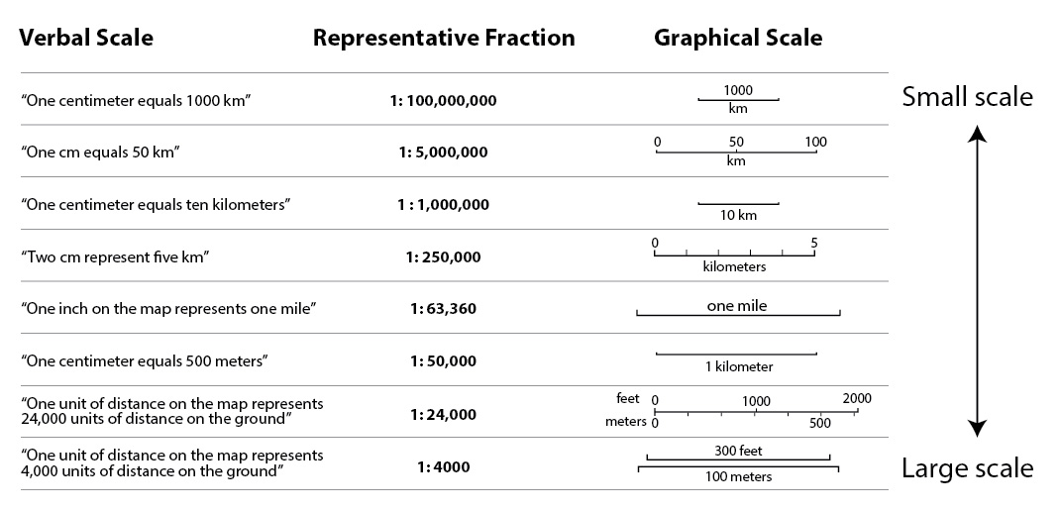
Map scales can assume different forms. The most common form, and perhaps the most intuitive to read, is a graphical scale bar, which shows units of distance on the map in terms of the real-world distance.
Anthamatten
Chapter 03

Slide 3
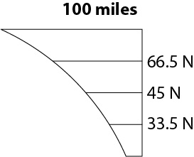
An example of a variable map scale.
Anthamatten
Chapter 03

Slide 4
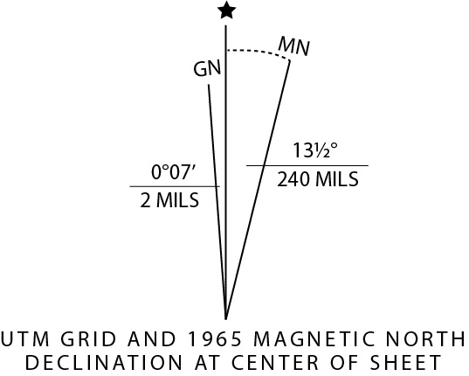
An example of a north arrow, as it appears on USGS Topographic Quadrangle Maps.
Anthamatten
Chapter 03

Slide 5
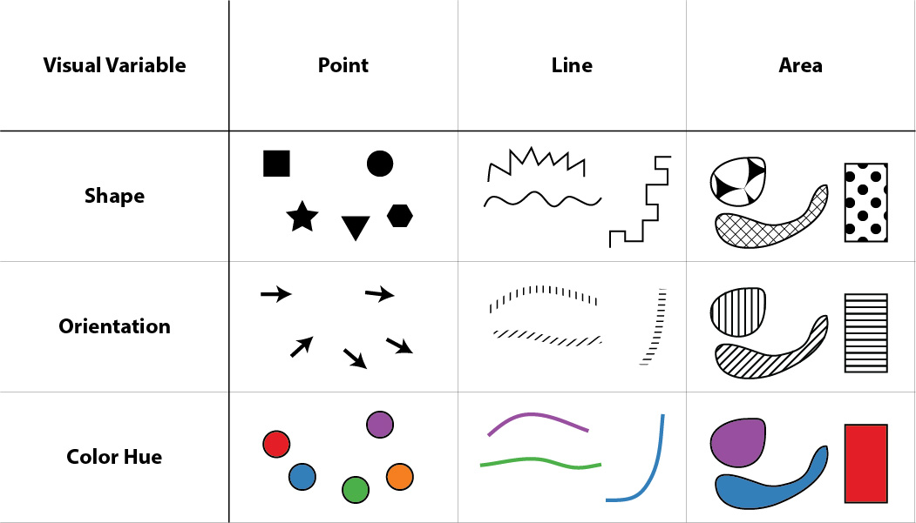
Bertin’s qualitative visual variables: shape, orientation, and color hue.
Anthamatten
Chapter 03

Slide 6
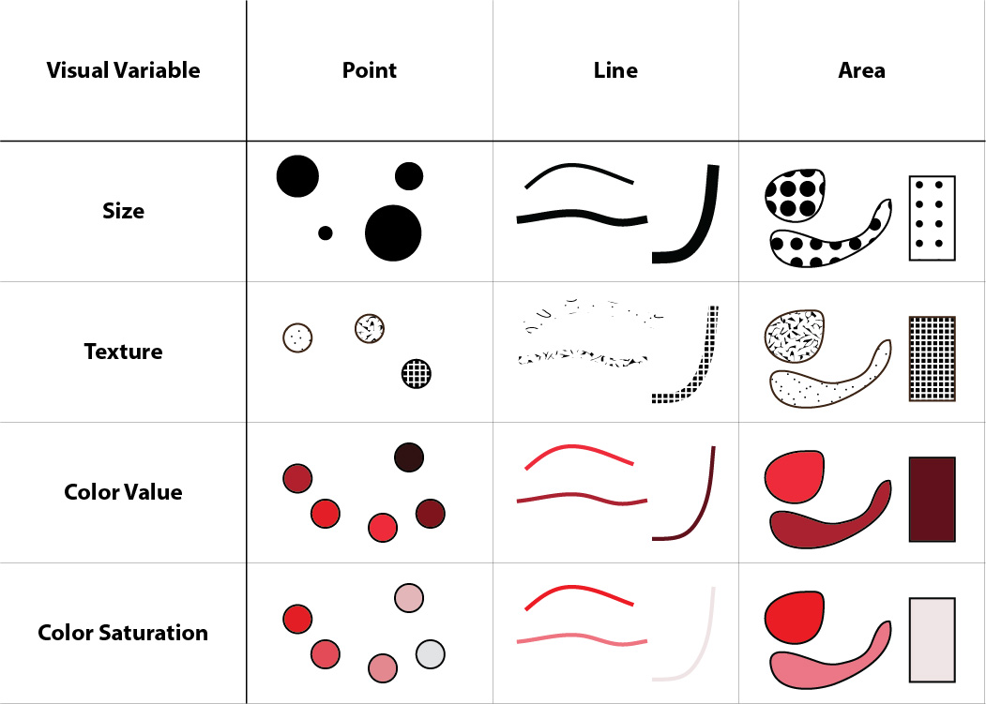
Bertin’s quantitative visual variables: size, texture, color value, and color saturation.
Anthamatten
Chapter 03

Slide 7
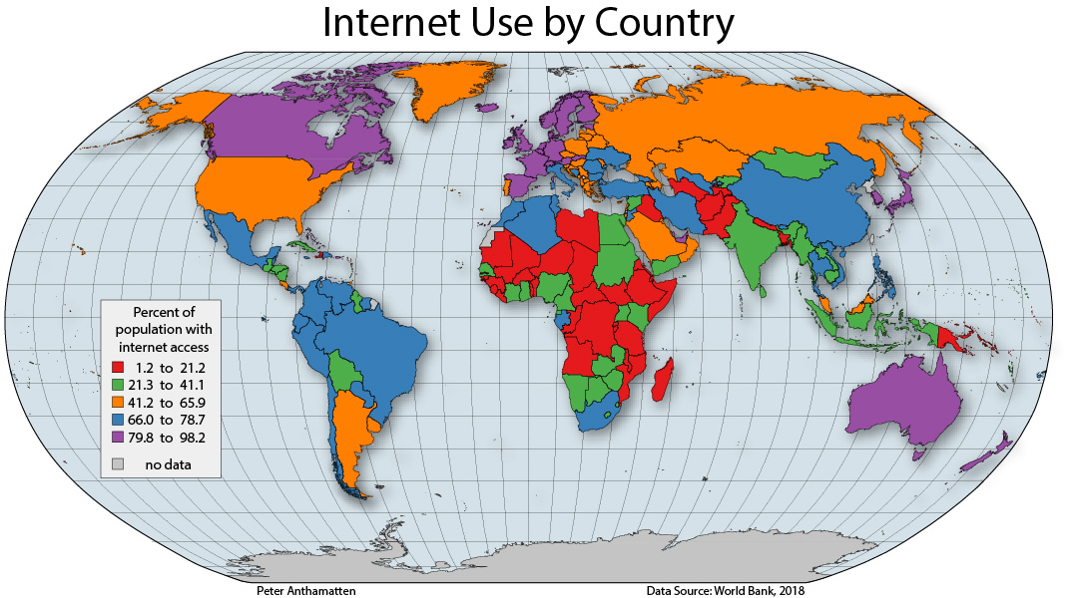
An example of a choropleth map with a poor selection of visual variables (color hue to represent quantitative data).
Anthamatten
Chapter 03

Slide 8
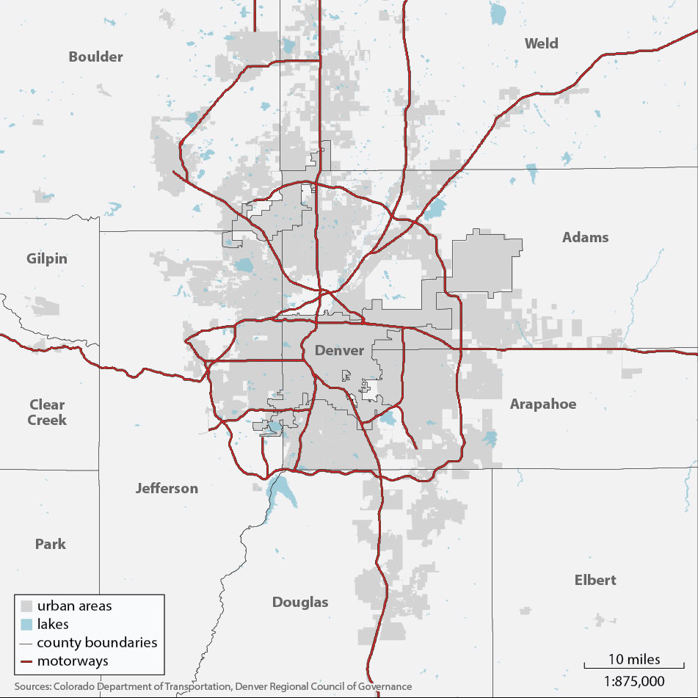
The roads on this map appear to be 1450 feet wide, an example of a form of generalization to make the roads legible.
Anthamatten
Chapter 03

Slide 9
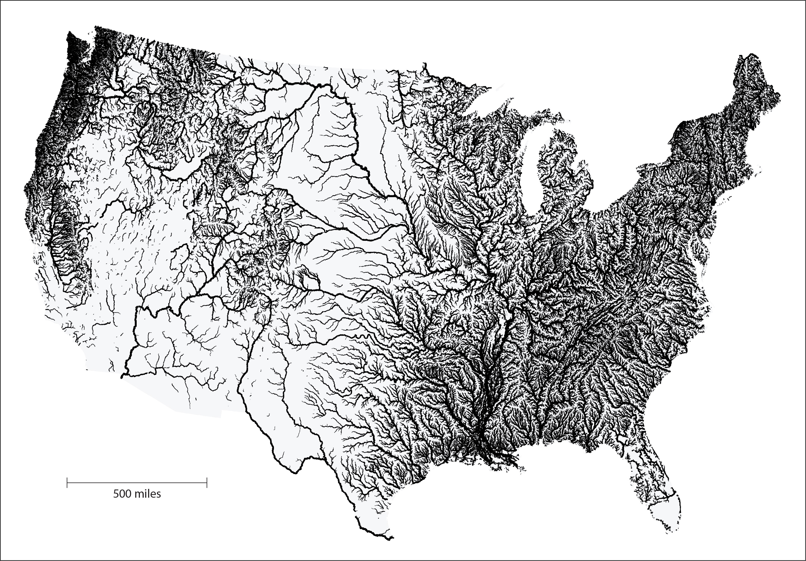
A map from the US National Hydrography data set that does not include any selection.
Tinker, M., P. Anthamatten, J. Simley, and M.P. Finn. 2013. “A Method to Generalize Stream Flowlines in Small-Scale Maps by a Variable Flow-based Pruning Threshold.” Cartography and Geographic Information Science 40 (5):444–457. doi: 10.1080/15230406.2013.801701.
Anthamatten
Chapter 03

Slide 10
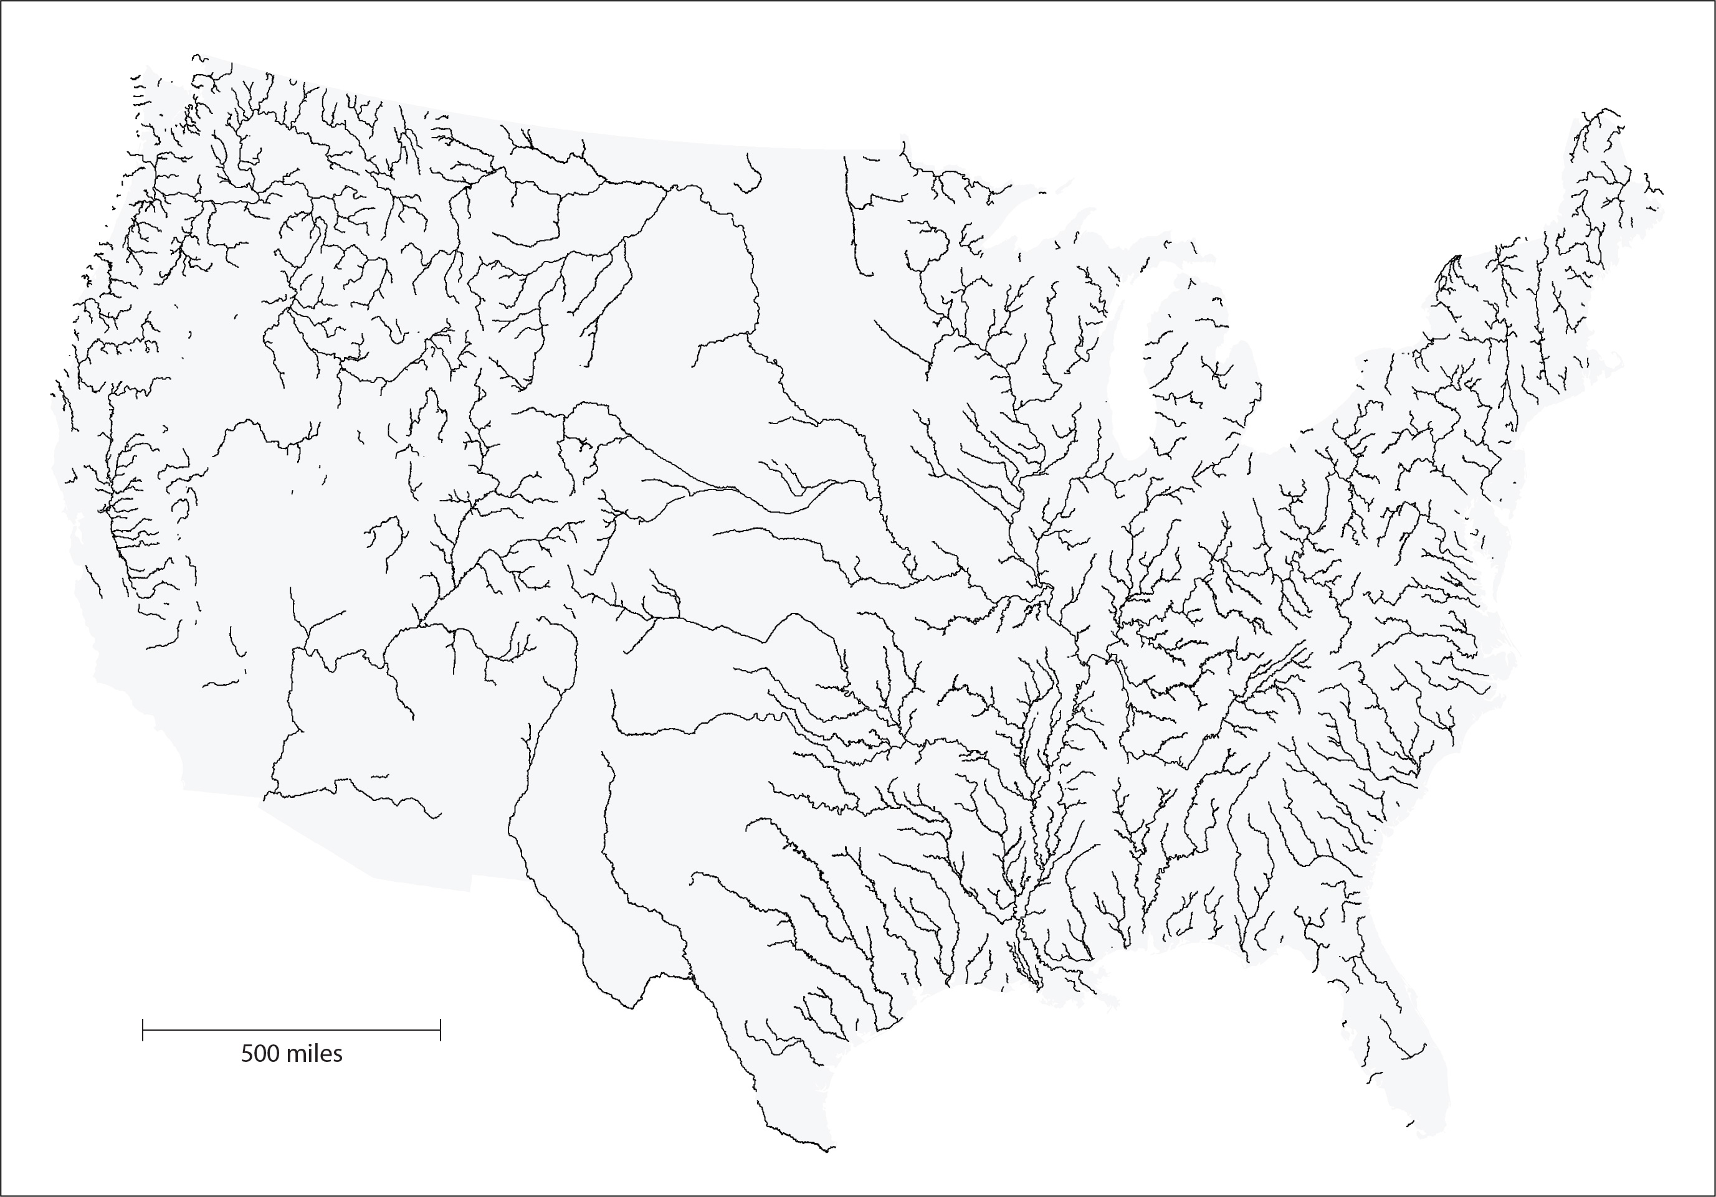
A map from the US National Hydrography data set with automated selection.
Tinker, M., P. Anthamatten, J. Simley, and M.P. Finn. 2013. “A Method to Generalize Stream Flowlines in Small-Scale Maps by a Variable Flow-based Pruning Threshold.” Cartography and Geographic Information Science 40 (5):444–457. doi: 10.1080/15230406.2013.801701.
Anthamatten
Chapter 03

Slide 11
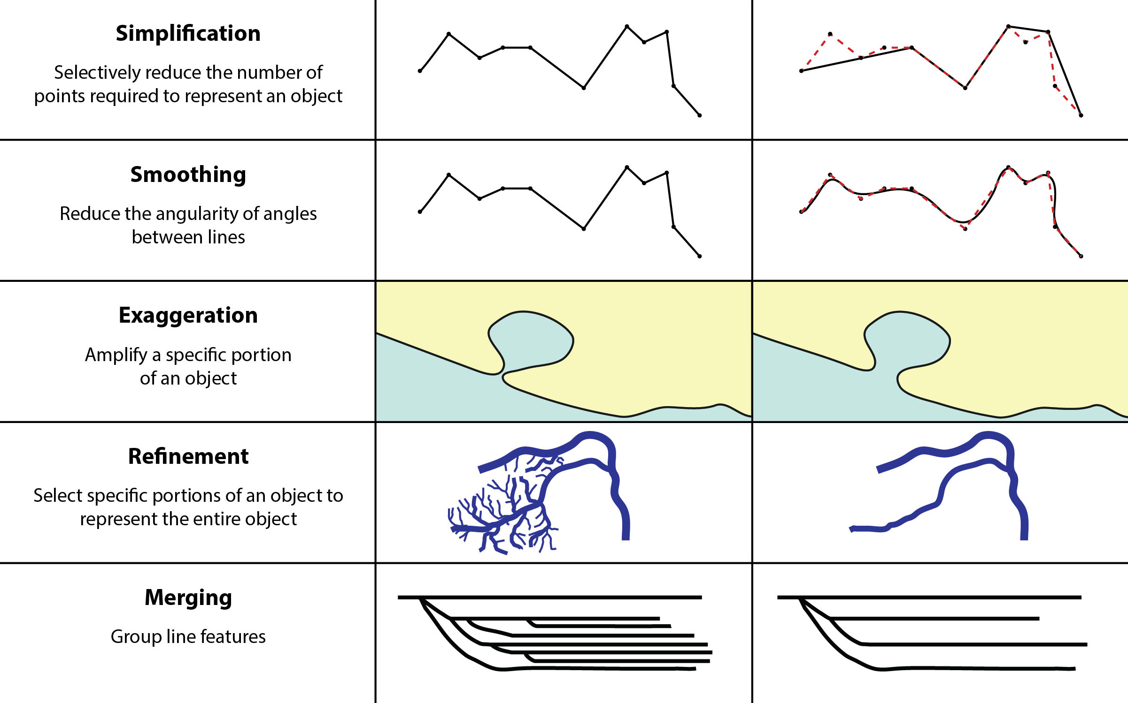
Examples of spatial operators in generalization.
Anthamatten
Chapter 03

Slide 12
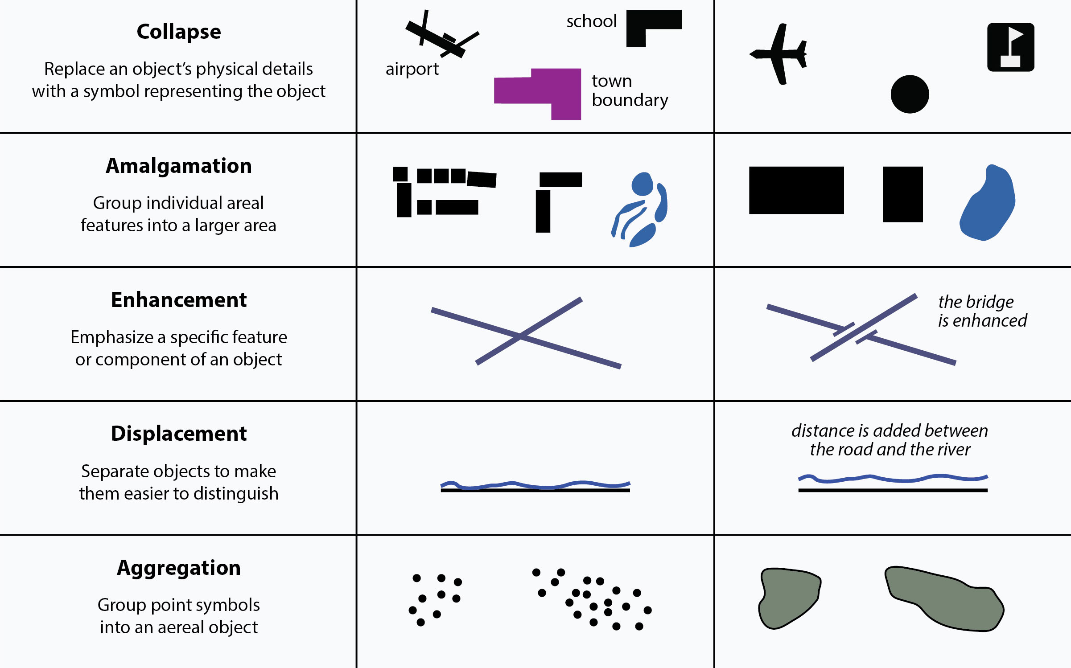
Examples of spatial operators in generalization.
Anthamatten
Chapter 03

Slide 13
How to Make Maps: Chapter 03
“The Language of Maps”
World Map by Michael Tompsett
source: www.michael-tompsett.pixels.com

