Slide 1
How to Make Maps: Chapter 02
“Mapping Concepts”
World Map by Michael Tompsett
source: www.michael-tompsett.pixels.com

Slide 2
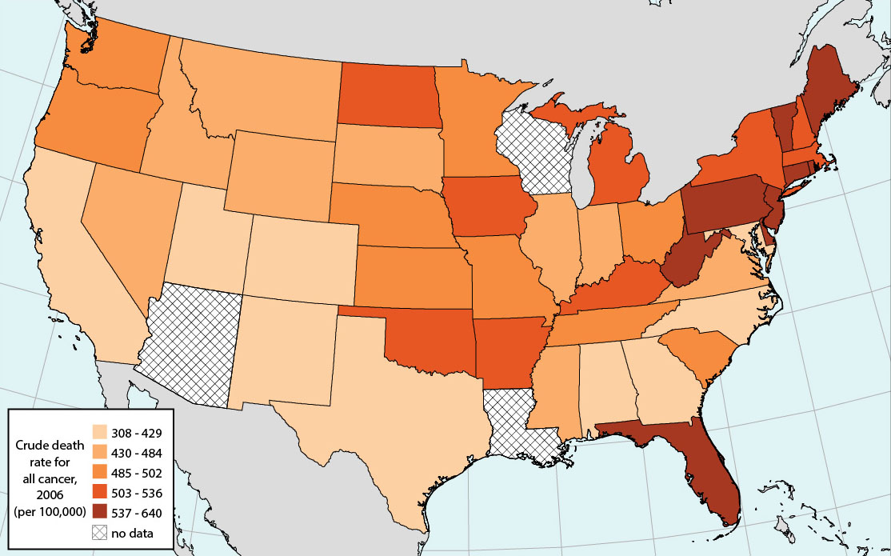
A choropleth map of heart disease among women based on data from Health Service Area in the United States.
The map has essentially transformed health statistics from each of the administrative areas into a legible summary that shows the key patterns in mortality rates across the country.
Anthamatten
Chapter 02

Slide 3
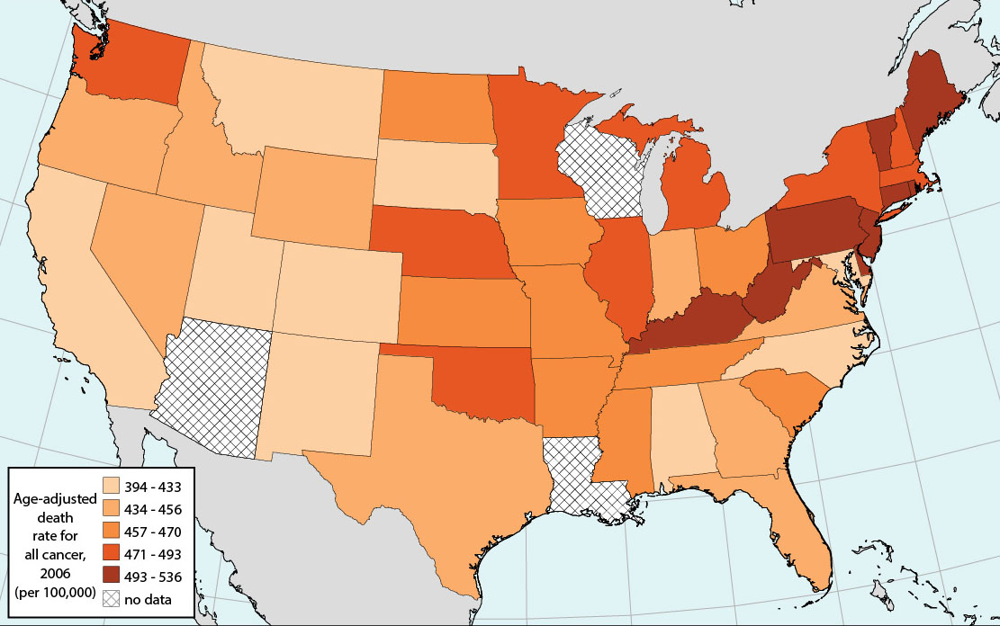
We can standardize for the data by performing age adjustments on the mapped data, which removes the effects of the population structure by applying the same age structure to each state. The age-adjusted version is a better map for the purpose of exploring cancer rates because it removes age from the equation, which is an important driver of that pattern.
Anthamatten
Chapter 02

Slide 4
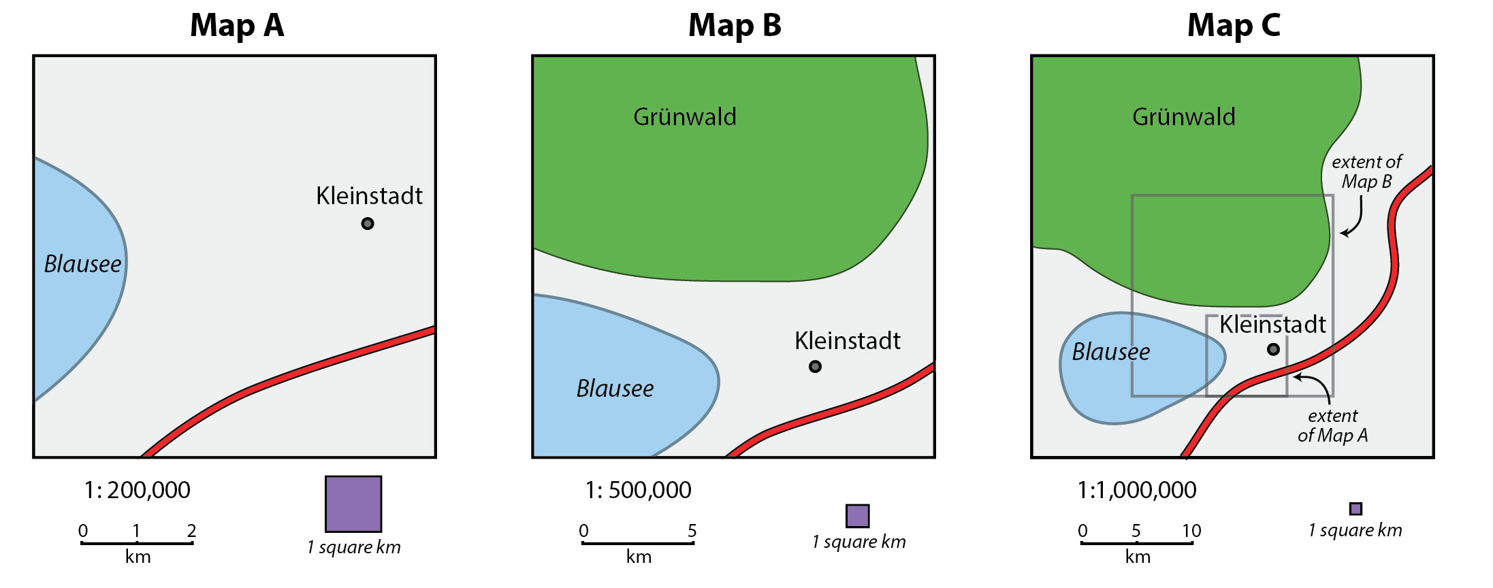
A basic example of maps of a fictional area at different scales.
Map A is the largest-scale map that shows the least amount of area, the smallest extent. Maps B and C show progressively smaller scales, showing more land area using the same amount of map space on the paper. Consequently, Map C has a much larger extent, showing 25 times the amount of area as map A.
Anthamatten
Chapter 02

Slide 5
A screenshot of a map of London using volumetric symbols from Google Earth.
Google and the Google logo are registered trademarks of Google Inc., used with permission.
Anthamatten
Chapter 02

Slide 6
How to Make Maps: Chapter 02
“Mapping Concepts”
World Map by Michael Tompsett
source: www.michael-tompsett.pixels.com

