Slide 1
How to Make Maps: Chapter 01
“Mapping Concepts”
World Map by Michael Tompsett
source: www.michael-tompsett.pixels.com

Slide 2
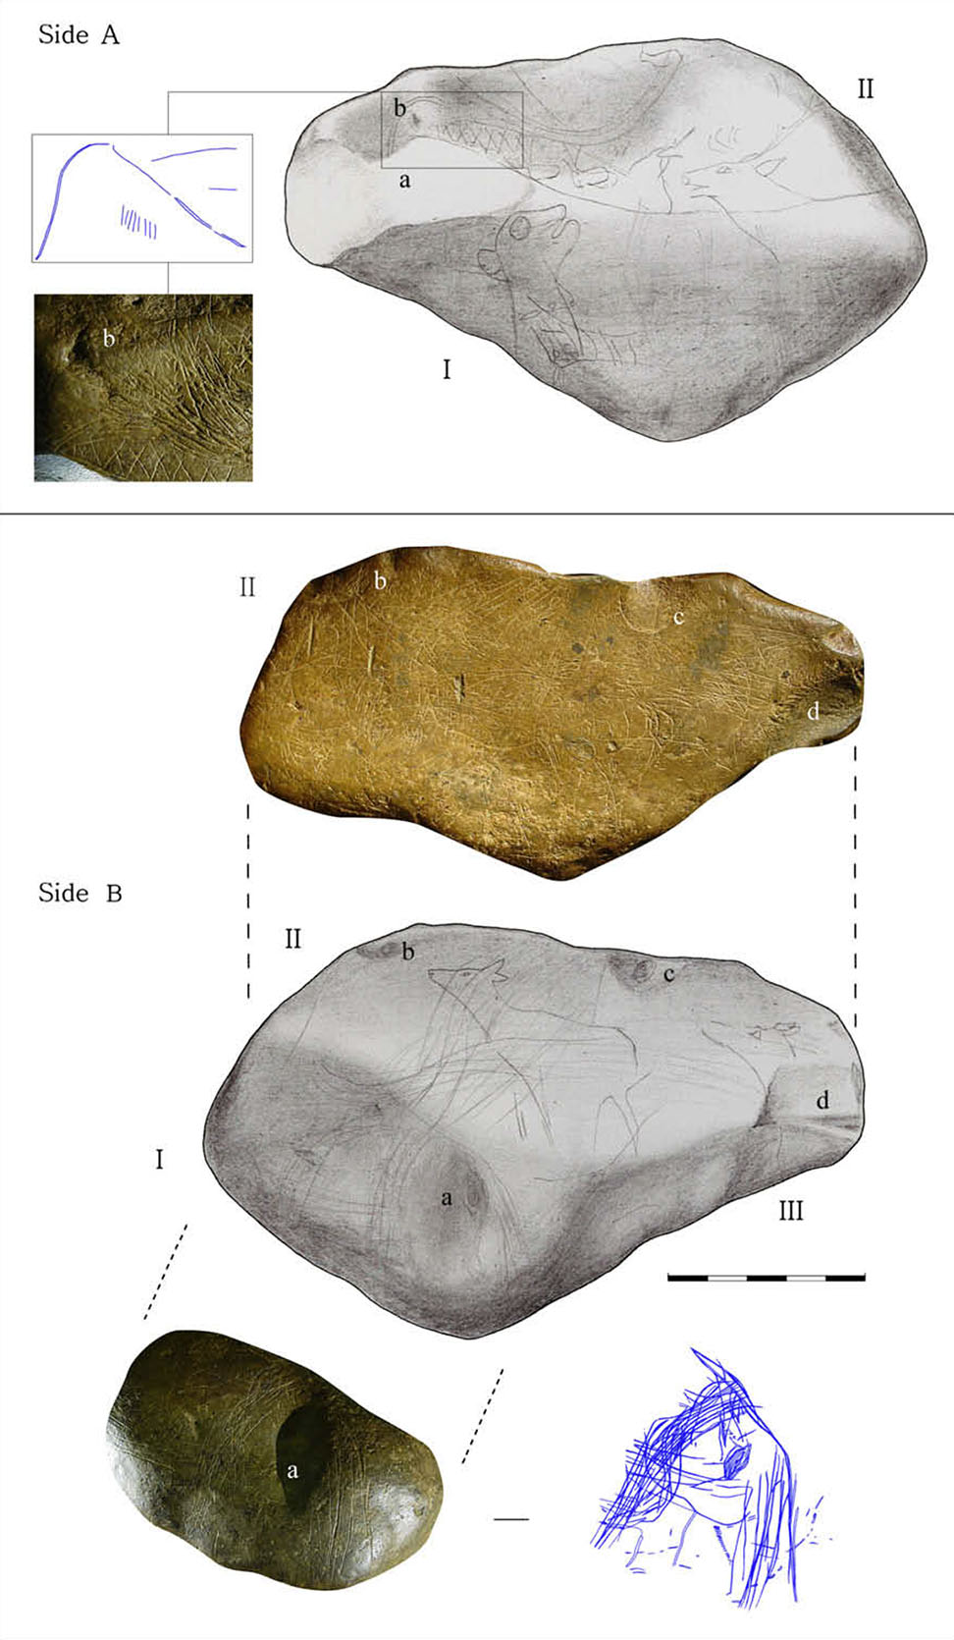
The oldest identified map may have been an engraved block cave in Spain showing landscape features and hunting sites. The map originates from about 14,000 years ago (Utrilla et al. 2009), 7,000 years before the first writing appeared in China, in China, circa 7,000 BP.
Utrilla, P., C. Mazo, M.C. Sopena, M. Martinez-Bea, and R. Domingo. 2009. “A Palaeolithic Map from 13,660 calBP: Engraved Stone Blocks from the Late Magdalenian in Abauntz Cave (Navarra, Spain).” Journal of Human Evolution 57 (2):99–111. doi: 10.1016/j.jhevol.2009.05.005.
Anthamatten
Chapter 01

Slide 3
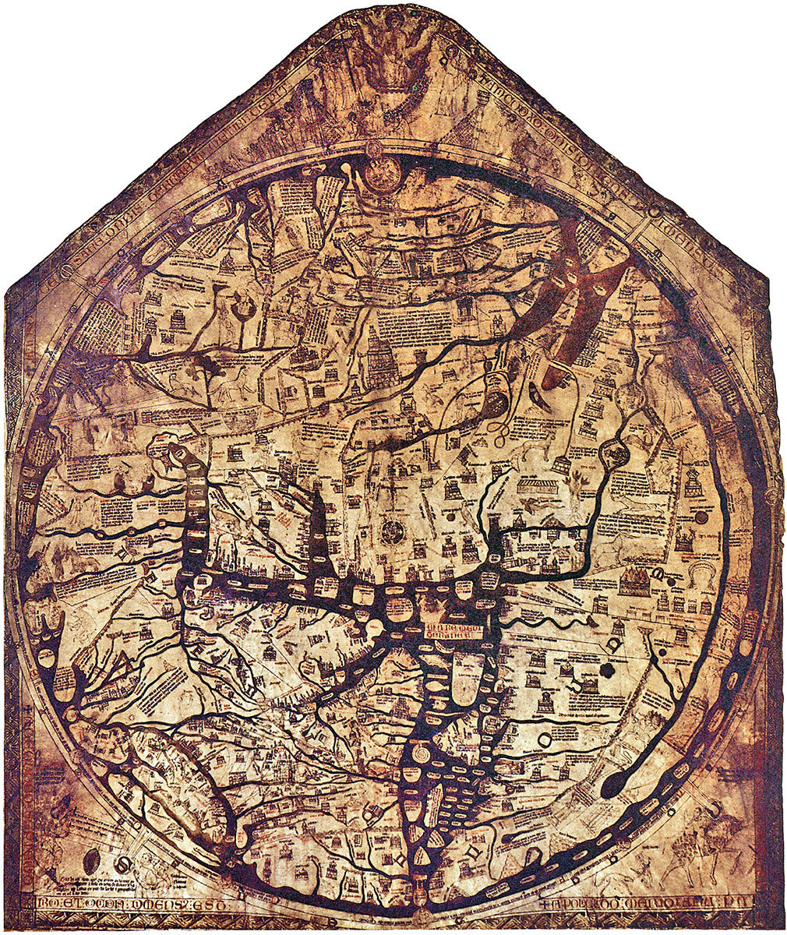
Like all cartographic work, these maps reflect the culture and society of the time. One of the best-known maps from near the end of the Middle Ages is the Hereford Mappa Mundi, located in England.
Anthamatten
Chapter 01

Slide 4
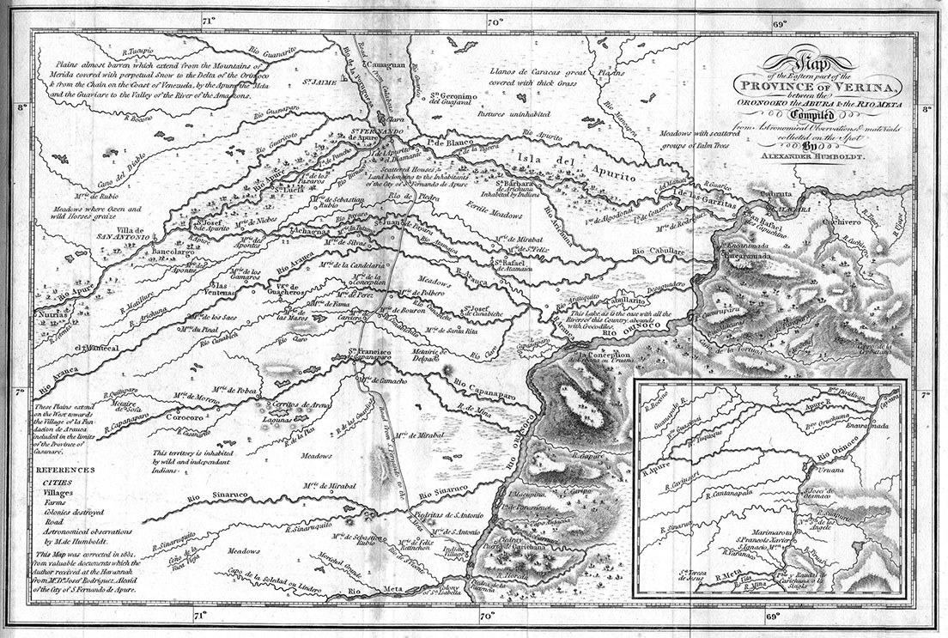
“Map of the Eastern Part of the Province of Verina, between the Oronooko the Abura & the Rio Meta Compiled from Astronomical Observations & Materials Collected on the Spot by Alexander Humboldt.” The image was taken from Princeton University’s Digital Collection. (http://libweb5.princeton.edu/visual_materials/maps/websites/thematic-maps/humboldt/humboldt.html).
Anthamatten
Chapter 01

Slide 5
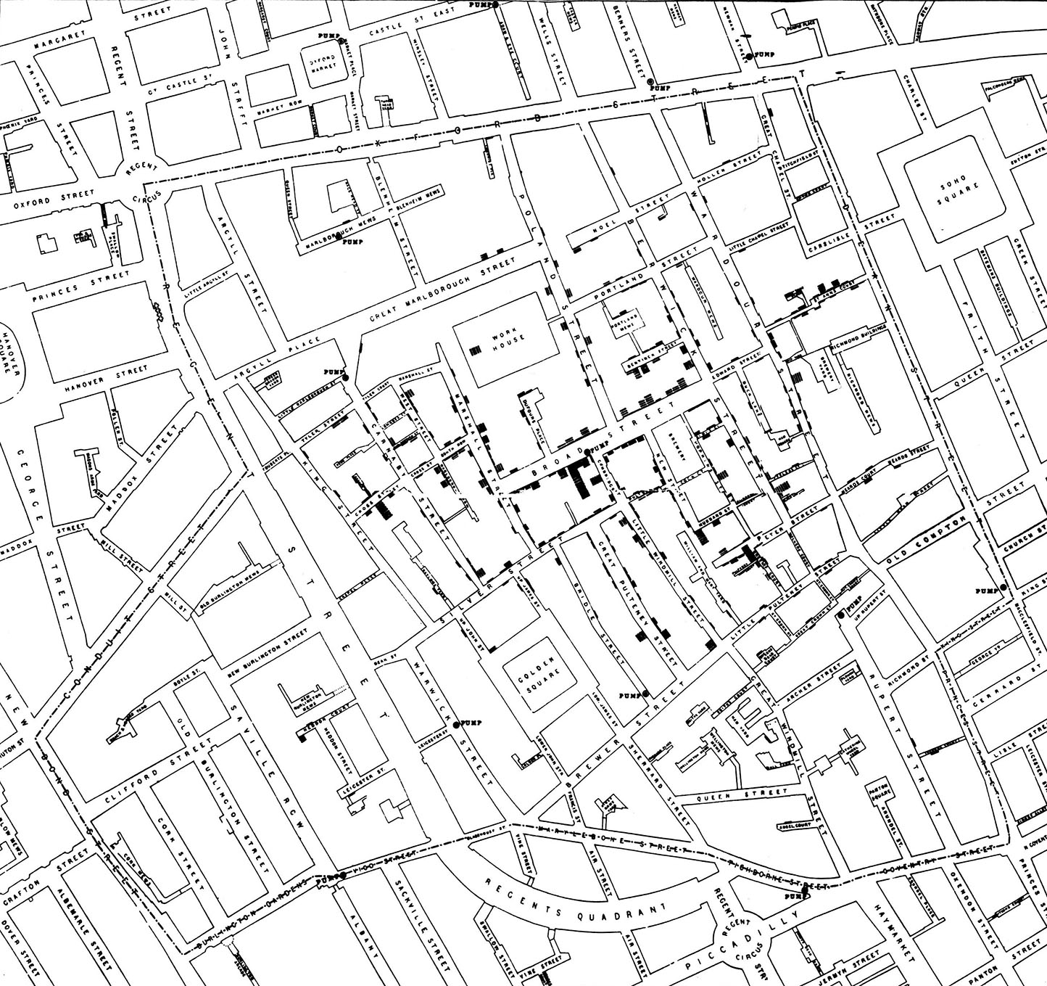
One of the best-known early examples of analytical cartography was a map by John Snow, a eighteenth century doctor who produced maps of cholera deaths in the Soho neighborhood in London to support his idea that cholera was water-borne (Johnson 2006).
The black marks represent cholera deaths that occurred during an outbreak. Snow made the compelling case that the deaths were clustered around the Broad Street water pump, arguing that the pump was the origin of the disease.
Anthamatten
Chapter 01

Slide 6
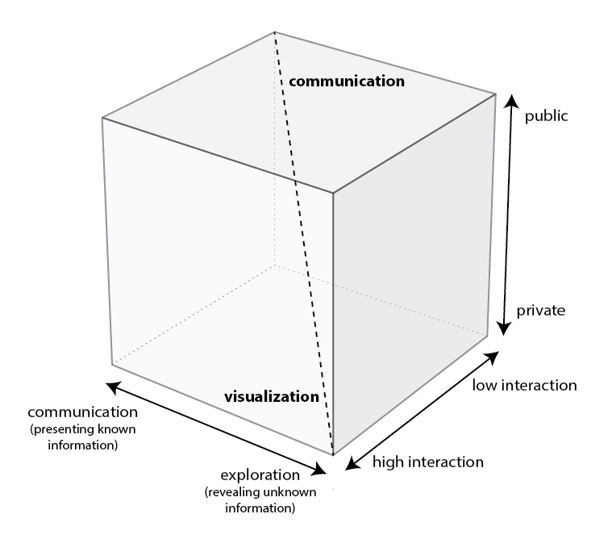
MacEachren discusses three primary factors that make up a theoretical “map cube.” Maps can serve to present known information on the one hand, or be conceived as an exploratory project to reveal unknown information on the other.
MacEachren, A.M. 2004. How Maps Work: Representation, Visualization, and Design. New York: Guilford Publications.
Anthamatten
Chapter 01

Slide 7
How to Make Maps: Chapter 01
“Mapping Concepts”
World Map by Michael Tompsett
source: www.michael-tompsett.pixels.com

